Slide 1



Notes:
This template is for educational, non-commercial purposes only. For more free game templates like this one, visit https://www.taysteachingtoolkit.com

Slide 2
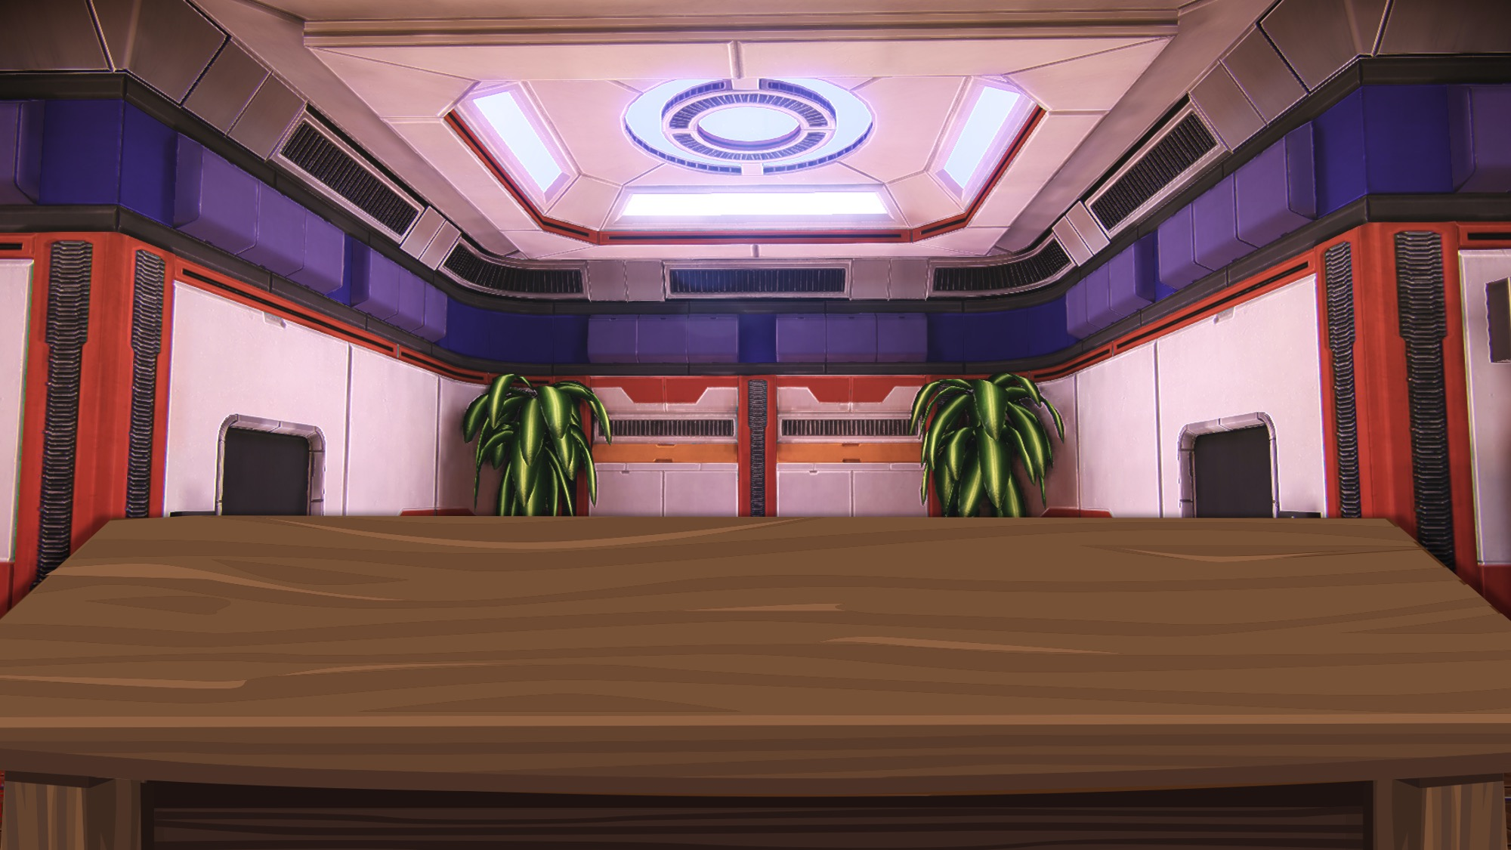



A Pokémon goes in a ball.
a
b
c

Slide 3
Watch that ball carefully.
a
b
c

Slide 4
The balls will shuffle.
a
b
c

Slide 5
Where is the Pokémon now?
a
b
c

Slide 6
Guess. Write the word or sentence under the ball.
a
b
c

Slide 7
If you are right, you get points!
+1
a
b
c

Slide 8

Let’s play!

Slide 9
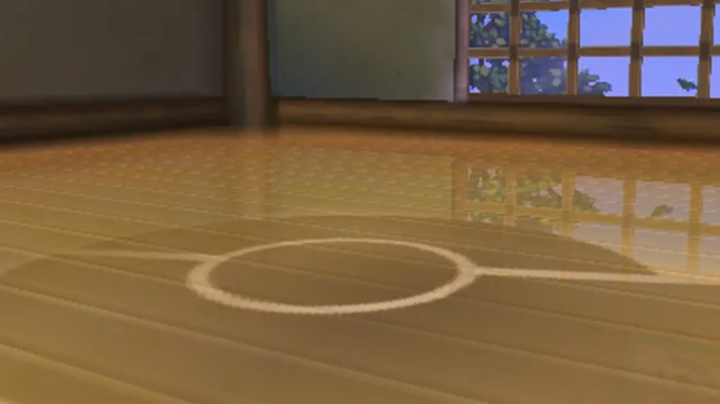


Ready…
a
q
b
Notes:
Click to hide the Pokémon
Click again to shuffle the Pokéballs
Once the Pokéballs have stopped shuffling, music will start playing to let students know it’s time to write (~25 seconds, feel free to delete if you don’t want the music)
After music stops, click reveal where the Pokémon.
Click to go to the next slide
(Also note: To save space, for longer sentences you can use the top text box for the part of the sentences that are the same and the bottom text boxes for the parts that are different. i.e. TOP TEXT BOX SAYS: Where is the // BOTTOM TEXT BOXES SAY: bathroom – library – park > Then, students write either: Where is the bathroom? Where is the library? OR Where is the park? - Feel free to delete this box if not needed or use it for other purposes.)

Slide 10


Ready…
s
m
j
Notes:
Click to hide the Pokémon
Click again to shuffle the Pokéballs
Once the Pokéballs have stopped shuffling, music will start playing to let students know it’s time to write (~25 seconds, feel free to delete if you don’t want the music)
After music stops, click reveal where the Pokémon.
Click to go to the next slide
(Also note: To save space, for longer sentences you can use the top text box for the part of the sentences that are the same and the bottom text boxes for the parts that are different. i.e. TOP TEXT BOX SAYS: Where is the // BOTTOM TEXT BOXES SAY: bathroom – library – park > Then, students write either: Where is the bathroom? Where is the library? OR Where is the park? - Feel free to delete this box if not needed or use it for other purposes.)

Slide 11


Ready…
j
c
J
Notes:
Click to hide the Pokémon
Click again to shuffle the Pokéballs
Once the Pokéballs have stopped shuffling, music will start playing to let students know it’s time to write (~25 seconds, feel free to delete if you don’t want the music)
After music stops, click reveal where the Pokémon.
Click to go to the next slide
(Also note: To save space, for longer sentences you can use the top text box for the part of the sentences that are the same and the bottom text boxes for the parts that are different. i.e. TOP TEXT BOX SAYS: Where is the // BOTTOM TEXT BOXES SAY: bathroom – library – park > Then, students write either: Where is the bathroom? Where is the library? OR Where is the park? - Feel free to delete this box if not needed or use it for other purposes.)

Slide 12
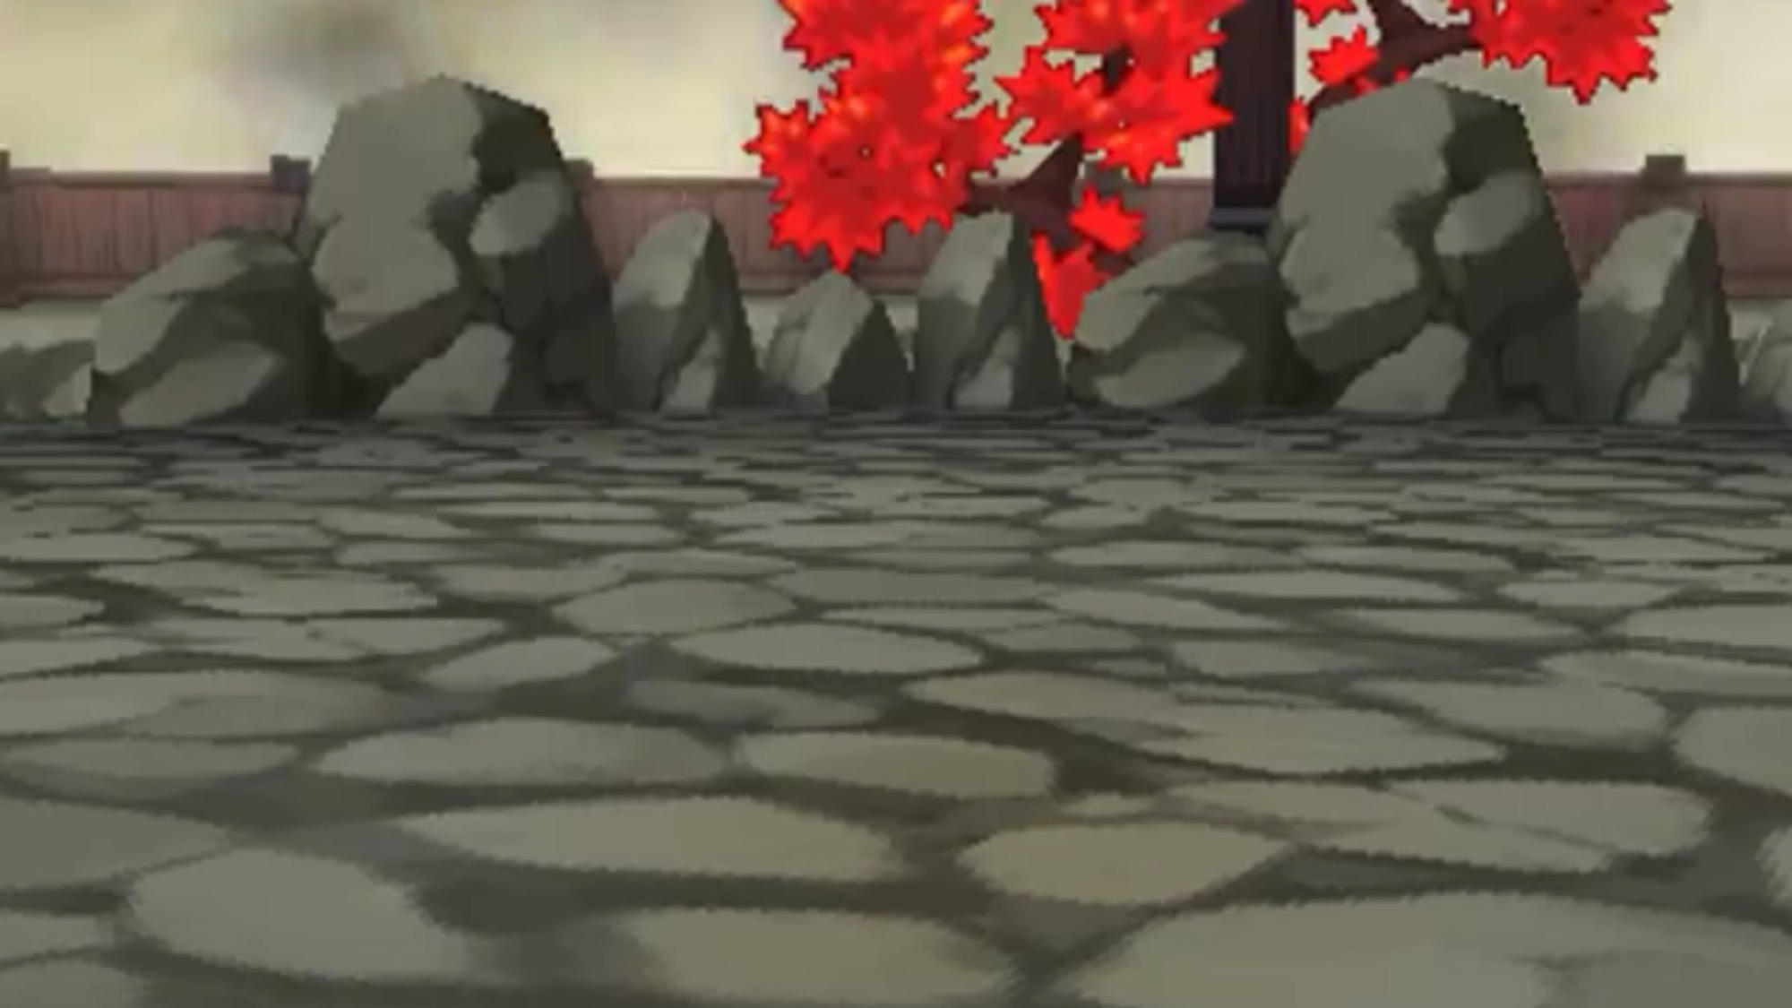

First part of the sentence...
b
B
p
Notes:
Click to hide the Pokémon
Click again to shuffle the Pokéballs
Once the Pokéballs have stopped shuffling, music will start playing to let students know it’s time to write (~25 seconds, feel free to delete if you don’t want the music)
After music stops, click reveal where the Pokémon.
Click to go to the next slide
(Also note: To save space, for longer sentences you can use the top text box for the part of the sentences that are the same and the bottom text boxes for the parts that are different. i.e. TOP TEXT BOX SAYS: Where is the // BOTTOM TEXT BOXES SAY: bathroom – library – park > Then, students write either: Where is the bathroom? Where is the library? OR Where is the park? - Feel free to delete this box if not needed or use it for other purposes.)

Slide 13
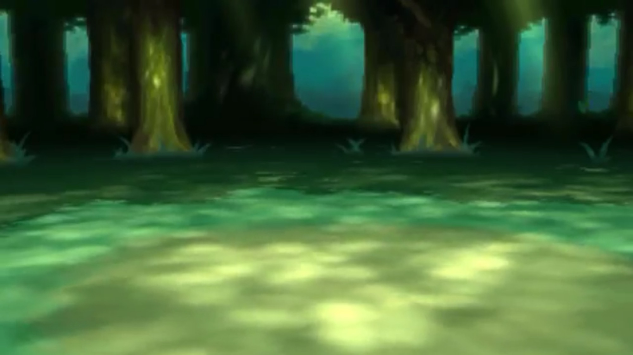

First part of the sentence...
t
F
f
Notes:
Click to hide the Pokémon
Click again to shuffle the Pokéballs
Once the Pokéballs have stopped shuffling, music will start playing to let students know it’s time to write (~25 seconds, feel free to delete if you don’t want the music)
After music stops, click reveal where the Pokémon.
Click to go to the next slide
(Also note: To save space, for longer sentences you can use the top text box for the part of the sentences that are the same and the bottom text boxes for the parts that are different. i.e. TOP TEXT BOX SAYS: Where is the // BOTTOM TEXT BOXES SAY: bathroom – library – park > Then, students write either: Where is the bathroom? Where is the library? OR Where is the park? - Feel free to delete this box if not needed or use it for other purposes.)

Slide 14
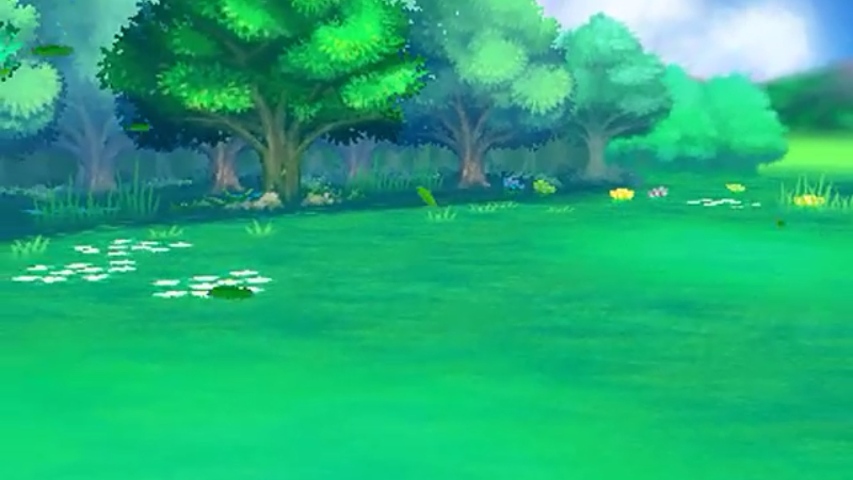

First part of the sentence...
r
x
V
Notes:
Click to hide the Pokémon
Click again to shuffle the Pokéballs
Once the Pokéballs have stopped shuffling, music will start playing to let students know it’s time to write (~25 seconds, feel free to delete if you don’t want the music)
After music stops, click reveal where the Pokémon.
Click to go to the next slide
(Also note: To save space, for longer sentences you can use the top text box for the part of the sentences that are the same and the bottom text boxes for the parts that are different. i.e. TOP TEXT BOX SAYS: Where is the // BOTTOM TEXT BOXES SAY: bathroom – library – park > Then, students write either: Where is the bathroom? Where is the library? OR Where is the park? - Feel free to delete this box if not needed or use it for other purposes.)

Slide 15
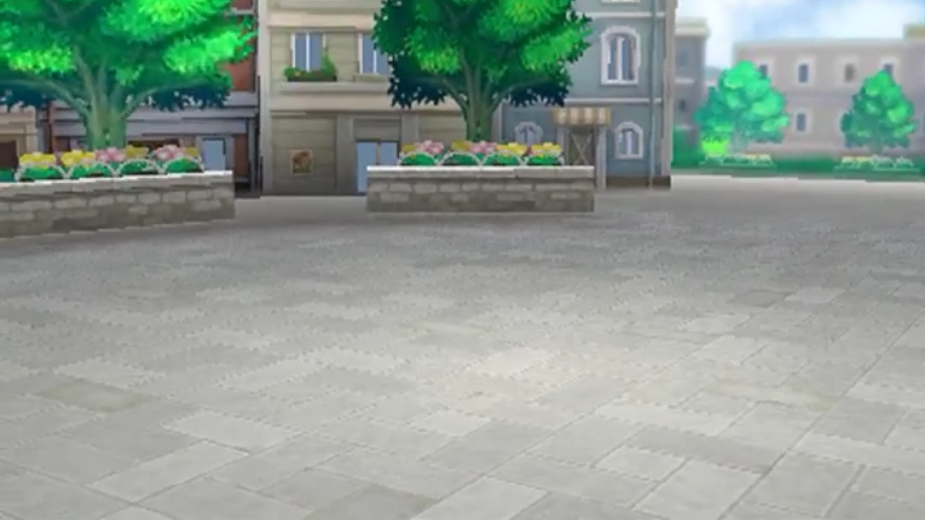

First part of the sentence...
\
v
|
Notes:
Click to hide the Pokémon
Click again to shuffle the Pokéballs
Once the Pokéballs have stopped shuffling, music will start playing to let students know it’s time to write (~25 seconds, feel free to delete if you don’t want the music)
After music stops, click reveal where the Pokémon.
Click to go to the next slide
(Also note: To save space, for longer sentences you can use the top text box for the part of the sentences that are the same and the bottom text boxes for the parts that are different. i.e. TOP TEXT BOX SAYS: Where is the // BOTTOM TEXT BOXES SAY: bathroom – library – park > Then, students write either: Where is the bathroom? Where is the library? OR Where is the park? - Feel free to delete this box if not needed or use it for other purposes.)

Slide 16
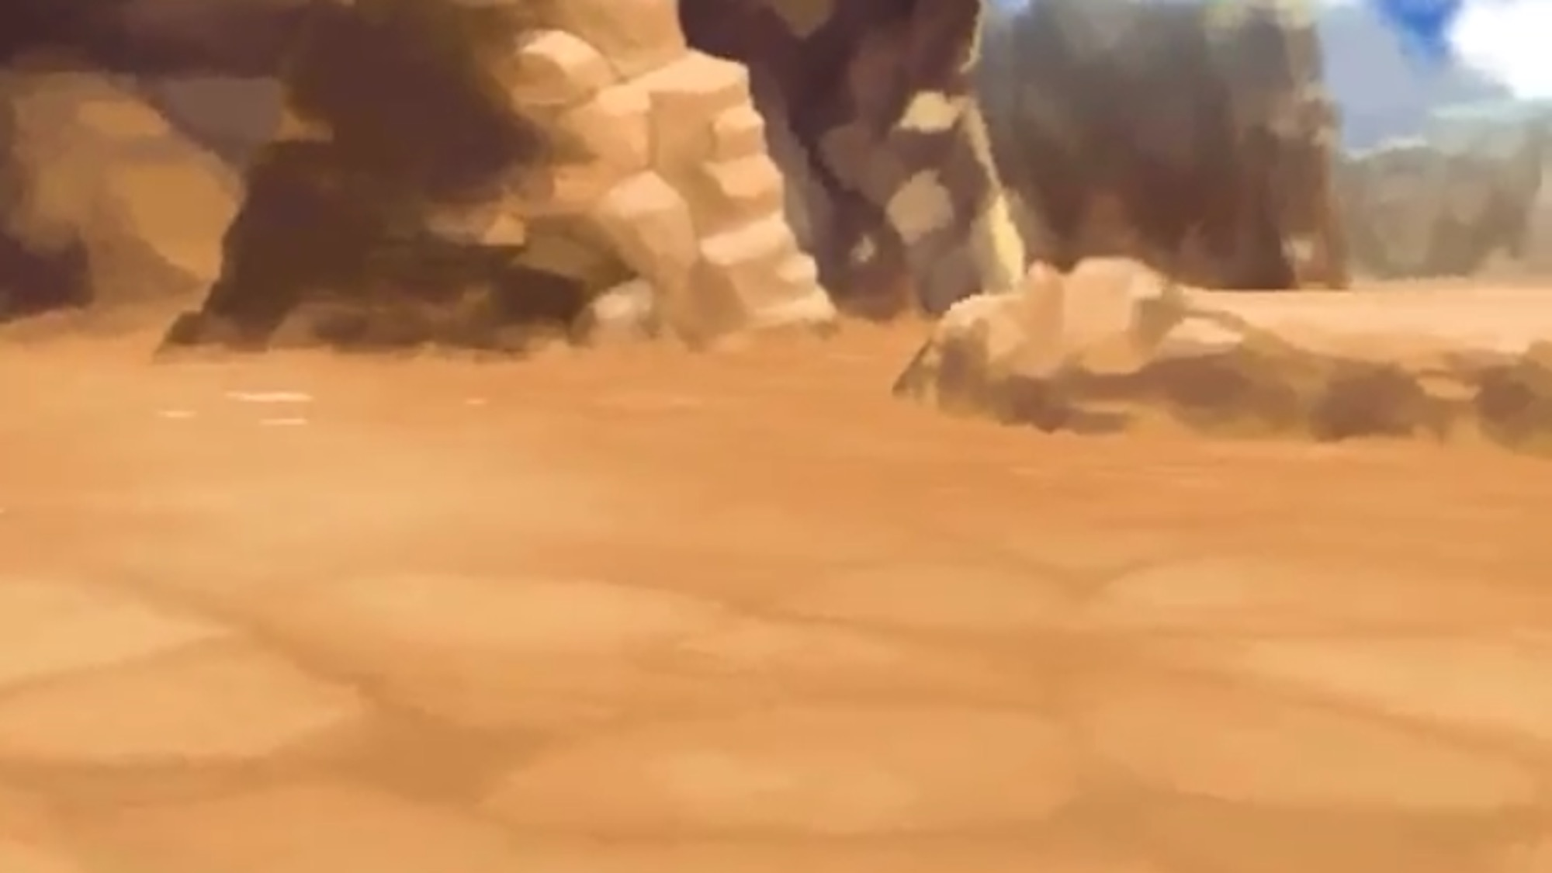

First part of the sentence...
q
Q
D
Notes:
Click to hide the Pokémon
Click again to shuffle the Pokéballs
Once the Pokéballs have stopped shuffling, music will start playing to let students know it’s time to write (~25 seconds, feel free to delete if you don’t want the music)
After music stops, click reveal where the Pokémon.
Click to go to the next slide
(Also note: To save space, for longer sentences you can use the top text box for the part of the sentences that are the same and the bottom text boxes for the parts that are different. i.e. TOP TEXT BOX SAYS: Where is the // BOTTOM TEXT BOXES SAY: bathroom – library – park > Then, students write either: Where is the bathroom? Where is the library? OR Where is the park? - Feel free to delete this box if not needed or use it for other purposes.)

Slide 17
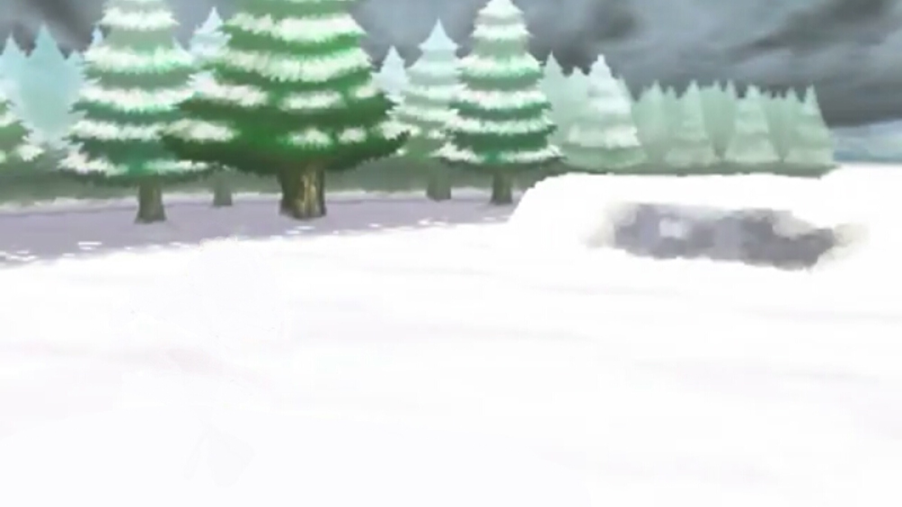

First part of the sentence...
e
t
P
Notes:
Click to hide the Pokémon
Click again to shuffle the Pokéballs
Once the Pokéballs have stopped shuffling, music will start playing to let students know it’s time to write (~25 seconds, feel free to delete if you don’t want the music)
After music stops, click reveal where the Pokémon.
Click to go to the next slide
(Also note: To save space, for longer sentences you can use the top text box for the part of the sentences that are the same and the bottom text boxes for the parts that are different. i.e. TOP TEXT BOX SAYS: Where is the // BOTTOM TEXT BOXES SAY: bathroom – library – park > Then, students write either: Where is the bathroom? Where is the library? OR Where is the park? - Feel free to delete this box if not needed or use it for other purposes.)

Slide 18
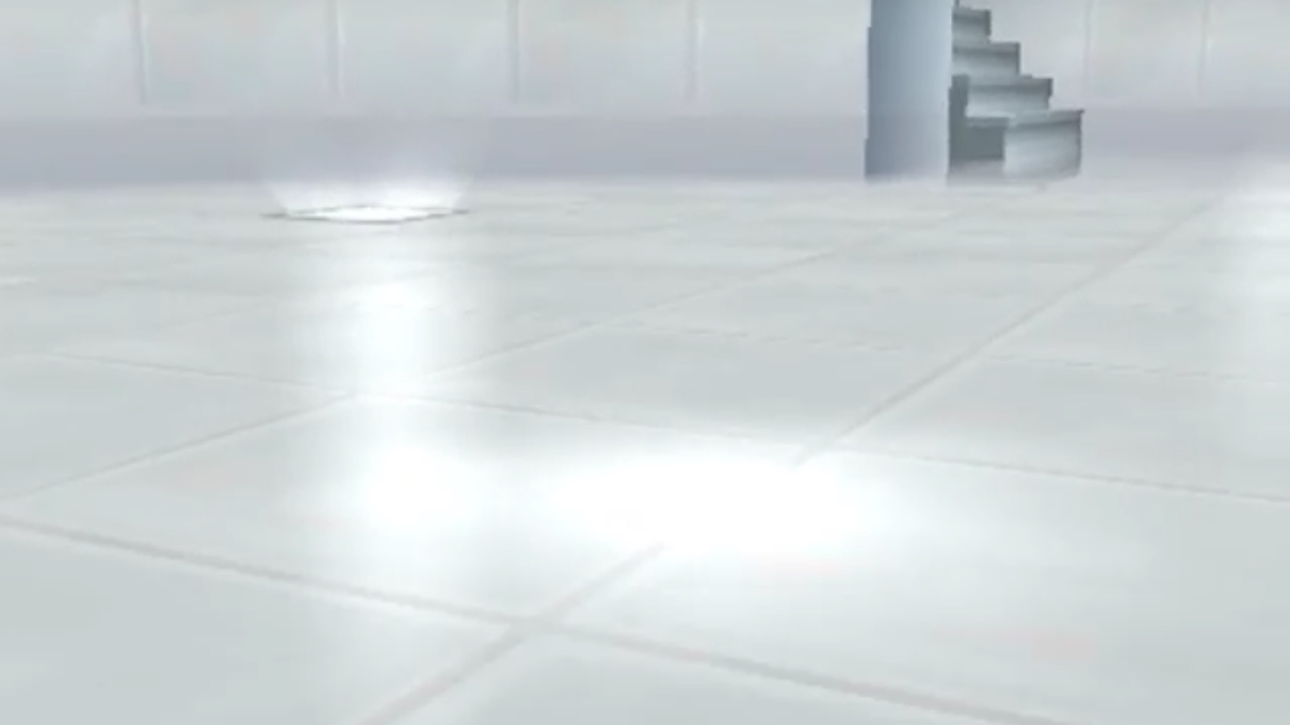

First part of the sentence...
p
P
P.
Notes:
Click to hide the Pokémon
Click again to shuffle the Pokéballs
Once the Pokéballs have stopped shuffling, music will start playing to let students know it’s time to write (~25 seconds, feel free to delete if you don’t want the music)
After music stops, click reveal where the Pokémon.
Click to go to the next slide
(Also note: To save space, for longer sentences you can use the top text box for the part of the sentences that are the same and the bottom text boxes for the parts that are different. i.e. TOP TEXT BOX SAYS: Where is the // BOTTOM TEXT BOXES SAY: bathroom – library – park > Then, students write either: Where is the bathroom? Where is the library? OR Where is the park? - Feel free to delete this box if not needed or use it for other purposes.)

Slide 19
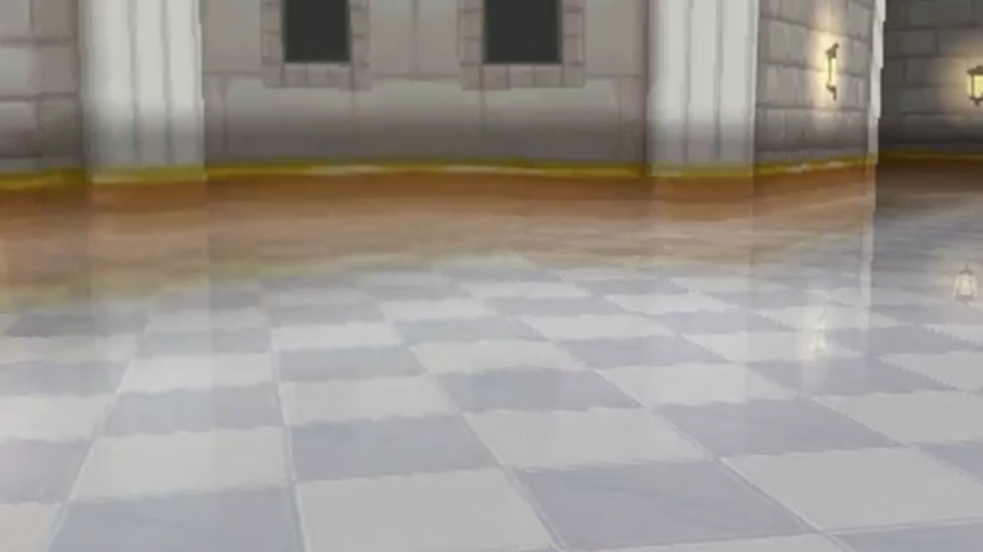

First part of the sentence...
G
k
g
Notes:
Click to hide the Pokémon
Click again to shuffle the Pokéballs
Once the Pokéballs have stopped shuffling, music will start playing to let students know it’s time to write (~25 seconds, feel free to delete if you don’t want the music)
After music stops, click reveal where the Pokémon.
Click to go to the next slide
(Also note: To save space, for longer sentences you can use the top text box for the part of the sentences that are the same and the bottom text boxes for the parts that are different. i.e. TOP TEXT BOX SAYS: Where is the // BOTTOM TEXT BOXES SAY: bathroom – library – park > Then, students write either: Where is the bathroom? Where is the library? OR Where is the park? - Feel free to delete this box if not needed or use it for other purposes.)

Slide 20
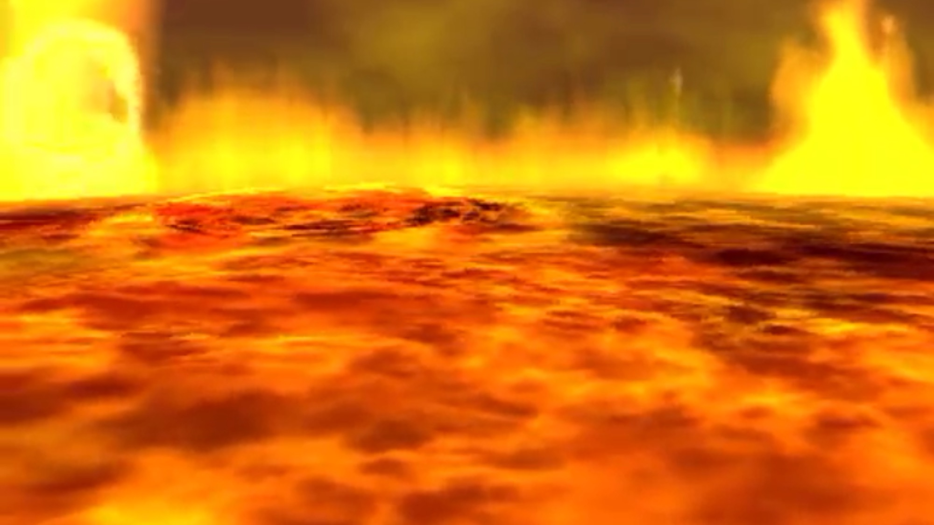

First part of the sentence...
c
C
S
Notes:
Click to hide the Pokémon
Click again to shuffle the Pokéballs
Once the Pokéballs have stopped shuffling, music will start playing to let students know it’s time to write (~25 seconds, feel free to delete if you don’t want the music)
After music stops, click reveal where the Pokémon.
Click to go to the next slide
(Also note: To save space, for longer sentences you can use the top text box for the part of the sentences that are the same and the bottom text boxes for the parts that are different. i.e. TOP TEXT BOX SAYS: Where is the // BOTTOM TEXT BOXES SAY: bathroom – library – park > Then, students write either: Where is the bathroom? Where is the library? OR Where is the park? - Feel free to delete this box if not needed or use it for other purposes.)

Slide 21


First part of the sentence...
h
r
c
Notes:
Click to hide the Pokémon
Click again to shuffle the Pokéballs
Once the Pokéballs have stopped shuffling, music will start playing to let students know it’s time to write (~25 seconds, feel free to delete if you don’t want the music)
After music stops, click reveal where the Pokémon.
Click to go to the next slide
(Also note: To save space, for longer sentences you can use the top text box for the part of the sentences that are the same and the bottom text boxes for the parts that are different. i.e. TOP TEXT BOX SAYS: Where is the // BOTTOM TEXT BOXES SAY: bathroom – library – park > Then, students write either: Where is the bathroom? Where is the library? OR Where is the park? - Feel free to delete this box if not needed or use it for other purposes.)

Slide 22


First part of the sentence...
d
F
f
Notes:
Click to hide the Pokémon
Click again to shuffle the Pokéballs
Once the Pokéballs have stopped shuffling, music will start playing to let students know it’s time to write (~25 seconds, feel free to delete if you don’t want the music)
After music stops, click reveal where the Pokémon.
Click to go to the next slide
(Also note: To save space, for longer sentences you can use the top text box for the part of the sentences that are the same and the bottom text boxes for the parts that are different. i.e. TOP TEXT BOX SAYS: Where is the // BOTTOM TEXT BOXES SAY: bathroom – library – park > Then, students write either: Where is the bathroom? Where is the library? OR Where is the park? - Feel free to delete this box if not needed or use it for other purposes.)

Slide 23
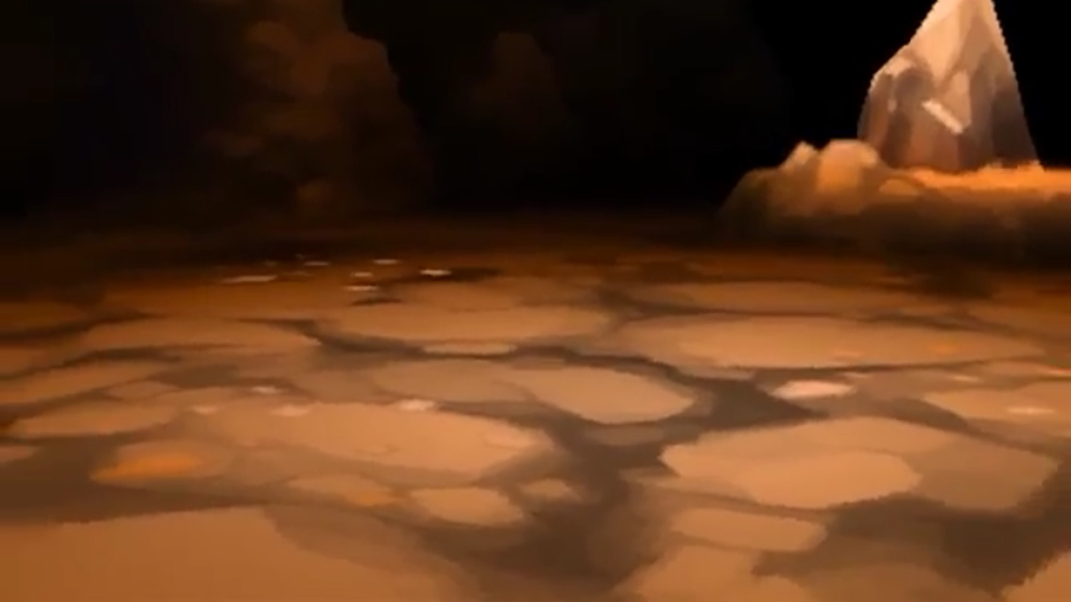
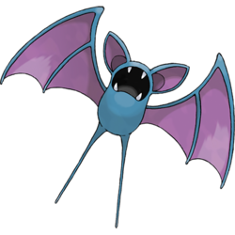
First part of the sentence...
f
V
B
Notes:
Click to hide the Pokémon
Click again to shuffle the Pokéballs
Once the Pokéballs have stopped shuffling, music will start playing to let students know it’s time to write (~25 seconds, feel free to delete if you don’t want the music)
After music stops, click reveal where the Pokémon.
Click to go to the next slide
(Also note: To save space, for longer sentences you can use the top text box for the part of the sentences that are the same and the bottom text boxes for the parts that are different. i.e. TOP TEXT BOX SAYS: Where is the // BOTTOM TEXT BOXES SAY: bathroom – library – park > Then, students write either: Where is the bathroom? Where is the library? OR Where is the park? - Feel free to delete this box if not needed or use it for other purposes.)

Slide 24
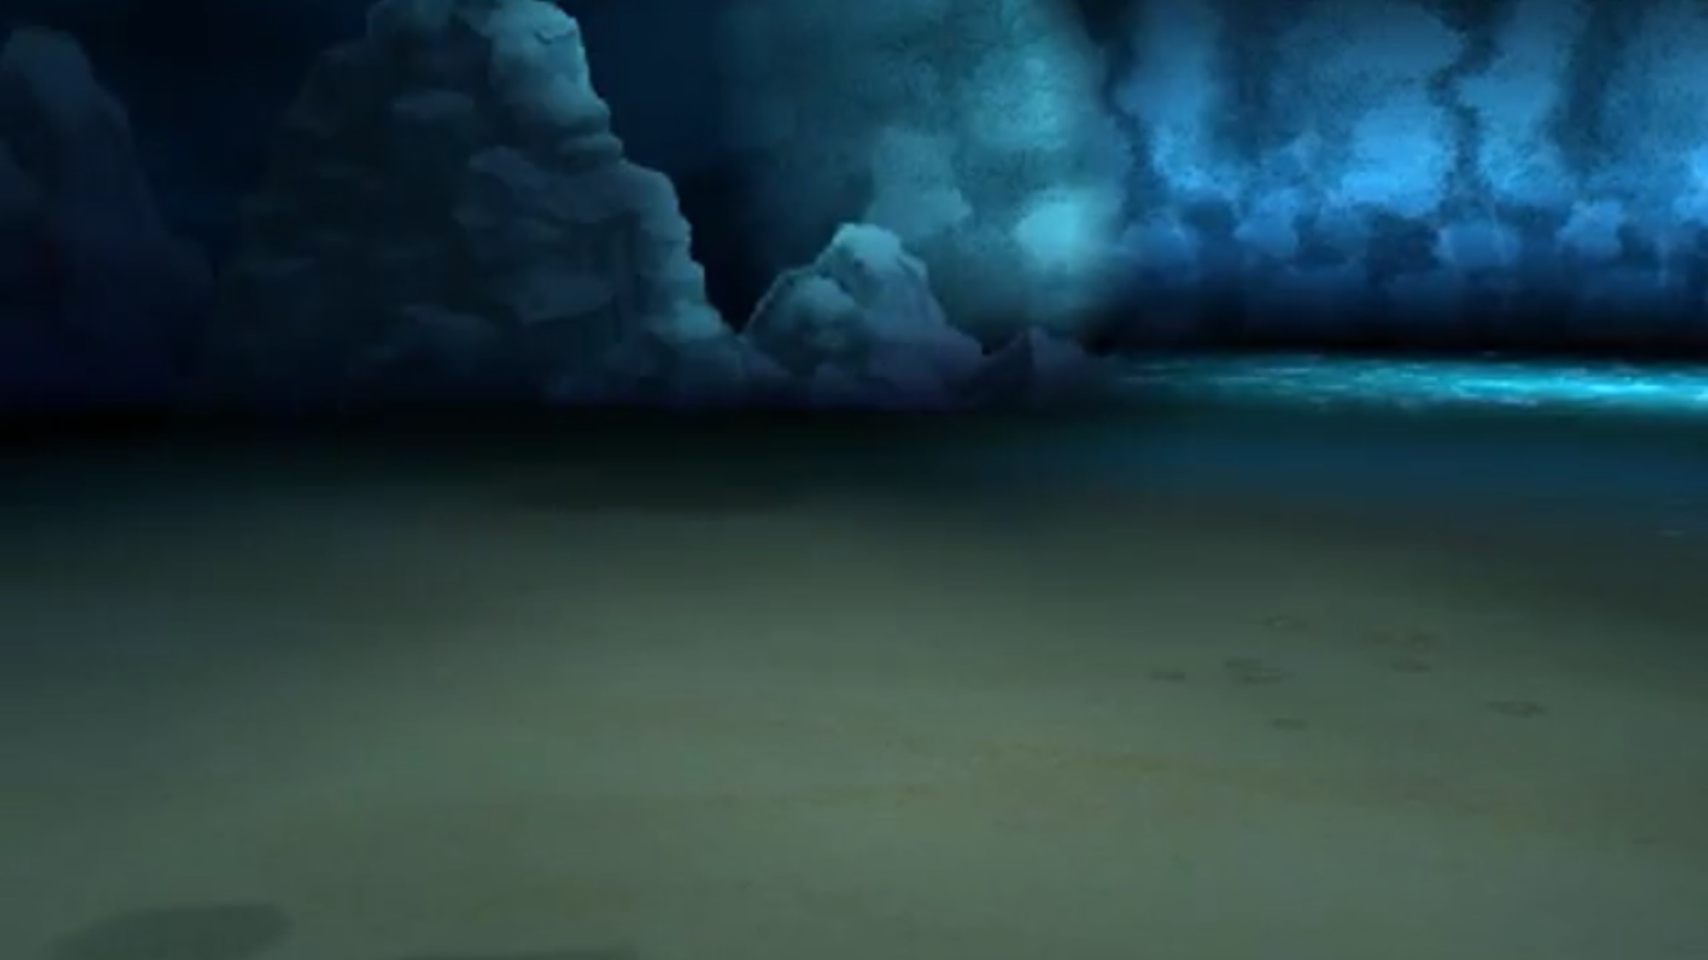

First part of the sentence...
X
v
V
Notes:
Click to hide the Pokémon
Click again to shuffle the Pokéballs
Once the Pokéballs have stopped shuffling, music will start playing to let students know it’s time to write (~25 seconds, feel free to delete if you don’t want the music)
After music stops, click reveal where the Pokémon.
Click to go to the next slide
(Also note: To save space, for longer sentences you can use the top text box for the part of the sentences that are the same and the bottom text boxes for the parts that are different. i.e. TOP TEXT BOX SAYS: Where is the // BOTTOM TEXT BOXES SAY: bathroom – library – park > Then, students write either: Where is the bathroom? Where is the library? OR Where is the park? - Feel free to delete this box if not needed or use it for other purposes.)

Slide 25


First part of the sentence...
d
D
f
Notes:
Click to hide the Pokémon
Click again to shuffle the Pokéballs
Once the Pokéballs have stopped shuffling, music will start playing to let students know it’s time to write (~25 seconds, feel free to delete if you don’t want the music)
After music stops, click reveal where the Pokémon.
Click to go to the next slide
(Also note: To save space, for longer sentences you can use the top text box for the part of the sentences that are the same and the bottom text boxes for the parts that are different. i.e. TOP TEXT BOX SAYS: Where is the // BOTTOM TEXT BOXES SAY: bathroom – library – park > Then, students write either: Where is the bathroom? Where is the library? OR Where is the park? - Feel free to delete this box if not needed or use it for other purposes.)

Slide 26
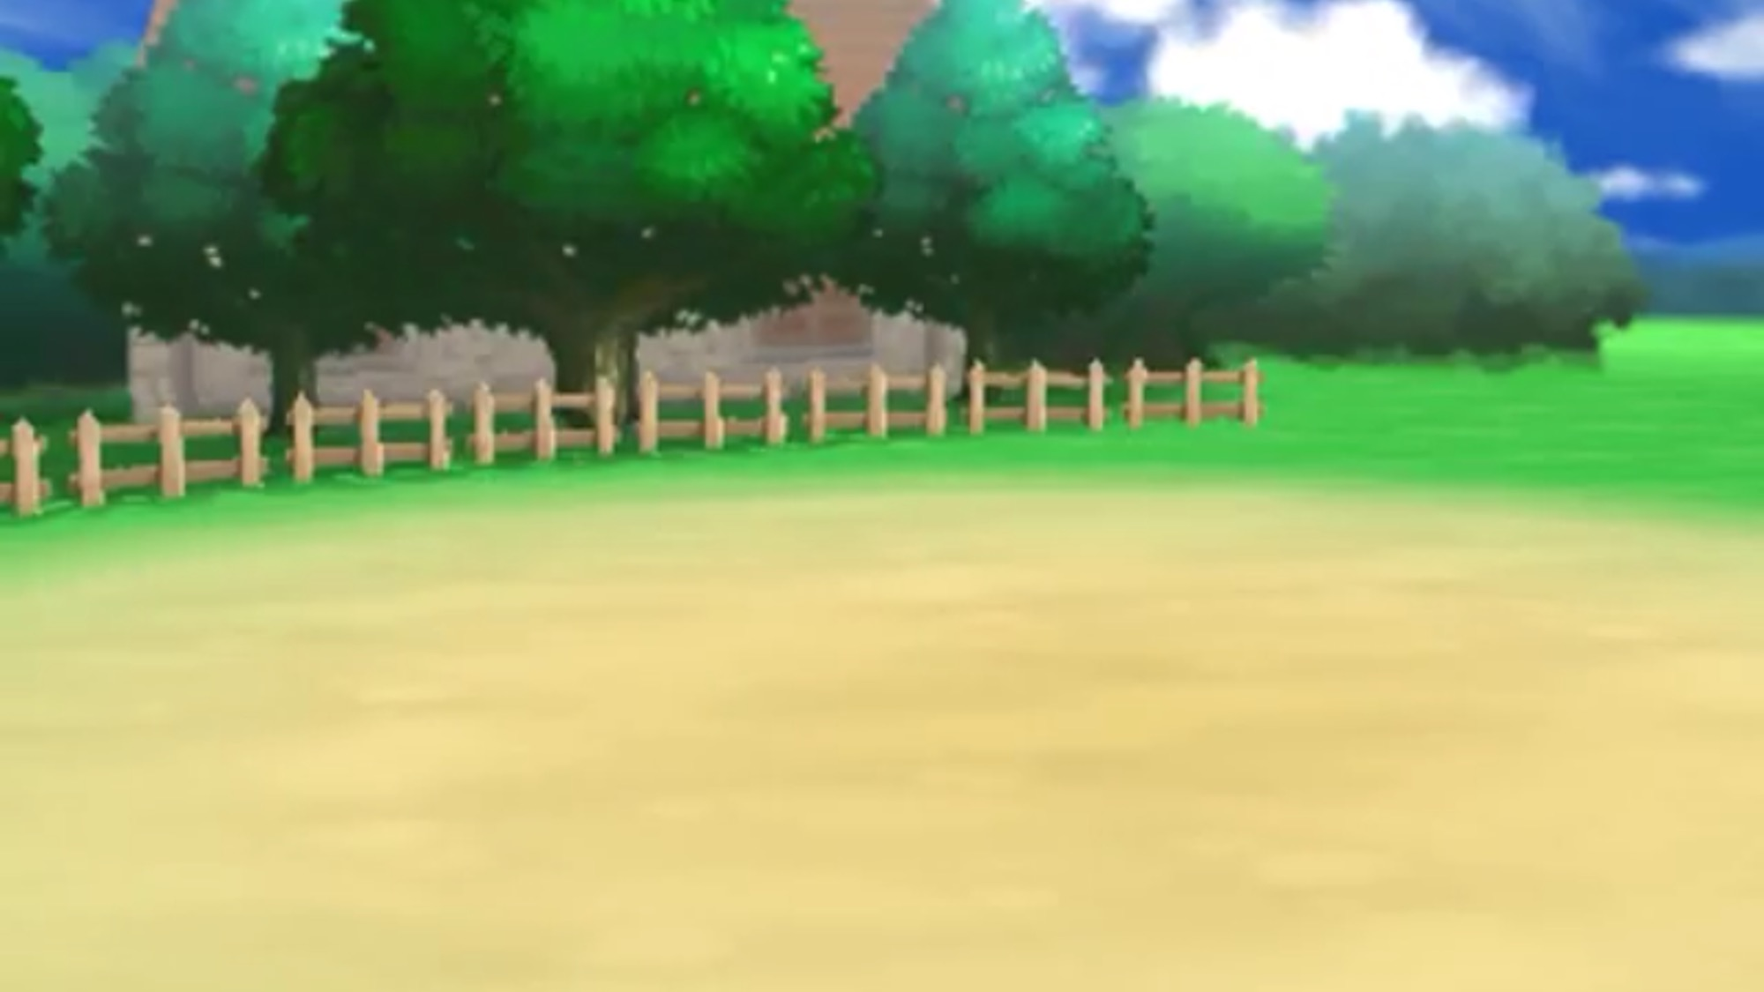

First part of the sentence...
t
T
n
Notes:
Click to hide the Pokémon
Click again to shuffle the Pokéballs
Once the Pokéballs have stopped shuffling, music will start playing to let students know it’s time to write (~25 seconds, feel free to delete if you don’t want the music)
After music stops, click reveal where the Pokémon.
Click to go to the next slide
(Also note: To save space, for longer sentences you can use the top text box for the part of the sentences that are the same and the bottom text boxes for the parts that are different. i.e. TOP TEXT BOX SAYS: Where is the // BOTTOM TEXT BOXES SAY: bathroom – library – park > Then, students write either: Where is the bathroom? Where is the library? OR Where is the park? - Feel free to delete this box if not needed or use it for other purposes.)

Slide 27
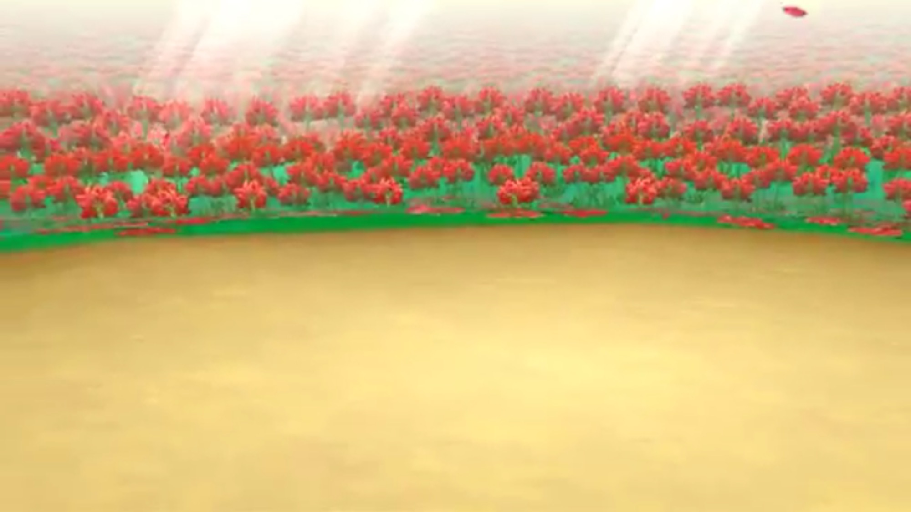

First part of the sentence...
T
n
l
Notes:
Click to hide the Pokémon
Click again to shuffle the Pokéballs
Once the Pokéballs have stopped shuffling, music will start playing to let students know it’s time to write (~25 seconds, feel free to delete if you don’t want the music)
After music stops, click reveal where the Pokémon.
Click to go to the next slide
(Also note: To save space, for longer sentences you can use the top text box for the part of the sentences that are the same and the bottom text boxes for the parts that are different. i.e. TOP TEXT BOX SAYS: Where is the // BOTTOM TEXT BOXES SAY: bathroom – library – park > Then, students write either: Where is the bathroom? Where is the library? OR Where is the park? - Feel free to delete this box if not needed or use it for other purposes.)

