Slide 1

Gurmukhi Class
Level 2
A
e
a
Prem Ras Kids

Slide 2
TEST TIME!

Slide 3



a
A
e
s
h
k
K
g
G
|
c
C
j
J
\
t
T
f
F
x
q
Q
d
D
n
p
P
b
B
m
X
r
l
v
V

Slide 4


a
A
e
s
h
k
K
g
G
|
c
C
j
J
\
t
T
f
F
x
q
Q
d
D
n
p
P
b
B
m
X
r
l
v
V

Slide 5


a
A
e
s
h
k
K
g
G
|
c
C
j
J
\
t
T
f
F
x
q
Q
d
D
n
p
P
b
B
m
X
r
l
v
V

Slide 6
Introduction to Muharni

Slide 7


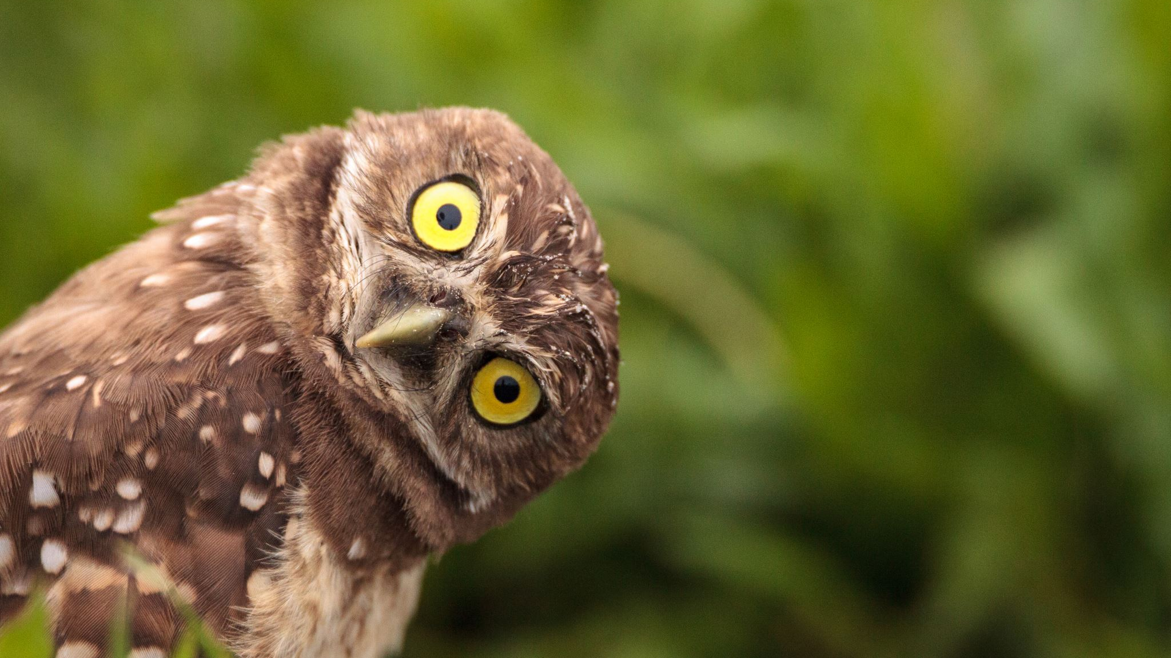



What is this animal’s NAME?
Notes:
What is this animal’s NAME?

Slide 8
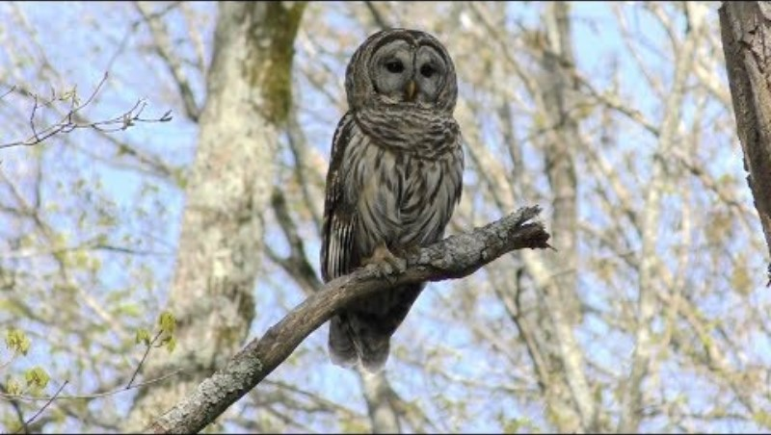
What is this animal’s SOUND?
Notes:
What is this animal’s SOUND?

Slide 9
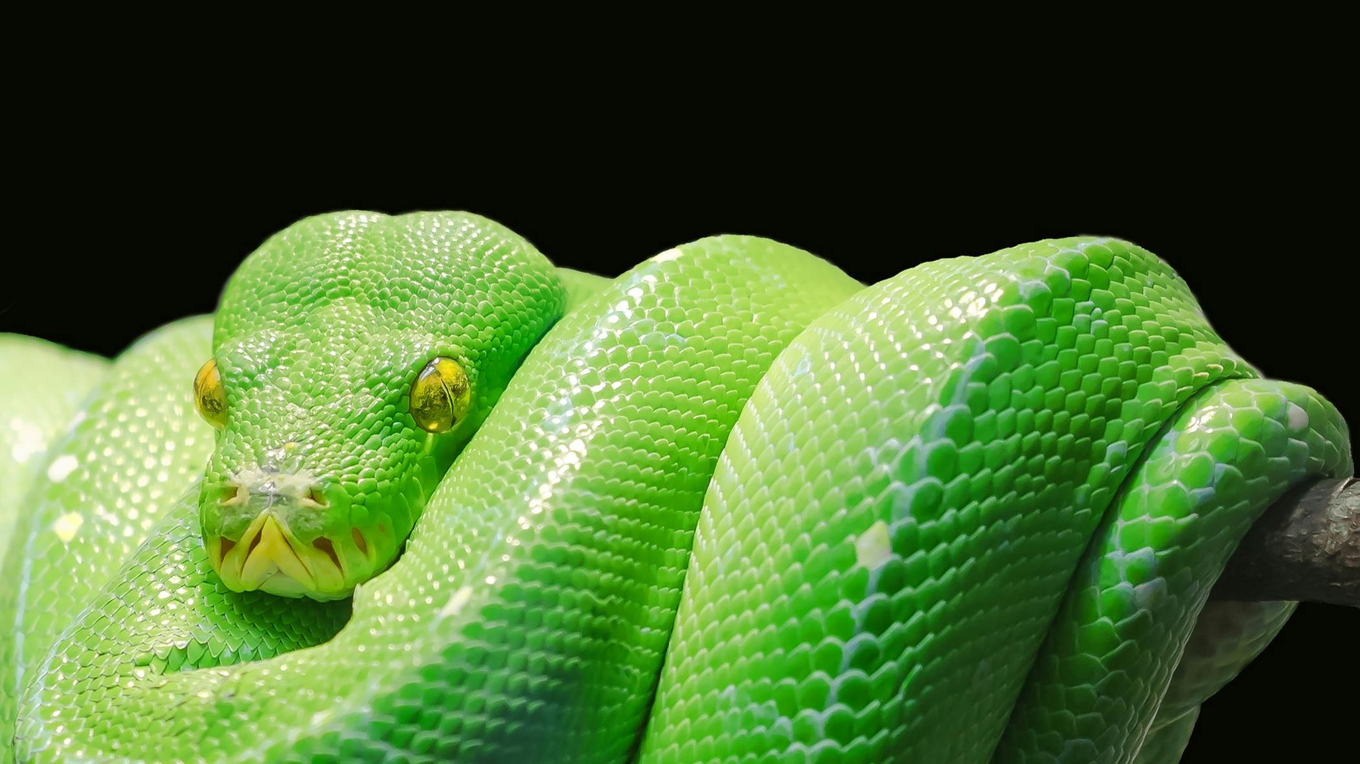
What is this animal’s NAME?
Notes:
What is this animal’s NAME?

Slide 10

What is this animal’s SOUND?
Notes:
What is this animal’s SOUND?

Slide 11
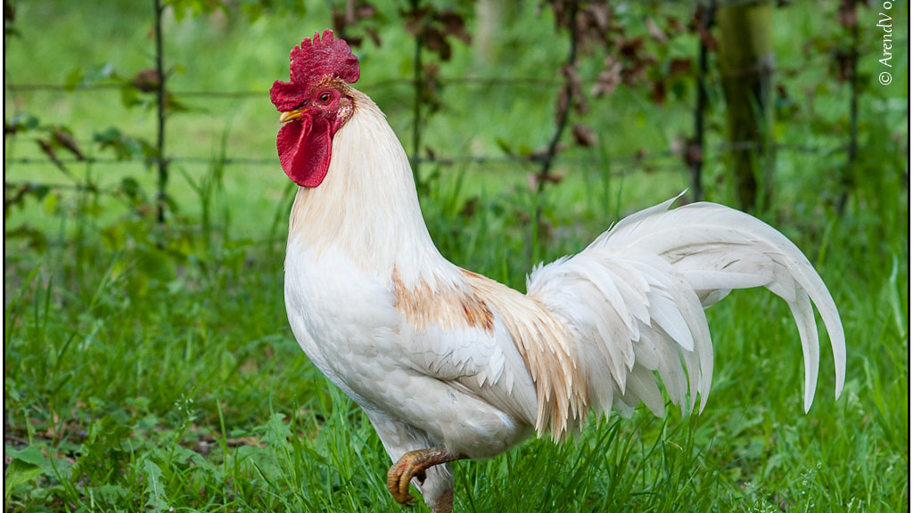
What is this animal’s NAME?
This Photo by Unknown Author is licensed under CC BY

Slide 12
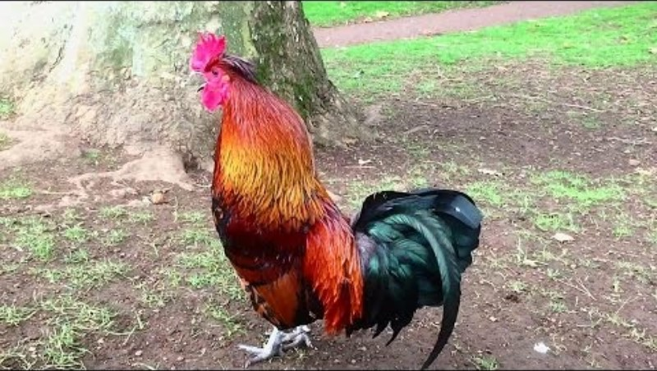
What is this animal’s SOUND?

Slide 13
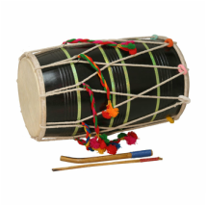
What is this object’s NAME?
This Photo by Unknown Author is licensed under CC BY-SA-NC

Slide 14
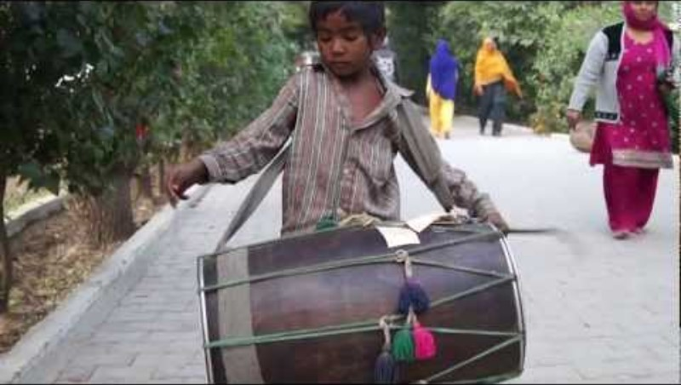
What is this object’s SOUND?

Slide 15
AKHAR also have NAME + SOUND

Slide 16
s
Notes:
(Say “This letter’s NAME is ----)

Slide 17
h

Slide 18
k

Slide 19
K

Slide 20
g

Slide 21
c

Slide 22
C

Slide 23
j

Slide 24
t

Slide 25
T

Slide 26
f

Slide 27

Notes:
These letters also all have SOUNDS.

Slide 28









These are all MUKTA forms, meaning the akhar are by themselves. When the letters have their friends with them, they make different sounds, I’ll show you who their friends are NEXT WEEK, but we won’t be learning about them until next week.

Slide 29
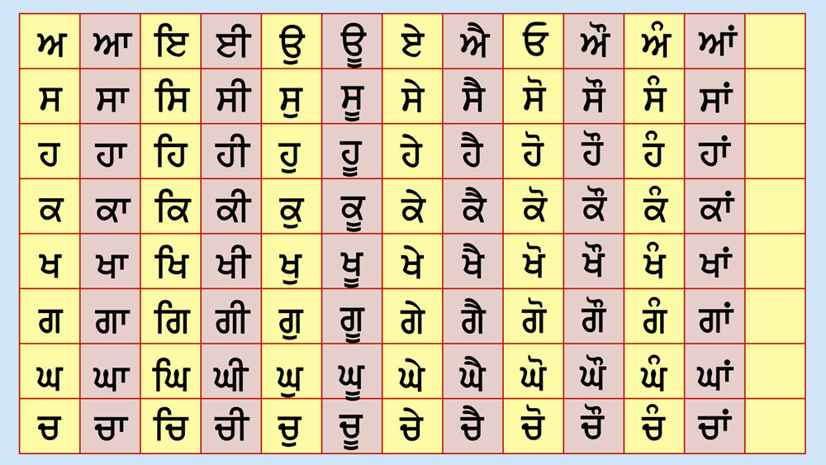
Do you see the different lines and shapes that are connected to the letters? These are called Lagamatra and they actually help the letters make DIFFERENT sounds. But today we are just going to focus on practicing the sounds of the letters that are all by themselves. Do you remember what they are called? MUKTA.

Slide 30
A
s
h
When the Akhar changes colour, we are going to say its NAME.
k
K
g
G
c

Slide 31
A
s
h
This time when the akhar changes colour, we are going to say its MUKTA SOUND. I’ll do it once, then we will do it together.
k
K
g
G
c

Slide 32
A
s
h
This time when the akhar changes colour, we are going to say its MUKTA SOUND. I’ll do it once, then we will do it together.
k
K
g
G
c

Slide 33
A
s
h
Okay, we are going to say the SOUND of the letter one more time, but this time we will also say the WORD Mukta so we can remember that it is a Mukta form, meaning the letter is by itself. Like this: ---
k
K
g
G
c

Slide 34
A
s
h
Okay, ready?
k
K
g
G
c

Slide 35
s
Very good! Now I want to show you something really interesting. Did you know that there are a couple of letters in the PAINTI Akhri that can make more than one sound? They are…
g

Slide 36
s
Very good! Now I want to show you something really interesting. Did you know that there are a couple of letters in the PAINTI Akhri that can make more than one sound? They are…
g

Slide 37
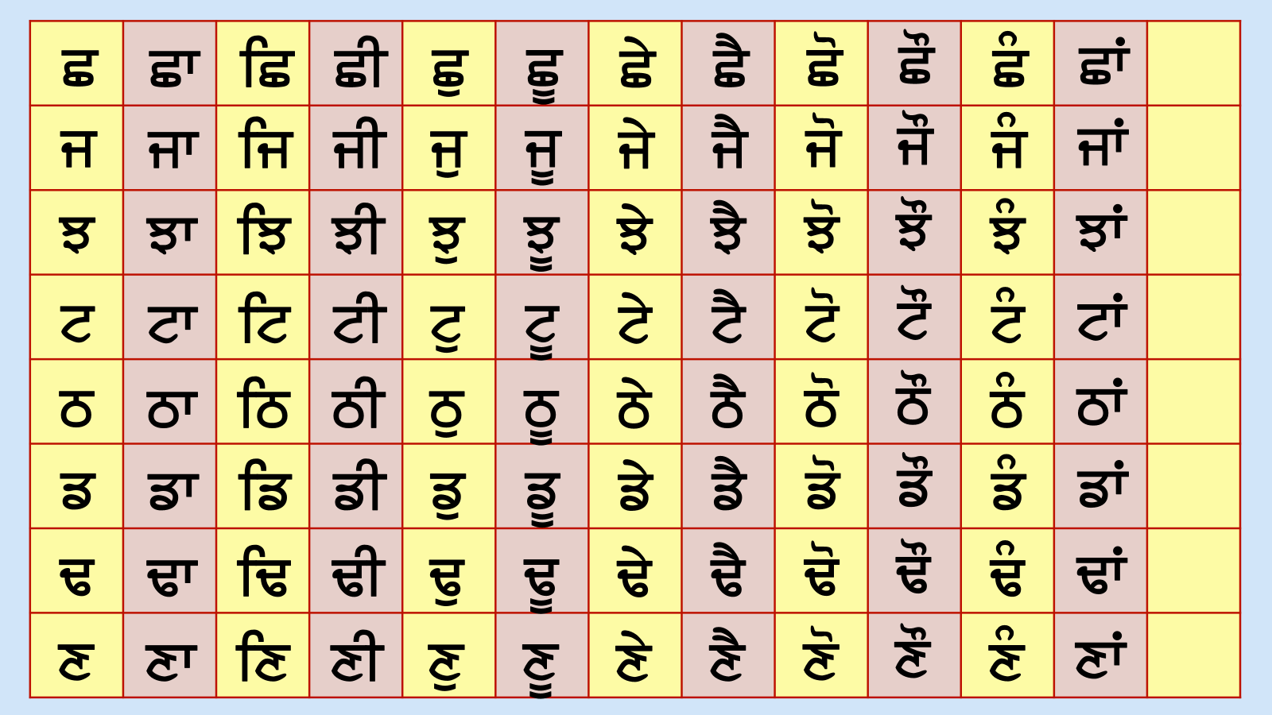
j
Very good! Now I want to show you something really interesting. Did you know that there are a couple of letters in the PAINTI Akhri that can make more than one sound? They are…

Slide 38
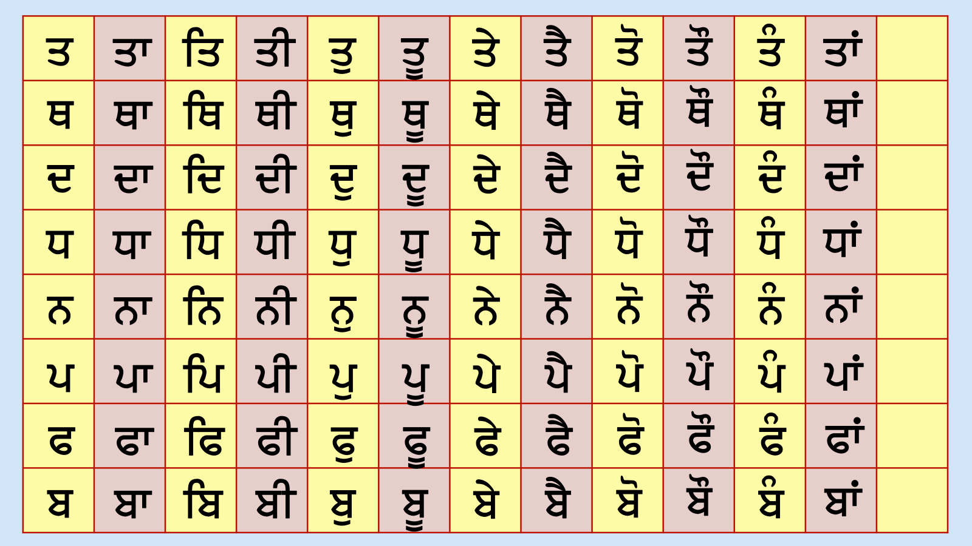
Very good! Now I want to show you something really interesting. Did you know that there are a couple of letters in the PAINTI Akhri that can make more than one sound? They are…
P

Slide 39
These are all of the letters that can make 2 sounds, not just one.
s K g j P l

Slide 40

These are all of the letters that can make 2 sounds, not just one.
S K g j P l
s K g j P l

Slide 41
Now we have practiced all of the Mukta sounds, so we are going to use them to make words today.

Slide 42

p
d

Slide 43
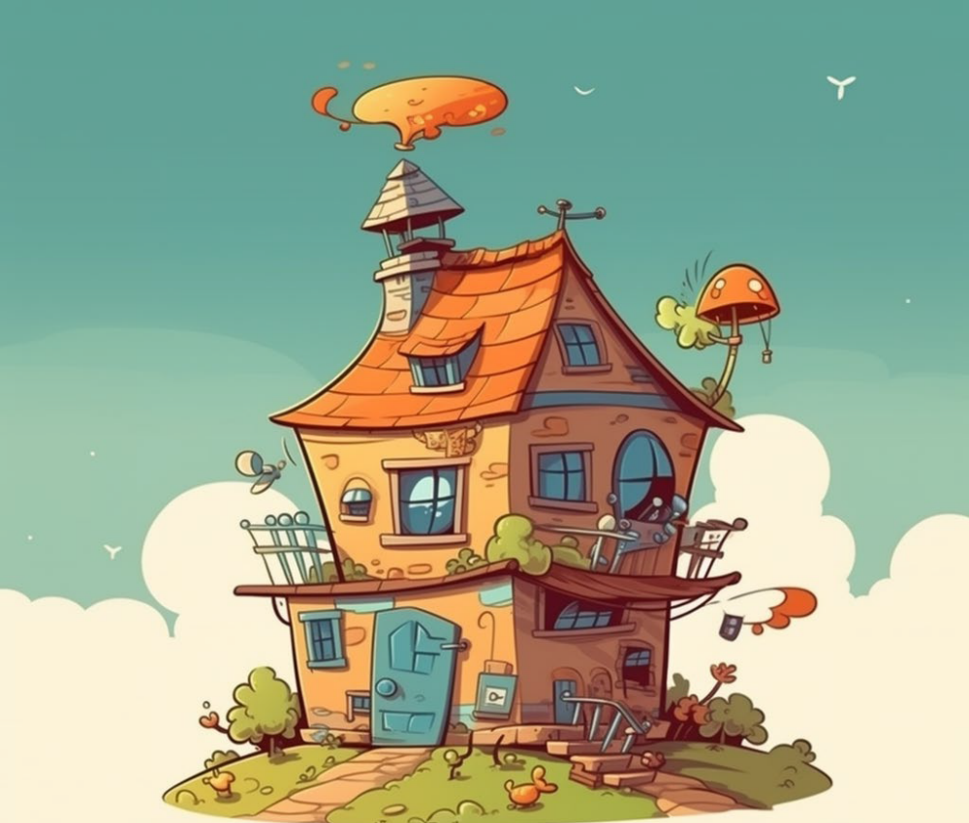
G
r

Slide 44
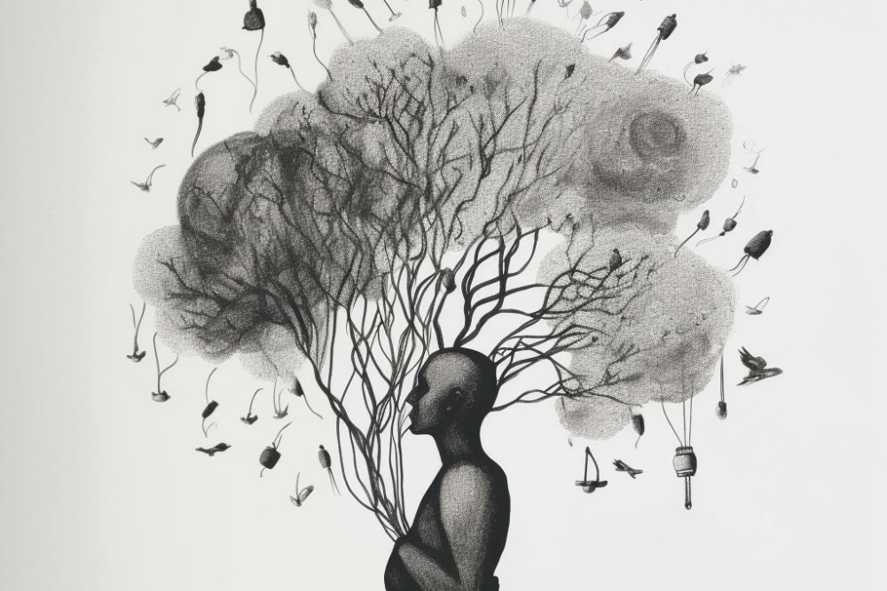
m
n

Slide 45
b
n

Slide 46

r
v

Slide 47

B
v

Slide 48

q
v

Slide 49

s
B

Slide 50

j
m

Slide 51
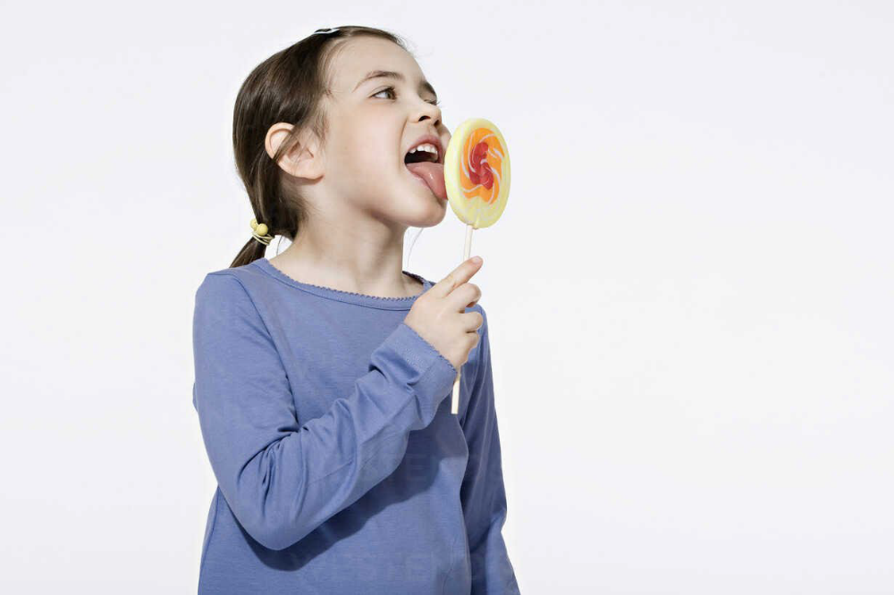
r
s

Slide 52
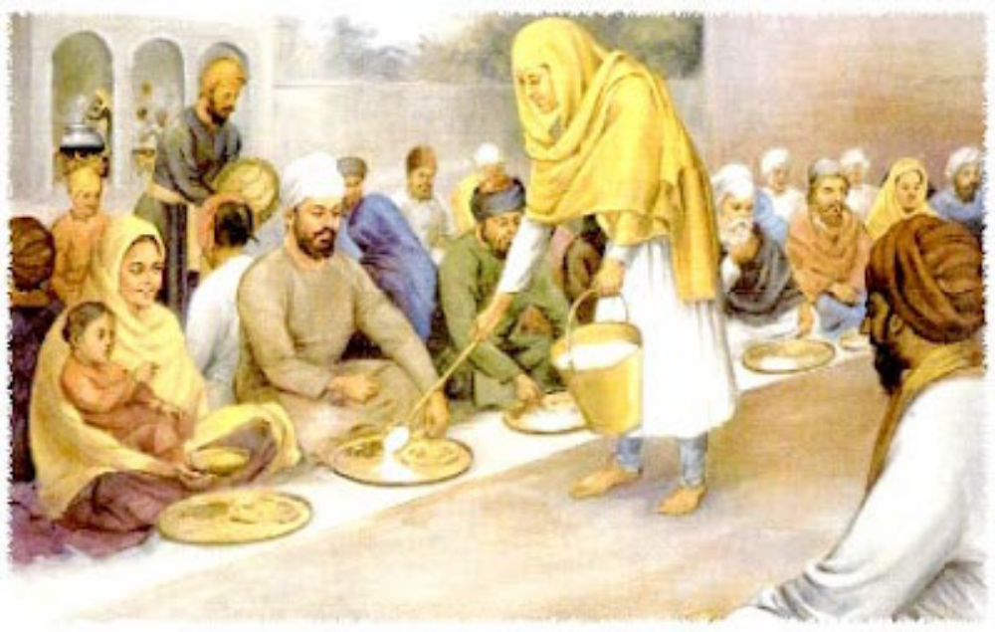
j
n

Slide 53

j
l

