Slide 1

Punjabi Fun
Level 2
A
e
a
Prem Ras Kids

Slide 2
TEST
#2!

Slide 3



a
A
e
s
h
k
K
g
G
|
c
C
j
J
\
t
T
f
F
x
q
Q
d
D
n
p
P
b
B
m
X
r
l
v
V

Slide 4
a
A
e
s
h
k
K
g
G
|
c
C
j
J
\
t
T
f
F
x
q
Q
d
D
n
p
P
b
B
m
X
r
l
v
V

Slide 5
a
A
e
s
h
k
K
g
G
|
c
C
j
J
\
t
T
f
F
x
q
Q
d
D
n
p
P
b
B
m
X
r
l
v
V

Slide 6
a
A
e
s
h
k
K
g
G
|
c
C
j
J
\
t
T
f
F
x
q
Q
d
D
n
p
P
b
B
m
X
r
l
v
V

Slide 7

a
A
e
s
h
k
K
g
G
|
c
C
j
J
\
t
T
f
F
x
q
Q
d
D
n
p
P
b
B
m
X
r
l
v
V

Slide 8
a
A
e
s
h
k
K
g
G
|
c
C
j
J
\
t
T
f
F
x
q
Q
d
D
n
p
P
b
B
m
X
r
l
v
V

Slide 9
a
A
e
s
h
k
K
g
G
|
c
C
j
J
\
t
T
f
F
x
q
Q
d
D
n
p
P
b
B
m
X
r
l
v
V

Slide 10
a
A
e
s
h
k
K
g
G
|
c
C
j
J
\
t
T
f
F
x
q
Q
d
D
n
p
P
b
B
m
X
r
l
v
V

Slide 11
a
A
e
s
h
k
K
g
G
|
c
C
j
J
\
t
T
f
F
x
q
Q
d
D
n
p
P
b
B
m
X
r
l
v
V

Slide 12
Muharni for Beginners

Slide 13


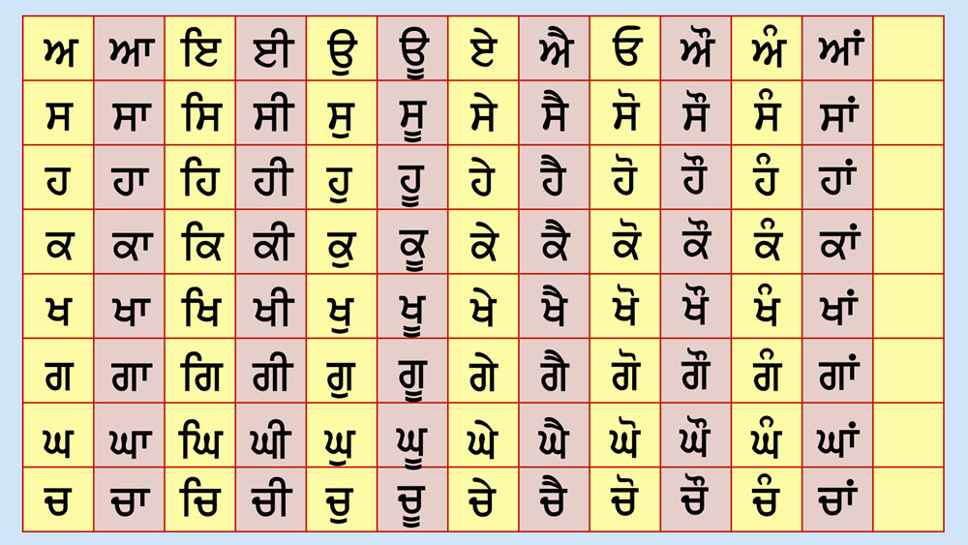



Let’s review our Muharni chart. Last time, we did only the first column from the Muharni chart, which were all Mukta sounds.

Slide 14
A
s
h
The sounds were:
k
K
g
G
c

Slide 15
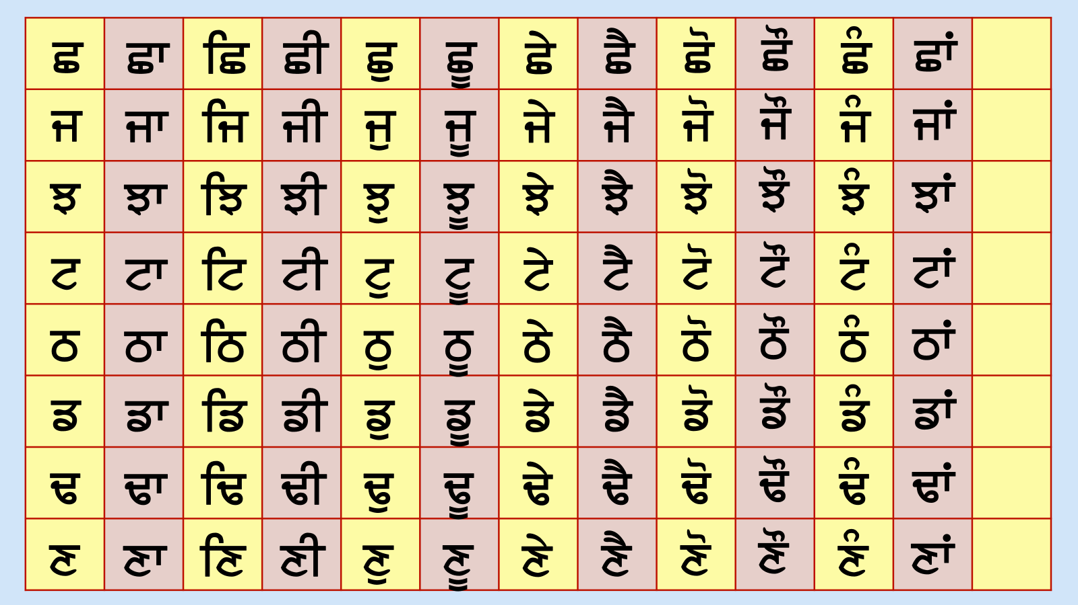
C
j
J
t
T
f
F
x

Slide 16
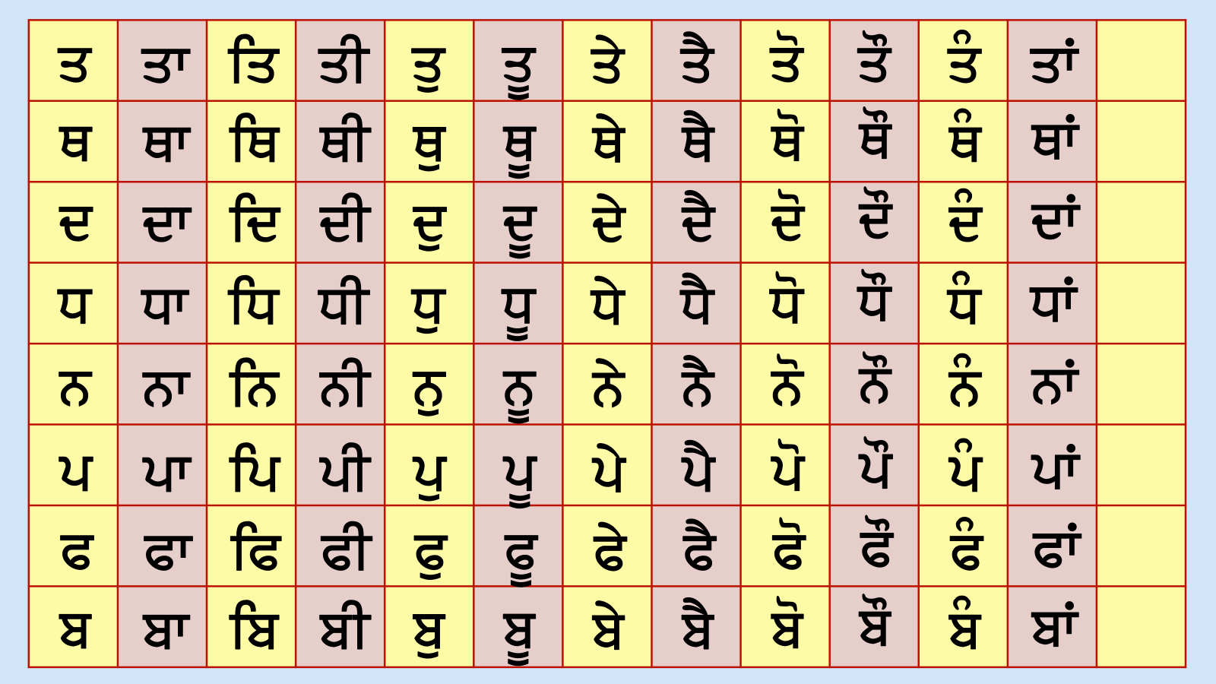
q
Q
d
D
n
p
P
P
b

Slide 17
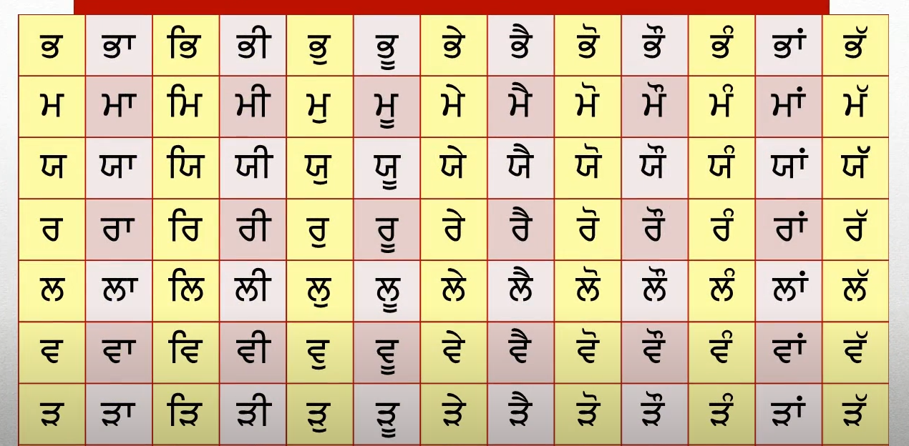
B
m
X
r
l
v
V

Slide 18
Also, remember that some of these can make an extra sound as well.
s K g j P l

Slide 19
Sassa can say S as well as Sh.
s K g j P l
s

Slide 20
Khakha can say KH as well as kh.
s K g j P l
K

Slide 21
Khakha can say KH as well as kh.
s K g j P l
g

Slide 22
Khakha can say KH as well as kh.
s K g j P l
j

Slide 23
Khakha can say KH as well as kh.
s K g j P l
P

Slide 24
Khakha can say KH as well as kh.
s K g j P l
l

Slide 25
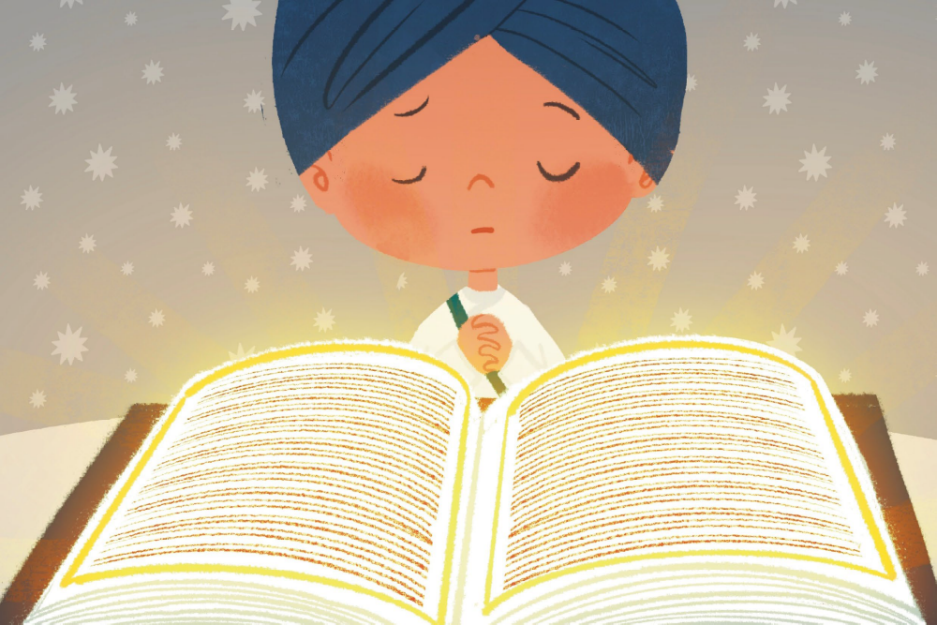
Here is an example of a word from Gurbani where the Sassa makes the second sound, SH.
s
b
d

Slide 26
Back in the olden days, people would just know from looking at a word whether to use the first sound or the second sound. But nowadays, to make it easier for the reader, writers add a “Bindi” to show that we should speak the second sound.
s K g j P l
s K g j P l

Slide 27

Like this:
S K g j P l
s K g j P l

Slide 28

Here’s an example. This is a SHALGAM. Since it starts with the SH sound, we are going to spell it with a Sassa with a Bindi / Sassay-pair-bindi (read the letter names only)
S
l
g
m

Slide 29
Let’s do that again, but this time, let’s all SOUND it out together by only saying the letter SOUNDS (not the names).
S
l
g
m

Slide 30
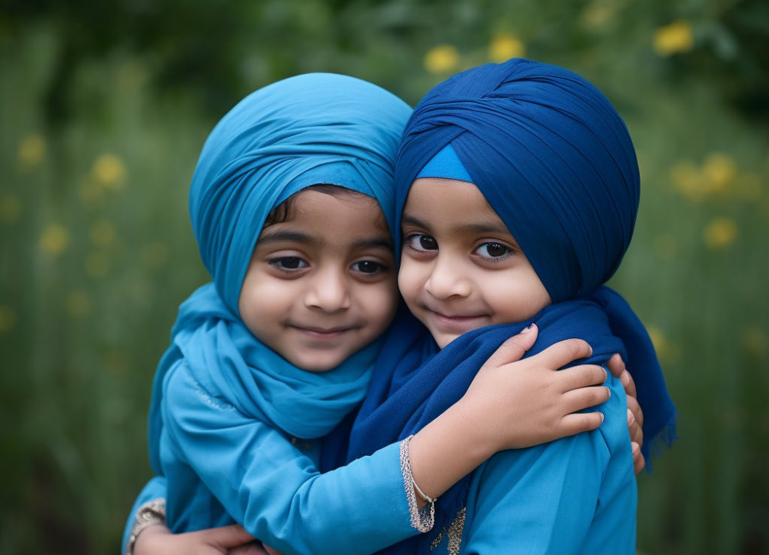
Great! Let’s practice reading some new words! These are all from Sri Sohila Sahib, just like the words we did last week, but these are going to be 3 letters-long instead of 2-letters long.
s
j
x

Slide 31

Great! Let’s practice reading some new words! These are all from Sri Sohila Sahib, just like the words we did last week, but these are going to be 3 letters-long instead of 2-letters long.
g
g
n

Slide 32


Great! Let’s practice reading some new words! These are all from Sri Sohila Sahib, just like the words we did last week, but these are going to be 3 letters-long instead of 2-letters long.
p
v
x

Slide 33
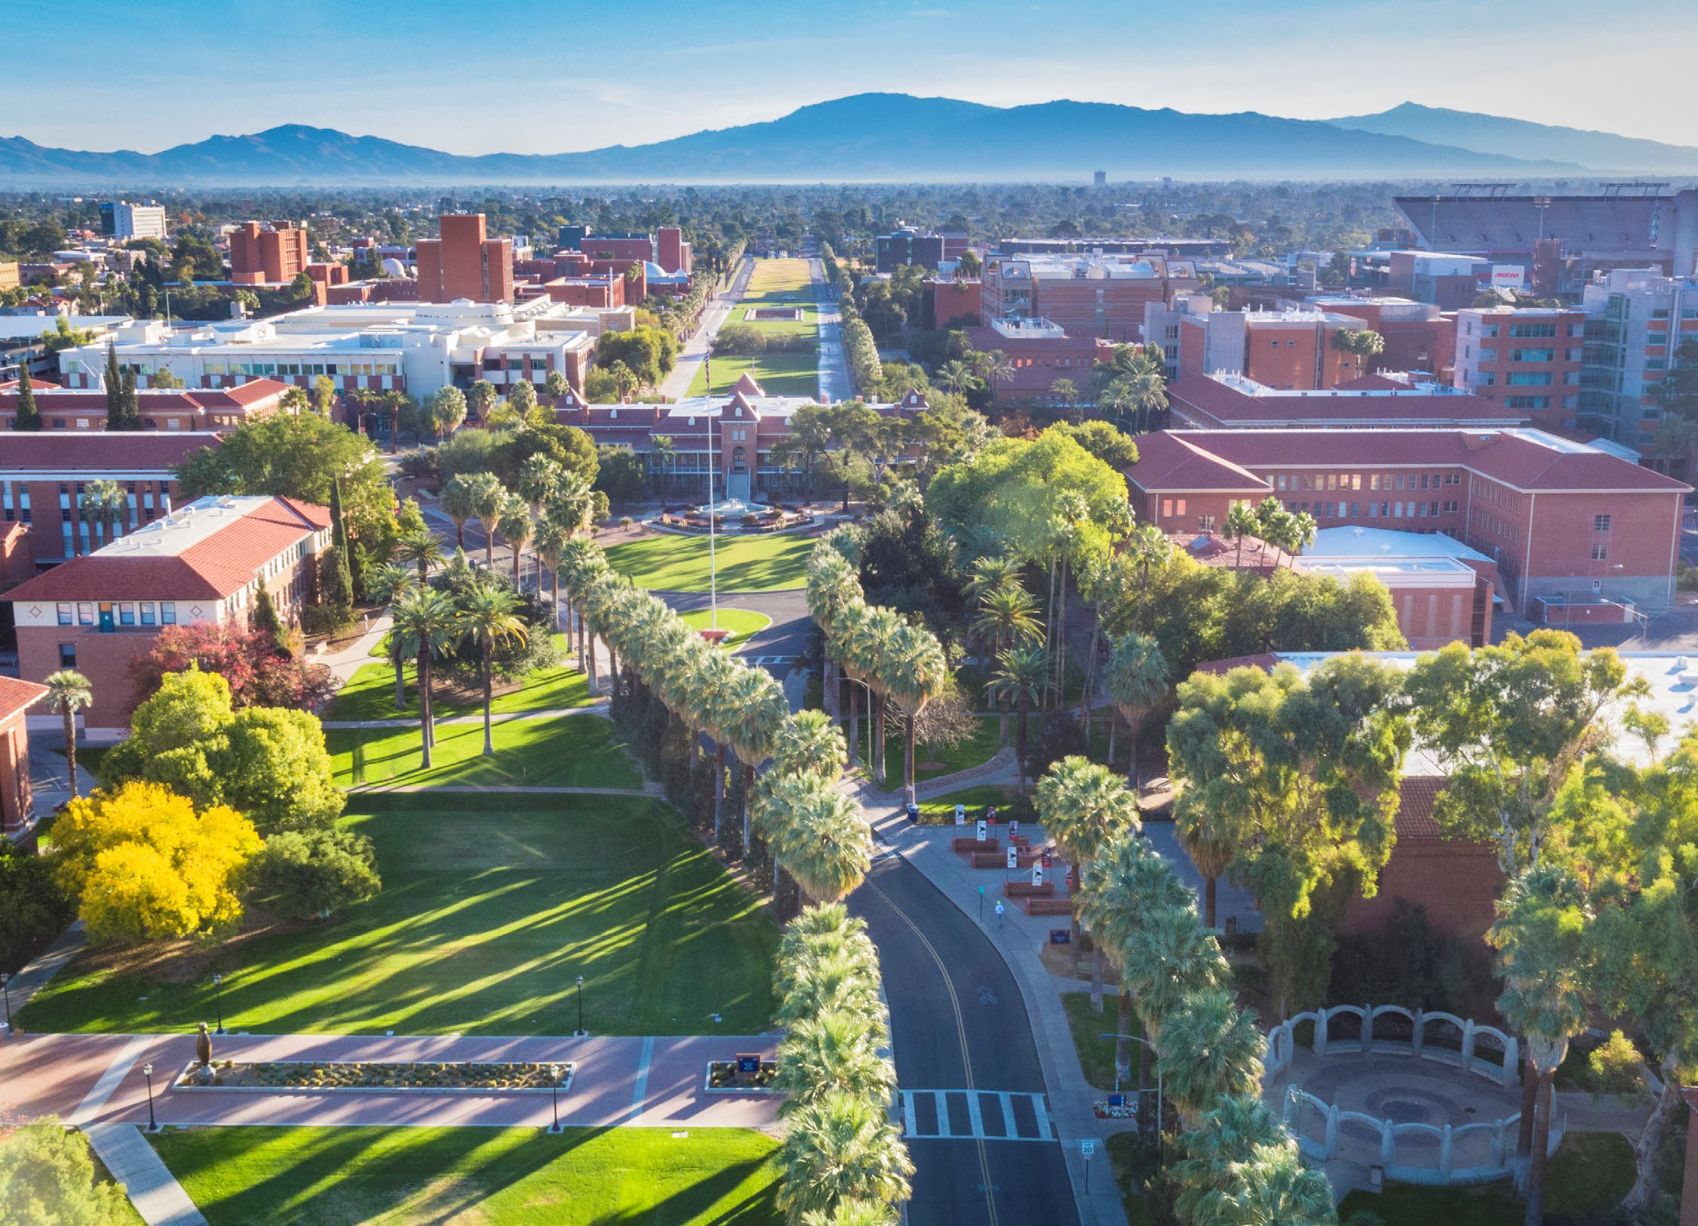
Great! Let’s practice reading some new words! These are all from Sri Sohila Sahib, just like the words we did last week, but these are going to be 3 letters-long instead of 2-letters long.
n
g
r

Slide 34
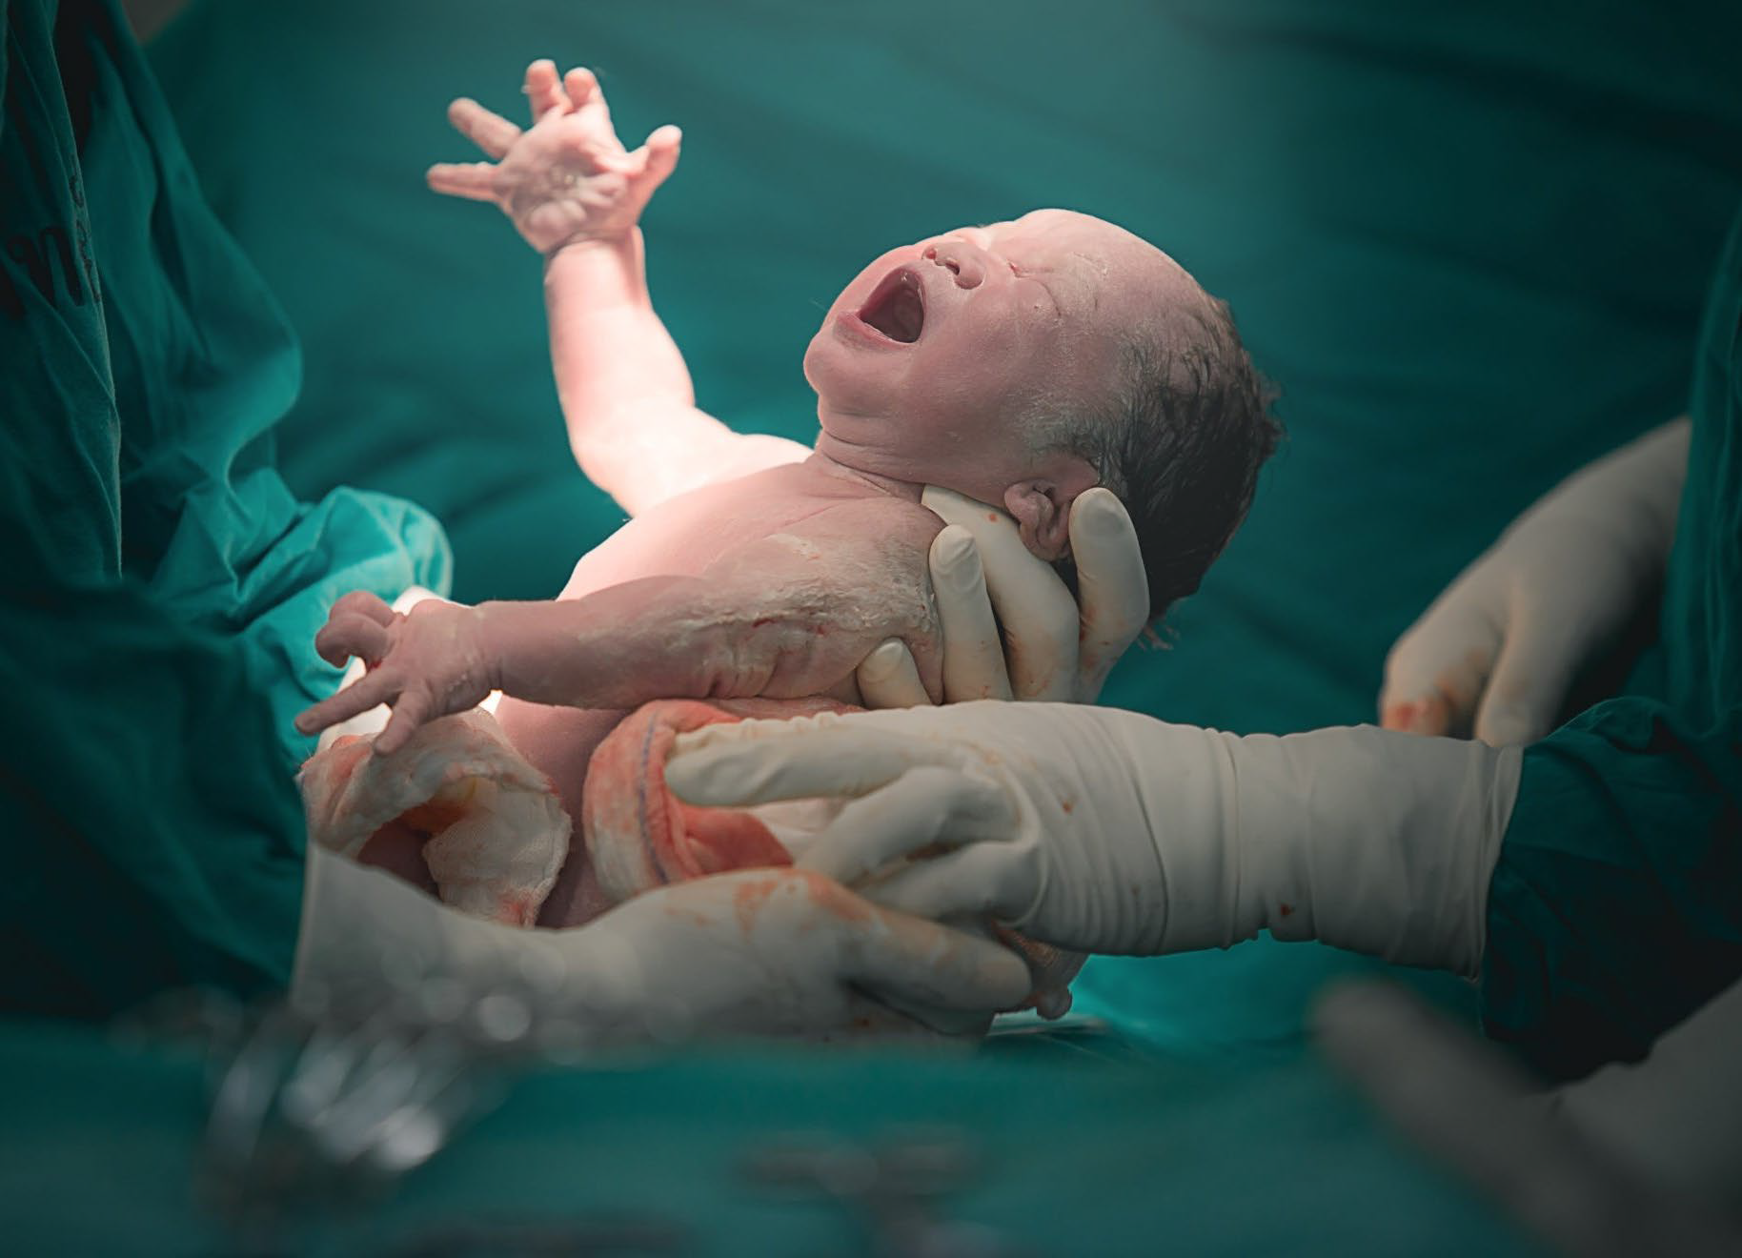
Great! Let’s practice reading some new words! These are all from Sri Sohila Sahib, just like the words we did last week, but these are going to be 3 letters-long instead of 2-letters long.
j
n
m

Slide 35
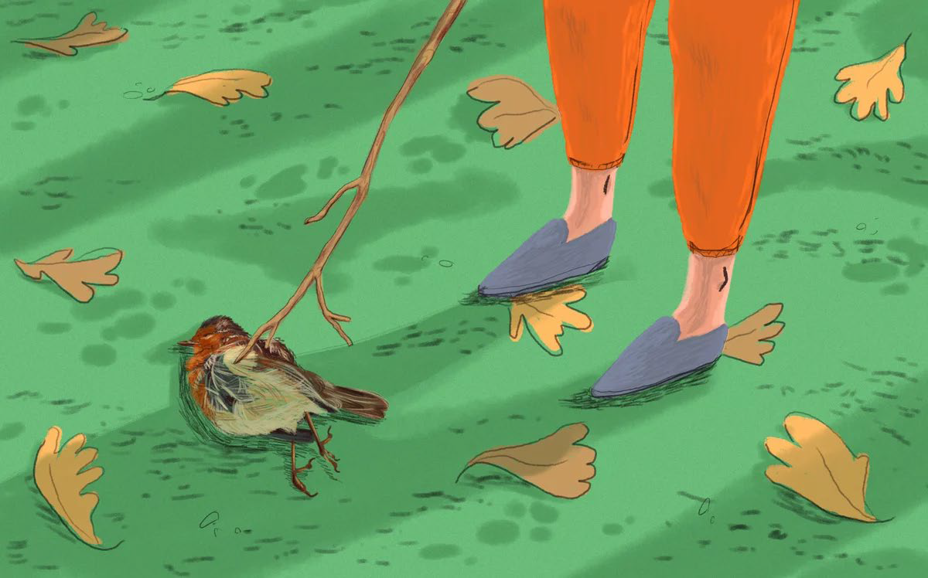
Great! Let’s practice reading some new words! These are all from Sri Sohila Sahib, just like the words we did last week, but these are going to be 3 letters-long instead of 2-letters long.
m
r
x

Slide 36
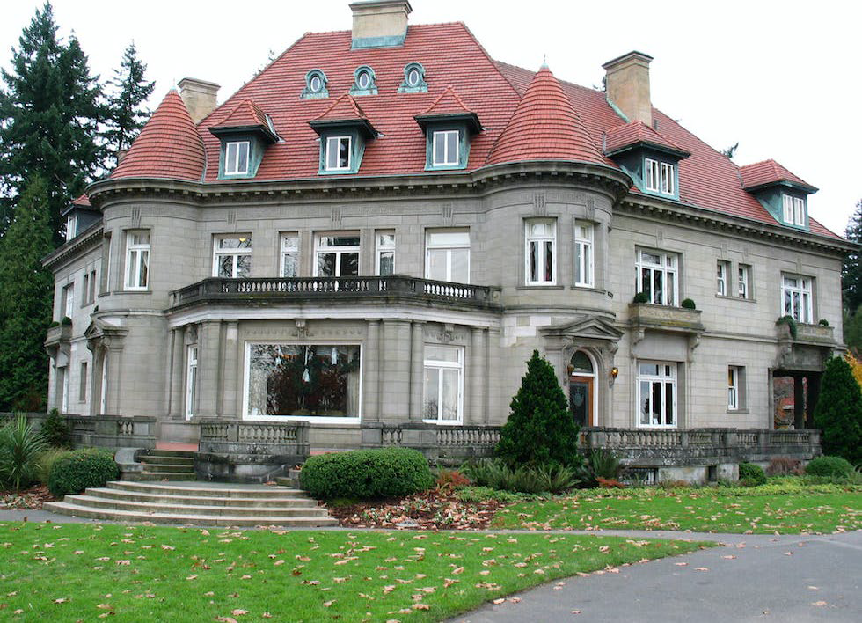
Great! Let’s practice reading some new words! These are all from Sri Sohila Sahib, just like the words we did last week, but these are going to be 3 letters-long instead of 2-letters long.
m
h
l

Slide 37
Let’s review the words we did last week.

Slide 38

p
d

Slide 39
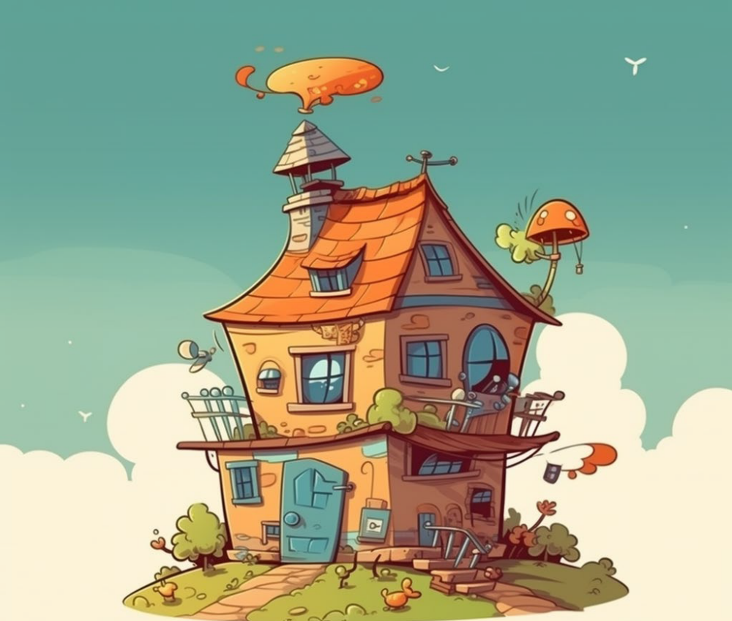
G
r

Slide 40
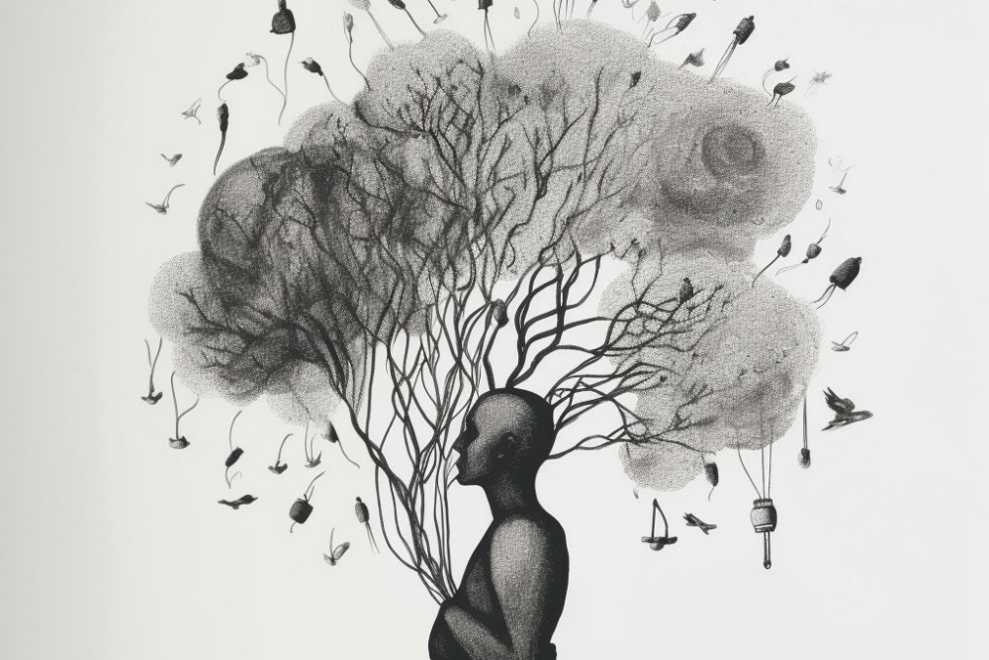
m
n

Slide 41
b
n

Slide 42

r
v

Slide 43
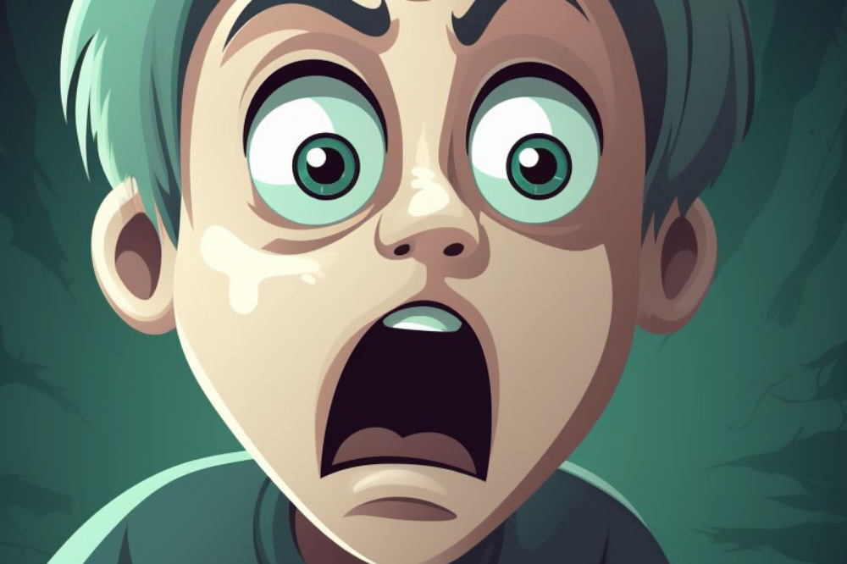
B
v

Slide 44

q
v

Slide 45

s
B

Slide 46

j
m

Slide 47
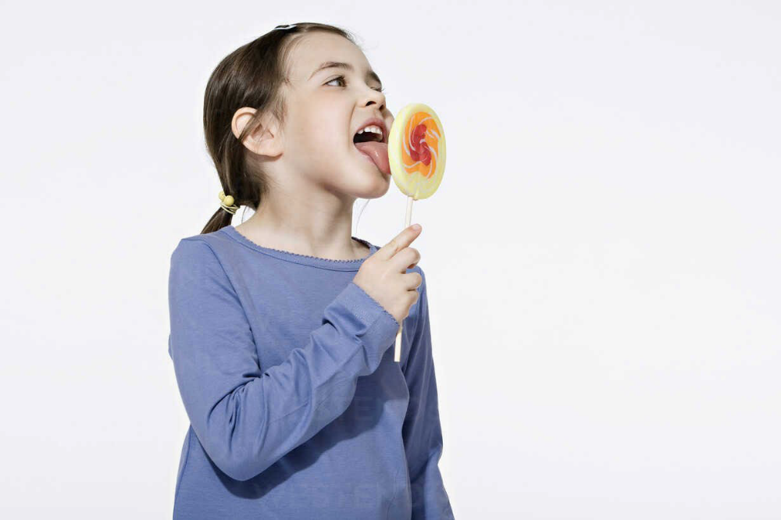
r
s

Slide 48
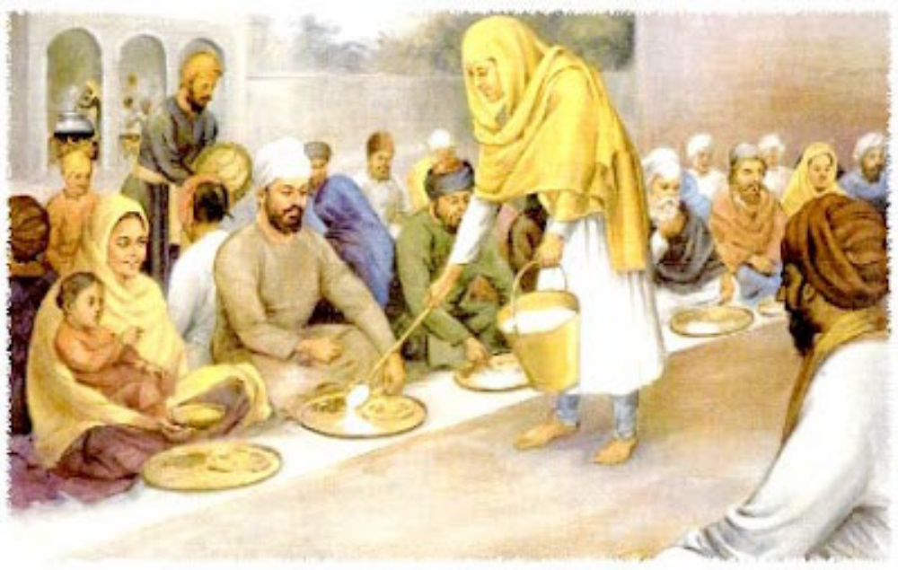
j
n

Slide 49

j
l

Slide 50
I am now going to introduce you to all of the other sounds on the Muharni chart.

Slide 51
We have learned all of the Mukta sounds, which are the sounds the letters make when they are all by themselves. Now I’m going to show you the sounds they make when they have a lagamatra.

Slide 52
The lagamatras look like this:
w

Slide 53
The lagamatras look like this:
i

Slide 54
The lagamatras look like this:
I

Slide 55
The lagamatras look like this:
U

Slide 56
The lagamatras look like this:
y

Slide 57
The lagamatras look like this:
Y

Slide 58
The lagamatras look like this:
o

Slide 59
The lagamatras look like this:
O

Slide 60
The lagamatras look like this:
M

Slide 61
The lagamatras look like this:
N

Slide 62
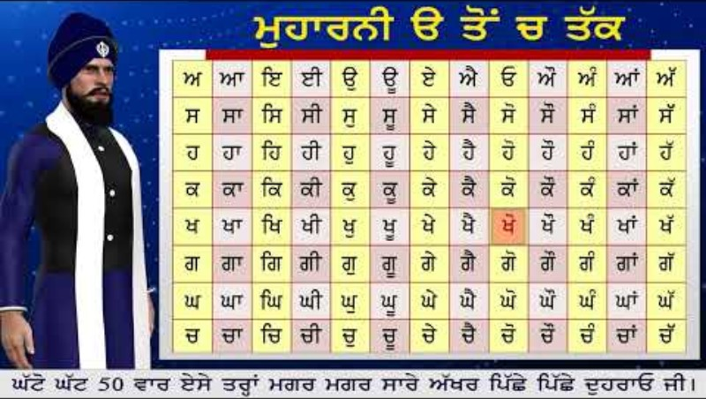

Slide 63
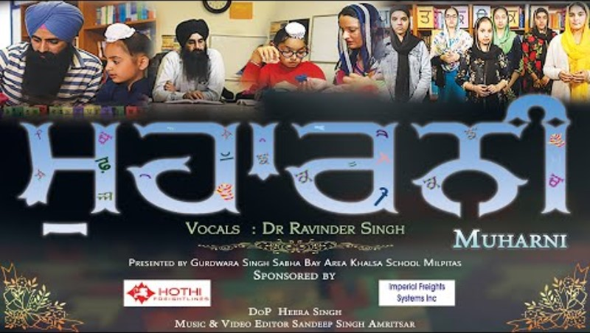

Slide 64


