Slide 1







CHALLENGE 1
s | sw | is | sI | su | sU | sy | sY | so | sO | sM
k | kw | ik | kI | ku | kU | ky | kY | ko | kO | kM
K | Kw | iK | KI | Ku | KU | Ky | KY | Ko | KO | KM
G | Gw | iG | GI | Gu | GU | Gy | GY | Go | GO | GM
q | qw | iq | qI | qu | qU | qy | qY | qo | qO | qM
d | dw | id | dI | du | dU | dy | dY | do | dO | dM
n | nw | in | nI | nu | nU | ny | nY | no | nO | nM
b | bw | ib | bI | bu | bU | by | bY | bo | bO | bM
m | mw | im | mI | mu | mU | my | mY | mo | mO | mM
r | rw | ir | rI | ru | rU | ry | rY | ro | rO | rM

Slide 2

CHALLENGE 2
s | sw | is | sI | su | sU | sy | sY | so | sO | sM
k | kw | ik | kI | ku | kU | ky | kY | ko | kO | kM
K | Kw | iK | KI | Ku | KU | Ky | KY | Ko | KO | KM
G | Gw | iG | GI | Gu | GU | Gy | GY | Go | GO | GM
q | qw | iq | qI | qu | qU | qy | qY | qo | qO | qM
d | dw | id | dI | du | dU | dy | dY | do | dO | dM
n | nw | in | nI | nu | nU | ny | nY | no | nO | nM
b | bw | ib | bI | bu | bU | by | bY | bo | bO | bM
m | mw | im | mI | mu | mU | my | mY | mo | mO | mM
r | rw | ir | rI | ru | rU | ry | rY | ro | rO | rM
inq
dyKy
qum
iqq
sdw
sMbq
ismr
nwnk

Slide 3

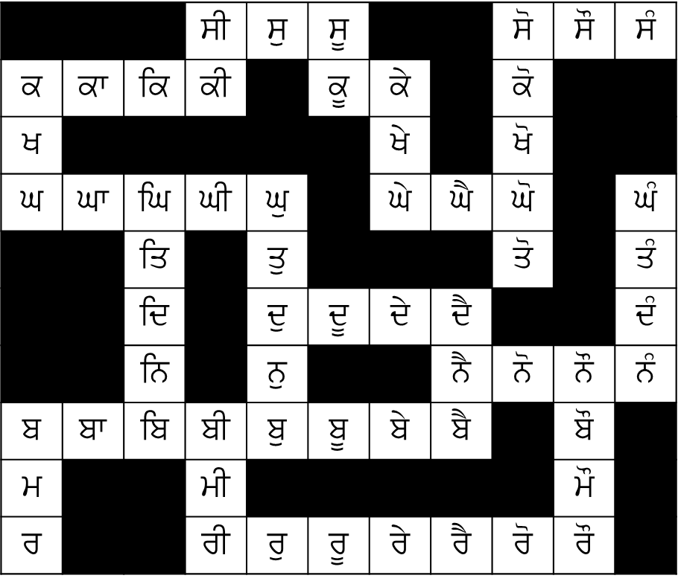
CHALLENGE 3
s | sw | is | sI | su | sU | sy | sY | so | sO | sM
k | kw | ik | kI | ku | kU | ky | kY | ko | kO | kM
K | Kw | iK | KI | Ku | KU | Ky | KY | Ko | KO | KM
G | Gw | iG | GI | Gu | GU | Gy | GY | Go | GO | GM
q | qw | iq | qI | qu | qU | qy | qY | qo | qO | qM
d | dw | id | dI | du | dU | dy | dY | do | dO | dM
n | nw | in | nI | nu | nU | ny | nY | no | nO | nM
b | bw | ib | bI | bu | bU | by | bY | bo | bO | bM
m | mw | im | mI | mu | mU | my | mY | mo | mO | mM
r | rw | ir | rI | ru | rU | ry | rY | ro | rO | rM
BONUS (homework): Can you get out of the maze? You have to read the sound to move forward!

Slide 4
s | sw | is | sI | su | sU | sy | sY | so | sO | sM
k | kw | ik | kI | ku | kU | ky | kY | ko | kO | kM
K | Kw | iK | KI | Ku | KU | Ky | KY | Ko | KO | KM
G | Gw | iG | GI | Gu | GU | Gy | GY | Go | GO | GM
q | qw | iq | qI | qu | qU | qy | qY | qo | qO | qM
d | dw | id | dI | du | dU | dy | dY | do | dO | dM
n | nw | in | nI | nu | nU | ny | nY | no | nO | nM
b | bw | ib | bI | bu | bU | by | bY | bo | bO | bM
m | mw | im | mI | mu | mU | my | mY | mo | mO | mM
r | rw | ir | rI | ru | rU | ry | rY | ro | rO | rM

