Slide 1
MUHARNI
LEVEL 2

Slide 2
Muharni Time!

Slide 3
Step 1: Read the Sound + Lagamatra Name

Slide 4
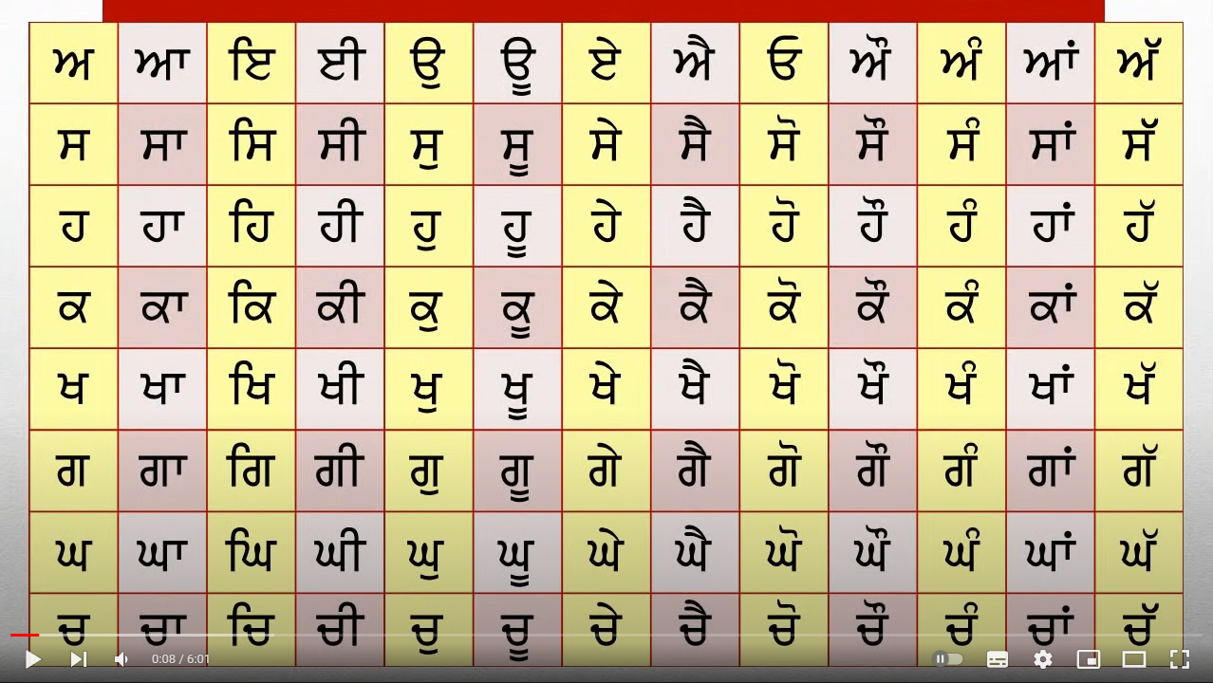


Slide 12


Slide 20


Slide 28


Slide 36


Slide 44


Slide 52


Slide 61


Slide 69


Slide 77


Slide 85


Slide 93


Slide 101
Step 2: Read the Sound by itself

Slide 102
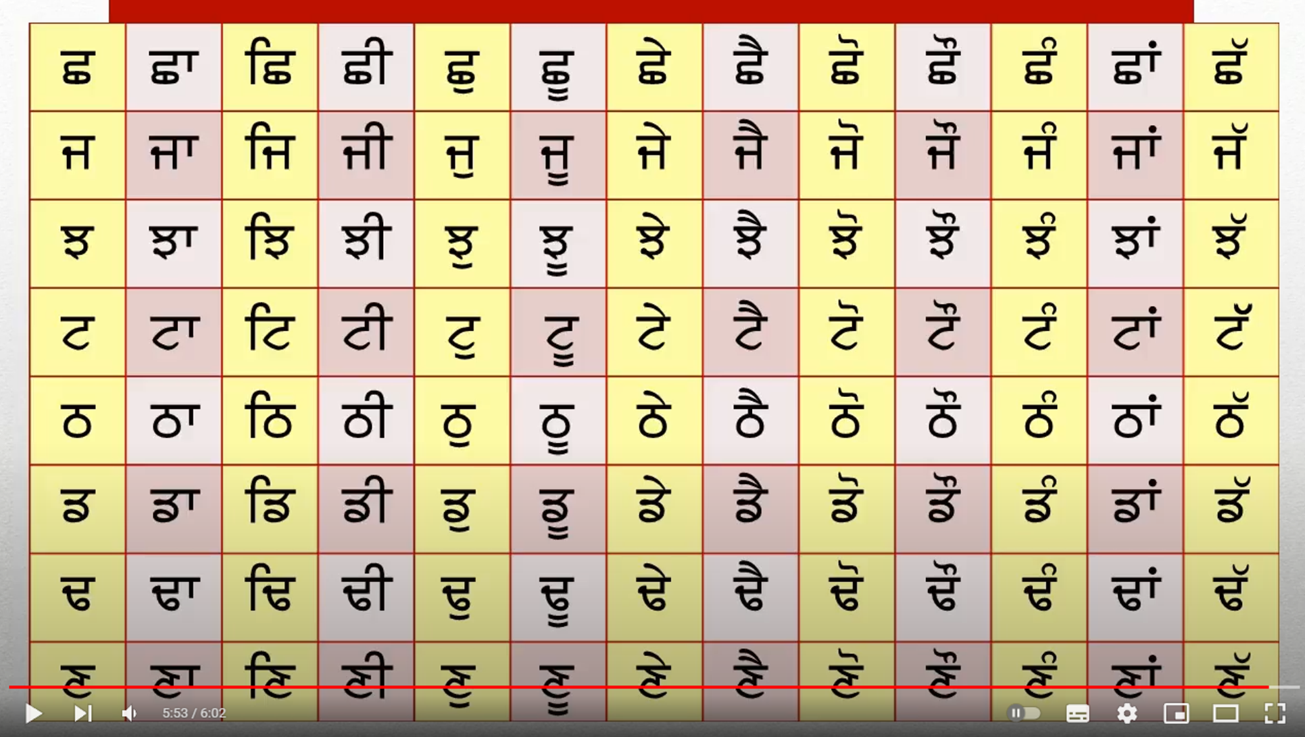

Slide 103
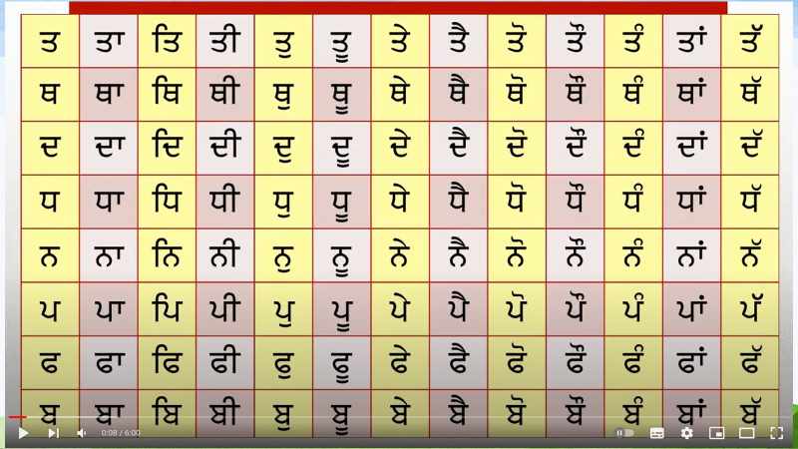

Slide 104
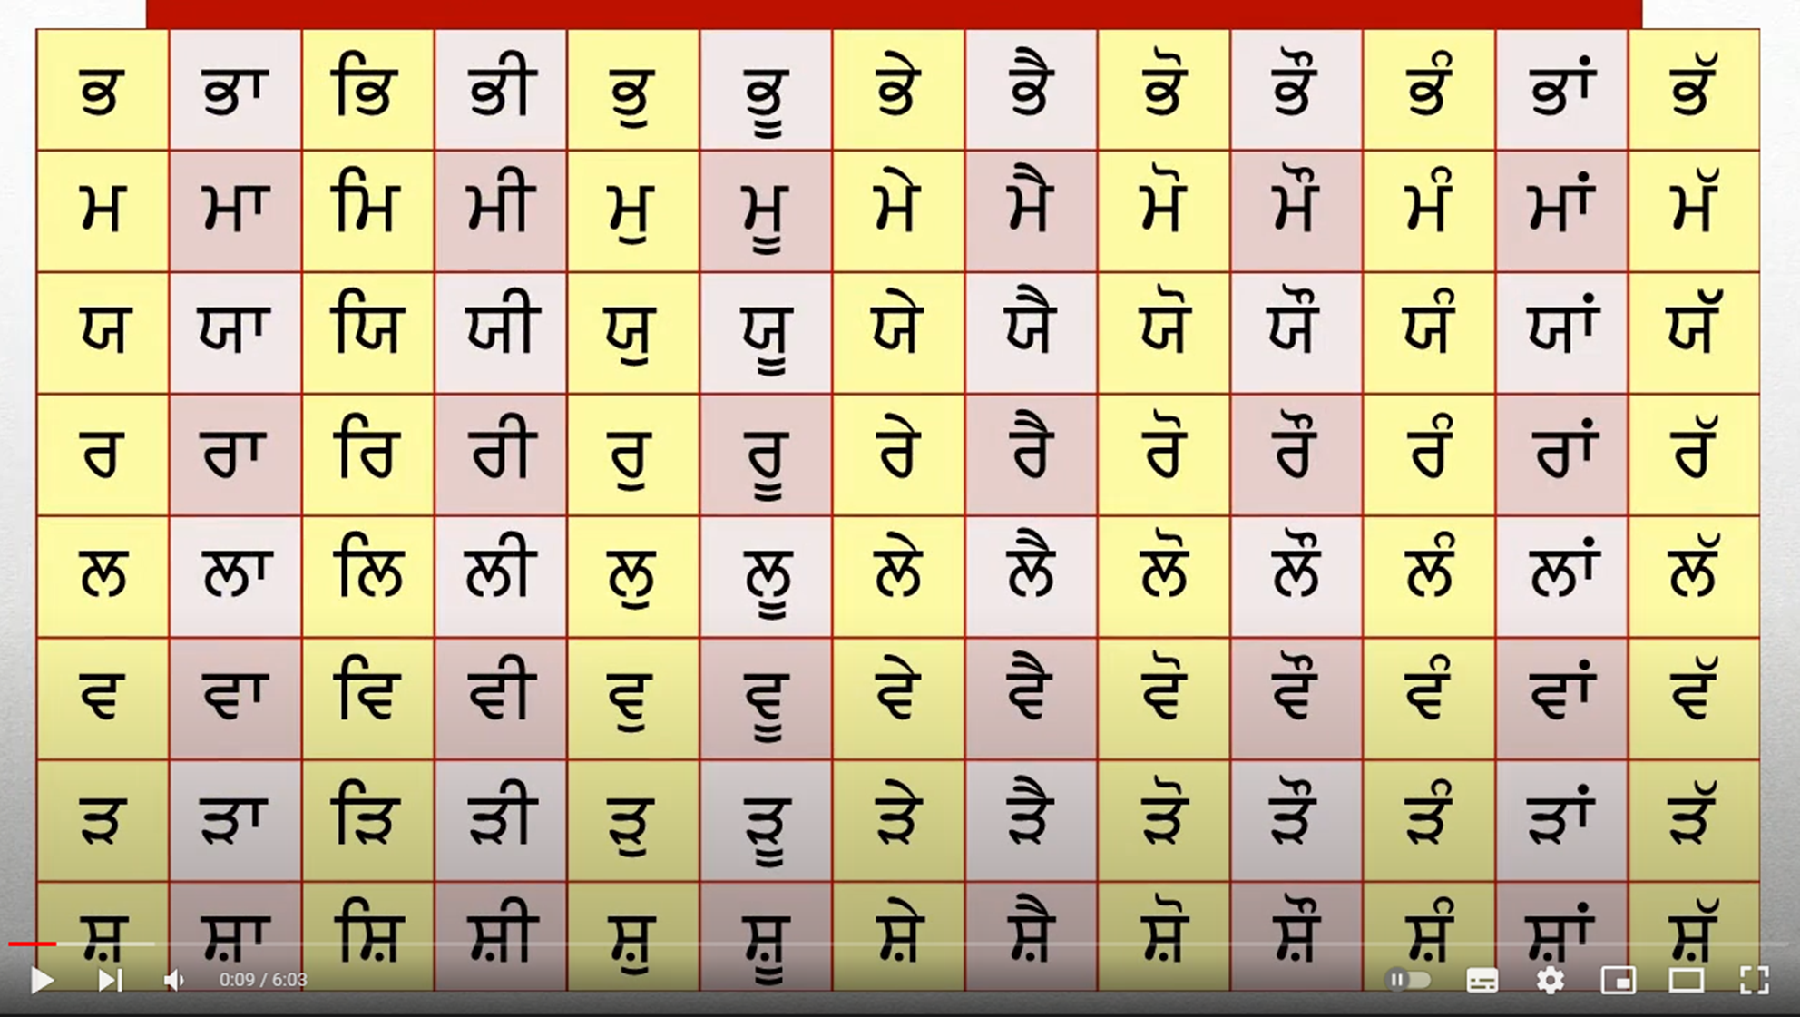

Slide 105
Step 3: Read across – sounds only! ☺

