Slide 1
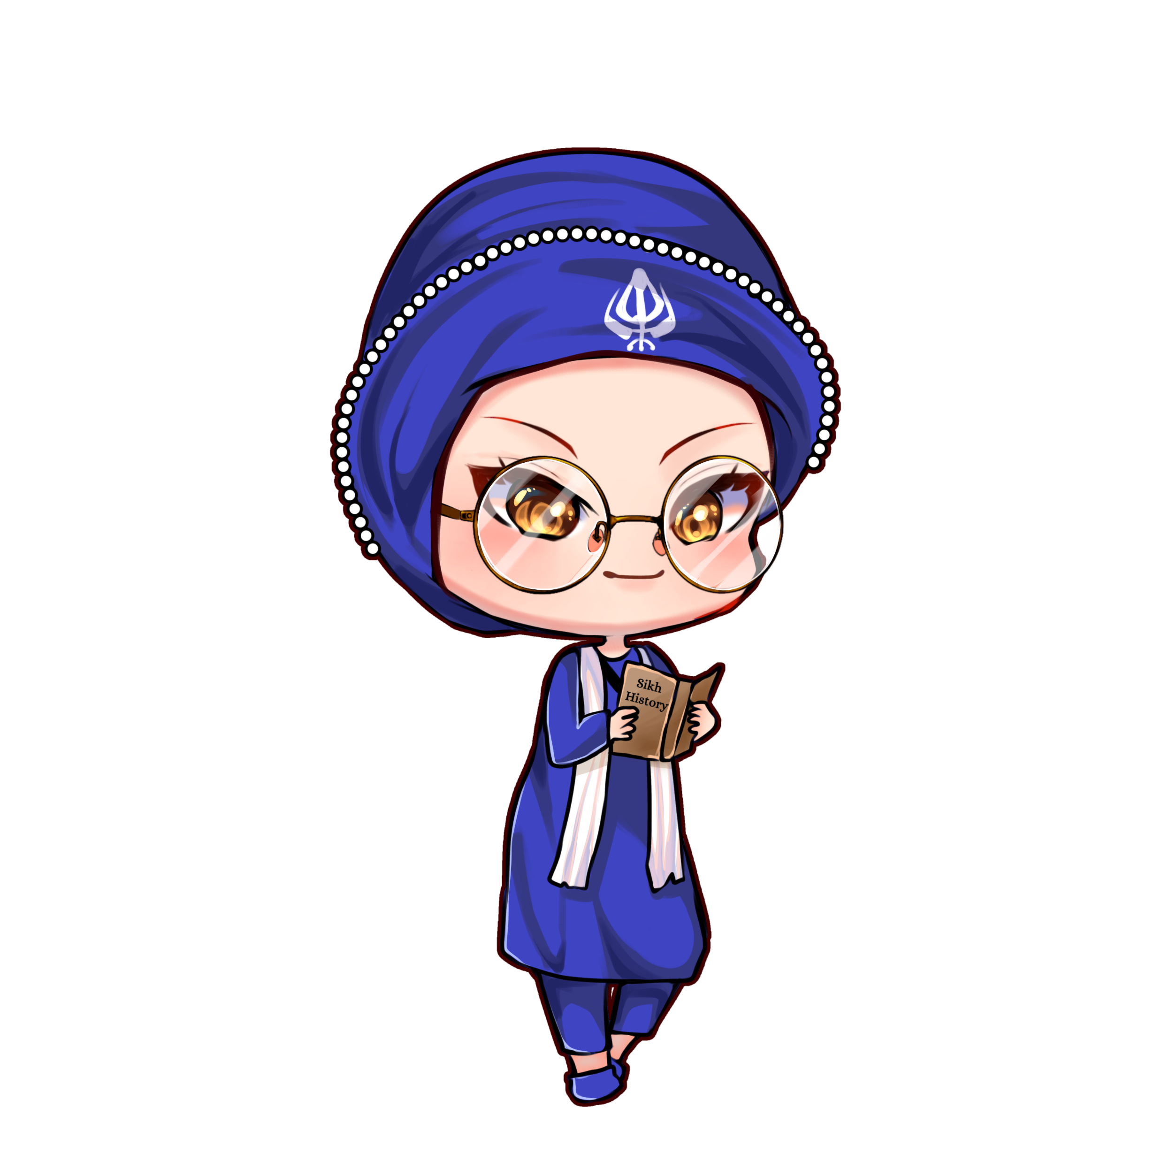

Painti Fun
LESSON: 1

Slide 2




PLEASE READ:
01
You can press “ESC” on your keypad to exit the screen.
02
You must “Enable external content for this session” in order for the embedded videos to play properly.
03
Click anywhere on the screen to move to the next slide.

Slide 3
FORMAT:
01
Varnmala Abhiyaas
06
Sunno Atey Pichhay Bolo
02
Practice Video
07
Akhar Labho (game)
03
Bhulavay Akhar
08
Akhar Pachhaano (game)
04
Letter of the Day
09
Bhulavay Akhar 2
Find the Pictures Starting with the Letter
05
10
Varnmala Final Repeat

Slide 4
Varnmala
Naal di naal bolo!

Slide 5
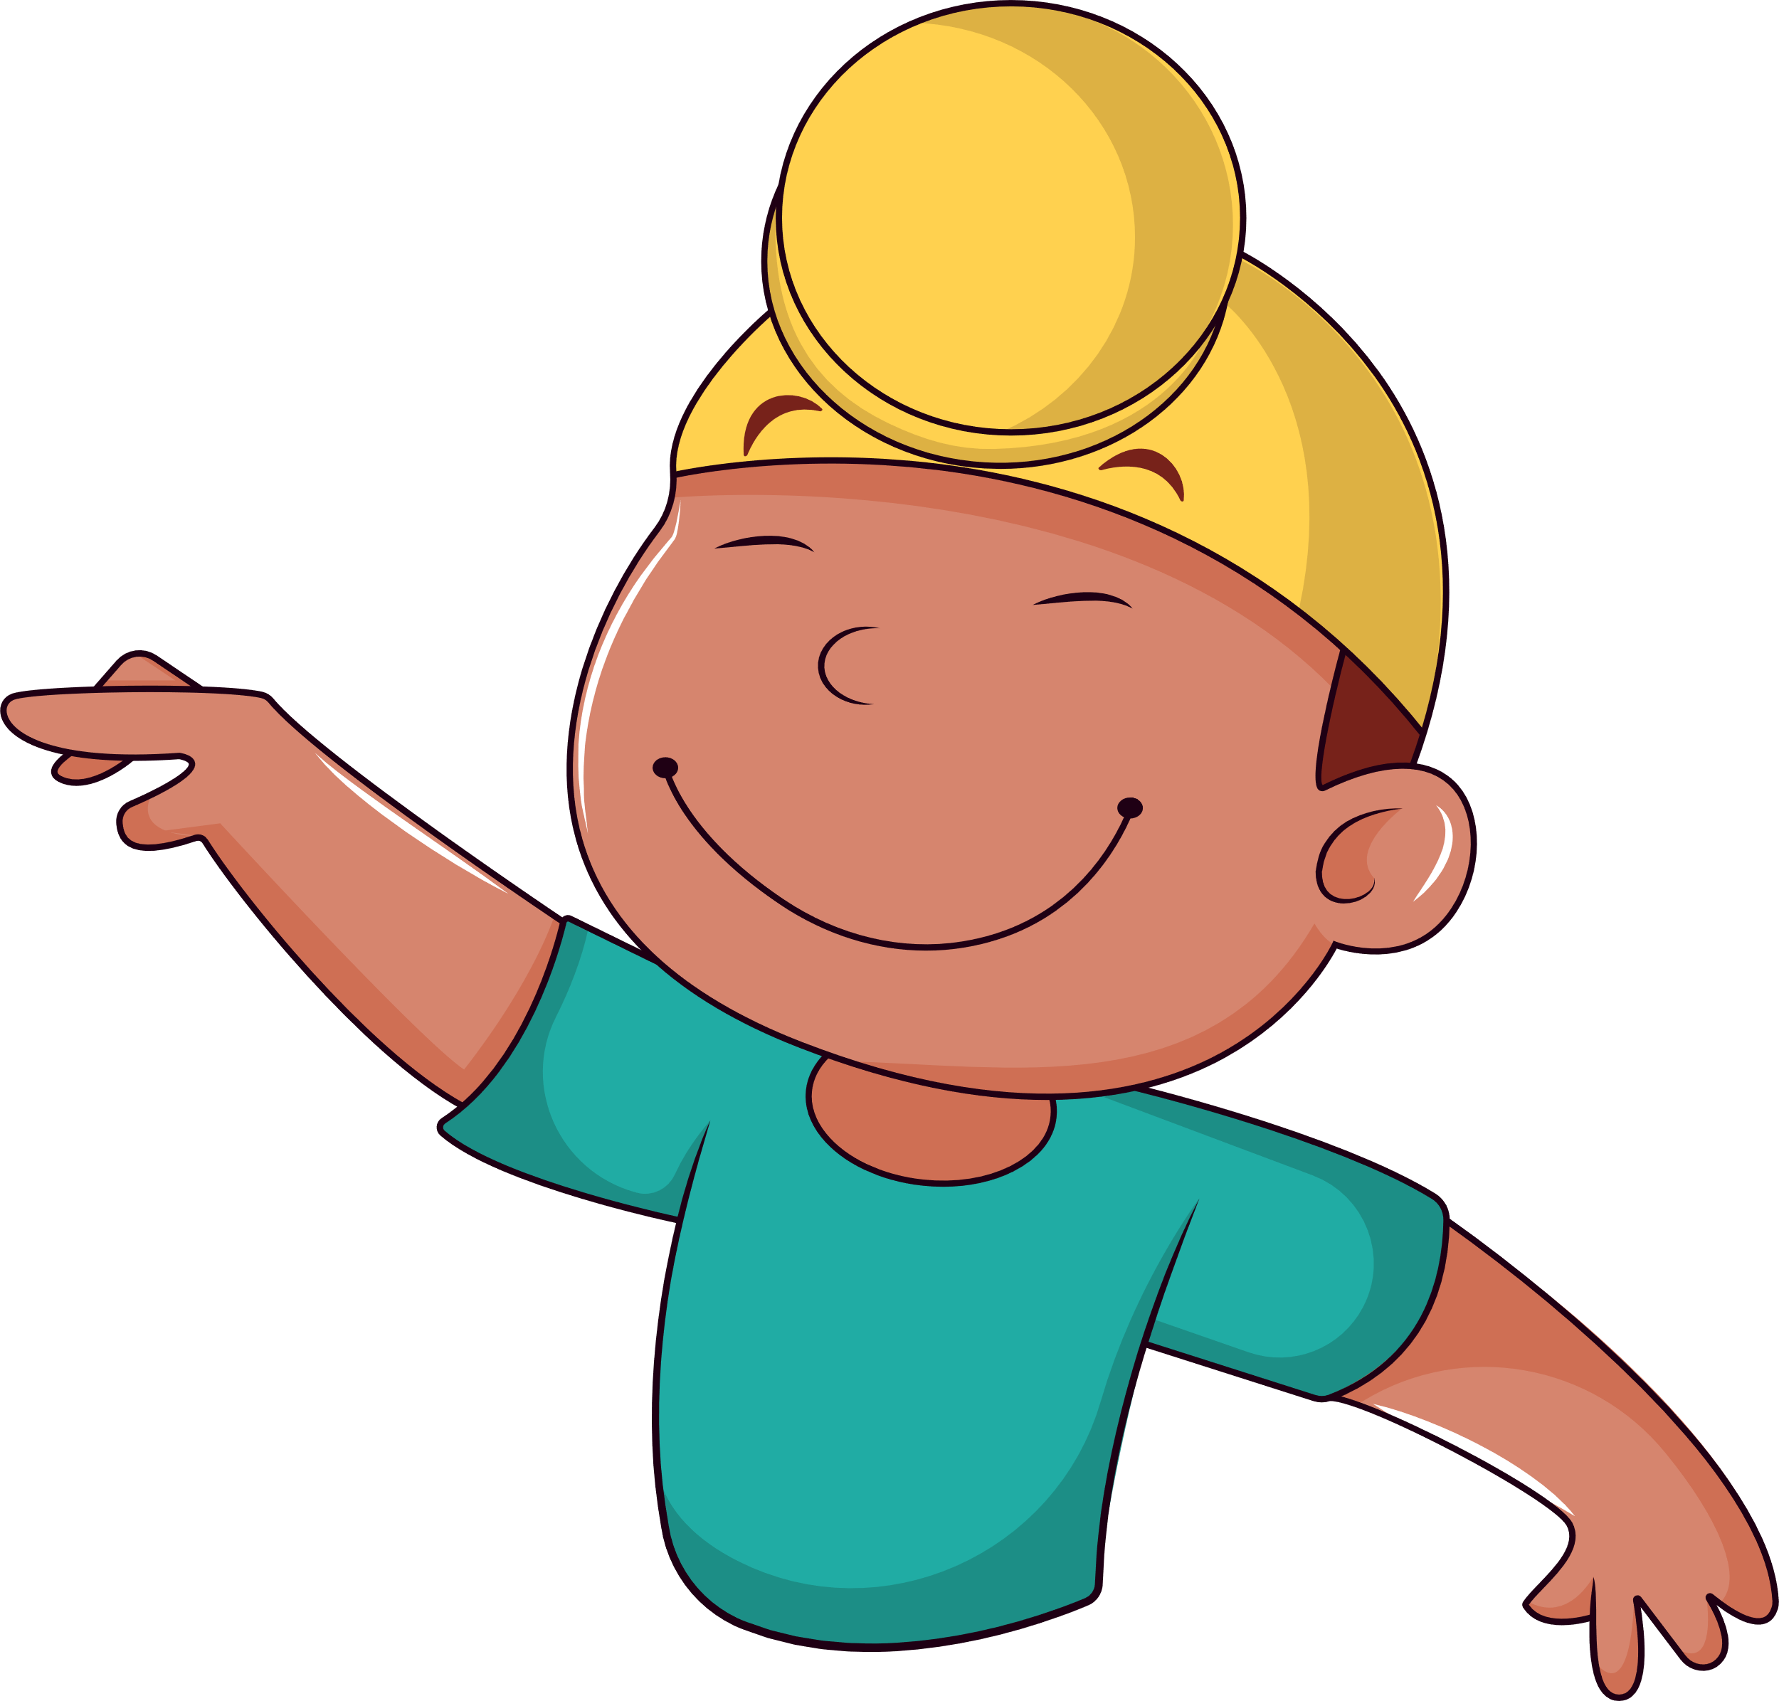

A
e
s
h
a
k
K
g
G
|
c
C
j
J
\
Complete 5 repetitions to move onto the next slide!
t
T
f
F
x
q
Q
d
D
n
p
P
b
B
m
X
r
l
v
V

Slide 6

Notes:
Video link not found

Slide 7
Bhulavay Akhar
PaD ke dasso akhar dey naam.

Slide 8




a

Slide 9
a

Slide 10
a

Slide 11

a

Slide 12


Slide 13
Labho
Find the images starting with Aira

Slide 14
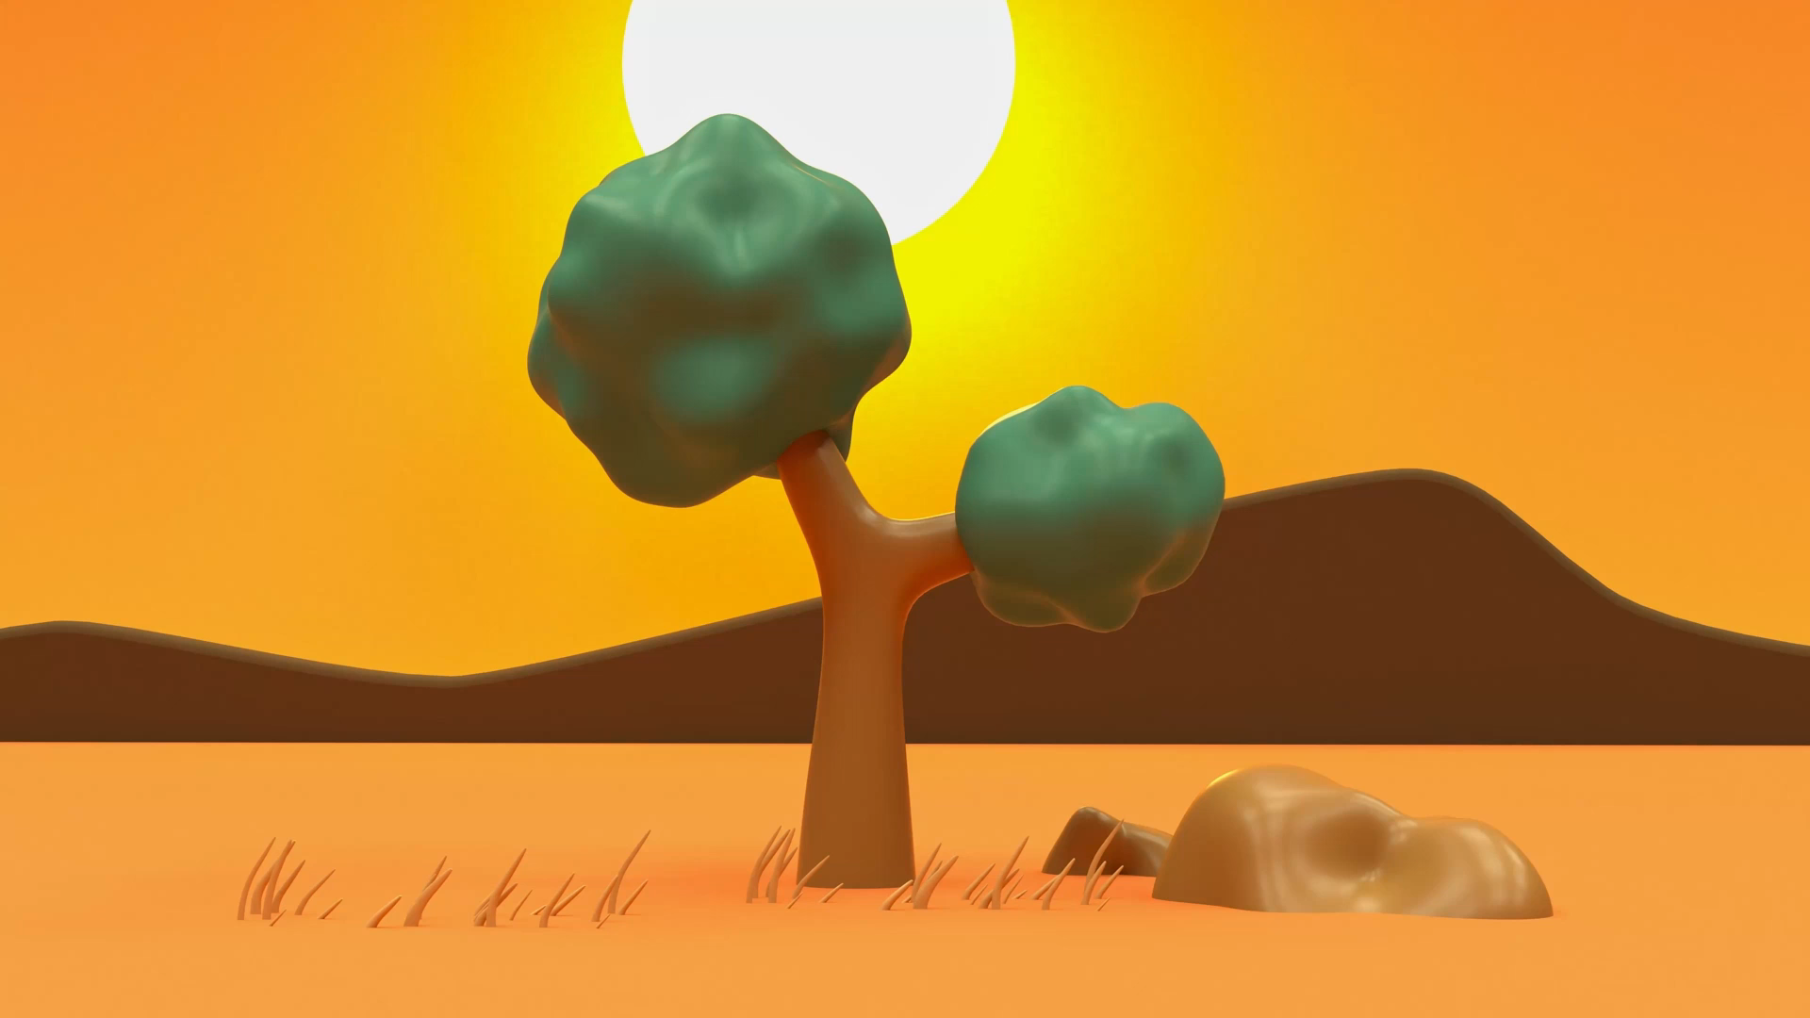
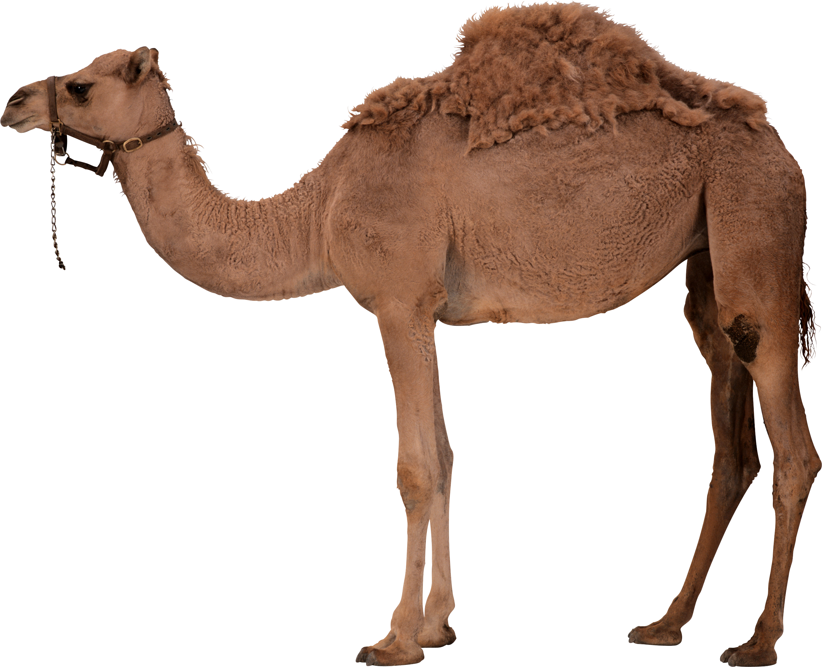

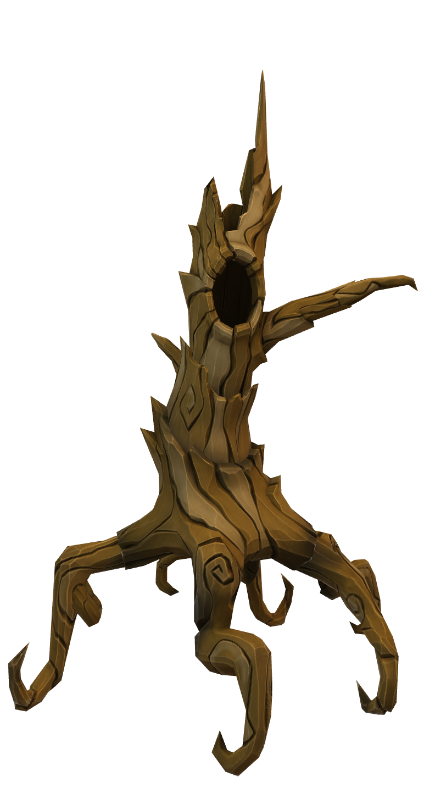
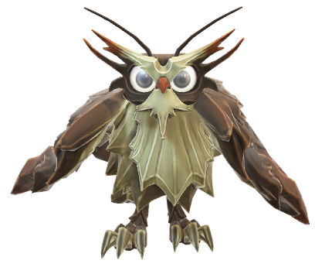
Find words starting with OORAH

Slide 15
Akhar Labho

Slide 16
FIND OORAH
A
e
s
h
a
k
K
g
G
|
c
C
j
J
\
t
T
f
F
x
q
Q
d
D
n
p
P
b
B
m
X
r
l
v
V

Slide 17
FIND OORAH
e
c
s
h
P
K
g
q
C
T
n
k
A
J
t
a
l
d
j
D
p
G
r
Q
v
m
B
b

Slide 18
FIND OORAH
e
s
h
q
g
a
n
T
A
k
P
j
G
Q
l
t
b
B
J
K
v
D
c
d
p
r
C
m

Slide 19
FIND OORAH
P
e
s
h
q
Q
g
r
n
t
B
m
b
J
T
k
D
K
d
a
G
C
v
l
A
j
p
c

Slide 20
FIND OORAH
q
s
Q
r
t
n
B
J
b
k
D
m
d
v
T
K
G
P
a
l
C
A
j
g
p
c
e
h

Slide 21
SHABAASH!

Slide 22
Akhar Pachhaano

Slide 23
WHICH ONE IS OORA?
a
q

Slide 24
WHICH ONE IS OORA?
b
a

Slide 25
WHICH ONE IS OORA?
a
Q

Slide 26
Bhulavay Akhar Repeat
PaD ke dasso akhar dey naam.

Slide 27
a

Slide 28
a

Slide 29
Varnmala
Naal di naal bolo!

Slide 30


Slide 31

Samapat!
Good Job Bachiyo!

