Slide 1


Painti Fun
LESSON: 10

Slide 2




PLEASE READ:
01
You can press “ESC” on your keypad to exit the screen.
02
You must “Enable external content for this session” in order for the embedded videos to play properly.
03
Click anywhere on the screen to move to the next slide.

Slide 3
FORMAT:
01
Varnmala Abhiyaas
06
Sunno Atey Pichhay Bolo
02
Practice Video
07
Akhar Labho (game)
03
Bhulavay Akhar
08
Akhar Pachhaano (game)
04
Letter of the Day
09
Bhulavay Akhar 2
Find the Pictures Starting with the Letter
05
10
Varnmala Final Repeat

Slide 4
Varnmala
Naal di naal bolo!

Slide 5


A
e
s
h
a
k
K
g
G
|
c
C
j
J
\
Complete 5 repetitions to move onto the next slide!
t
T
f
F
x
q
Q
d
D
n
p
P
b
B
m
X
r
l
v
V

Slide 6



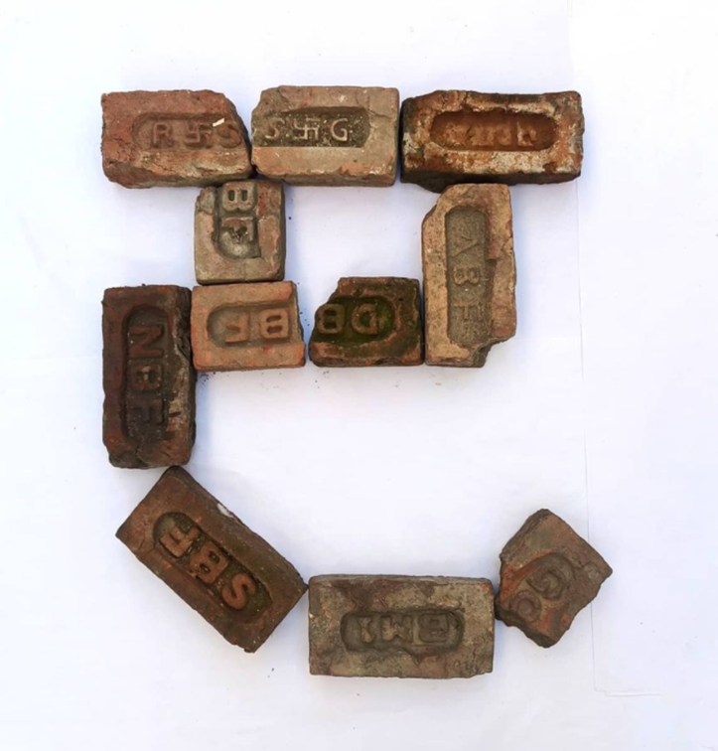






REVIEW:
(click on the correct answer)

Slide 7
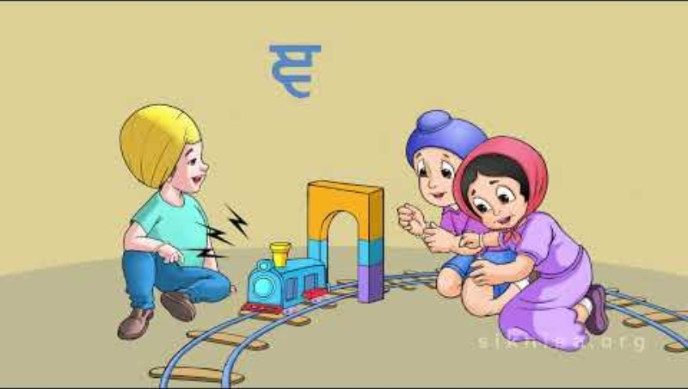

Slide 8


Slide 9


Slide 10


Slide 11
Akhar Labho

Slide 12


g
k
|
1
2
3

Slide 13
Akhar Pachhaano

Slide 14
Which one is Gnagna?
|
P

Slide 15
Which one is Gnagna?
\
|

Slide 16
Which one is Gnagna?
|
F

Slide 17
Varnmala
Naal di naal bolo!

Slide 18


Slide 19

Samapat!
Good Job Bachiyo!

