Slide 1


Painti Fun
LESSON: 11

Slide 2




PLEASE READ:
01
You can press “ESC” on your keypad to exit the screen.
02
You must “Enable external content for this session” in order for the embedded videos to play properly.
03
Click anywhere on the screen to move to the next slide.

Slide 3
FORMAT:
01
Varnmala Abhiyaas
06
Sunno Atey Pichhay Bolo
02
Practice Video
07
Akhar Labho (game)
03
Bhulavay Akhar
08
Akhar Pachhaano (game)
04
Letter of the Day
09
Bhulavay Akhar 2
Find the Pictures Starting with the Letter
05
10
Varnmala Final Repeat

Slide 4
Varnmala
Naal di naal bolo!

Slide 5


A
e
s
h
a
k
K
g
G
|
c
C
j
J
\
Complete 5 repetitions to move onto the next slide!
t
T
f
F
x
q
Q
d
D
n
p
P
b
B
m
X
r
l
v
V

Slide 6

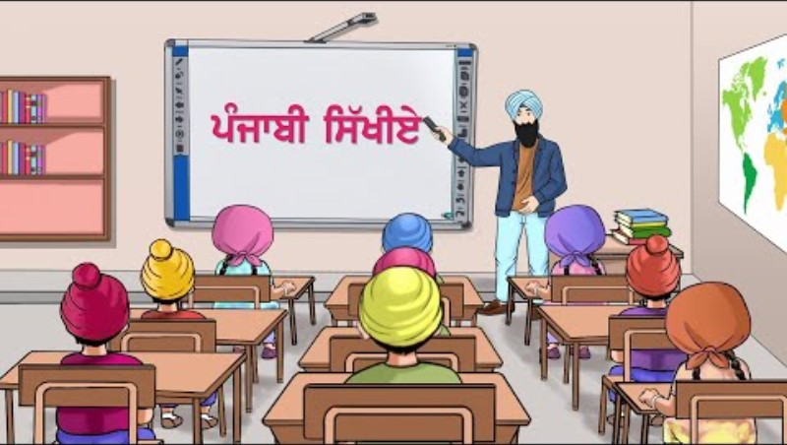

Slide 7


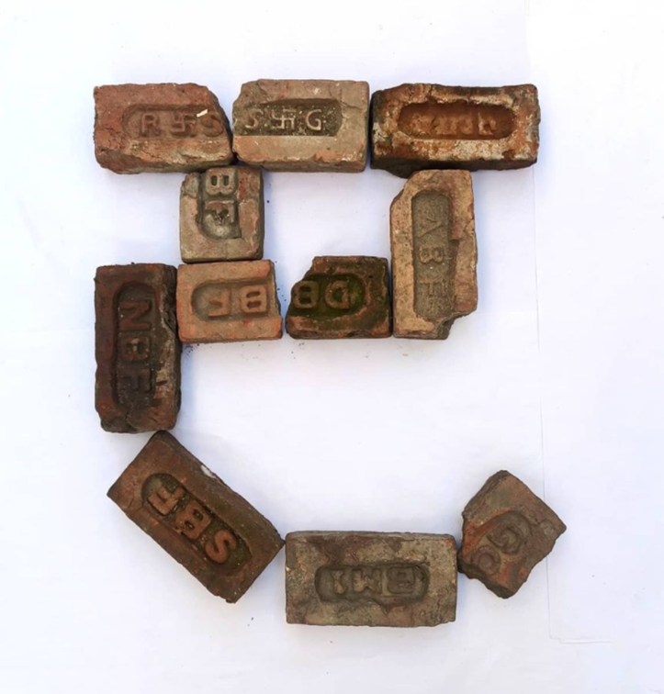








REVIEW:
(click on the correct answer)

Slide 8
Bhulavay Akhar
PaR ke dasso akhar dey naam.

Slide 9
C
j
J
|
c

Slide 10
J
c
|
C
j

Slide 11
c
j
C
J
|

Slide 12
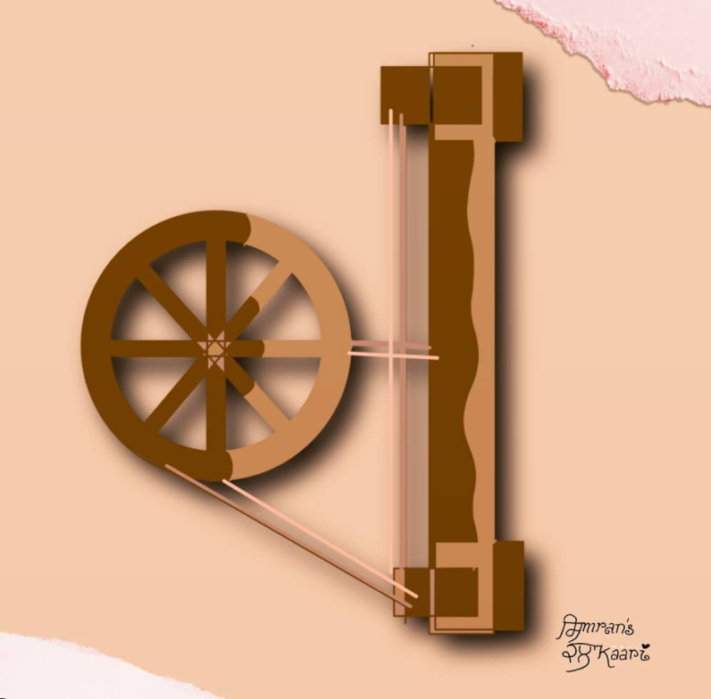


c

Slide 13
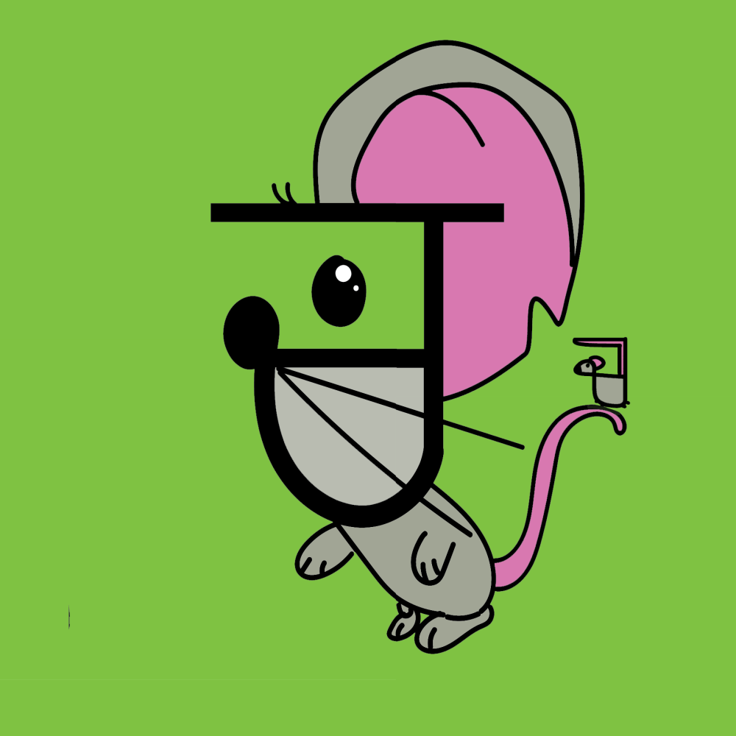
c
c

Slide 14


Slide 15
Labho
Identify which words start with Chacha.

Slide 16
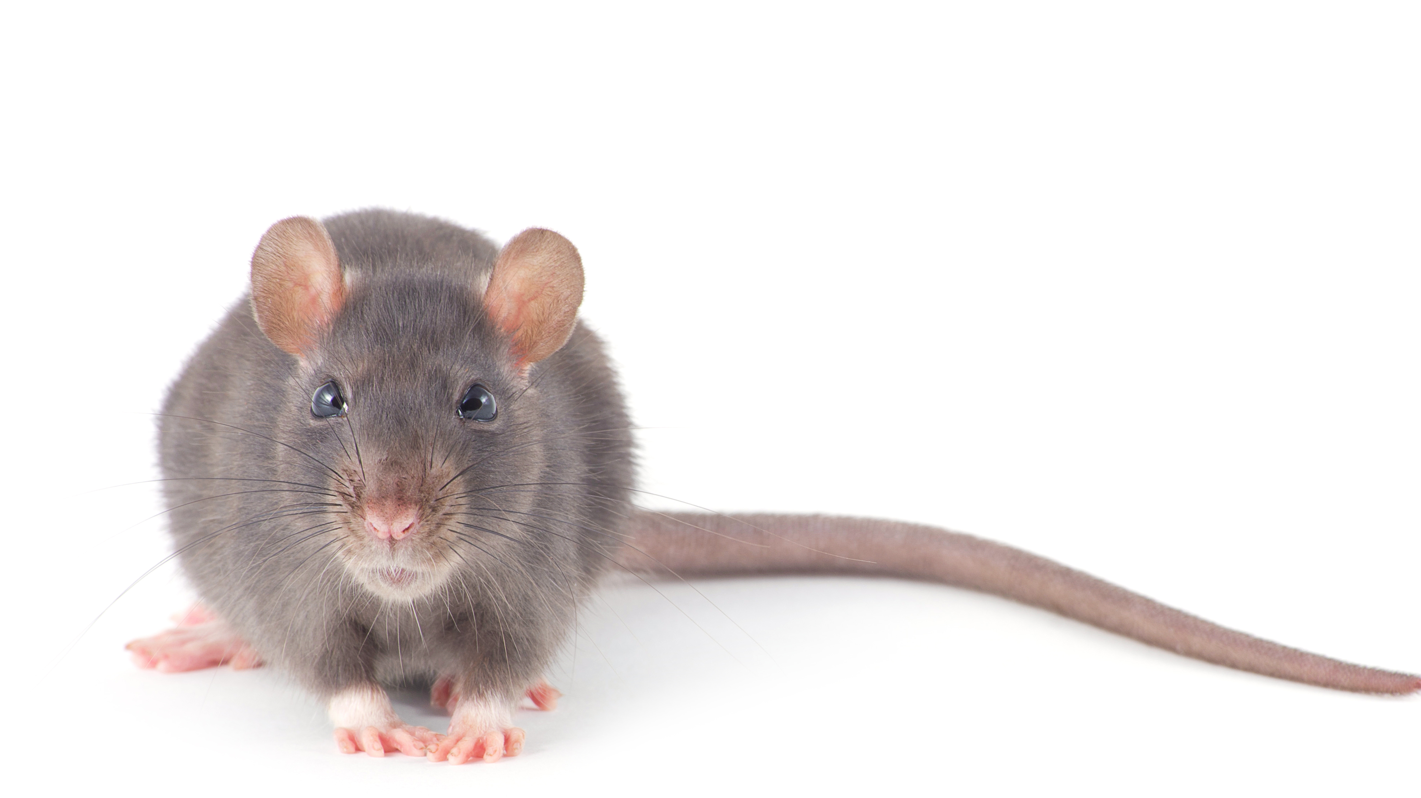
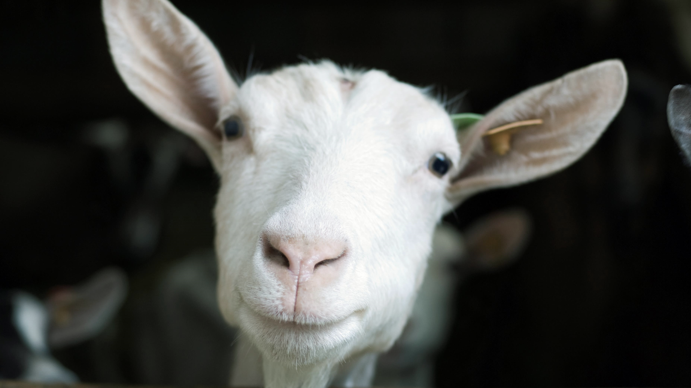
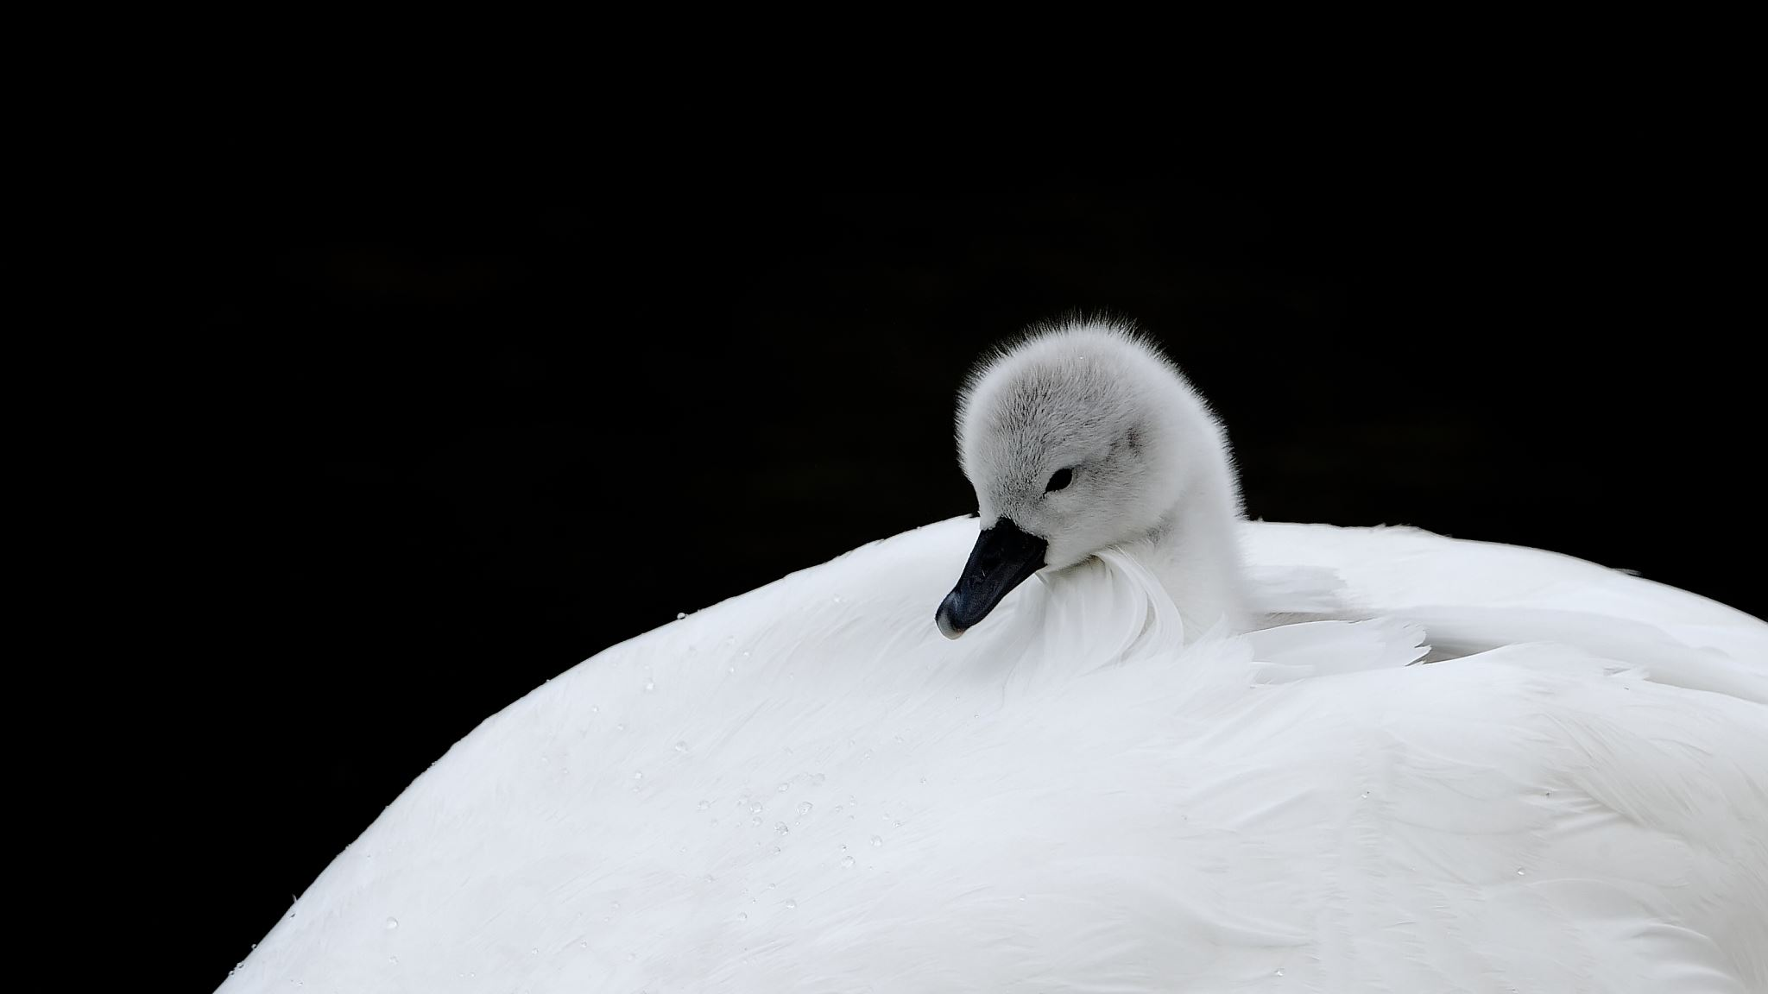


Slide 17
Sunno, Phir Pichhay Bolo
Listen, then repeat!

Slide 18

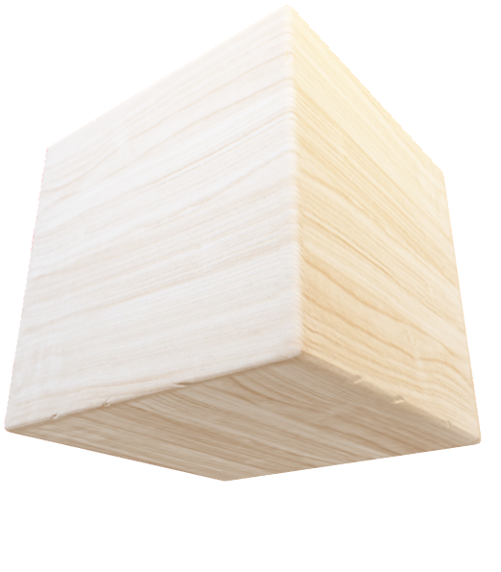

Slide 19
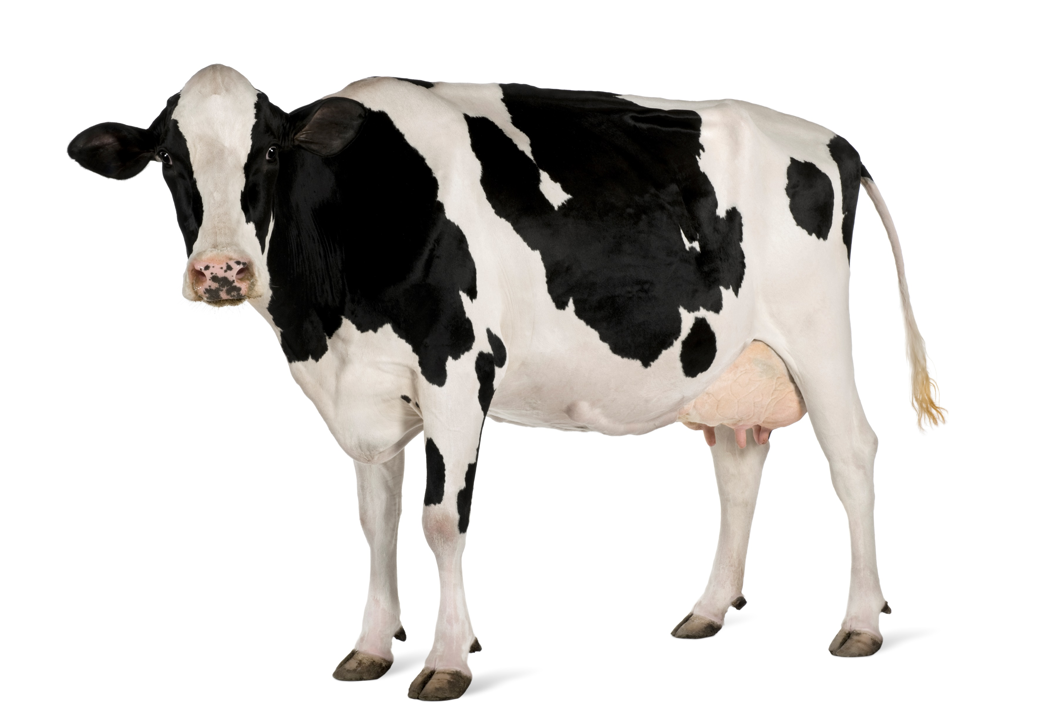

Slide 20
ÅÆ

Slide 21


Slide 22
Akhar Labho
Find all of the Chacha’s

Slide 23
K
j
C
D
X
F
c
r
h
J
K
h
p
r
c
K
Q
c
h
r
V
j
X
r
j
Reset

Slide 24
Akhar Pachhaano
In this game, try to find the acorn hiding behind the leaves by calling out the names of the letters you want to peak behind.

Slide 25


Find the hidden acorns!
text
a
s
k
c
text
g
|
c
text
text
Notes:
Hide the acorns!

Slide 26
Find the hidden acorns!
text
A
e
h
c
text
K
g
G
text
text
Notes:
Hide the acorns!

Slide 27
Find the hidden acorns!
text
c
C
j
c
text
J
\
a
text
text
Notes:
Hide the acorns!

Slide 28
Find the hidden acorns!
text
D
r
j
c
text
Q
p
q
text
text
Notes:
Hide the acorns!

Slide 29
Bhulavay Akhar Repeat
PaD ke dasso akhar dey naam.

Slide 30
c
j
C
|
J

Slide 31
j
J
c
|
C

Slide 32
c
C
j
J
|

Slide 33
Varnmala
Naal di naal bolo!

Slide 34


Slide 35

Samapat!
Good Job Bachiyo!

