Slide 1


Painti Fun
LESSON: 13

Slide 2




PLEASE READ:
01
You can press “ESC” on your keypad to exit the screen.
02
You must “Enable external content for this session” in order for the embedded videos to play properly.
03
Click anywhere on the screen to move to the next slide.

Slide 3
FORMAT:
01
Varnmala Abhiyaas
06
Sunno Atey Pichhay Bolo
02
Practice Video
07
Akhar Labho (game)
03
Bhulavay Akhar
08
Akhar Pachhaano (game)
04
Letter of the Day
09
Bhulavay Akhar 2
Find the Pictures Starting with the Letter
05
10
Varnmala Final Repeat

Slide 4
Varnmala
Naal di naal bolo!

Slide 5


A
e
s
h
a
k
K
g
G
|
c
C
j
J
\
Complete 5 repetitions to move onto the next slide!
t
T
f
F
x
q
Q
d
D
n
p
P
b
B
m
X
r
l
v
V

Slide 6
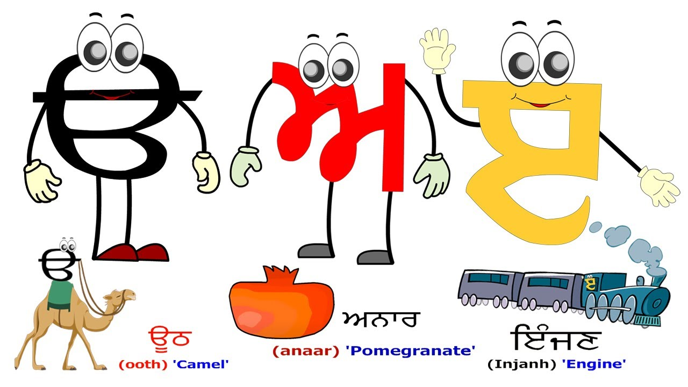

Slide 7









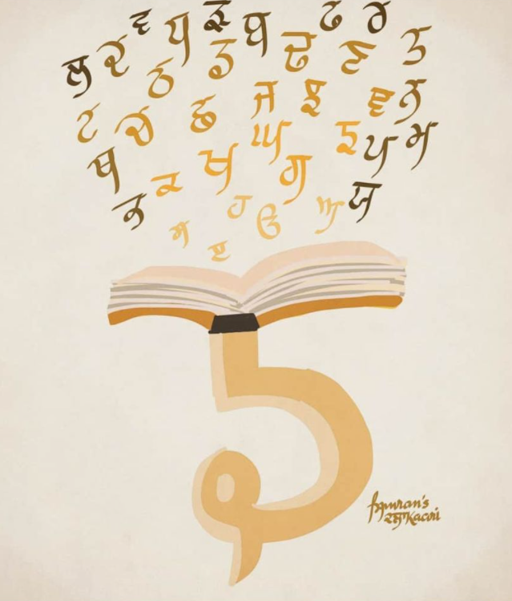

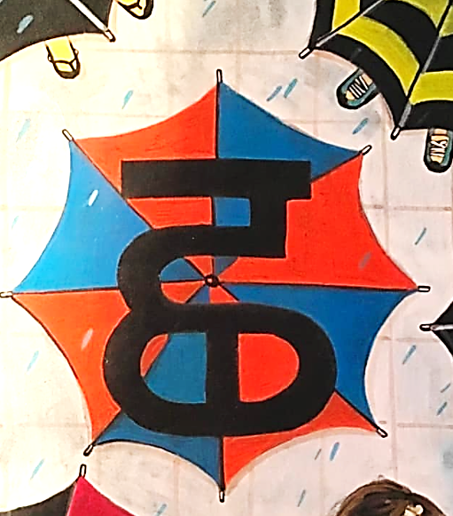

REVIEW:
(click on the correct answer)

Slide 8
Bhulavay Akhar
par ke dasso akhar dey naam.

Slide 9
c
C
j
J
\

Slide 10
j
J
c
\
C

Slide 11
c
j
C
\
J

Slide 12

j

Slide 13
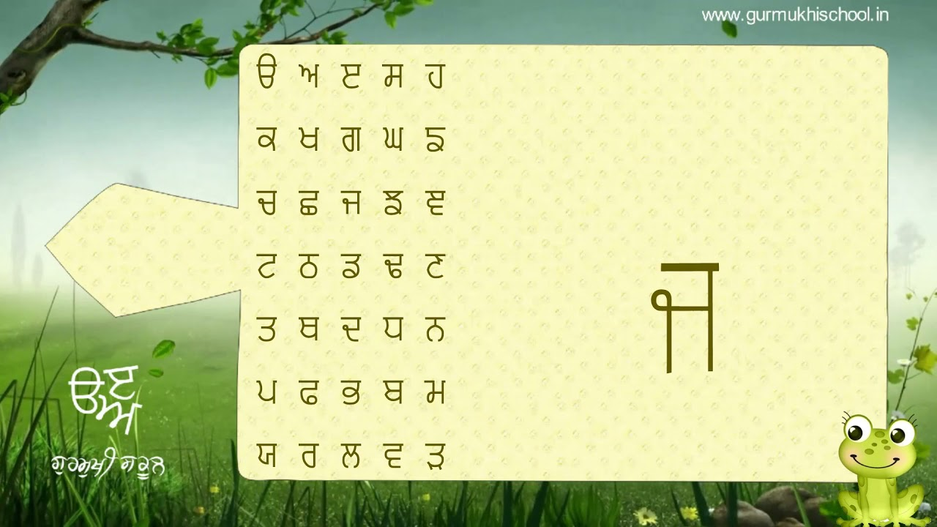

Slide 14
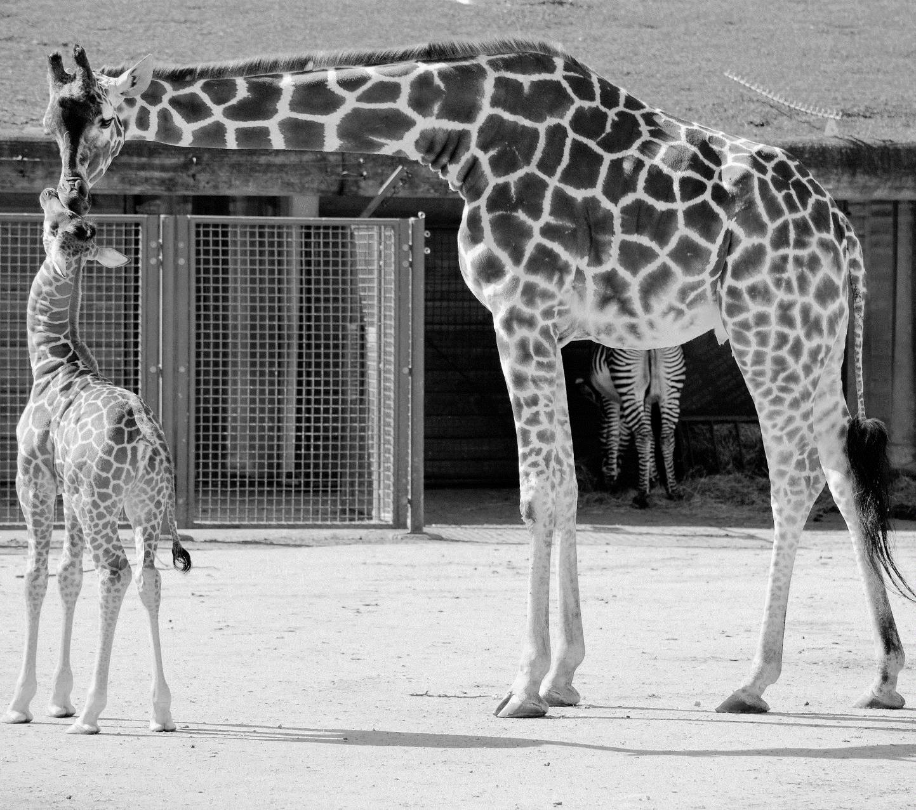
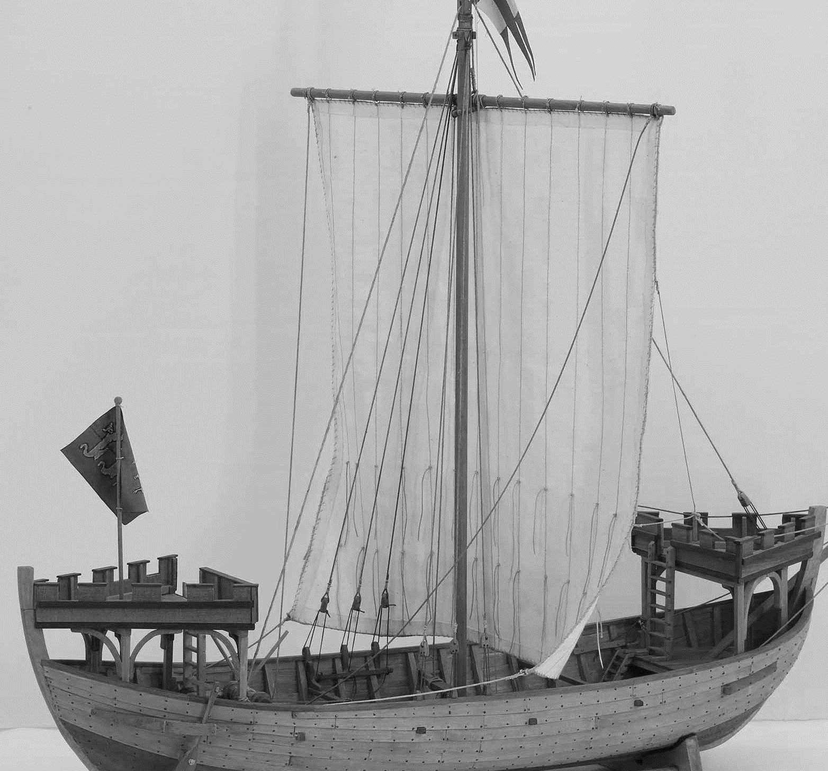







Slide 15
Sunno, Phir Pichhay Bolo
Listen, Then Repeat!

Slide 16
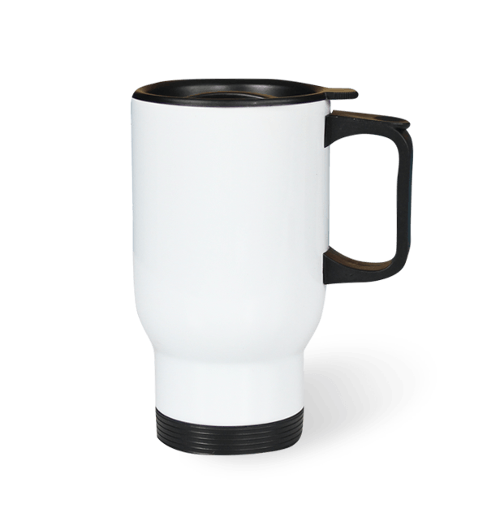

Slide 17
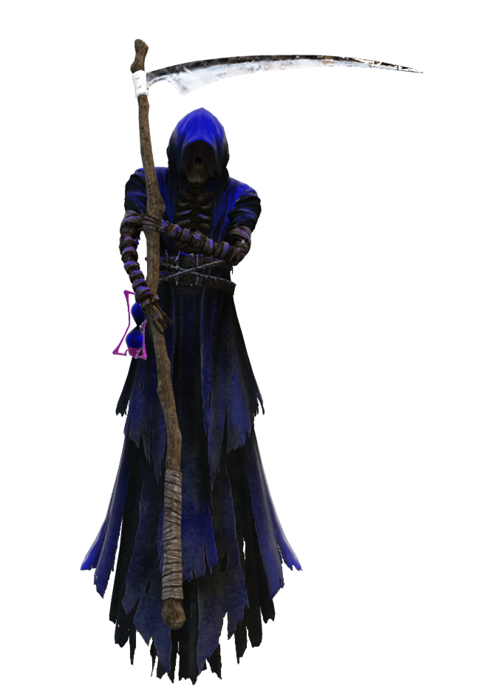
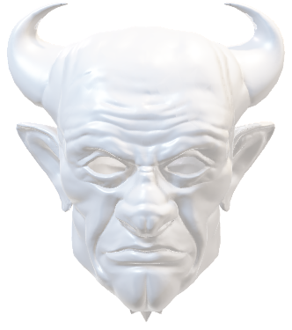

Slide 18


Slide 19


Slide 20
Akhar Labho

Slide 21

j
j
j
j
j
j
j
j
j
Reset
j

Slide 22
Akhar Pachhaano
Go in order of the numbers and click the number. If you get the letter right, then you are safe until the next question – if you get it wrong, then one balloon must be released. If all of the balloons fly away, then uh-oh! Click on the last balloon to see what happens!

Slide 23

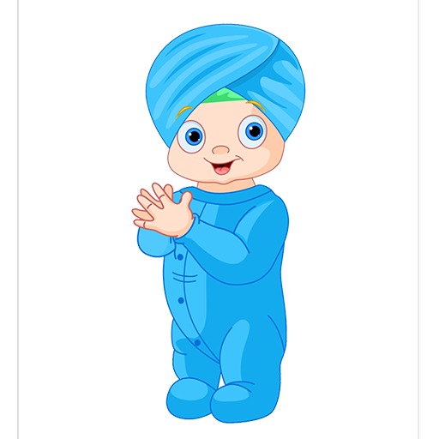




1
6
2
7
⇒
3
8
4
9
5
10
h
k
j
c
s
K
|
e
g
A

Slide 24
Bhulavay Akhar Repeat
Pad Ke Dasso Akhar Dey Naam.

Slide 25
c
C
j
J
|

Slide 26
j
J
c
|
C

Slide 27
c
j
C
|
J

Slide 28
Varnmala
Naal Di Naal Bolo!

Slide 29


Slide 30

Samapat!
Good Job Bachiyo!

