Slide 1


Painti Fun
LESSON: 16

Slide 2




PLEASE READ:
01
You can press “ESC” on your keypad to exit the screen.
02
You must “Enable external content for this session” in order for the embedded videos to play properly.
03
Click anywhere on the screen to move to the next slide.

Slide 3
FORMAT:
01
Varnmala Abhiyaas
06
Sunno Atey Pichhay Bolo
02
Practice Video
07
Akhar Labho (game)
03
Bhulavay Akhar
08
Akhar Pachhaano (game)
04
Letter of the Day
09
Bhulavay Akhar 2
Find the Pictures Starting with the Letter
05
10
Varnmala Final Repeat

Slide 4
Varnmala
Naal di naal bolo!

Slide 5


A
e
s
h
a
k
K
g
G
|
c
C
j
J
\
Complete 5 repetitions to move onto the next slide!
t
T
f
F
x
q
Q
d
D
n
p
P
b
B
m
X
r
l
v
V

Slide 6

Notes:
Video link not found

Slide 7



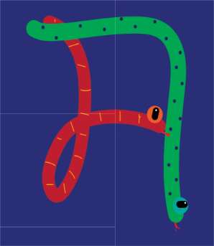







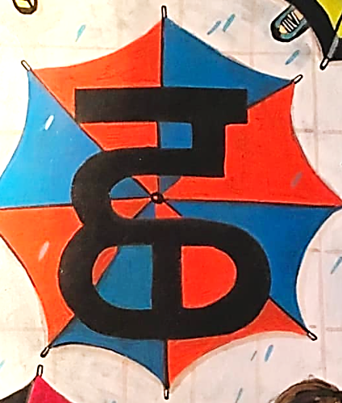



REVIEW:
\
(click on the correct answer)

Slide 8
Bhulavay Akhar
PaR ke dasso akhar dey naam.

Slide 9
t
T
f
F
x

Slide 10
T
t
x
f
F

Slide 11
x
T
F
f
t

Slide 12


t

Slide 13



t

Slide 14


Slide 15
Labho
Find images starting from Tainka

Slide 16

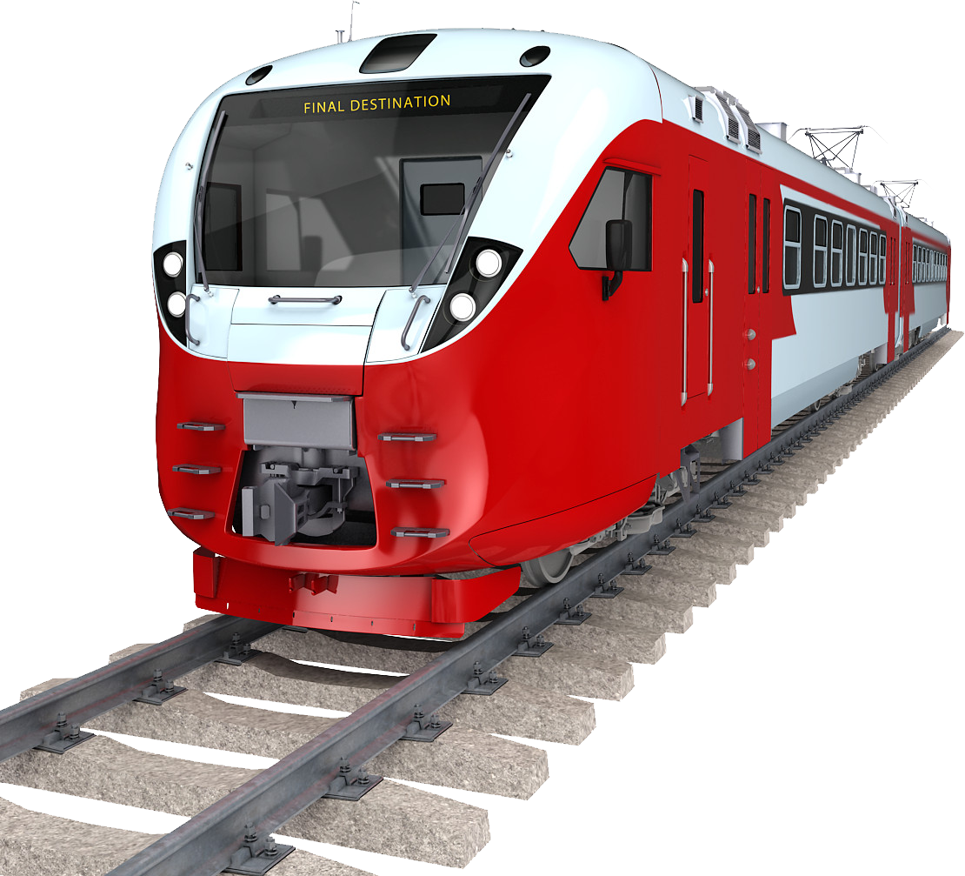



Slide 17
Akhar Labho
Guess which door Tainka is hiding behind!

Slide 18


t
T
e
1
2
3

Slide 19
t
q
a
1
2
3

Slide 20
r
t
h
1
2
3

Slide 21
t
d
g
1
2
3

Slide 22
n
t
s
1
2
3

Slide 23
Akhar Pachhaano
Find the bumblebee hiding behind the rainbows by guessing which letter it is hiding in in each slide!

Slide 24



t
\
J
|
G
e
Notes:
Hide the bees!

Slide 25
t
\
J
|
G
e
Notes:
Hide the bees!

Slide 26

t
\
J
|
G
e
Notes:
Hide the bees!

Slide 27
t
\
J
|
G
e
Notes:
Hide the bees!

Slide 28
t
\
J
|
G
e
Notes:
Hide the bees!

Slide 29
Bhulavay Akhar Repeat
PaD ke dasso akhar dey naam.

Slide 30
t
T
f
F
x

Slide 31
T
t
x
f
F

Slide 32
x
T
F
f
t

Slide 33
Varnmala
Naal di naal bolo!

Slide 34


Slide 35

Samapat!
Good Job Bachiyo!

