Slide 1


Painti Fun
LESSON: 17

Slide 2




PLEASE READ:
01
You can press “ESC” on your keypad to exit the screen.
02
You must “Enable external content for this session” in order for the embedded videos to play properly.
03
Click anywhere on the screen to move to the next slide.

Slide 3
FORMAT:
01
Varnmala Abhiyaas
06
Sunno Atey Pichhay Bolo
02
Practice Video
07
Akhar Labho (game)
03
Bhulavay Akhar
08
Akhar Pachhaano (game)
04
Letter of the Day
09
Bhulavay Akhar 2
Find the Pictures Starting with the Letter
05
10
Varnmala Final Repeat

Slide 4
Varnmala
Naal di naal bolo!

Slide 5


A
e
s
h
a
k
K
g
G
|
c
C
j
J
\
Complete 5 repetitions to move onto the next slide!
t
T
f
F
x
q
Q
d
D
n
p
P
b
B
m
X
r
l
v
V

Slide 6
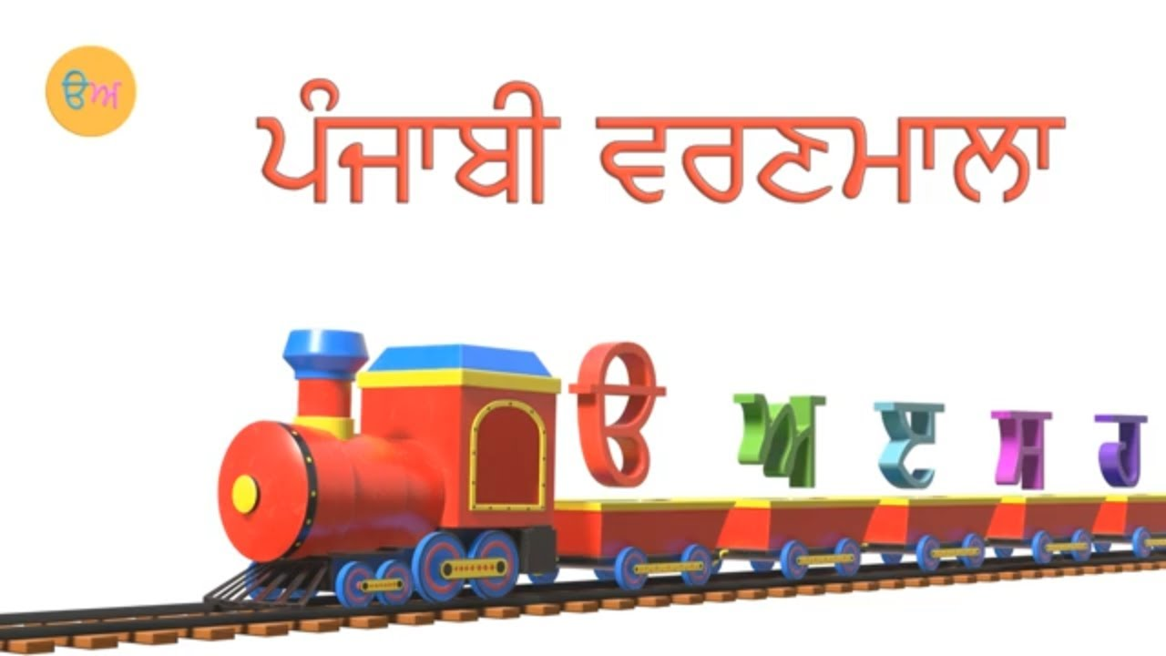

Slide 7



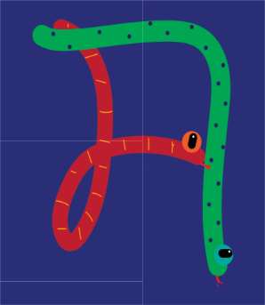








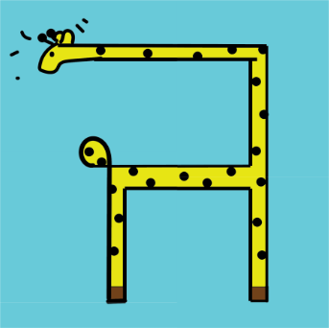



REVIEW:
\
(click on the correct answer)

Slide 8
Bhulavay Akhar
PaR ke dasso akhar dey naam.

Slide 9
t
T
f
F
x

Slide 10
T
t
x
f
F

Slide 11
x
T
F
f
t

Slide 12
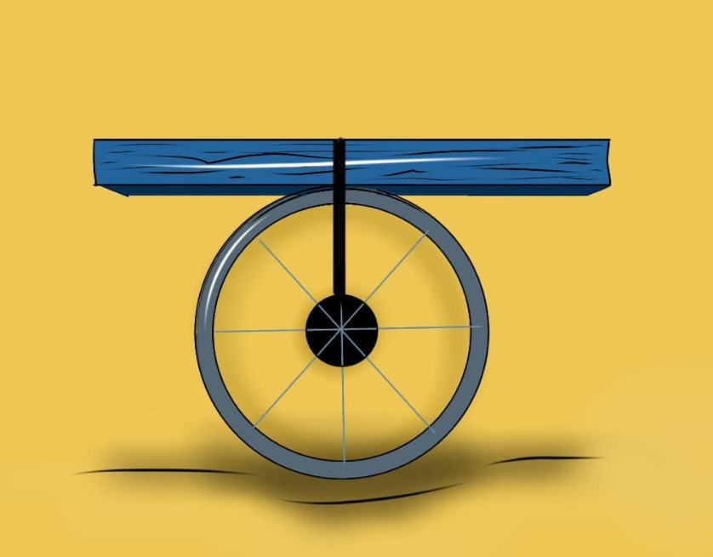
T

Slide 13
T

Slide 14
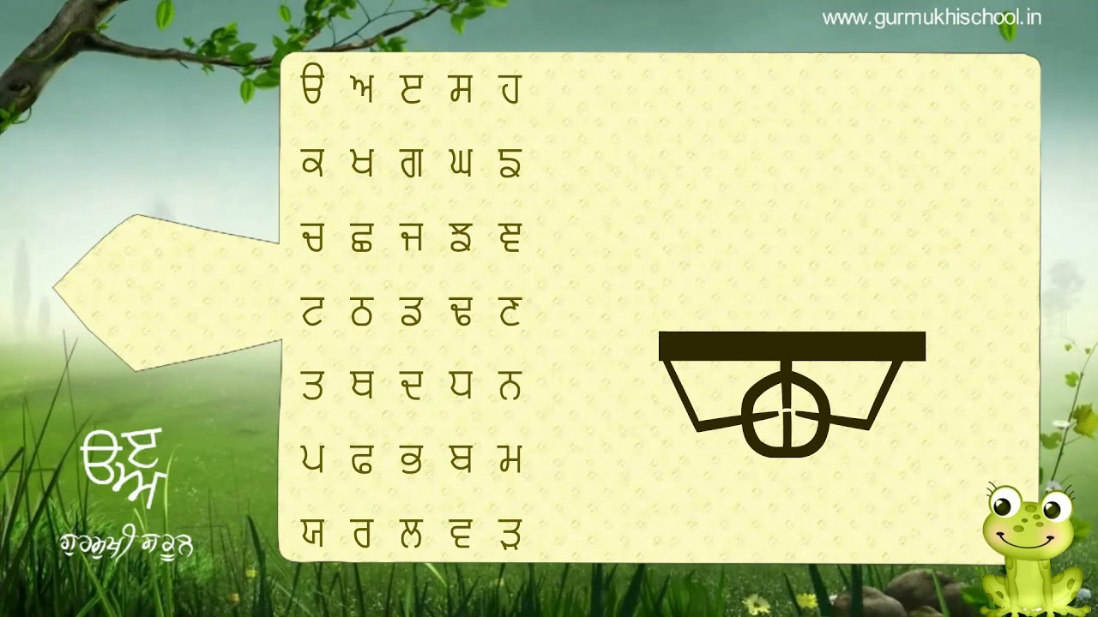

Slide 15
Labho
Find images starting from Tatta

Slide 16

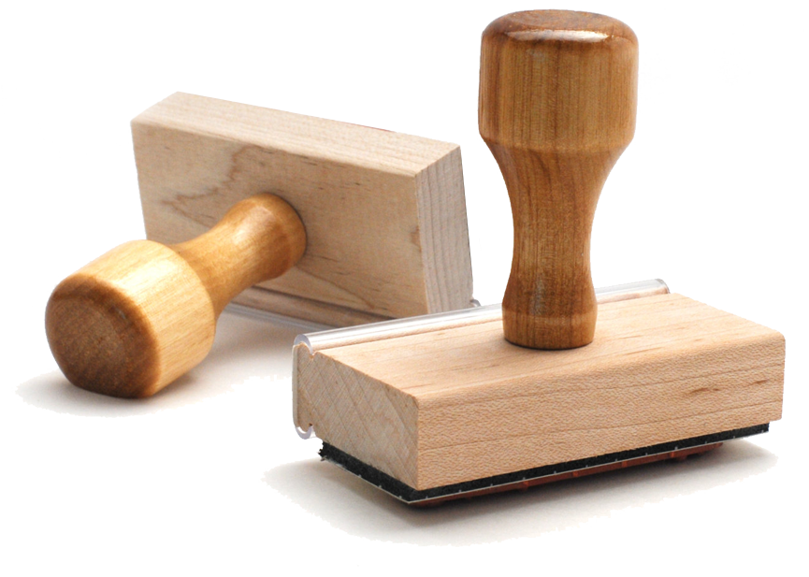

Slide 17
Sunno, Phir Pichhay Bolo
Listen, then repeat!

Slide 18


Slide 20
Akhar Labho

Slide 21

p
k
m
Find the letter
T
Ready? GO!
p
Q
k
t
m
Q
l
J
c
l
t
B
J
c
d
D
T

Slide 22
Akhar Pachhaano

Slide 23
Which one is Tatta?
T
n

Slide 24
Which one is Tatta?
t
T

Slide 25
Which one is Tatta?
T
ō

Slide 26
Bhulavay Akhar Repeat
PaD ke dasso akhar dey naam.

Slide 27
t
T
f
F
x

Slide 28
T
t
x
f
F

Slide 29
x
T
F
f
t

Slide 30
Varnmala
Naal di naal bolo!

Slide 31


Slide 32

Samapat!
Good Job Bachiyo!

