Slide 1


Painti Fun
LESSON: 18

Slide 2




PLEASE READ:
01
You can press “ESC” on your keypad to exit the screen.
02
You must “Enable external content for this session” in order for the embedded videos to play properly.
03
Click anywhere on the screen to move to the next slide.

Slide 3
FORMAT:
01
Varnmala Abhiyaas
06
Sunno Atey Pichhay Bolo
02
Practice Video
07
Akhar Labho (game)
03
Bhulavay Akhar
08
Akhar Pachhaano (game)
04
Letter of the Day
09
Bhulavay Akhar 2
Find the Pictures Starting with the Letter
05
10
Varnmala Final Repeat

Slide 4
Varnmala
Naal di naal bolo!

Slide 5


A
e
s
h
a
k
K
g
G
|
c
C
j
J
\
Complete 5 repetitions to move onto the next slide!
t
T
f
F
x
q
Q
d
D
n
p
P
b
B
m
X
r
l
v
V

Slide 6


Slide 7




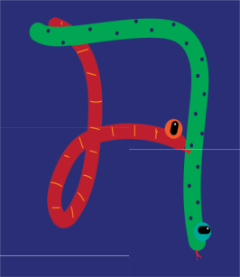






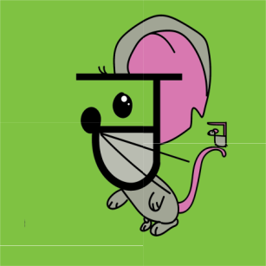
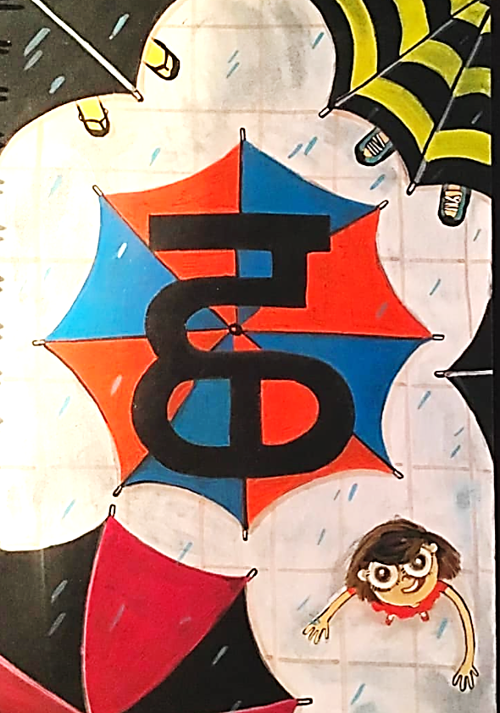




REVIEW:
(click on the correct answer)

Slide 8
Bhulavay Akhar
PaR ke dasso akhar dey naam.

Slide 9
t
T
f
F
x

Slide 10
T
t
x
f
F

Slide 11
x
T
F
f
t

Slide 12

f

Slide 13
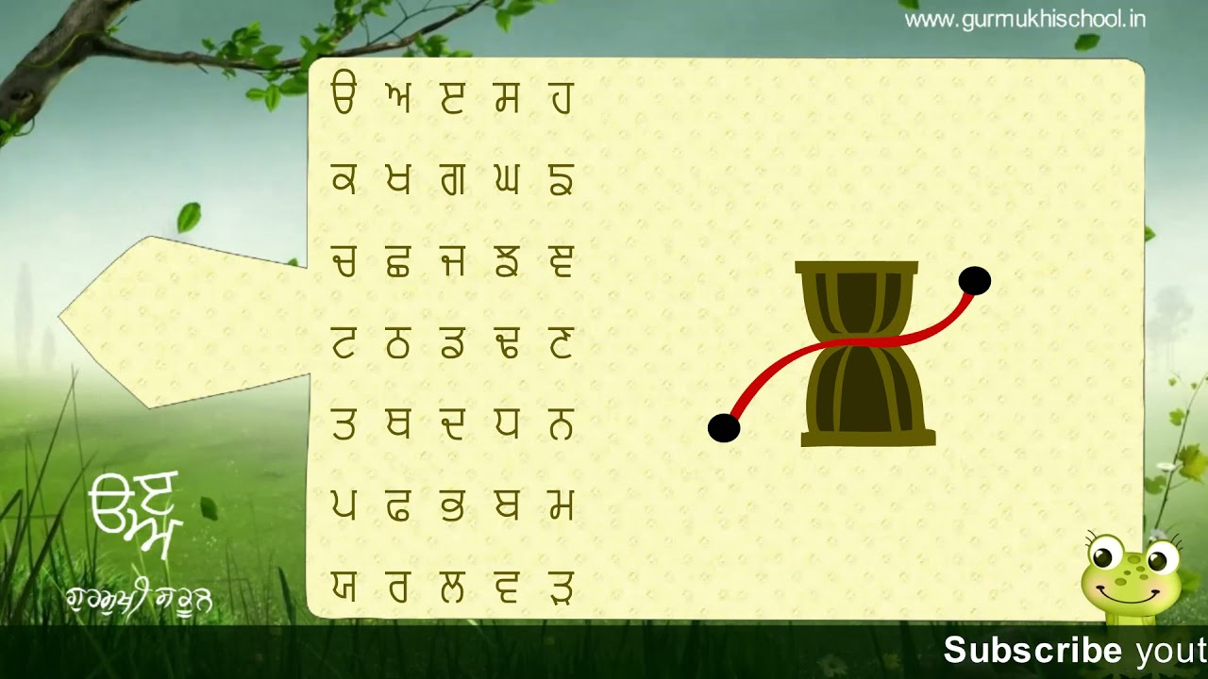

Slide 14
Labho
f
Find images starting from

Slide 15

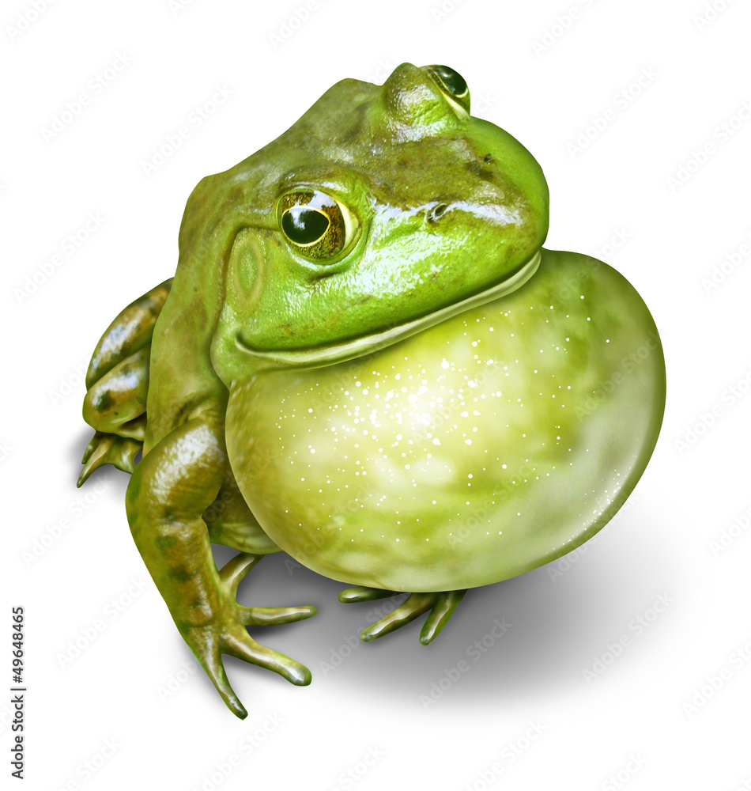
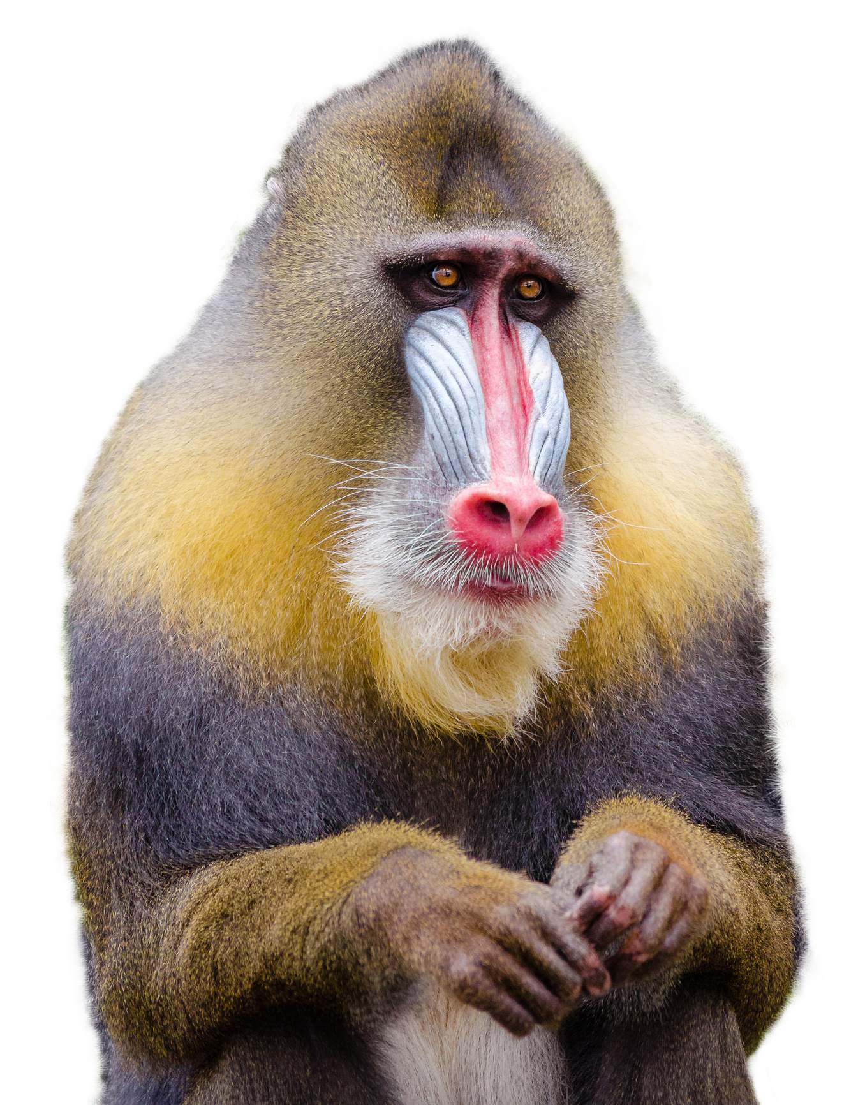


Slide 16
Sunno, Phir Pichhay Bolo
Listen, then repeat!

Slide 21
Akhar Labho

Slide 22
FIND f
A
e
s
h
a
k
K
g
G
|
c
C
j
J
\
t
T
f
F
x
q
Q
d
D
n
p
P
b
B
m
X
r
l
v
V

Slide 23
Find OORAH
h
c
f
K
g
n
T
P
q
C
J
k
A
d
e
t
a
l
j
s
p
D
r
Q
G
v
m
B
b

Slide 24
Find OORAH
h
q
s
g
a
n
T
f
P
A
j
G
Q
l
t
b
B
J
K
v
c
d
e
p
r
C
m

Slide 25
Find OORAH
h
q
s
g
Q
n
B
m
r
b
J
T
k
D
d
K
a
G
e
C
v
l
A
j
t
c
p
f

Slide 26
Find OORAH
q
s
b
Q
f
r
t
n
B
K
J
k
D
m
v
T
d
h
A
G
P
a
l
C
j
g
p
c
e

Slide 27
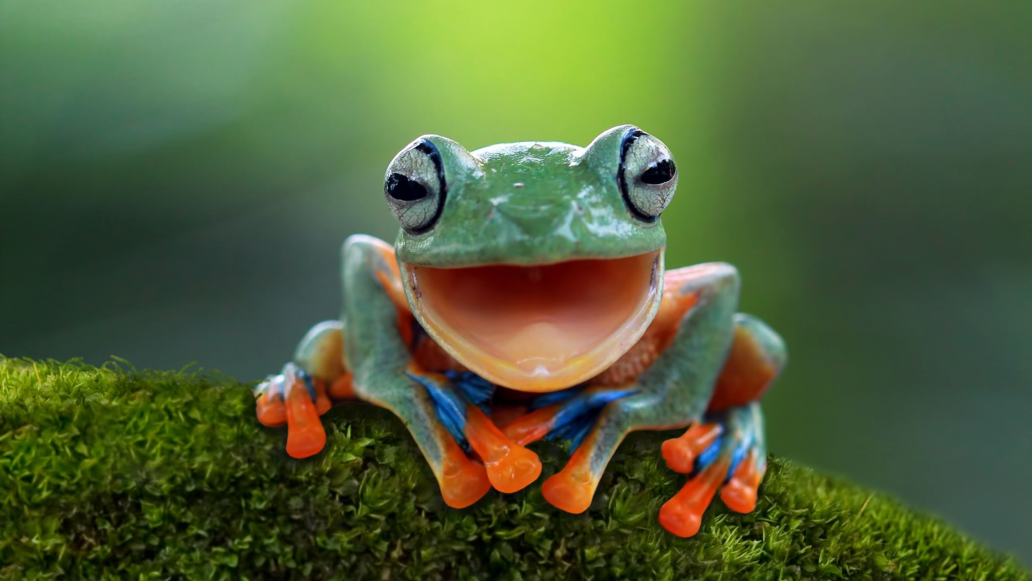

Slide 28
Akhar Pachhaano

Slide 29
Which one is f?
f
q

Slide 30
Which one is f?
B
f

Slide 31
Which one is f?
V
f

Slide 32
Bhulavay Akhar Repeat
Pad Ke Dasso Akhar Dey Naam.

Slide 33
t
T
f
F
x

Slide 34
T
t
x
f
F

Slide 35
x
T
F
f
t

Slide 36
Varnmala
Naal Di Naal Bolo!

Slide 37


Slide 38

Samapat!
Good Job Bachiyo!

