Slide 1
SANTHIYA PREPERATION
LESSON:

Slide 2
FORMAT:
01
Varnmala Abhiyaas
06
Sunno Atey Pichhay Bolo
02
Practice Video
07
Akhar Labho (game)
03
Bhulavay Akhar
08
Akhar Pachhaano (game)
04
Letter of the Day
09
Bhulavay Akhar 2
Find the Pictures Starting with the Letter
05
10
Varnmala Final Repeat

Slide 3
Varnmala
Naal di naal bolo!

Slide 4

A
e
s
h
a
k
K
g
G
|
c
C
j
J
\
t
T
f
F
x
q
Q
d
D
n
p
P
b
B
m
X
r
l
v
V

Slide 5
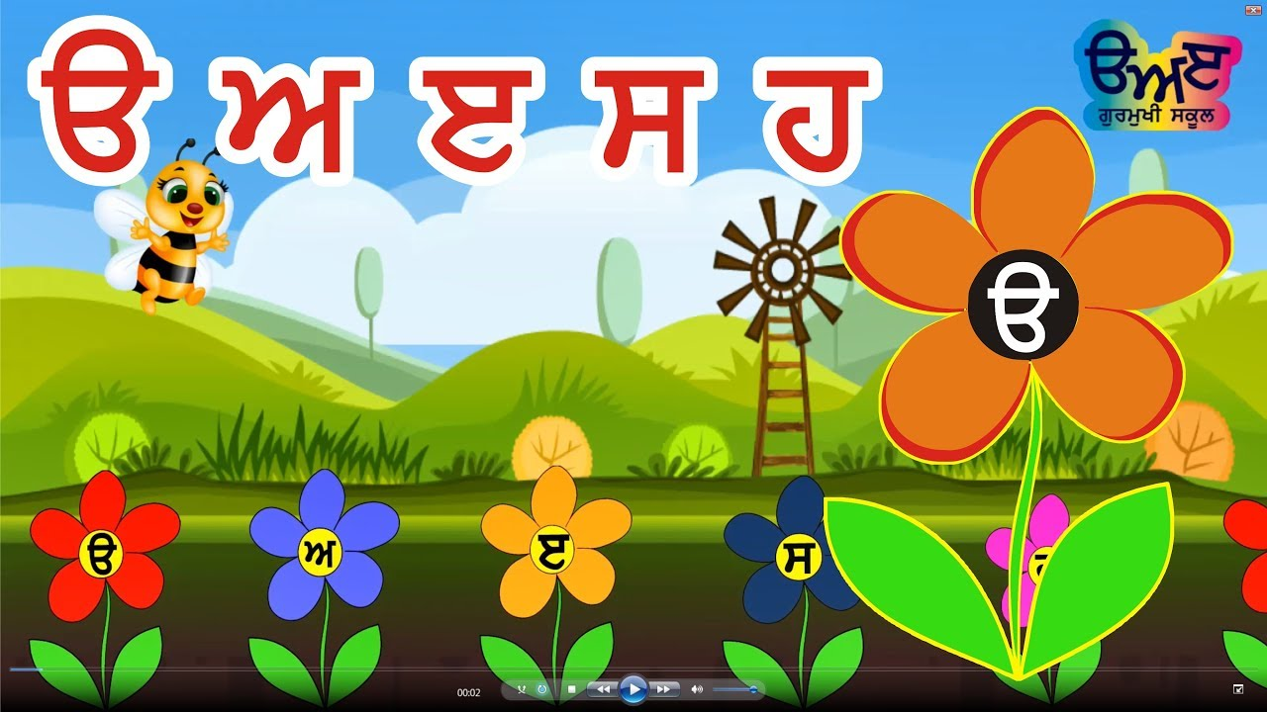

Slide 6

















REVIEW:
\
(click on the correct answer)

Slide 7
Bhulavay Akhar
PaR ke dasso akhar dey naam.

Slide 8
t
T
f
F
x

Slide 9
f
T
t
x
F

Slide 10
F
t
x
T
f

Slide 11

F

Slide 12
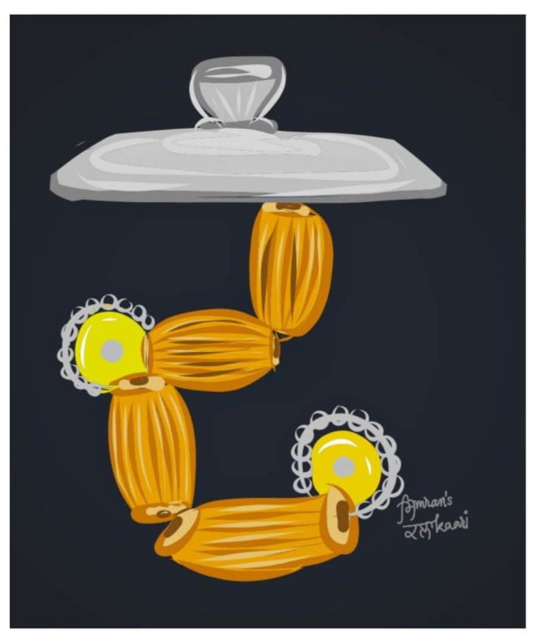

F

Slide 13
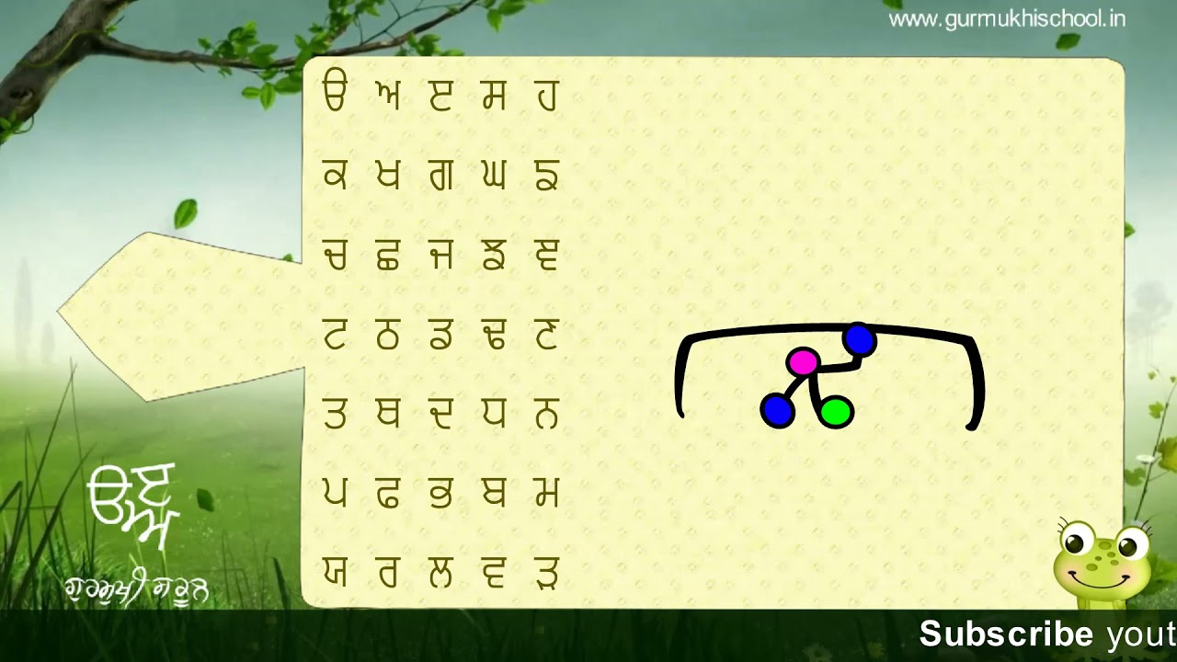

Slide 14

Notes:
Video link not found

Slide 15
Labho
Find images starting from F

Slide 16
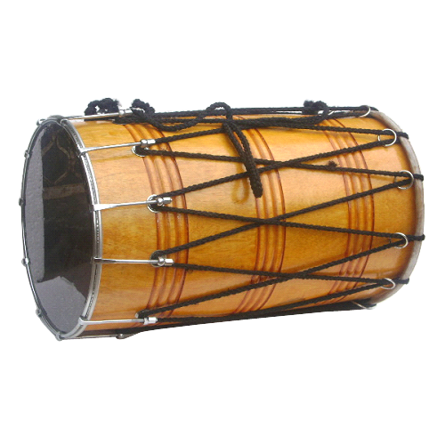
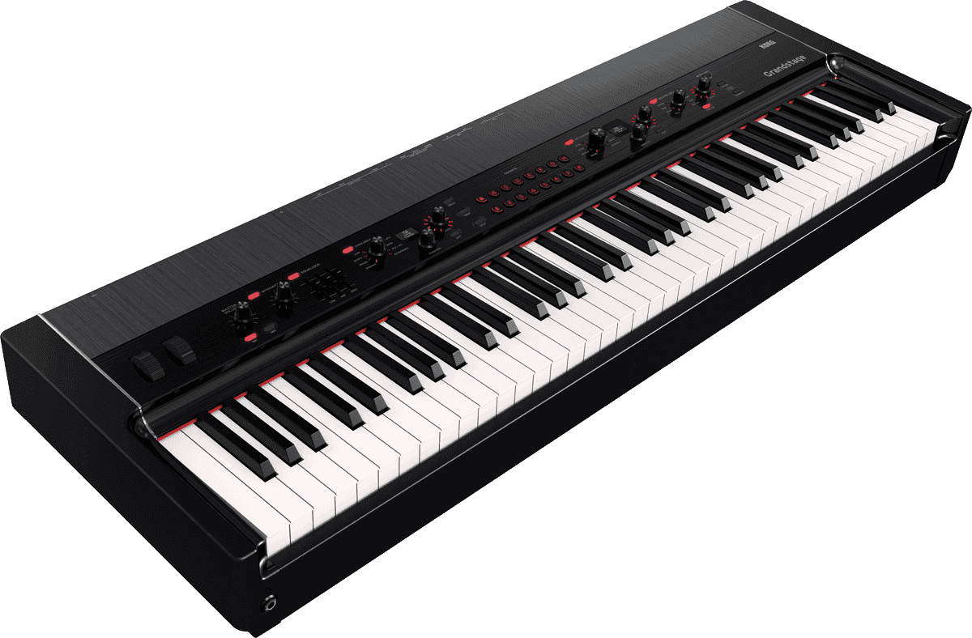
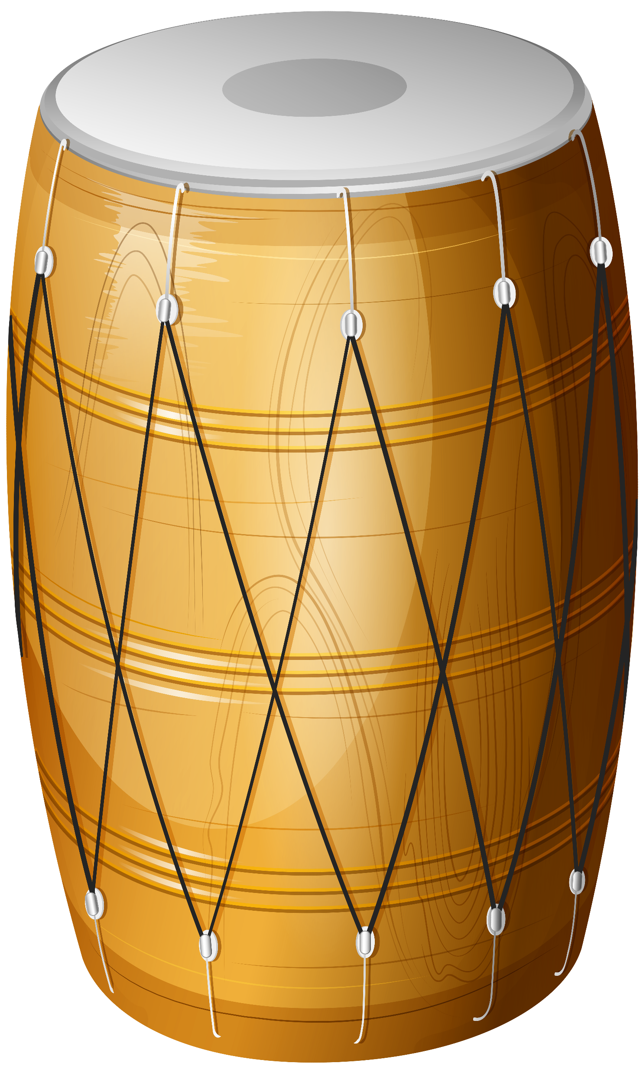
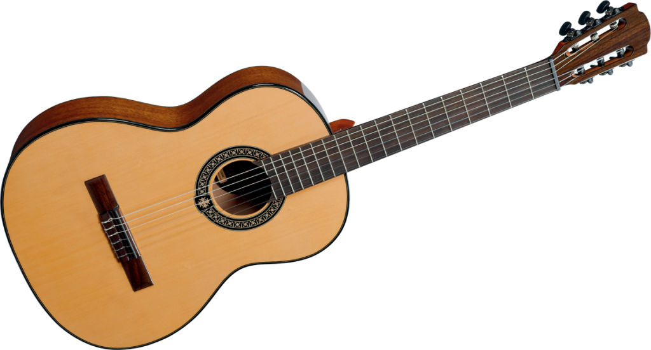

Slide 17
Sunno, Phir Pichhay Bolo
Listen, then repeat!

Slide 20
Akhar Labho

Slide 21

F
F
F
F
F
F
F
F
F
Reset
F

Slide 22
Akhar Pachhaano

Slide 23



G
|
g
c
F
C
Ç
f
j
T
J
t
|
\
CLICK HERE

Slide 24
Bhulavay Akhar Repeat
Pad ke dasso akhar dey naam.

Slide 25
t
T
f
F
x

Slide 26
T
t
x
f
F

Slide 27
x
T
F
f
t

Slide 28
Varnmala
Naal di naal bolo!

Slide 29
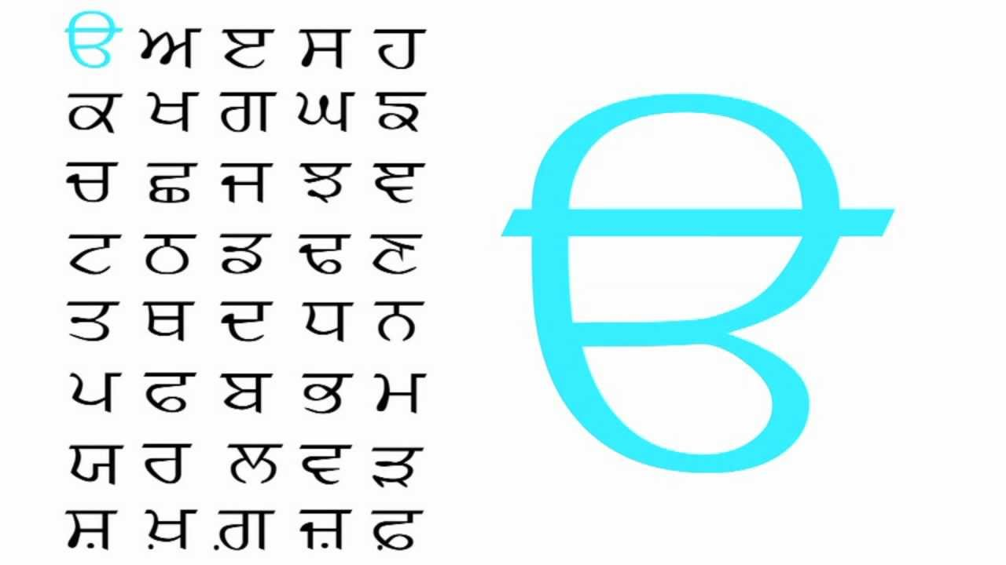

Slide 30

Samapat!
Good Job Bachiyo!

