Slide 1


Painti Fun
LESSON: 20

Slide 2




PLEASE READ:
01
You can press “ESC” on your keypad to exit the screen.
02
You must “Enable external content for this session” in order for the embedded videos to play properly.
03
Click anywhere on the screen to move to the next slide.

Slide 3
FORMAT:
01
Varnmala Abhiyaas
06
Sunno Atey Pichhay Bolo
02
Practice Video
07
Akhar Labho (game)
03
Bhulavay Akhar
08
Akhar Pachhaano (game)
04
Letter of the Day
09
Bhulavay Akhar 2
Find the Pictures Starting with the Letter
05
10
Varnmala Final Repeat

Slide 4
Varnmala
Naal di naal bolo!

Slide 5


A
e
s
h
a
k
K
g
G
|
c
C
j
J
\
Complete 5 repetitions to move onto the next slide!
t
T
f
F
x
q
Q
d
D
n
p
P
b
B
m
X
r
l
v
V

Slide 6

Notes:
Forward to 2.00 minutes

Slide 7



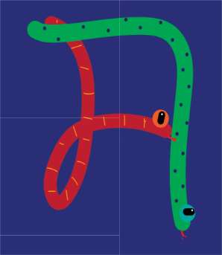









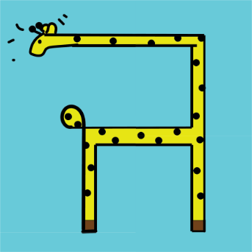




REVIEW:
\

Slide 8
Bhulavay Akhar
PaR ke dasso akhar dey naam.

Slide 9
t
T
f
F
x

Slide 10
f
T
t
x
F

Slide 11
F
t
x
T
f

Slide 12
x

Slide 13
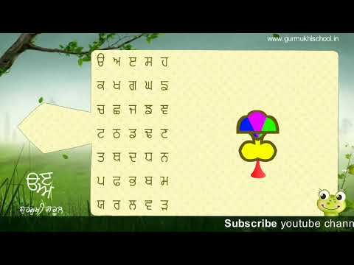

Slide 14
Sunnay Atey Pichhay Bolo

Slide 15


Slide 16
Akhar Labho

Slide 17
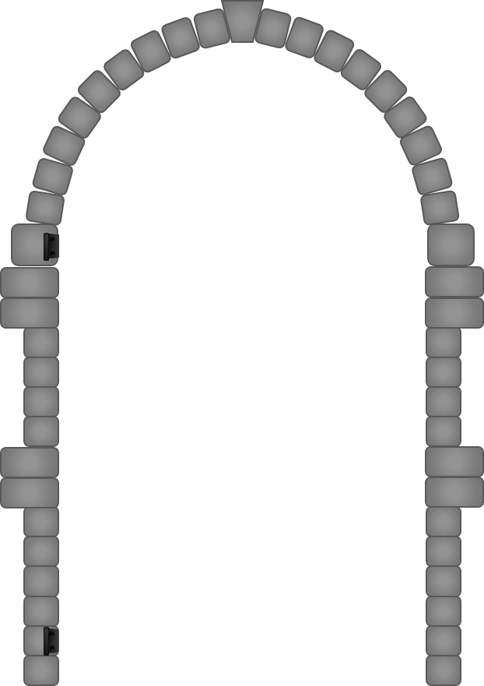

J
x
G
1
2
3

Slide 18
x
j
g
1
2
3

Slide 19
k
s
x
1
2
3

Slide 20
Akhar Pachhaano

Slide 21



G
|
g
c
F
C
Ç
f
j
T
J
t
|
\
CLICK HERE

Slide 22
Bhulavay Akhar Repeat
PaD ke dasso akhar dey naam.

Slide 23
t
T
f
F
x

Slide 24
T
t
x
f
F

Slide 25
x
T
F
f
t

Slide 26
Varnmala
Naal di naal bolo!

Slide 27


Slide 28

Samapat!
Good Job Bachiyo!

