Slide 1


Painti Fun
LESSON: 22

Slide 2




PLEASE READ:
01
You can press “ESC” on your keypad to exit the screen.
02
You must “Enable external content for this session” in order for the embedded videos to play properly.
03
Click anywhere on the screen to move to the next slide.

Slide 3
FORMAT:
01
Varnmala Abhiyaas
06
Sunno Atey Pichhay Bolo
02
Practice Video
07
Akhar Labho (game)
03
Bhulavay Akhar
08
Akhar Pachhaano (game)
04
Letter of the Day
09
Bhulavay Akhar 2
Find the Pictures Starting with the Letter
05
10
Varnmala Final Repeat

Slide 4
Varnmala
Naal di naal bolo!

Slide 5


A
e
s
h
a
k
K
g
G
|
c
C
j
J
\
Complete 5 repetitions to move onto the next slide!
t
T
f
F
x
q
Q
d
D
n
p
P
b
B
m
X
r
l
v
V

Slide 6
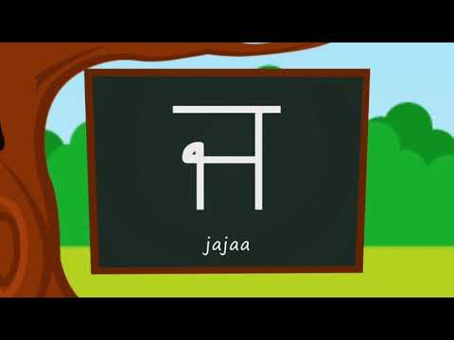

Slide 7




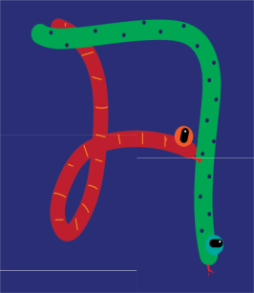




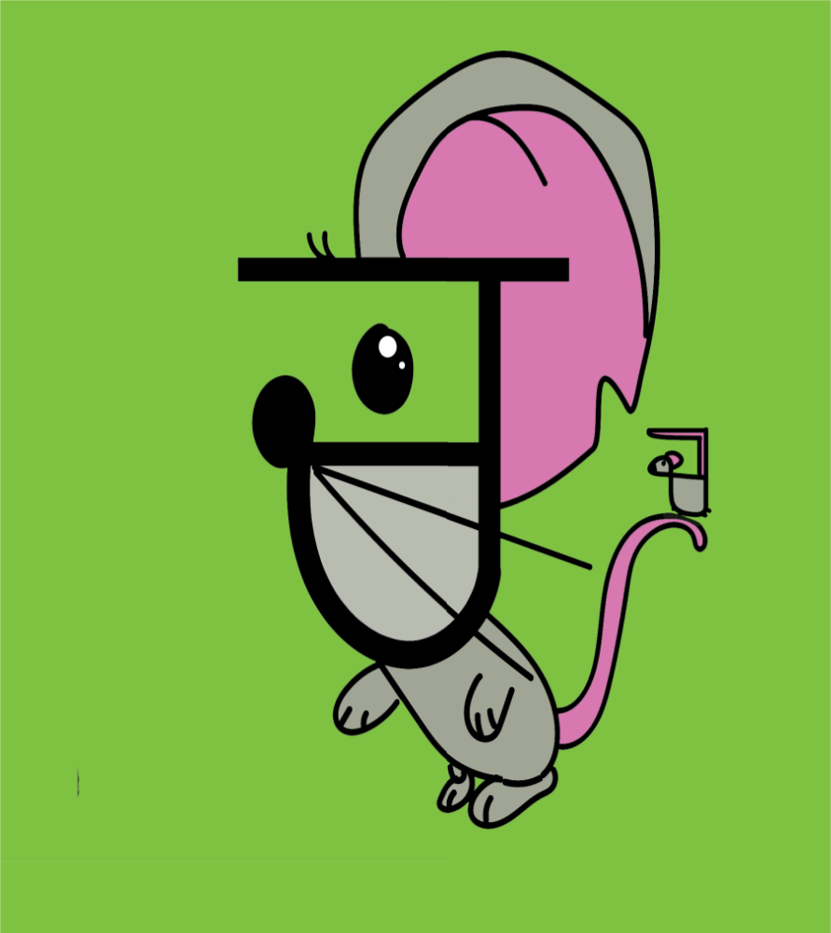
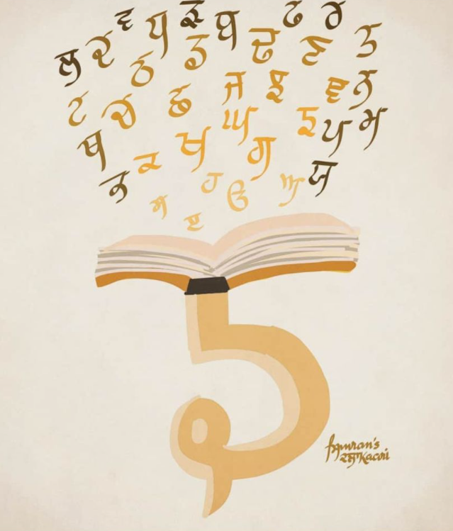
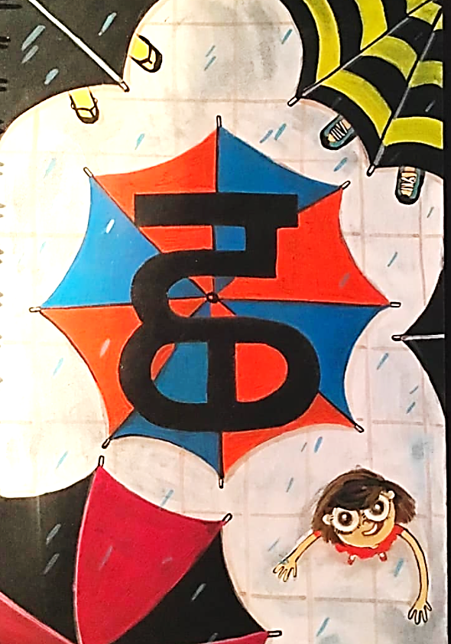









REVIEW:
\
x
(click on the correct answer)

Slide 8
Bhulavay Akhar
PaR ke dasso akhar dey naam.

Slide 9
q
Q
d
D
n

Slide 10
n
D
Q
d
q

Slide 11
d
n
q
D
Q

Slide 12


Q

Slide 13
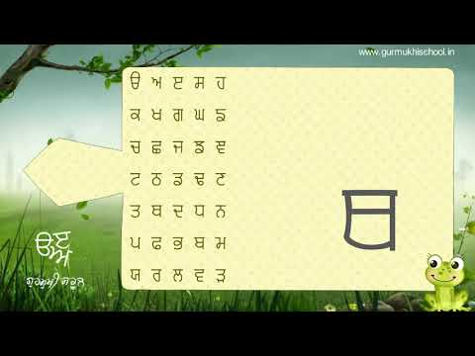

Slide 14
Labho
Find the image starting from THHATHHA

Slide 15
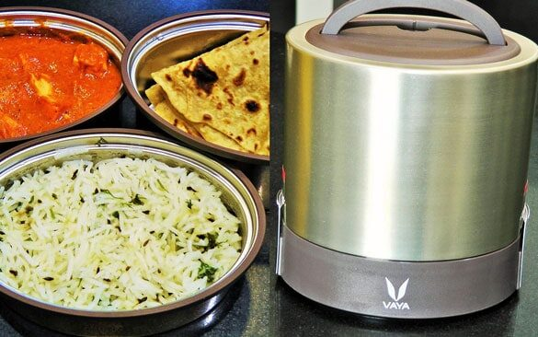

Slide 16
Sunno atey pichhay bolo

Slide 17
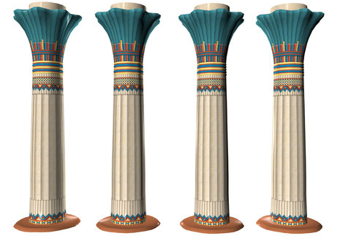

Slide 18
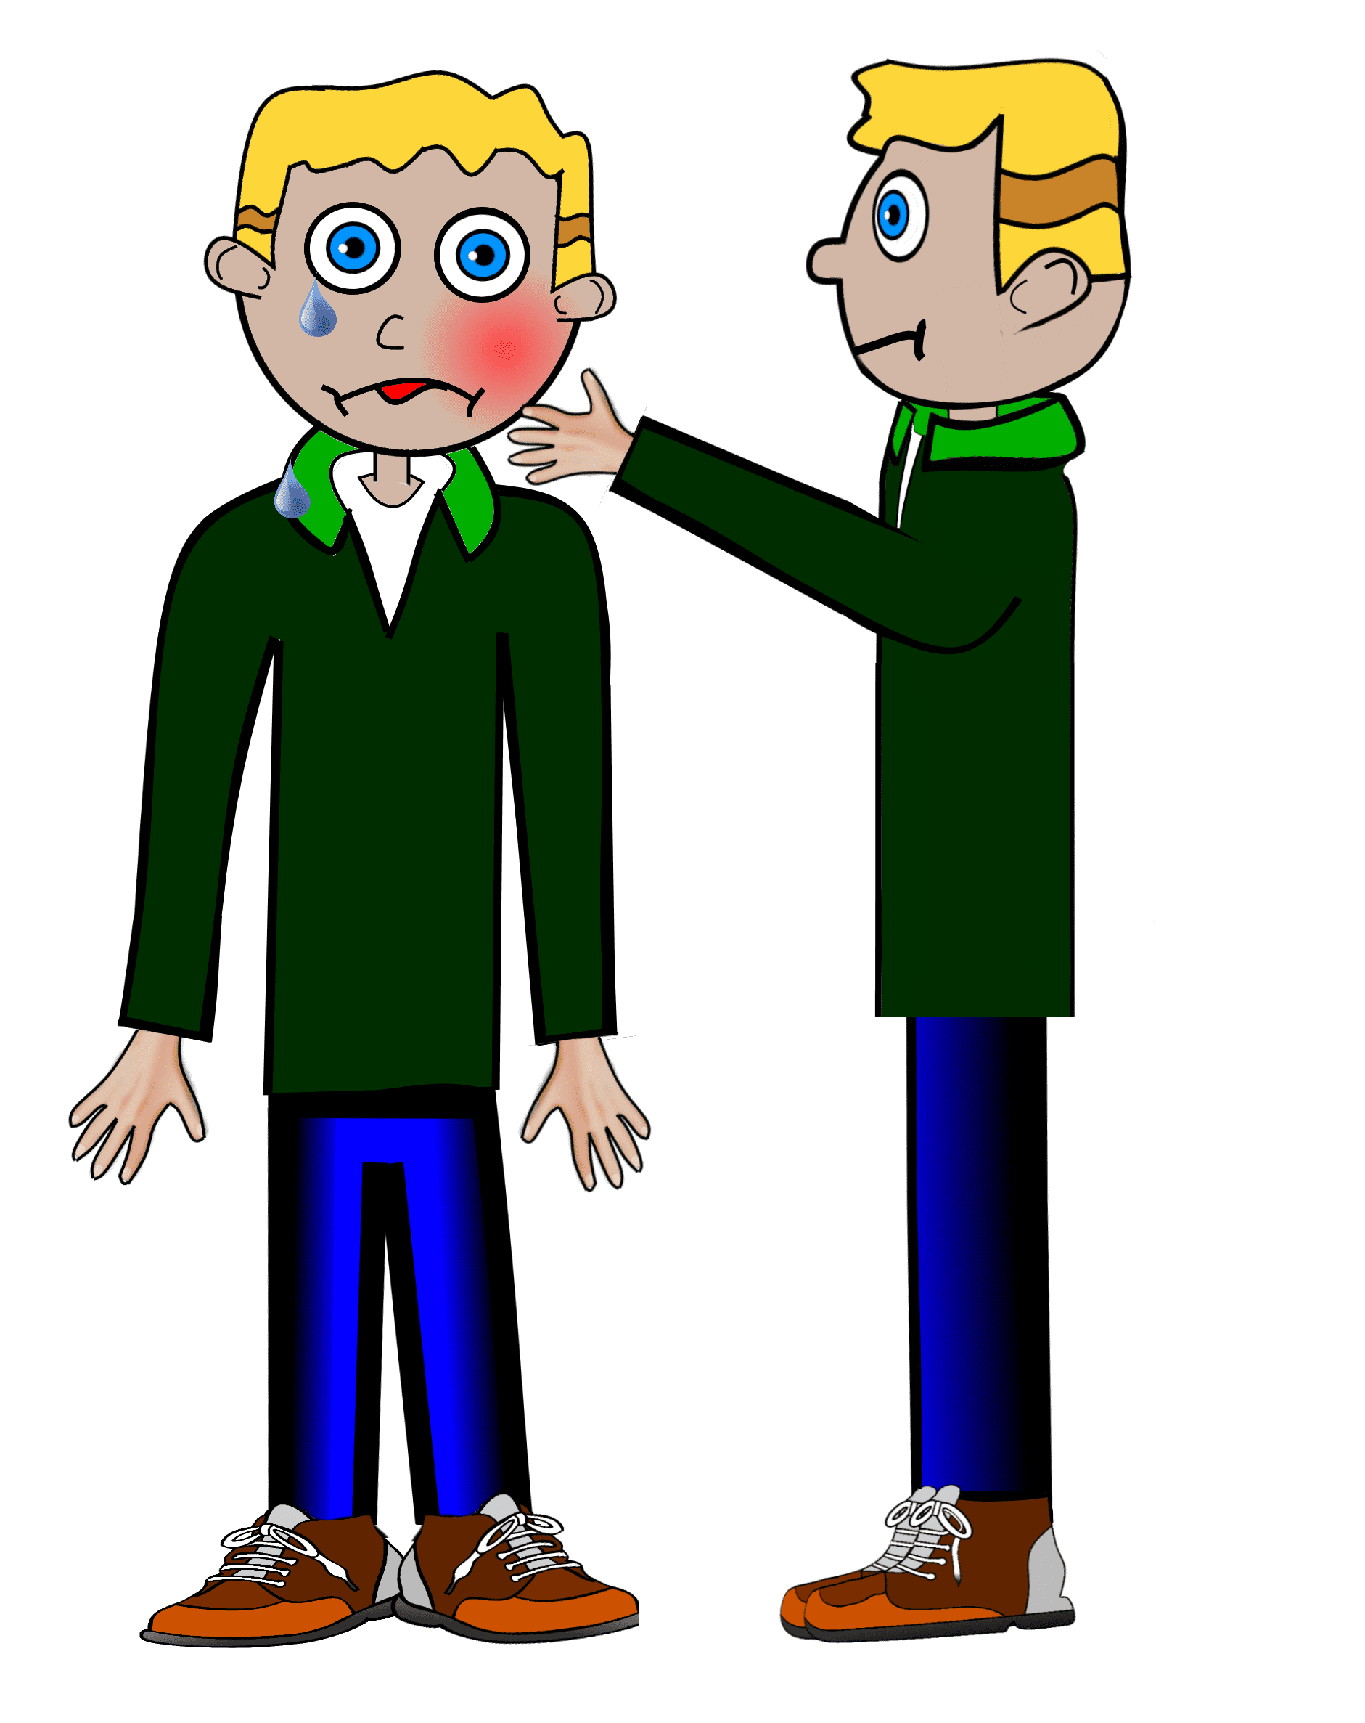

Slide 19


Slide 20
Akhar Labho
Find THHATHHA

Slide 21

b
D
b
K
b
D
D
b
Q
D
K
K
K
D
D
K
Reset
b
b

Slide 22
b
b
K
D
D
b
b
K
D
b
D
b
K
D
D
K
K
Q
D
Reset

Slide 23
K
D
b
K
b
D
D
Q
b
D
b
b
K
D
D
K
K
b
Reset
D

Slide 24
Akhar Pachhaano

Slide 25

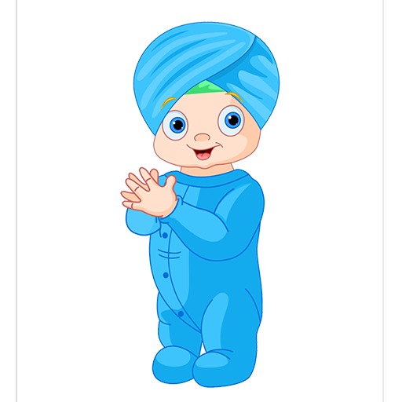



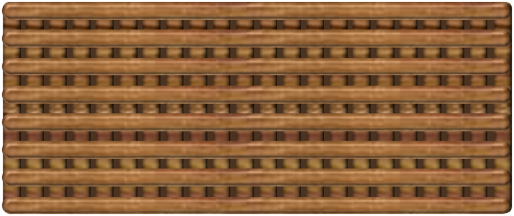

1
6
2
7
⇒
3
8
4
9
5
10
tekhnologic
Q
t
F
f
q
x
T
K
\
|

Slide 26
Bhulavay Akhar Repeat
PaD ke dasso akhar dey naam.

Slide 27
q
Q
d
D
n

Slide 28
T
t
x
f
F

Slide 29
x
T
F
f
t

Slide 30
Varnmala
Naal di naal bolo!

Slide 31


Slide 32

Samapat!
Good Job Bachiyo!

