Slide 1


Painti Fun
LESSON: 23

Slide 2




PLEASE READ:
01
You can press “ESC” on your keypad to exit the screen.
02
You must “Enable external content for this session” in order for the embedded videos to play properly.
03
Click anywhere on the screen to move to the next slide.

Slide 3
FORMAT:
01
Varnmala Abhiyaas
06
Sunno Atey Pichhay Bolo
02
Practice Video
07
Akhar Labho (game)
03
Bhulavay Akhar
08
Akhar Pachhaano (game)
04
Letter of the Day
09
Bhulavay Akhar 2
Find the Pictures Starting with the Letter
05
10
Varnmala Final Repeat

Slide 4
Varnmala
Naal di naal bolo!

Slide 5


A
e
s
h
a
k
K
g
G
|
c
C
j
J
\
Complete 5 repetitions to move onto the next slide!
t
T
f
F
x
q
Q
d
D
n
p
P
b
B
m
X
r
l
v
V

Slide 6


Slide 7



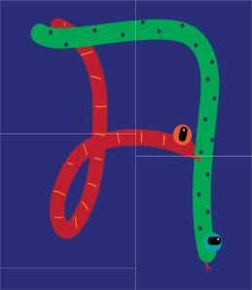















REVIEW:
\
x
(click on the correct answer)

Slide 8
Bhulavay Akhar
PaR ke dasso akhar dey naam.

Slide 9
q
Q
d
D
n

Slide 10
n
D
Q
d
q

Slide 11
d
n
q
D
Q

Slide 12




d

Slide 13


Slide 14
Labho
Find the image starting from DADA

Slide 15
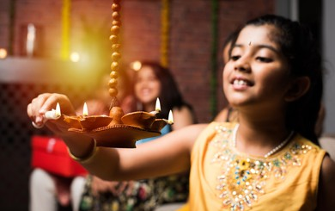

Slide 16
Akhar Labho
Find DADA

Slide 17
F
F
F
F
F
F
F
F
F
d
F
F
F
F
F
F
F
F
Reset

Slide 18

Akhar Pachhaano

Slide 19
Bhulavay Akhar Repeat
PaD ke dasso akhar dey naam.

Slide 20
q
Q
d
D
n

Slide 21
n
D
Q
d
q

Slide 22
d
n
q
D
Q

Slide 23
Varnmala
Naal di naal bolo!

Slide 24


Slide 25

Samapat!
Good Job Bachiyo!

