Slide 1


Painti Fun
LESSON: 24

Slide 2




PLEASE READ:
01
You can press “ESC” on your keypad to exit the screen.
02
You must “Enable external content for this session” in order for the embedded videos to play properly.
03
Click anywhere on the screen to move to the next slide.

Slide 3
FORMAT:
01
Varnmala Abhiyaas
06
Sunno Atey Pichhay Bolo
02
Practice Video
07
Akhar Labho (game)
03
Bhulavay Akhar
08
Akhar Pachhaano (game)
04
Letter of the Day
09
Bhulavay Akhar 2
Find the Pictures Starting with the Letter
05
10
Varnmala Final Repeat

Slide 4


A
e
s
h
a
k
K
g
G
|
c
C
j
J
\
Complete 5 repetitions to move onto the next slide!
t
T
f
F
x
q
Q
d
D
n
p
P
b
B
m
X
r
l
v
V

Slide 5

Notes:
Video link not found

Slide 6




















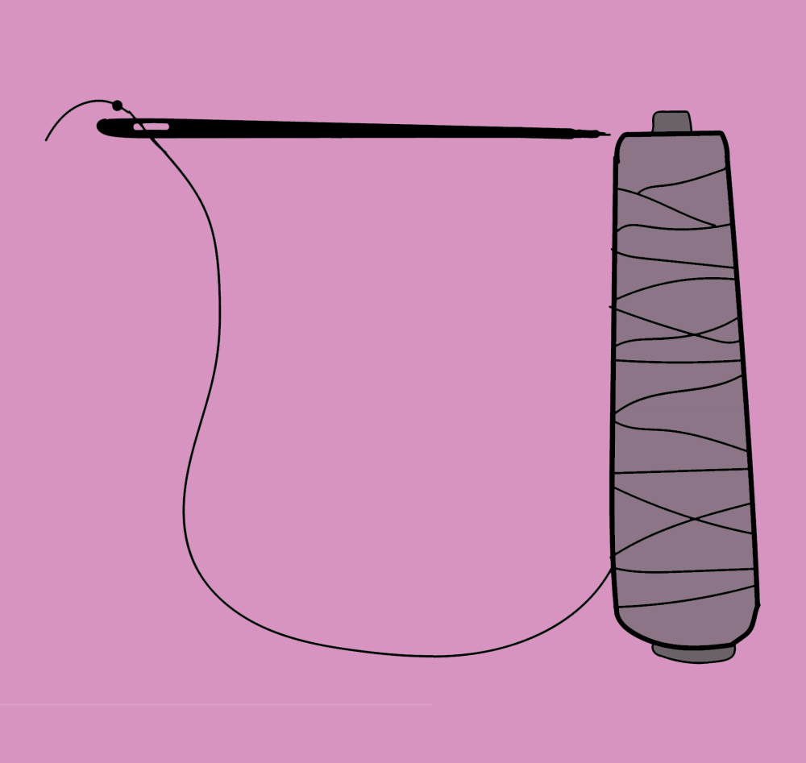

REVIEW: (ask at random):
\
x
(click on the correct answer)

Slide 7
Bhulavay Akhar
PaR ke dasso akhar dey naam.

Slide 8
q
Q
d
D
n

Slide 9
n
D
Q
d
q

Slide 10
d
n
q
D
Q

Slide 11
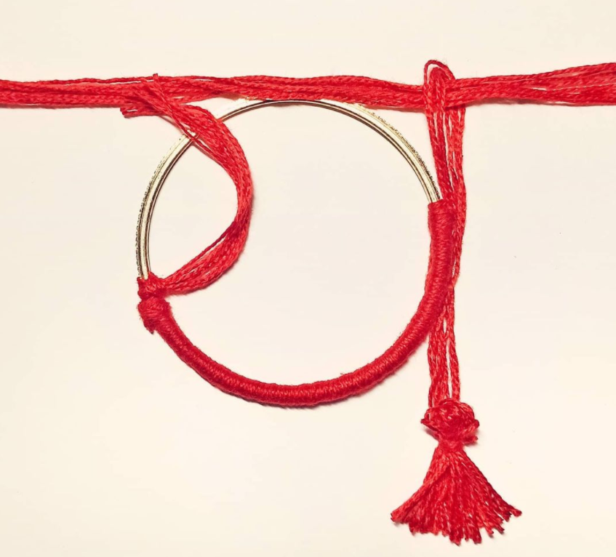
D

Slide 12
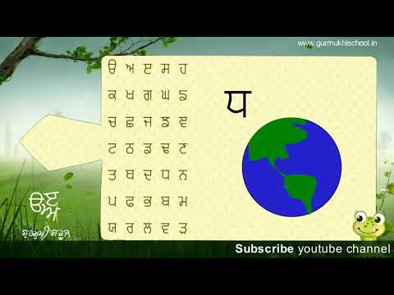

Slide 13
Labho
Find the image starting from DHADHA

Slide 14
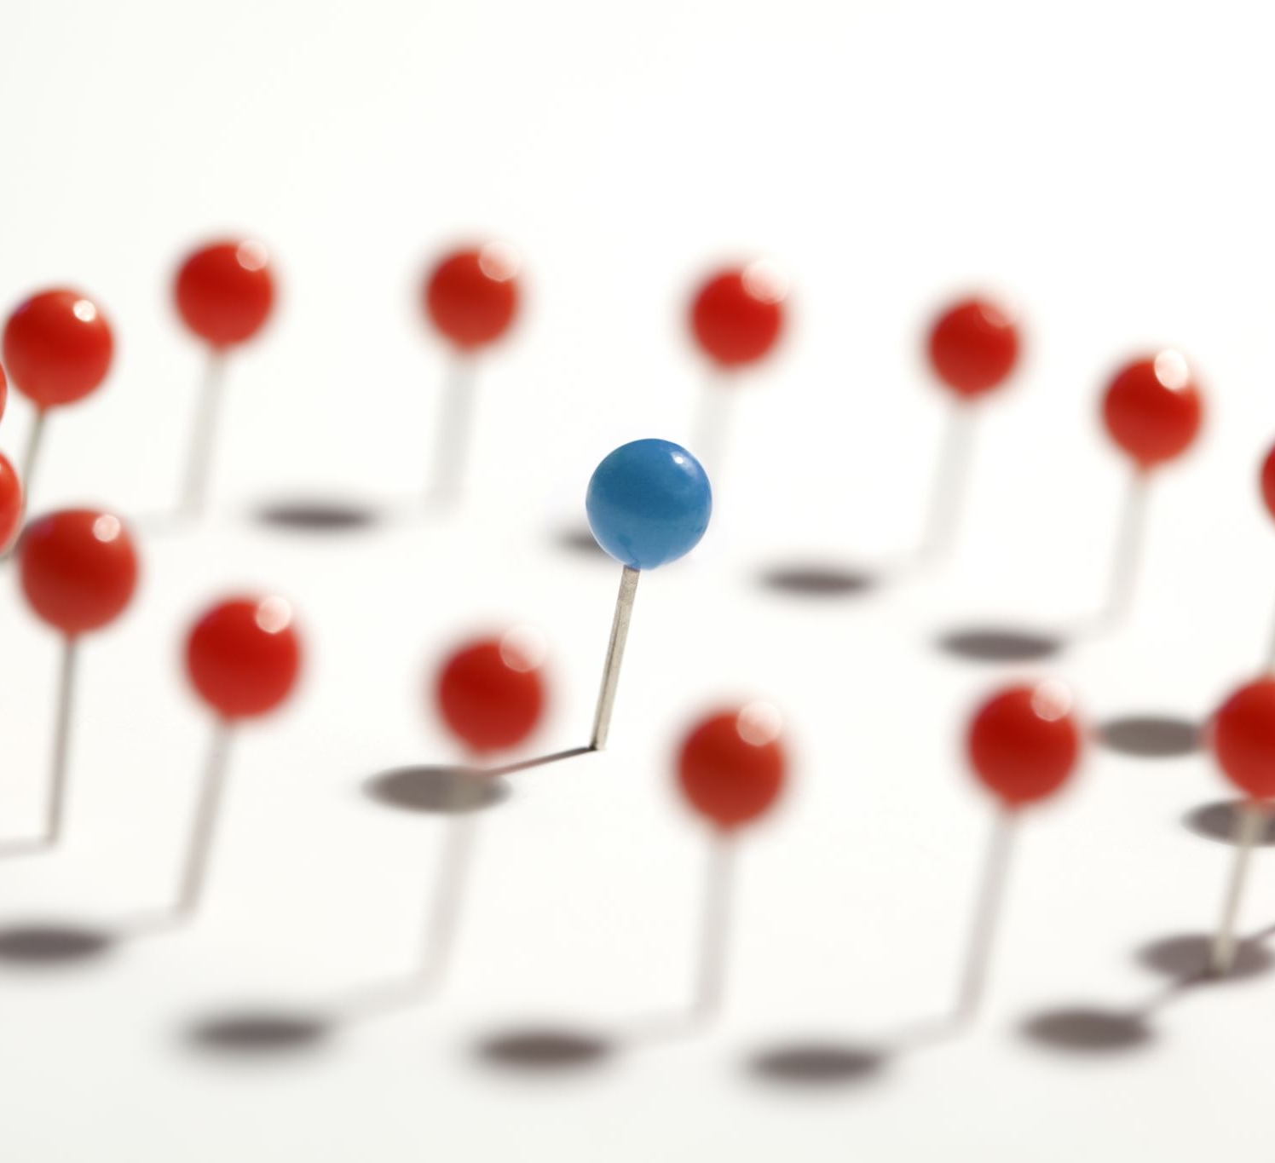

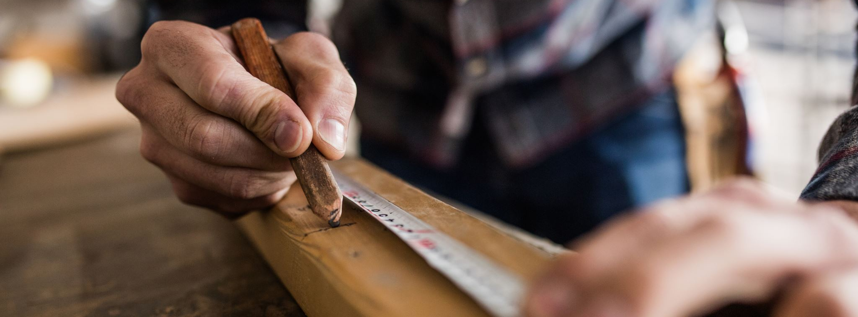

Slide 15
Akhar Labho
Find DHADHA

Slide 16




D
C
D
D
C
D
D

Slide 17
Bhulavay Akhar Repeat
PAD KE DASSO AKHAR DEY NAAM.

Slide 18
q
Q
d
D
n

Slide 19
n
D
Q
d
q

Slide 20
d
n
q
D
Q

Slide 21
Varnmala
Naal di naal bolo!

Slide 22


Slide 23

Samapat!
Good Job Bachiyo!

