Slide 1


Painti Fun
LESSON: 25

Slide 2




PLEASE READ:
01
You can press “ESC” on your keypad to exit the screen.
02
You must “Enable external content for this session” in order for the embedded videos to play properly.
03
Click anywhere on the screen to move to the next slide.

Slide 3
FORMAT:
01
Varnmala Abhiyaas
06
Sunno Atey Pichhay Bolo
02
Practice Video
07
Akhar Labho (game)
03
Bhulavay Akhar
08
Akhar Pachhaano (game)
04
Letter of the Day
09
Bhulavay Akhar 2
Find the Pictures Starting with the Letter
05
10
Varnmala Final Repeat

Slide 4
Varnmala
Naal di naal bolo!

Slide 5


A
e
s
h
a
k
K
g
G
|
c
C
j
J
\
Complete 5 repetitions to move onto the next slide!
t
T
f
F
x
q
Q
d
D
n
p
P
b
B
m
X
r
l
v
V

Slide 6
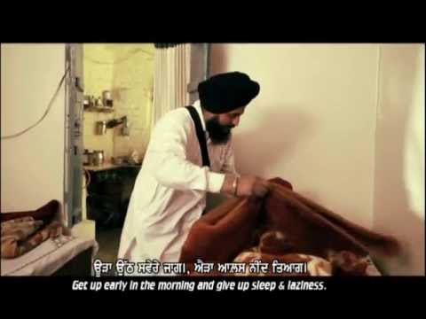

Slide 7




















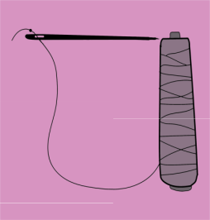
REVIEW: (ask at random):
\
x
(click on the correct answer)

Slide 8
Bhulavay Akhar
Pad ke dasso akhar dey naam.

Slide 9
q
Q
d
D
n

Slide 10
n
D
Q
d
q

Slide 11
d
n
q
D
Q

Slide 12

n

Slide 13
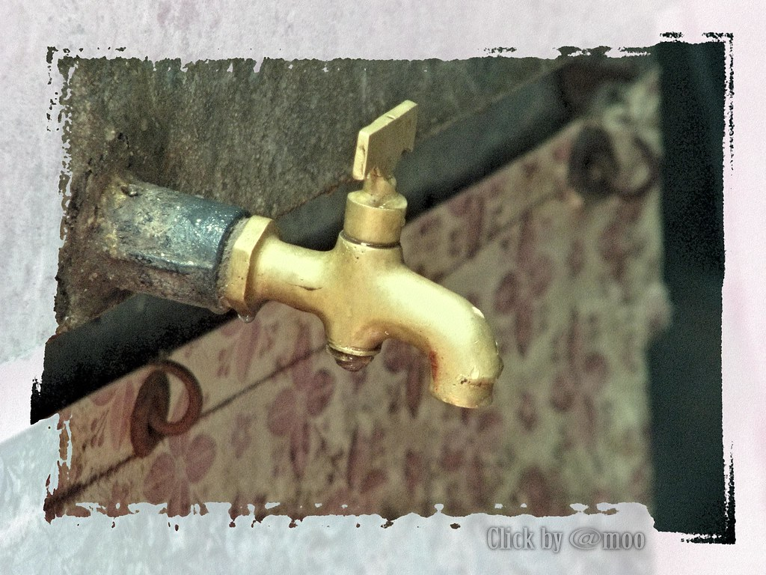
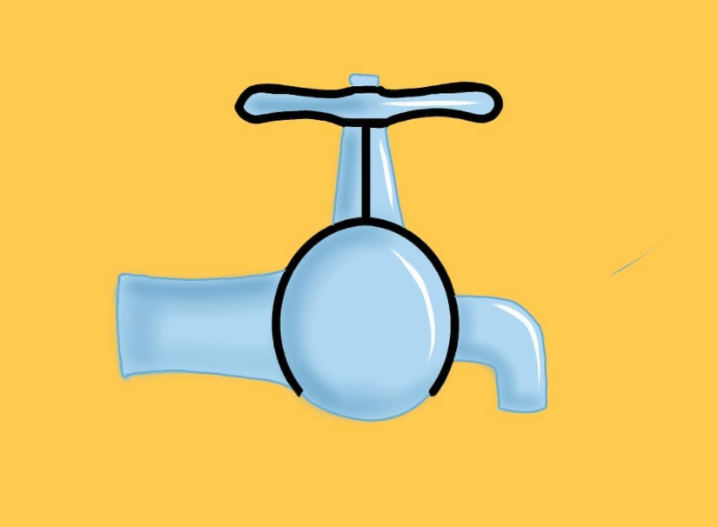
n

Slide 14
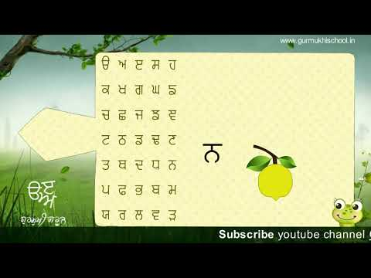

Slide 15
Labho
Find the image starting from NANNA

Slide 16







Slide 17
Akhar Labho
Find NANNA

Slide 18


p
k
Find the letter
n
Ready? GO!
m
p
Q
k
t
m
Q
l
J
c
\
t
B
J
c
d
D
n

Slide 19
Bhulavay Akhar Repeat
PaD ke dasso akhar dey naam.

Slide 20
q
Q
d
D
n

Slide 21
n
D
Q
d
q

Slide 22
d
n
q
D
Q

Slide 23
Varnmala
Naal di naal bolo!

Slide 24


Slide 25

Samapat!
Good Job Bachiyo!

