Slide 1
Painti Fun

Slide 2
FORMAT:
01
Varnmala Abhiyaas
06
Sunno Atey Pichhay Bolo
02
Practice Video
07
Akhar Labho (game)
03
Bhulavay Akhar
08
Akhar Pachhaano (game)
04
Letter of the Day
09
Bhulavay Akhar 2
Find the Pictures Starting with the Letter
05
10
Varnmala Final Repeat

Slide 3
Varnmala
Naal di naal bolo!

Slide 4

A
e
s
h
a
k
K
g
G
|
c
C
j
J
\
t
T
f
F
x
q
Q
d
D
n
p
P
b
B
m
X
r
l
v
V

Slide 5




















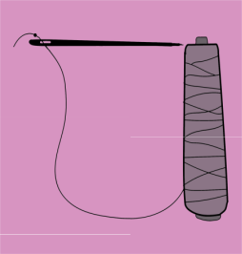
REVIEW: (ask at random):
\
x
(click on the correct answer)

Slide 6


Slide 7
Bhulavay Akhar
Pad ke dasso akhar dey naam.

Slide 8
p
P
b
B
m

Slide 9
m
B
P
b
p

Slide 10
B
m
p
b
P

Slide 11

p

Slide 12


Slide 13
Akhar Labho
Find NANNA

Slide 14


p
k
Find the letter
p
Ready? GO!
m
p
Q
k
t
m
Q
l
J
c
\
t
B
J
c
d
D
n

Slide 15
Bhulavay Akhar Repeat
PaD ke dasso akhar dey naam.

Slide 16
p
P
b
B
m

Slide 17
m
B
P
b
p

Slide 18
b
m
p
B
P

Slide 19
Varnmala
Naal di naal bolo!

Slide 20


Slide 21

Samapat!
Good Job Bachiyo!

