Slide 1
Painti Fun

Slide 2
FORMAT:
01
Varnmala Abhiyaas
06
Sunno Atey Pichhay Bolo
02
Practice Video
07
Akhar Labho (game)
03
Bhulavay Akhar
08
Akhar Pachhaano (game)
04
Letter of the Day
09
Bhulavay Akhar 2
Find the Pictures Starting with the Letter
05
10
Varnmala Final Repeat

Slide 3
Varnmala
Naal di naal bolo!

Slide 4

A
e
s
h
a
k
K
g
G
|
c
C
j
J
\
t
T
f
F
x
q
Q
d
D
n
p
P
b
B
m
X
r
l
v
V

Slide 5


Slide 6



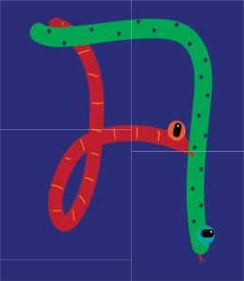















REVIEW:
\
x
(click on the correct answer)

Slide 7
Bhulavay Akhar
PaR ke dasso akhar dey naam.

Slide 8
p
P
b
B
m

Slide 9
m
B
P
b
p

Slide 10
B
m
p
b
P

Slide 11



b

Slide 12


Slide 13
Akhar Labho
Find DADA

Slide 14
x
F
s
r
h
K
j
t
b
q
e
F
b
A
l
F
F
b
Reset

Slide 15

Akhar Pachhaano

Slide 16
Bhulavay Akhar Repeat
PaD ke dasso akhar dey naam.

Slide 17
p
P
b
B
m

Slide 18
m
B
b
P
p

Slide 19
b
m
p
B
P

Slide 20
Varnmala
Naal di naal bolo!

Slide 21


Slide 22

Samapat!
Good Job Bachiyo!

