Slide 1
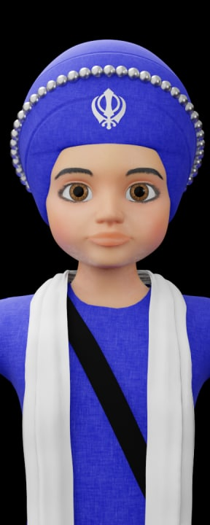
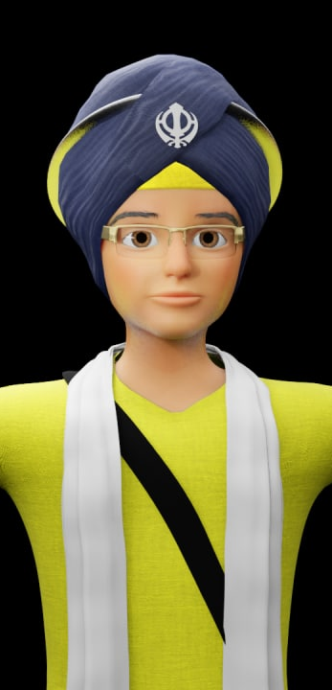
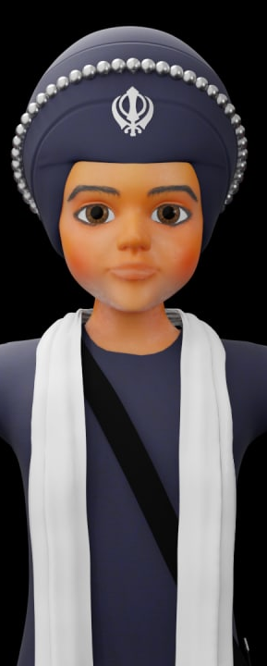
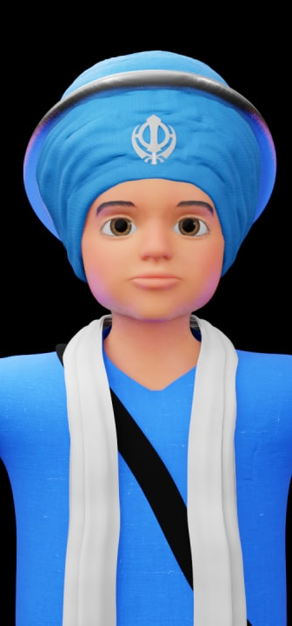
SANTHIYA PREPERATION

Slide 2
FORMAT:
01
Varnmala Abhiyaas
06
Sunno Atey Pichhay Bolo
02
Practice Video
07
Akhar Labho (game)
03
Bhulavay Akhar
08
Akhar Pachhaano (game)
04
Letter of the Day
09
Bhulavay Akhar 2
Find the Pictures Starting with the Letter
05
10
Varnmala Final Repeat

Slide 3
Varnmala
Naal di naal bolo!

Slide 4

A
e
s
h
a
k
K
g
G
|
c
C
j
J
\
t
T
f
F
x
q
Q
d
D
n
p
P
b
B
m
X
r
l
v
V

Slide 5


Slide 6
X
r
l
v
V

Slide 7

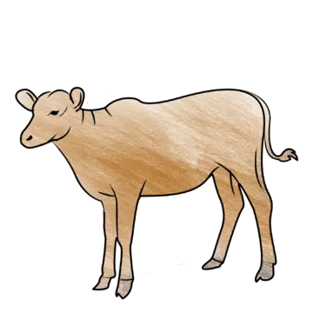




V

Slide 8


Slide 9
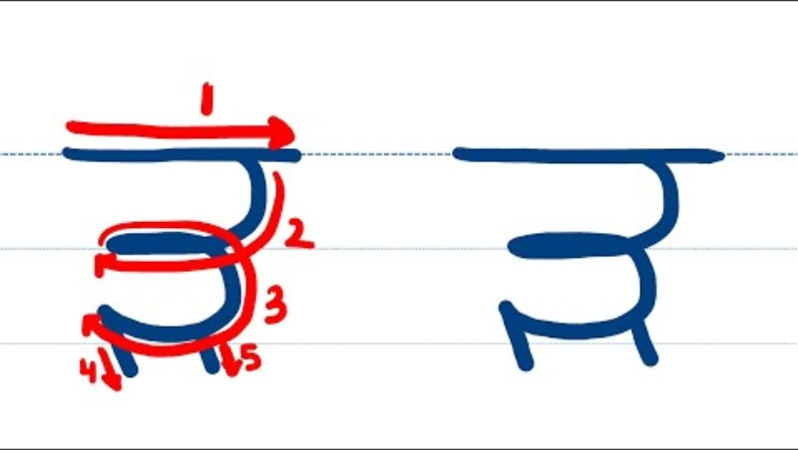

Slide 10

Samapat!
Good Job Bachiyo!

Slide 11


