Slide 1


Painti Fun
LESSON: 5

Slide 2

FORMAT:
01
Varnmala Abhiyaas
06
Sunno Atey Pichhay Bolo
02
Practice Video
07
Akhar Labho (game)
03
Bhulavay Akhar
08
Akhar Pachhaano (game)
04
Letter of the Day
09
Bhulavay Akhar 2
Find the Pictures Starting with the Letter
05
10
Varnmala Final Repeat

Slide 3

Varnmala
Naal di naal bolo!

Slide 4

A
e
s
h
a
k
K
g
G
|
c
C
j
J
\
t
T
f
F
x
Complete 5 repetitions to move onto the next slide!
q
Q
d
D
n
p
P
b
B
m
X
r
l
v
V

Slide 5


Slide 6





REVIEW:
(click on the correct answer)

Slide 7
Bhulavay Akhar
PaD ke dasso akhar dey naam.

Slide 8
A
e
s
h
a

Slide 9

A
s
e
a

Slide 10

e
A
s
a

Slide 11

h

Slide 12


Slide 13
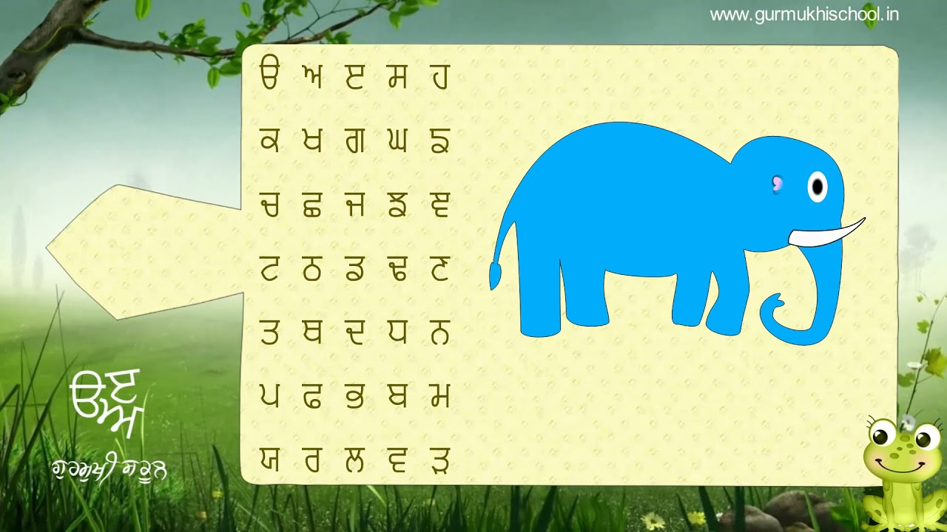

Slide 14




Slide 15


Slide 16
Labho
Find the image starting with Haha

Slide 17
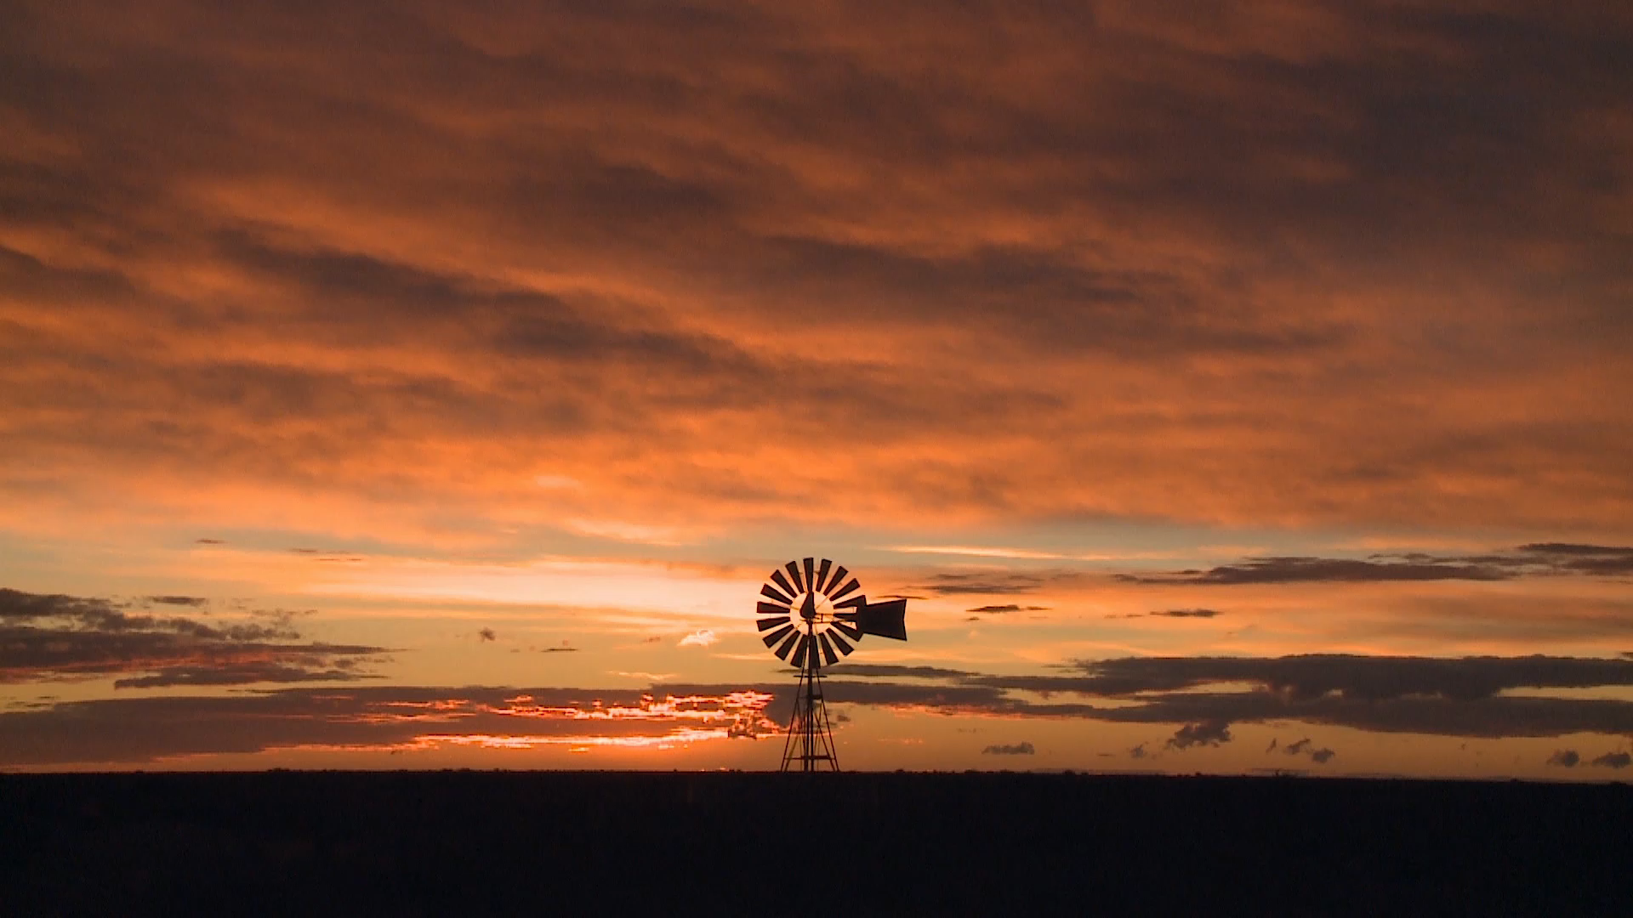


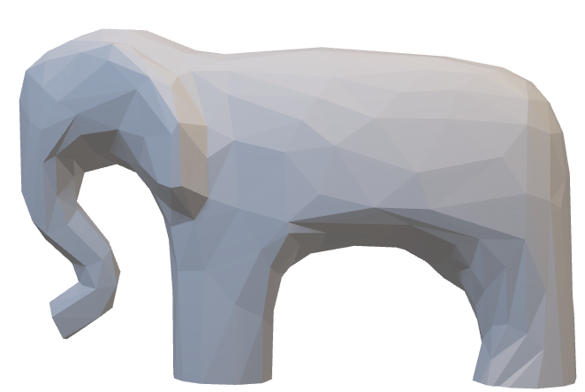
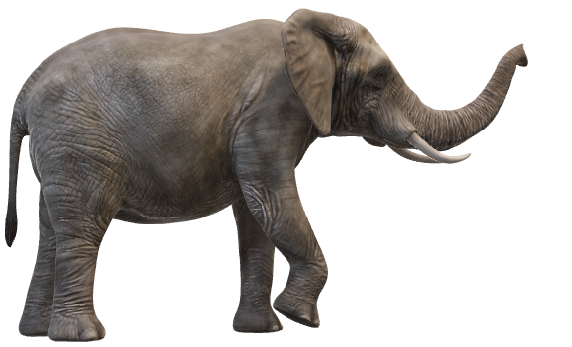

Slide 18
Sunno, Phir Pichhay Bolo
Listen, then repeat!

Slide 19
Listen and Repeat!

Slide 20
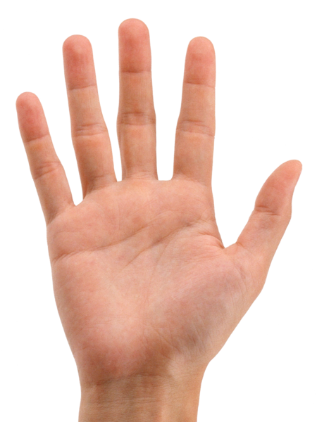

Slide 21


Slide 22


Slide 23


Slide 24
Akhar Labho

Slide 25
A
e
s
h
a
Find:
1. HAHA
2. AIRA
Bonus:
Dadda
Pappa
Thatha
k
K
g
G
|
c
C
j
J
\
t
T
f
F
x
q
Q
d
D
n
p
P
b
B
m
X
r
l
v
V

Slide 26
FIND HAHA
A
e
s
h
a
k
K
g
G
|
c
C
j
J
\
t
T
f
F
x
q
Q
d
D
n
p
P
b
B
m
X
r
l
v
V

Slide 27
FIND HAHA
c
K
g
n
T
P
q
C
J
k
A
d
e
t
h
a
l
s
j
p
D
r
Q
G
v
m
B
b

Slide 28
FIND HAHA
q
g
s
n
T
a
P
A
j
G
h
Q
l
t
b
B
J
K
v
c
d
e
p
r
C
m

Slide 29
FIND HAHA
q
Q
n
s
B
m
r
g
b
J
T
k
D
d
h
K
a
G
e
C
v
l
A
j
t
c
p

Slide 30
FIND HAHA
q
Q
s
b
B
t
n
r
K
J
d
k
m
D
v
T
A
G
P
a
l
C
j
g
p
c
e
h

Slide 31
SHABAASH!

Slide 32
Akhar Pachhaano

Slide 33

WHEEL OF WINNING WHEEL OF WINNING WHEEL OF WINNING WHEEL OF WINNING WHEEL OF WINNING WHEEL OF WINNING WHEEL OF WINNING WHEEL OF WINNING WHEEL OF WINNING WHEEL OF WINNING WHEEL OF WINNING WHEEL OF WINNING
WHEEL OF WINNING WHEEL OF WINNING WHEEL OF WINNING WHEEL OF WINNING WHEEL OF WINNING WHEEL OF WINNING WHEEL OF WINNING WHEEL OF WINNING WHEEL OF WINNING WHEEL OF WINNING WHEEL OF WINNING WHEEL OF WINNING
PLAY GAME
Notes:
Wheel of WINNING Powerpoint Template - Introduction Slide
Designed by Reid Powell at YouthDownloads.com

Slide 34

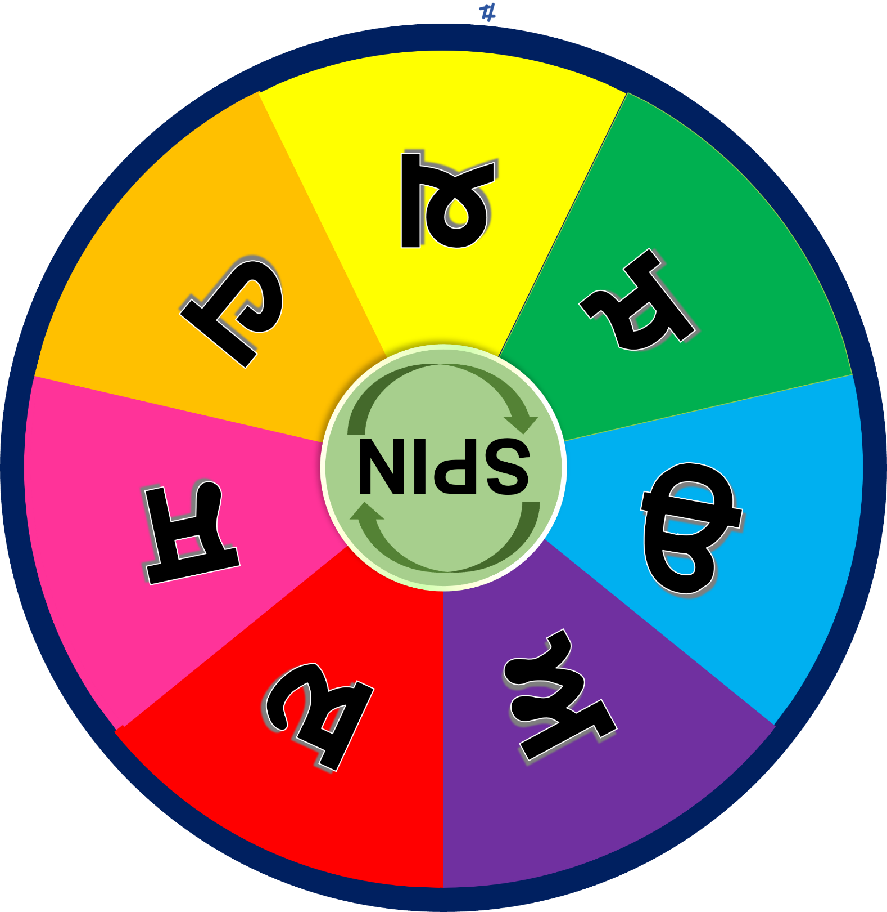

SPIN
STOP
Win
Bankrupt
Cheer
Boo
Silence
Notes:
*DO NOT DELETE THIS SLIDE*. It is automatically transitioning slide that resets the animation for the wheel on the following slide.

Slide 35
SPIN
STOP
Win
Bankrupt
Cheer
Boo
Silence
Notes:
*DO NOT DELETE THIS SLIDE*. It is automatically transitioning slide that resets the animation for the wheel on the following slide.

Slide 36
SPIN
STOP
Win
Bankrupt
Cheer
Boo
Silence
Notes:
Wheel of WINNING Spinner
Click the SPIN button to spin the wheel. Click STOP to stop.

Slide 37
Bhulavay Akhar Repeat
PaD ke dasso akhar dey naam.

Slide 38
A
e
s
h
a

Slide 39
A
s
e
a

Slide 40
e
A
s
a

Slide 41
Varnmala
Naal di naal bolo!

Slide 42


Slide 43

Samapat!
Good Job Bachiyo!

