Slide 1


Painti Fun
LESSON: 6

Slide 2




PLEASE READ:
01
You can press “ESC” on your keypad to exit the screen.
02
You must “Enable external content for this session” in order for the embedded videos to play properly.
03
Click anywhere on the screen to move to the next slide.

Slide 3
FORMAT:
01
Varnmala Abhiyaas
06
Sunno Atey Pichhay Bolo
02
Practice Video
07
Akhar Labho (game)
03
Bhulavay Akhar
08
Akhar Pachhaano (game)
04
Letter of the Day
09
Bhulavay Akhar 2
Find the Pictures Starting with the Letter
05
10
Varnmala Final Repeat

Slide 4
Varnmala
Naal di naal bolo!

Slide 5


A
e
s
h
a
k
K
g
G
|
c
C
j
J
\
t
T
f
F
x
q
Q
d
D
n
p
P
b
B
m
X
r
l
v
V

Slide 6


Slide 7



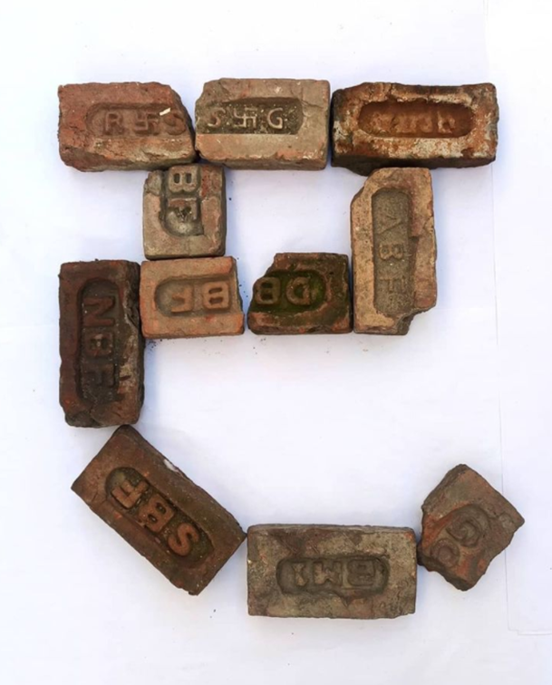


REVIEW:
(click on the correct answer)

Slide 8
Bhulavay Akhar
PaR ke dasso akhar dey naam.

Slide 9
K
g
G
|
k

Slide 10
|
k
G
g
K

Slide 11
G
k
g
|
K

Slide 12

k

Slide 13
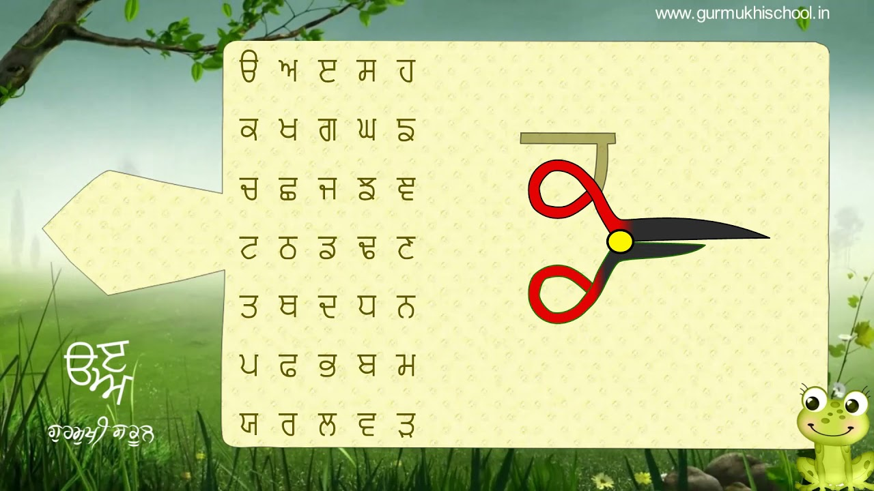

Slide 14
Labho
Which images start from Kakka?

Slide 15
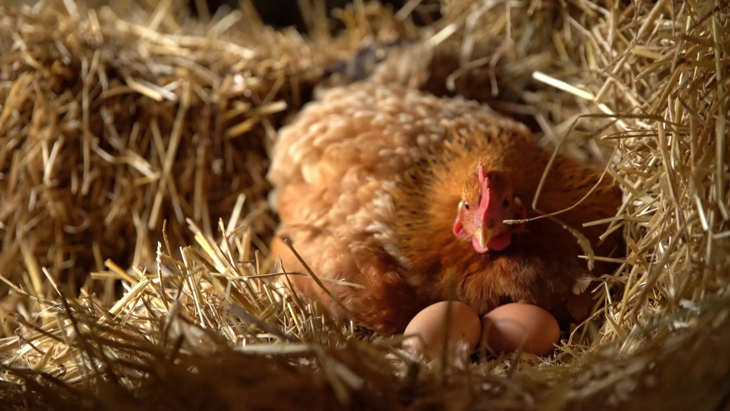

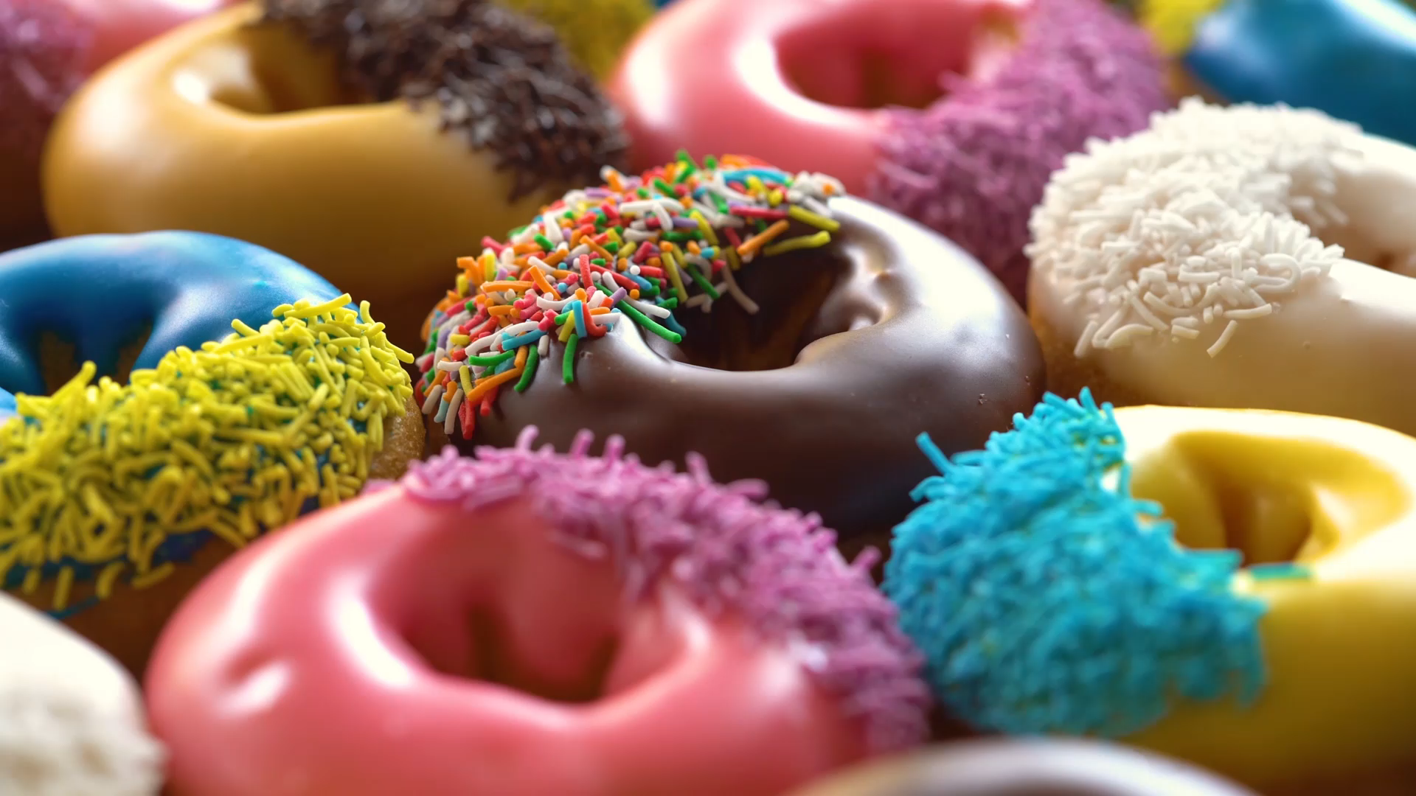

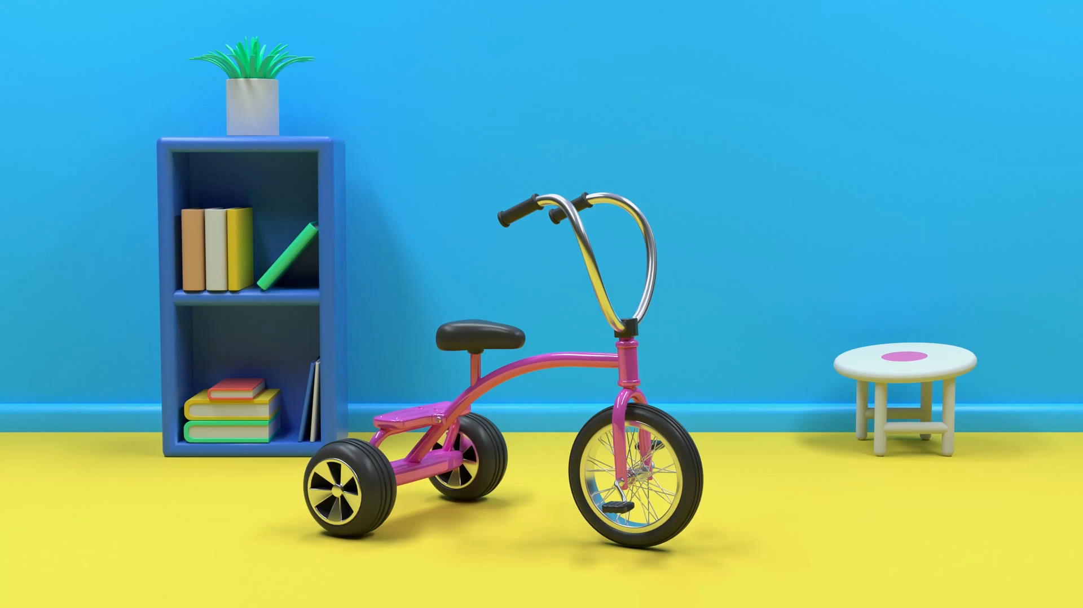

Slide 16
Sunno, Phir Pichhay Bolo
Listen, then repeat!

Slide 17
Listen and Repeat!

Slide 18


Slide 19


Slide 20


Slide 21


Slide 22
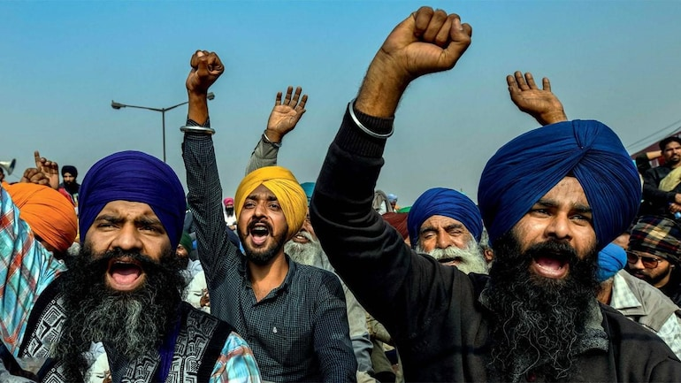

Slide 23


Slide 24


Slide 25
Akhar Labho

Slide 26
A
e
s
h
a
k
K
g
G
|
Find:
1. KAKA
Bonus:
Gagga
Chacha
Nanna
c
C
j
J
\
t
T
f
F
x
q
Q
d
D
n
p
P
b
B
m
X
r
l
v
V

Slide 27
FIND KAKA
k
e
s
h
a

Slide 28
FIND KAKA
K
k
G
|
k

Slide 29
FIND KAKA
k
j
J
\
c

Slide 30
FIND KAKA
T
f
k
x
t

Slide 31
FIND KAKA
Q
d
D
n
k

Slide 32
SHABAASH!

Slide 33
Akhar Pachhaano

Slide 34

WHEEL OF WINNING WHEEL OF WINNING WHEEL OF WINNING WHEEL OF WINNING WHEEL OF WINNING WHEEL OF WINNING WHEEL OF WINNING WHEEL OF WINNING WHEEL OF WINNING WHEEL OF WINNING WHEEL OF WINNING WHEEL OF WINNING
WHEEL OF WINNING WHEEL OF WINNING WHEEL OF WINNING WHEEL OF WINNING WHEEL OF WINNING WHEEL OF WINNING WHEEL OF WINNING WHEEL OF WINNING WHEEL OF WINNING WHEEL OF WINNING WHEEL OF WINNING WHEEL OF WINNING
PLAY GAME
Notes:
Wheel of WINNING Powerpoint Template - Introduction Slide
Designed by Reid Powell at YouthDownloads.com

Slide 35

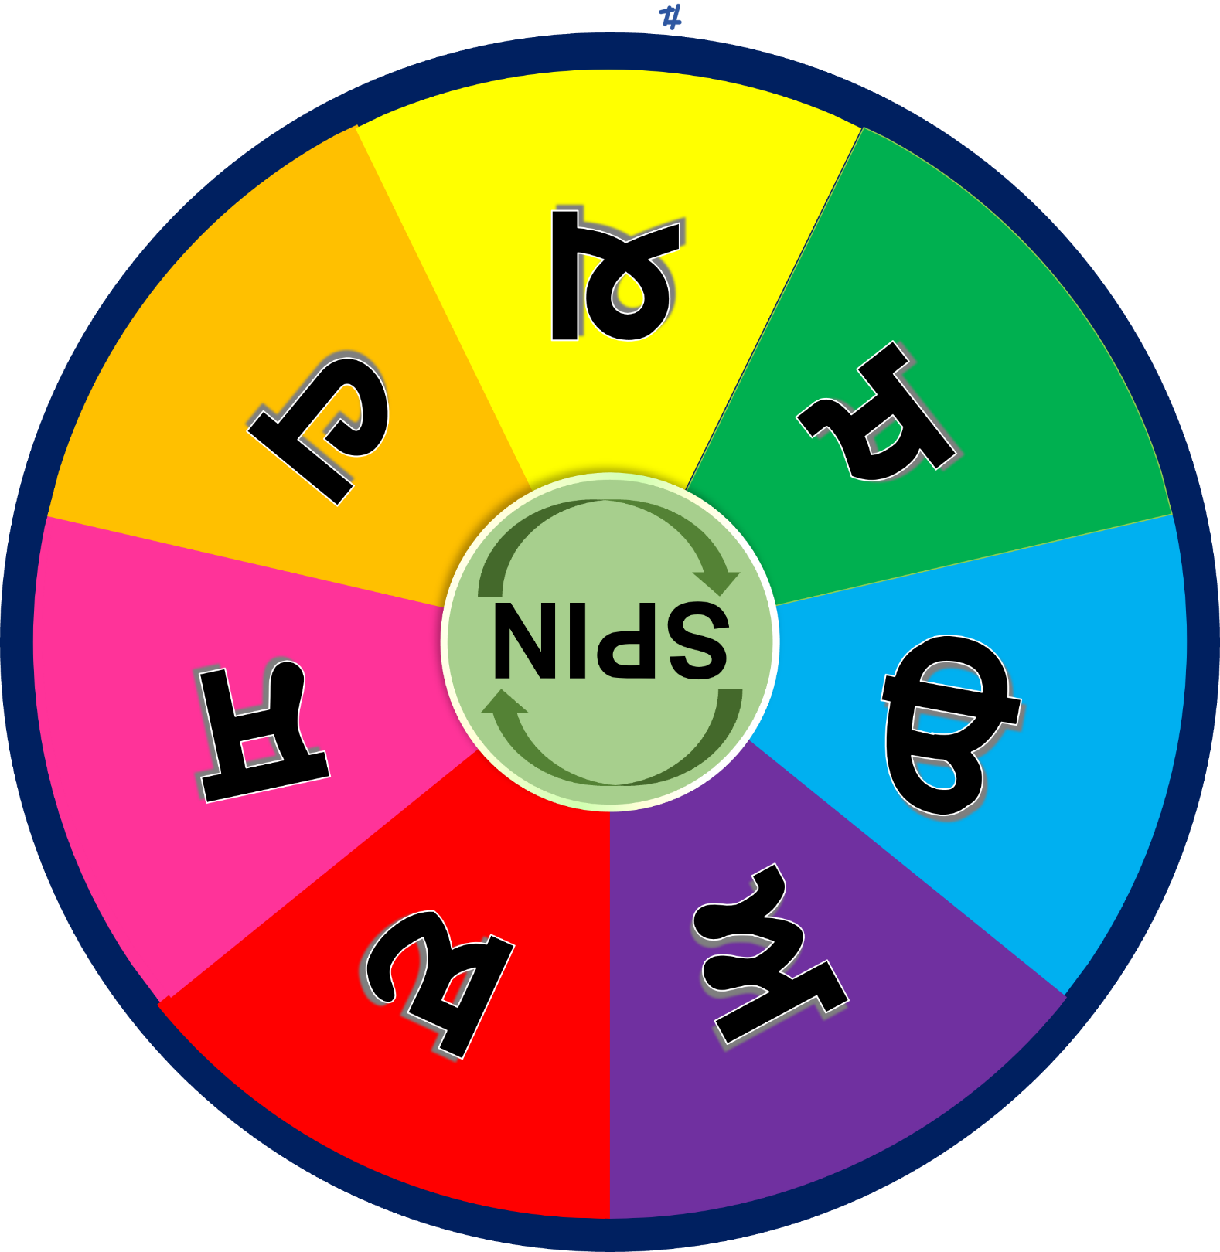

SPIN
STOP
Win
Bankrupt
Cheer
Boo
Silence
Notes:
*DO NOT DELETE THIS SLIDE*. It is automatically transitioning slide that resets the animation for the wheel on the following slide.

Slide 36
SPIN
STOP
Win
Bankrupt
Cheer
Boo
Silence
Notes:
*DO NOT DELETE THIS SLIDE*. It is automatically transitioning slide that resets the animation for the wheel on the following slide.

Slide 37
SPIN
STOP
Win
Bankrupt
Cheer
Boo
Silence
Notes:
Wheel of WINNING Spinner
Click the SPIN button to spin the wheel. Click STOP to stop.

Slide 38
Bhulavay Akhar Repeat
PaD ke dasso akhar dey naam.

Slide 39
G
k
g
|
K

Slide 40
K
|
k
g
G

Slide 41
k
K
g
|
G

Slide 42
Varnmala
Naal di naal bolo!

Slide 43
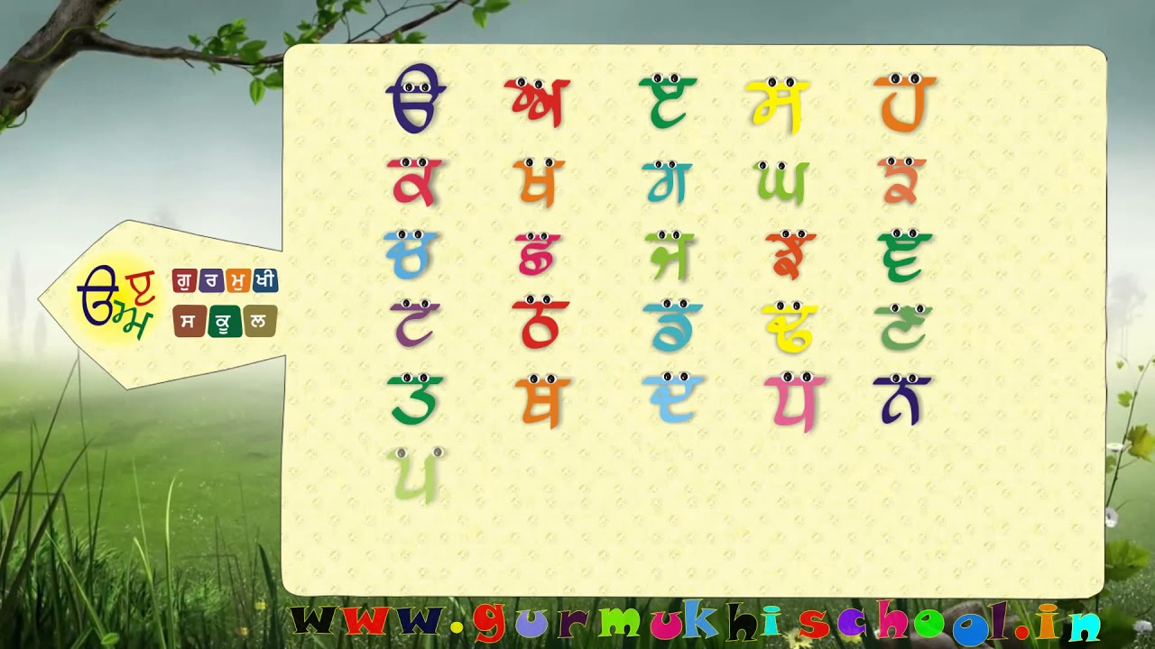

Slide 44

Samapat!
Good Job Bachiyo!

