Slide 1
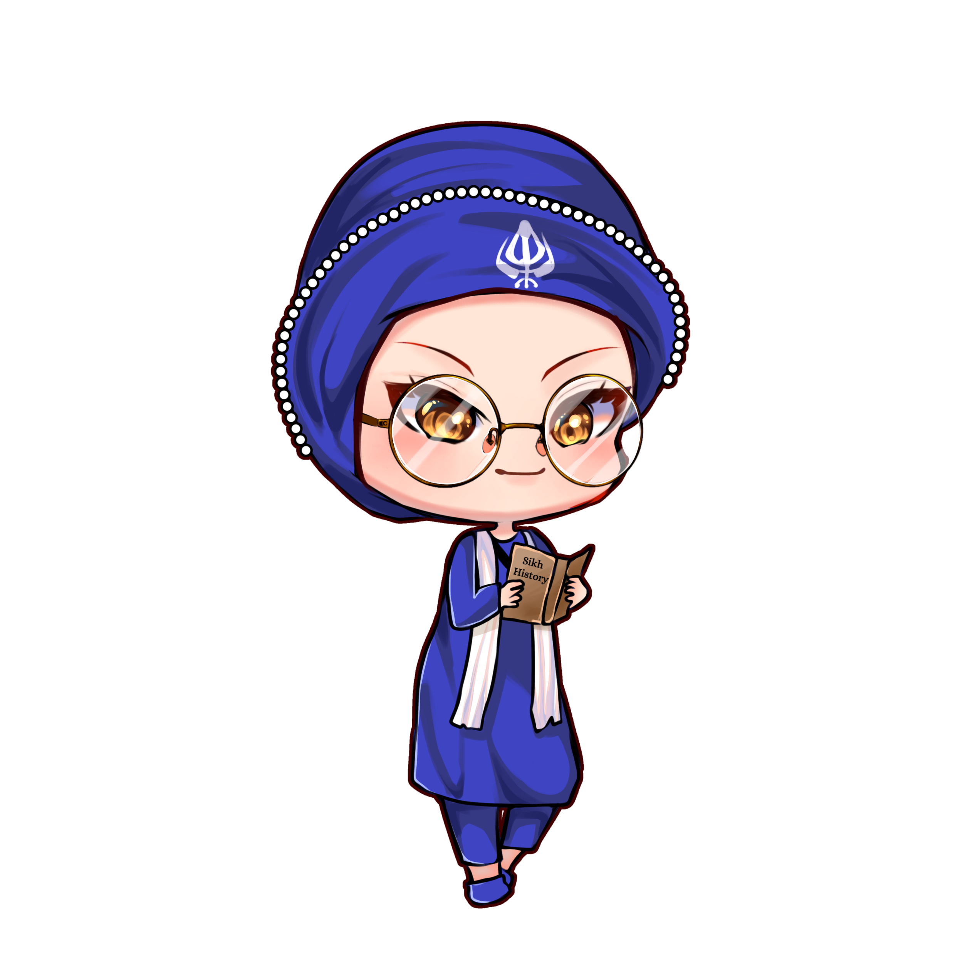

Painti Fun
LESSON: 7

Slide 2




PLEASE READ:
01
You can press “ESC” on your keypad to exit the screen.
02
You must “Enable external content for this session” in order for the embedded videos to play properly.
03
Click anywhere on the screen to move to the next slide.

Slide 3
FORMAT:
01
Varnmala Abhiyaas
06
Sunno Atey Pichhay Bolo
02
Practice Video
07
Akhar Labho (game)
03
Bhulavay Akhar
08
Akhar Pachhaano (game)
04
Letter of the Day
09
Bhulavay Akhar 2
Find the Pictures Starting with the Letter
05
10
Varnmala Final Repeat

Slide 4
Varnmala
Naal di naal bolo!

Slide 5


A
e
s
h
a
k
K
g
G
|
c
C
j
J
\
Complete 5 repetitions to move onto the next slide!
t
T
f
F
x
q
Q
d
D
n
p
P
b
B
m
X
r
l
v
V

Slide 6
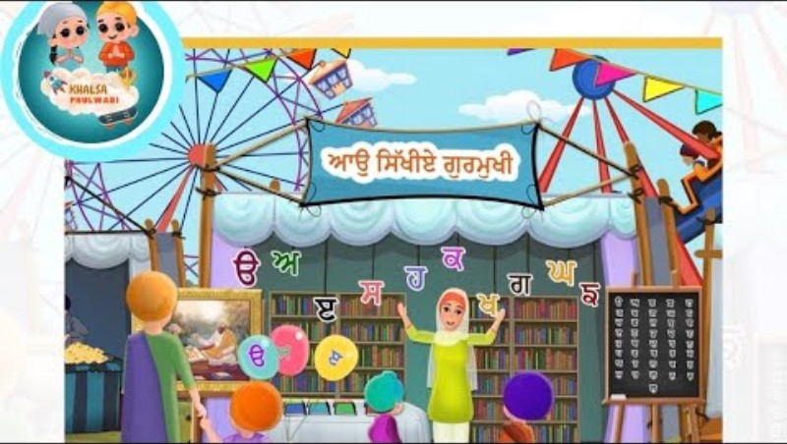
Notes:
Video link not found

Slide 7



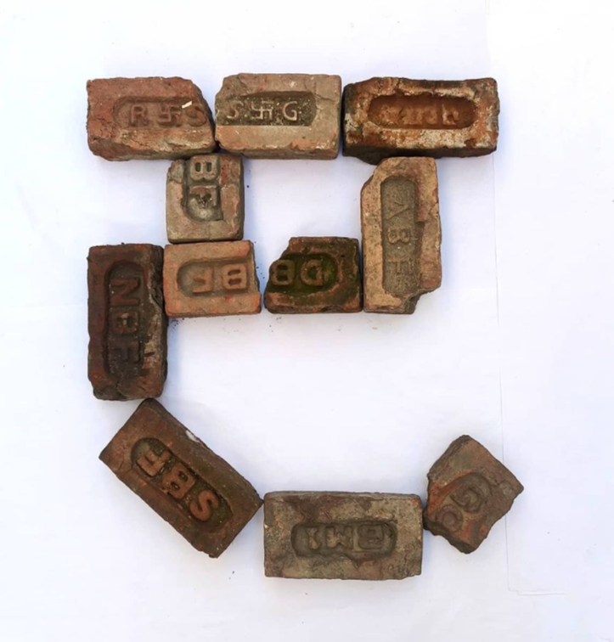



REVIEW:
(click on the correct answer)

Slide 8
Bhulavay Akhar
PaR ke dasso akhar dey naam.

Slide 9
K
g
G
|
k

Slide 10
|
k
G
g
K

Slide 11
G
k
g
|
K

Slide 12

K

Slide 13

K

Slide 14
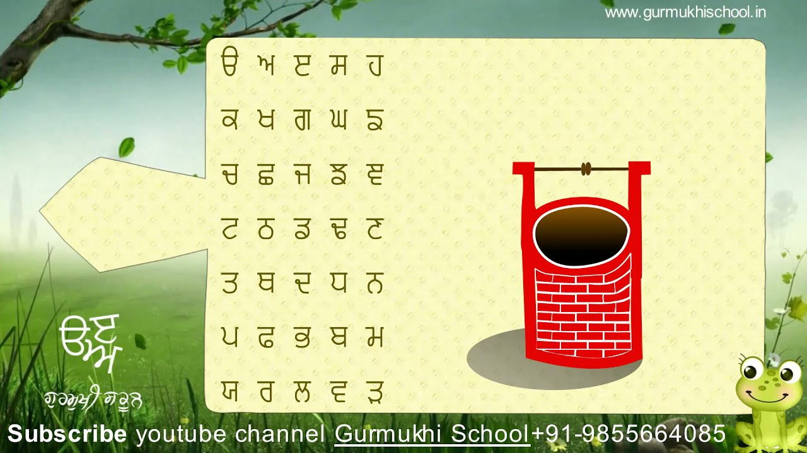

Slide 15
Labho
Which images start from khakha

Slide 16

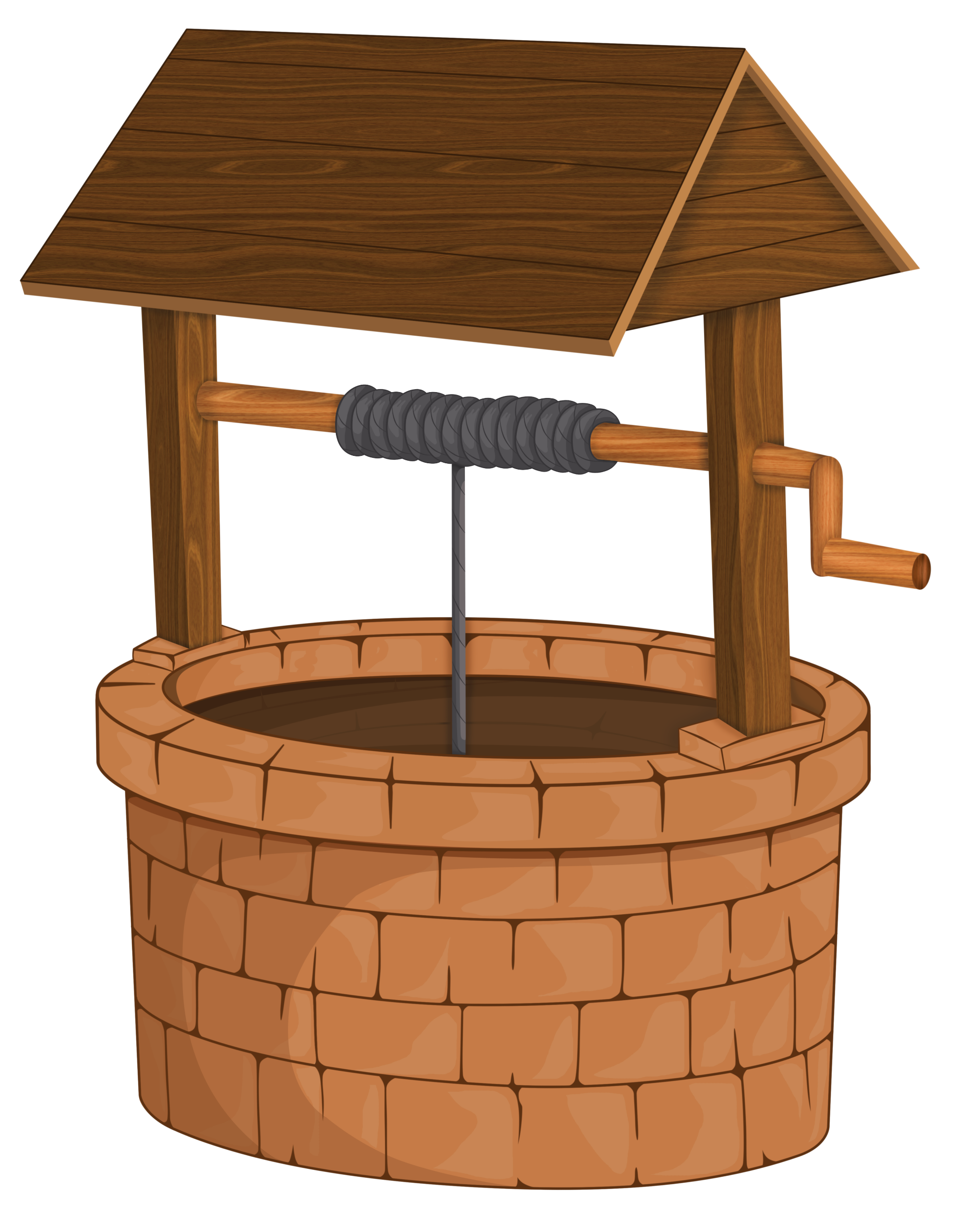
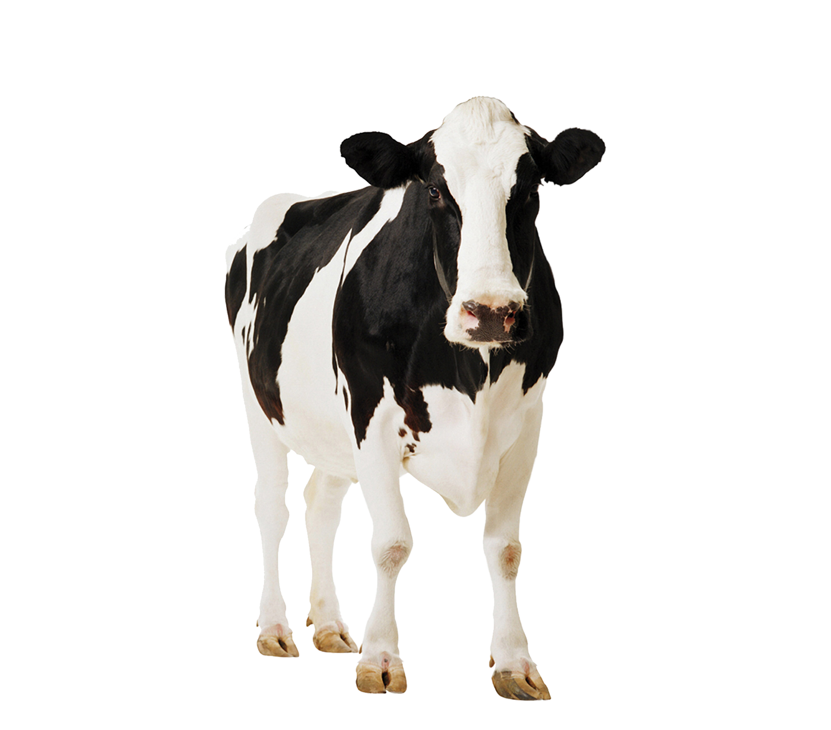
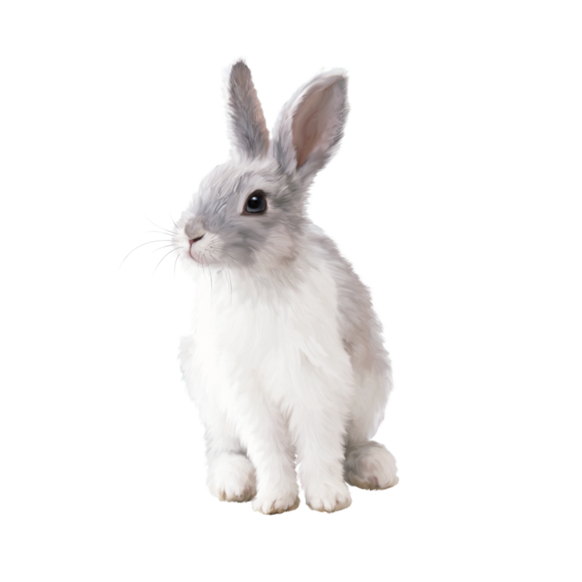

Slide 17
Sunno, Phir Pichhay Bolo
Listen, then repeat!

Slide 18
Listen and Repeat!

Slide 19
100,000

Slide 20
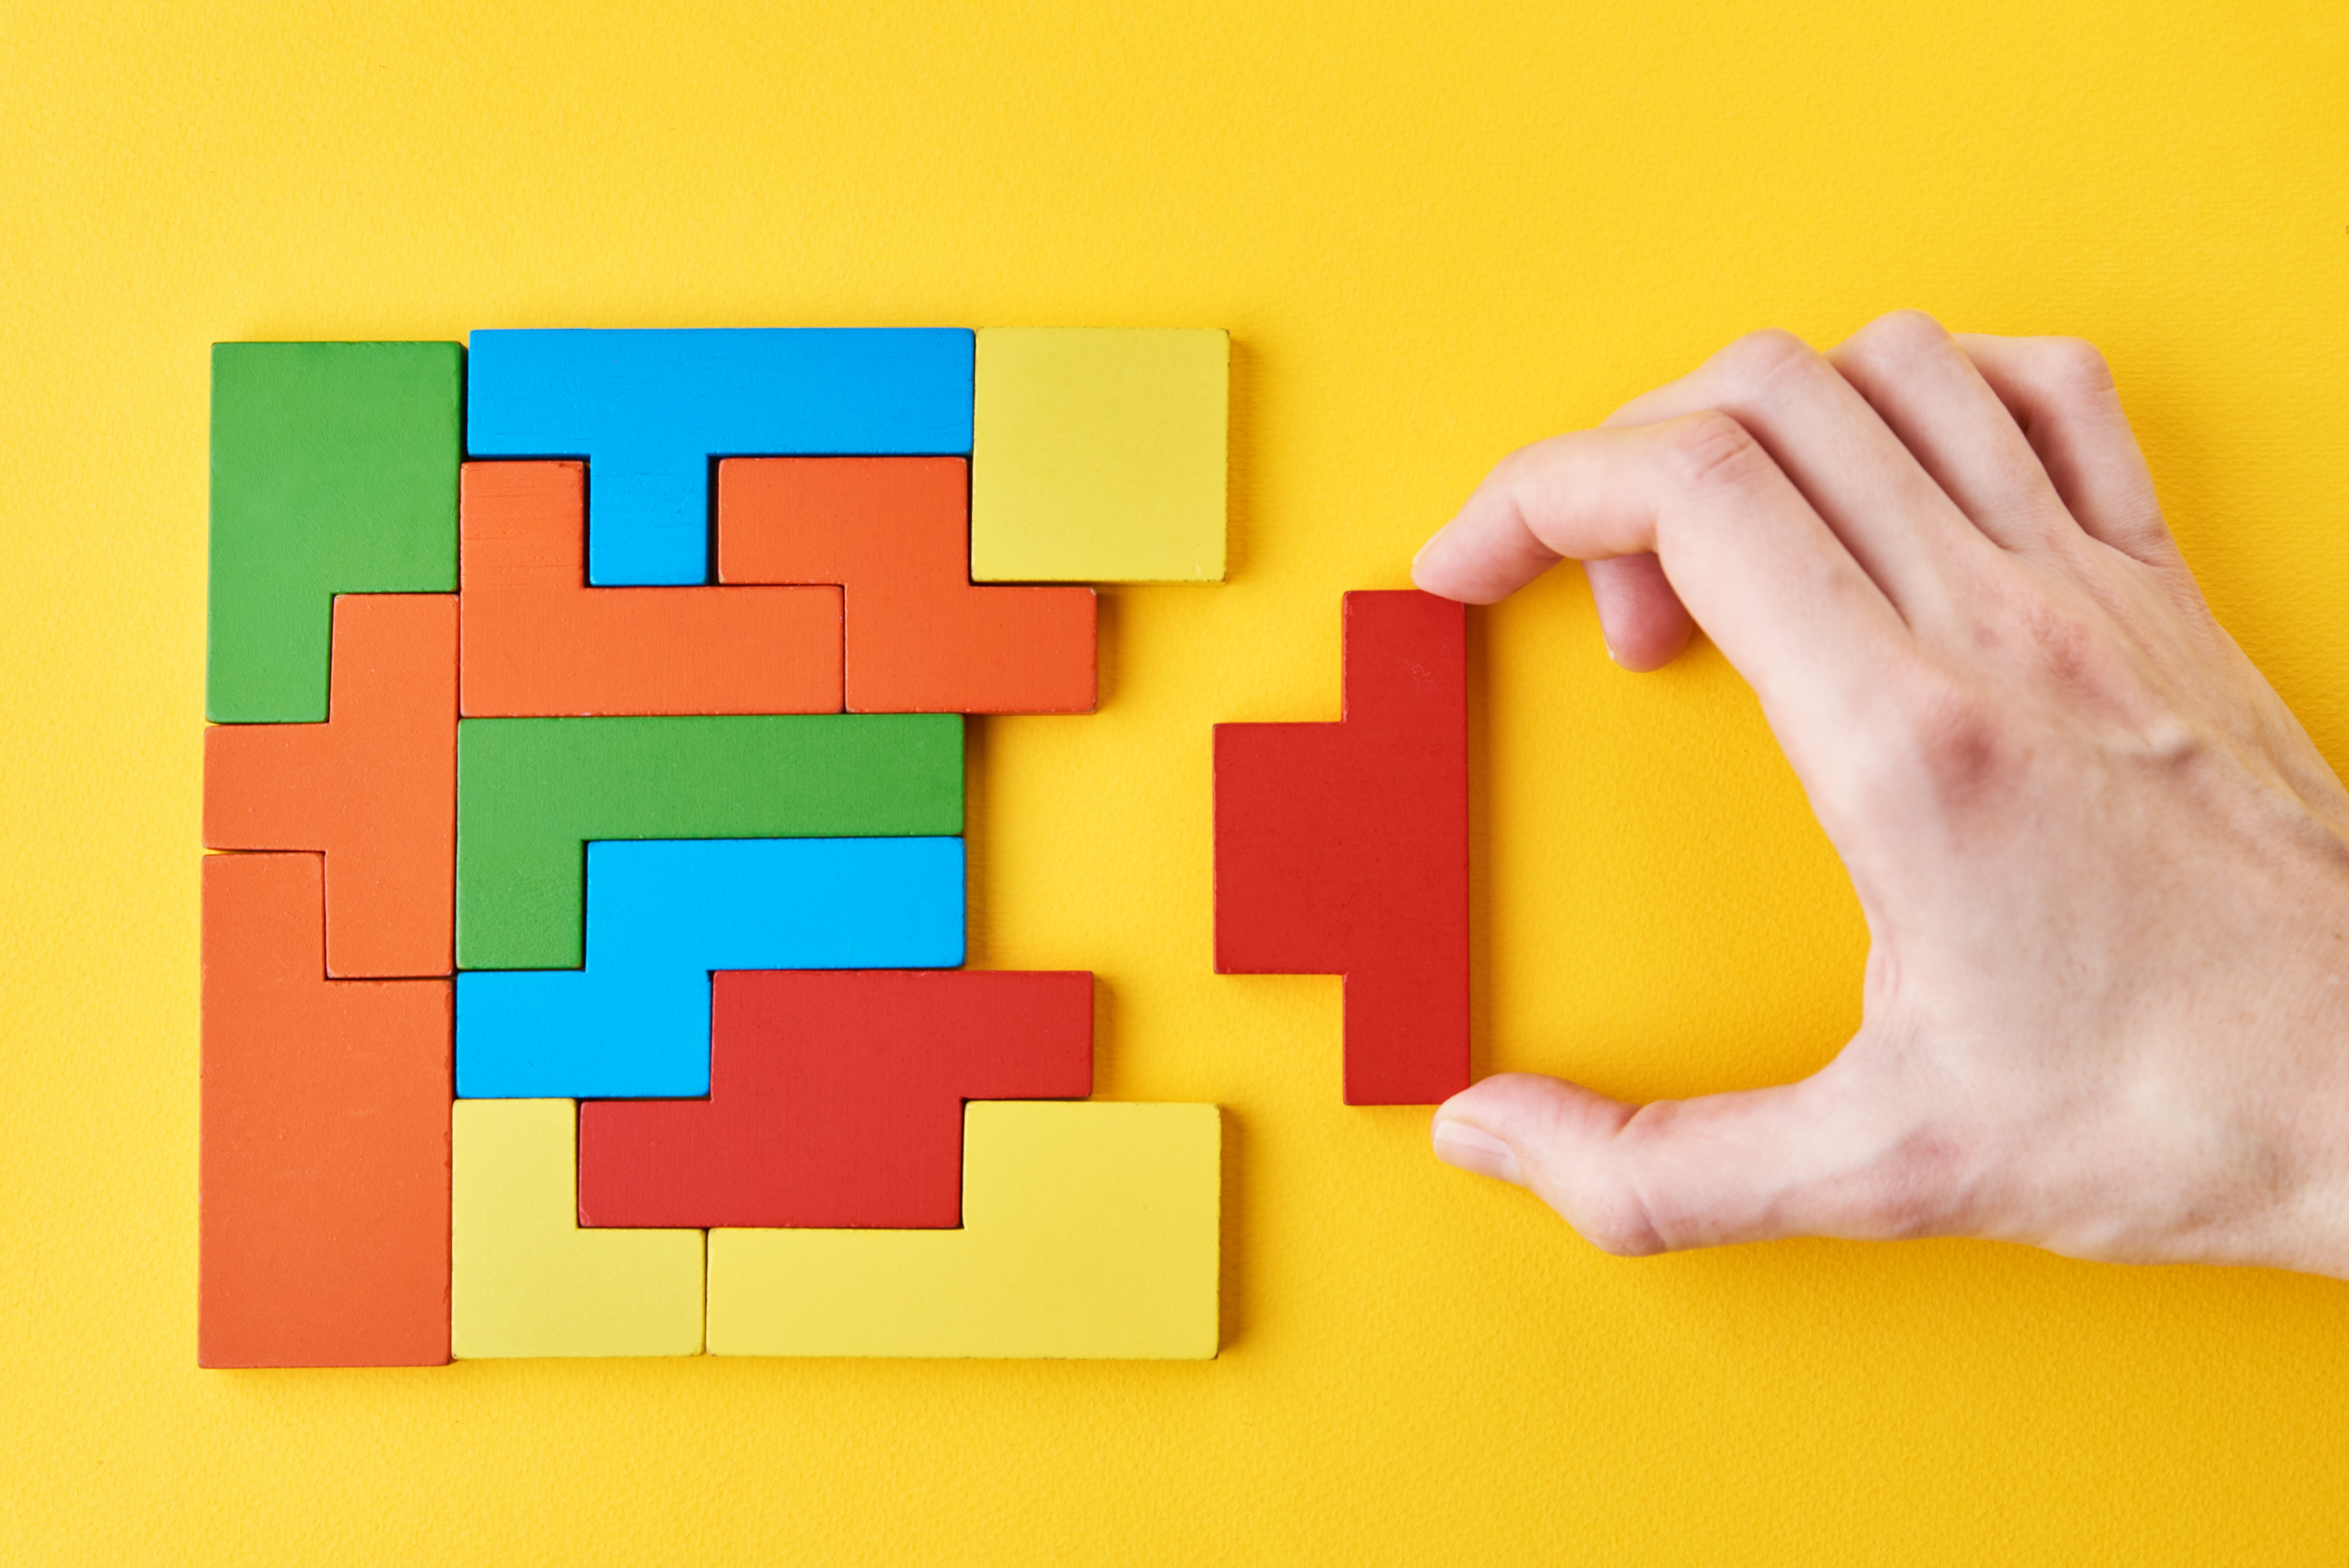

Slide 21



Slide 22
Akhar Labho

Slide 23
A
e
s
h
a
k
K
g
G
|
FIND:
1.KHAKA
BONUS:
TAINKA
MAMA
JAJJA
c
C
j
J
\
t
T
f
F
x
q
Q
d
D
n
p
P
b
B
m
X
r
l
v
V

Slide 24
FIND KHAKHA
K
e
s
h
a

Slide 25
FIND KHAKHA
K
k
G
|
k

Slide 26
FIND KHAKHA
K
j
J
\
c

Slide 27
FIND KHAKHA
T
f
K
x
t

Slide 28
FIND KHAKHA
Q
d
D
n
K

Slide 29
SHABAASH!

Slide 30
Akhar Pachhaano

Slide 31
Which one is Khakha?
K
Q

Slide 32
Which one is Khakha?
p
K

Slide 33
Which one is Khakha?
K
D

Slide 34
Bhulavay Akhar Repeat
PaD ke dasso akhar dey naam.

Slide 35
G
k
g
|
K

Slide 36
|
k
G
g
K

Slide 37
K
g
G
|
k

Slide 38
Varnmala
Naal di naal bolo!

Slide 39


Slide 40

Samapat!
Good Job Bachiyo!

