Slide 1
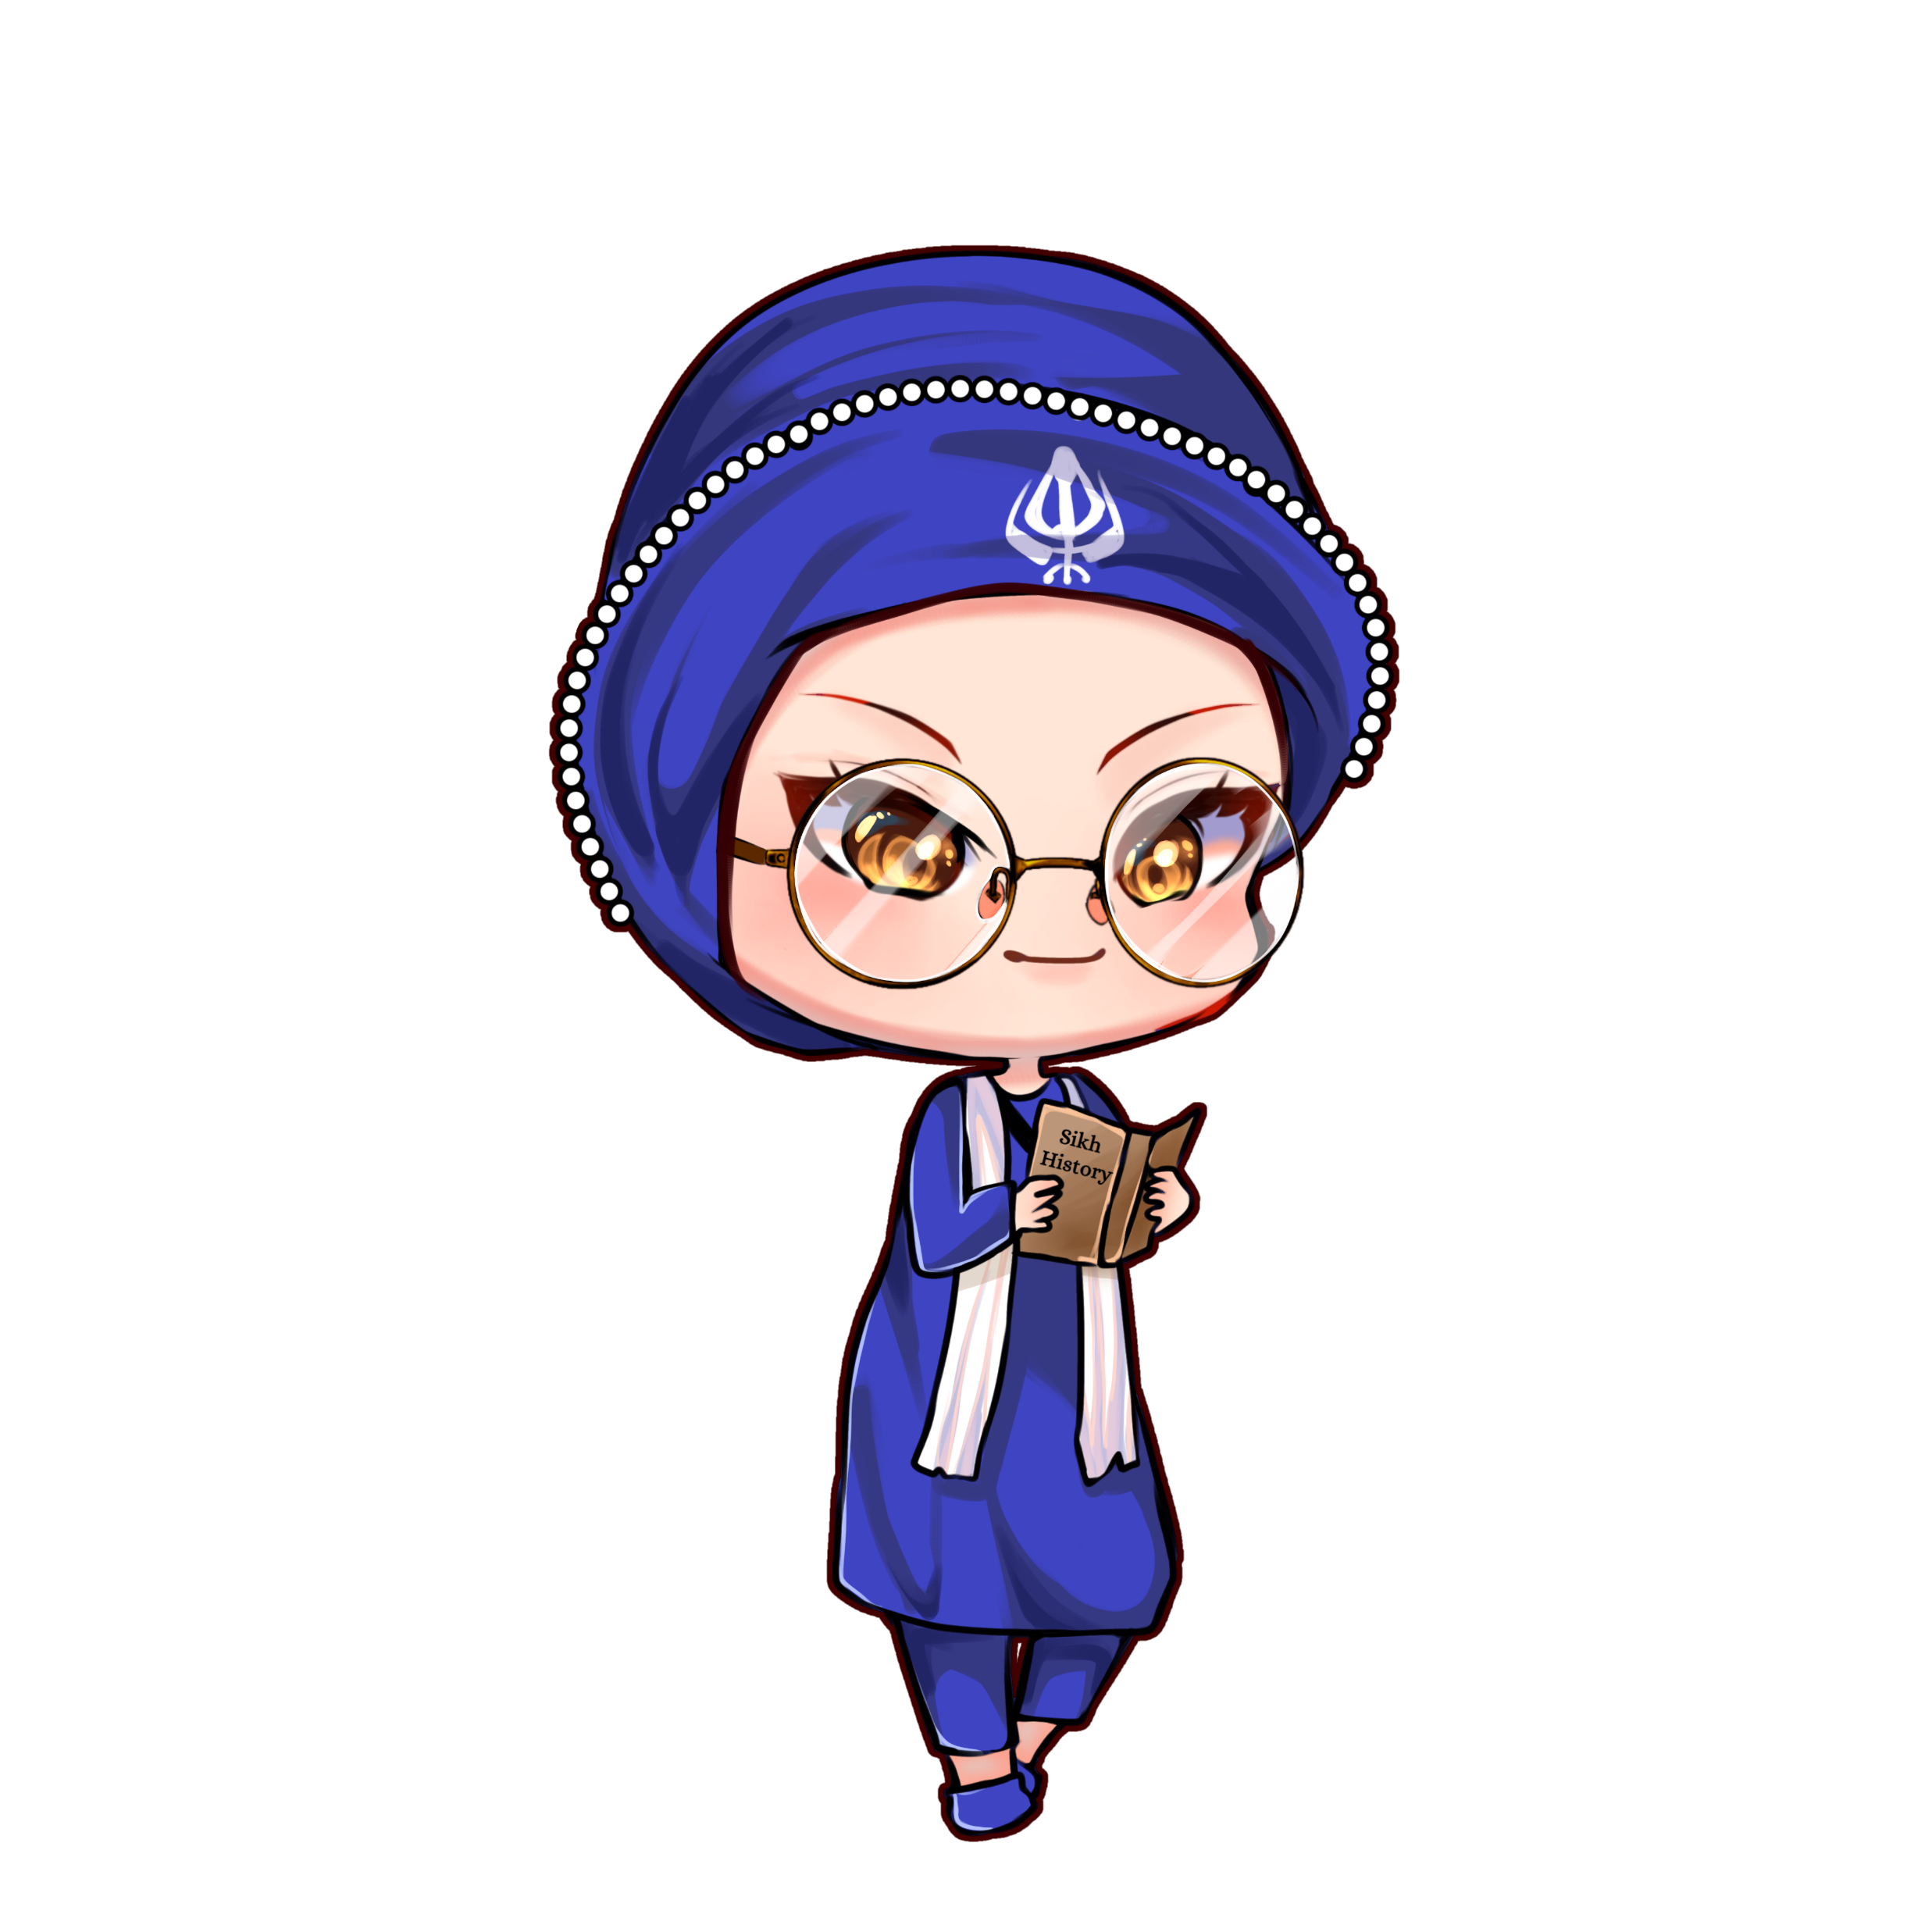

Painti Fun
LESSON: 8

Slide 2




PLEASE READ:
01
You can press “ESC” on your keypad to exit the screen.
02
You must “Enable external content for this session” in order for the embedded videos to play properly.
03
Click anywhere on the screen to move to the next slide.

Slide 3
FORMAT:
01
Varnmala Abhiyaas
06
Sunno Atey Pichhay Bolo
02
Practice Video
07
Akhar Labho (game)
03
Bhulavay Akhar
08
Akhar Pachhaano (game)
04
Letter of the Day
09
Bhulavay Akhar 2
Find the Pictures Starting with the Letter
05
10
Varnmala Final Repeat

Slide 4
Varnmala
Naal di naal bolo!

Slide 5
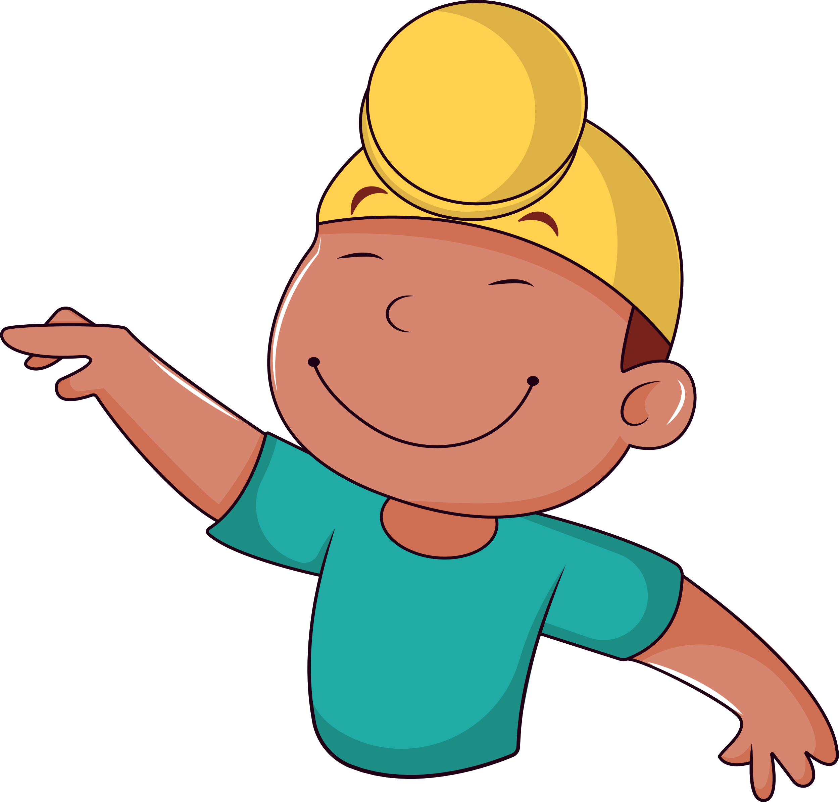

A
e
s
h
a
k
K
g
G
|
c
C
j
J
\
Complete 5 repetitions to move onto the next slide!
t
T
f
F
x
q
Q
d
D
n
p
P
b
B
m
X
r
l
v
V

Slide 6
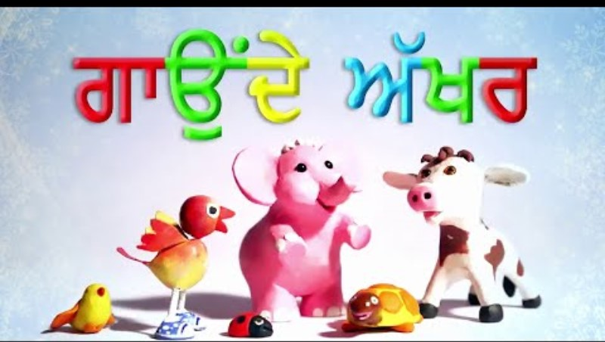

Slide 7



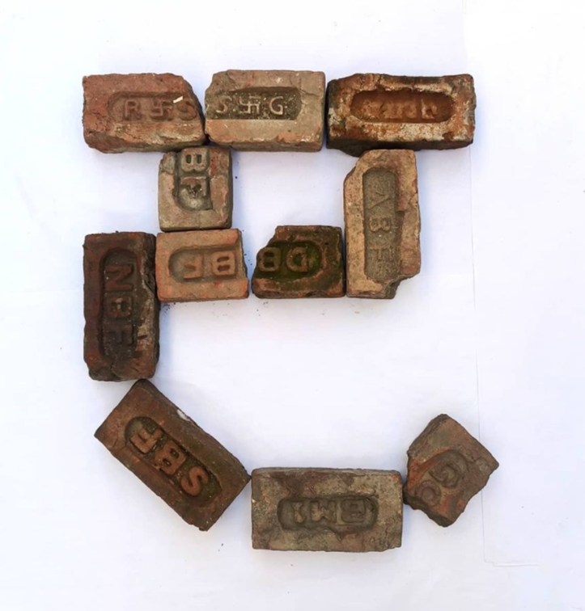




REVIEW:
(click on the correct answer)

Slide 8
Bhulavay Akhar
PaR ke dasso akhar dey naam.

Slide 9
K
g
G
|
k

Slide 10
|
k
G
g
K

Slide 11
G
k
g
|
K

Slide 12

g

Slide 13

g

Slide 14

g

Slide 15
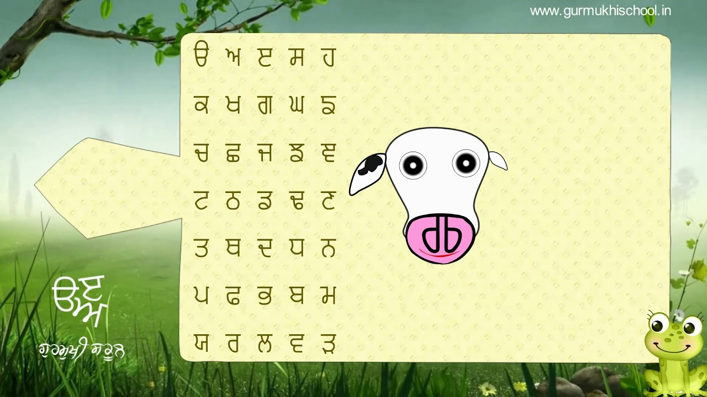

Slide 16
Labho
Find images starting from gagga.

Slide 17
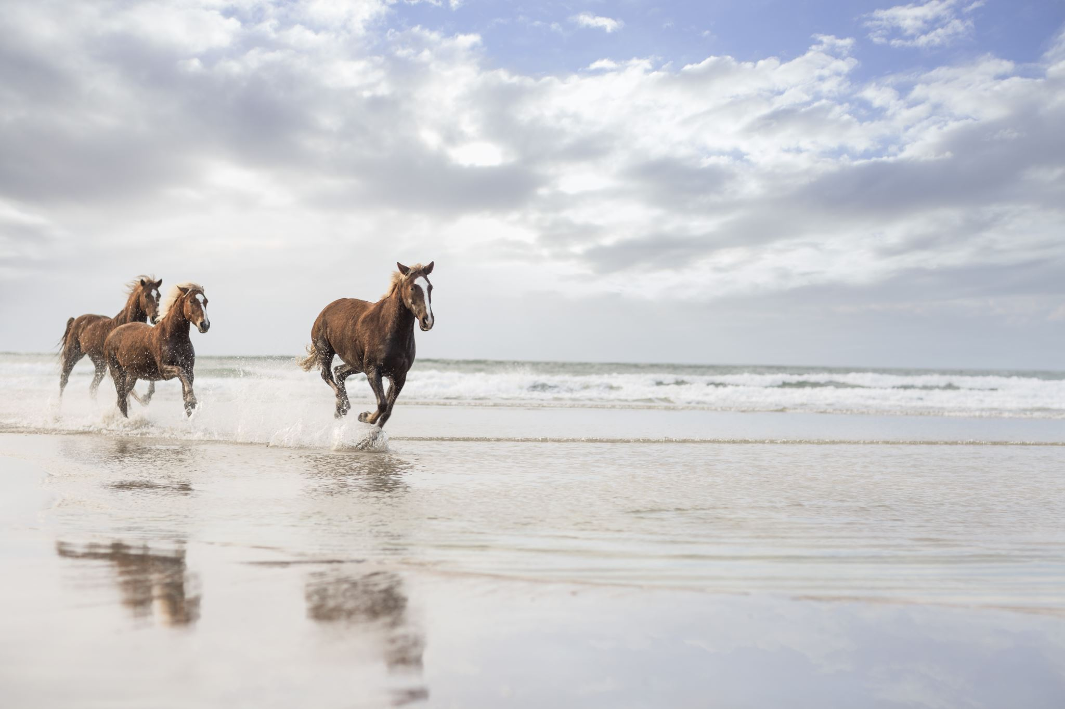
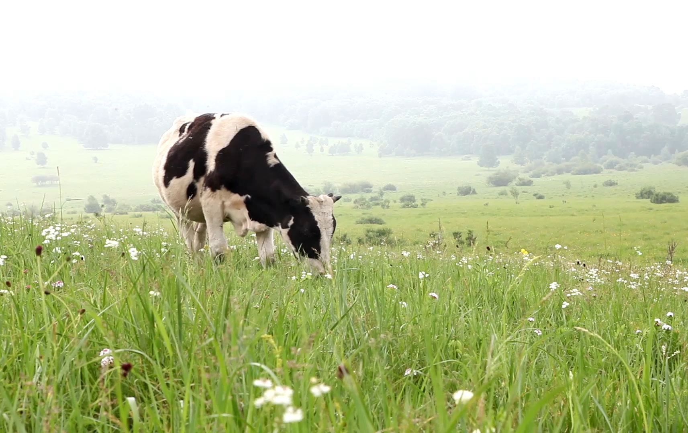
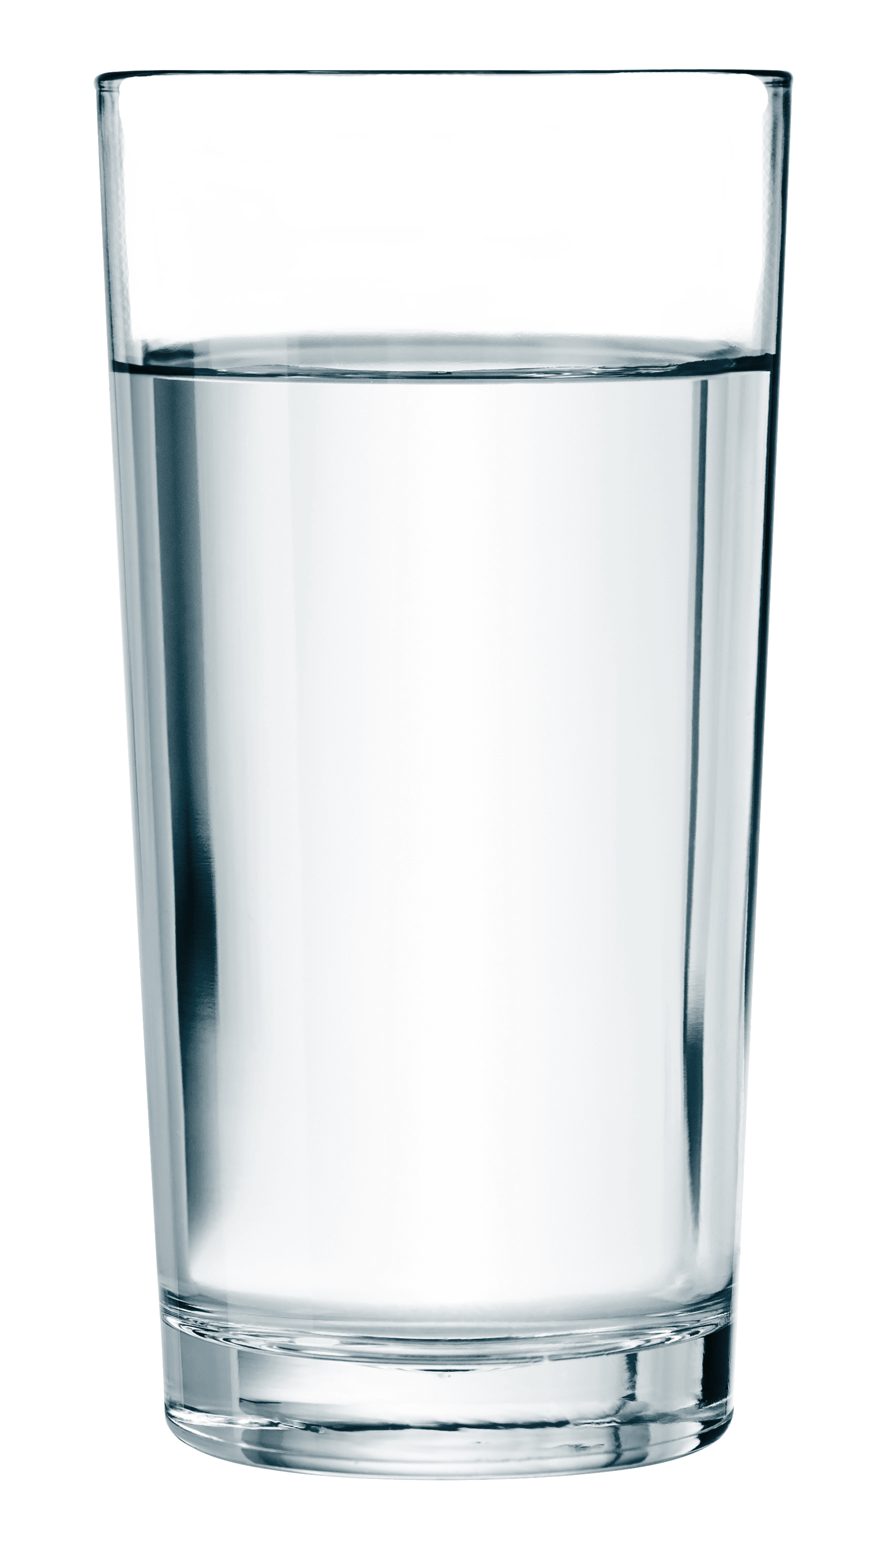



Slide 18
Sunno, Phir Pichhay Bolo
Listen, then repeat!

Slide 19
Listen and Repeat!

Slide 20
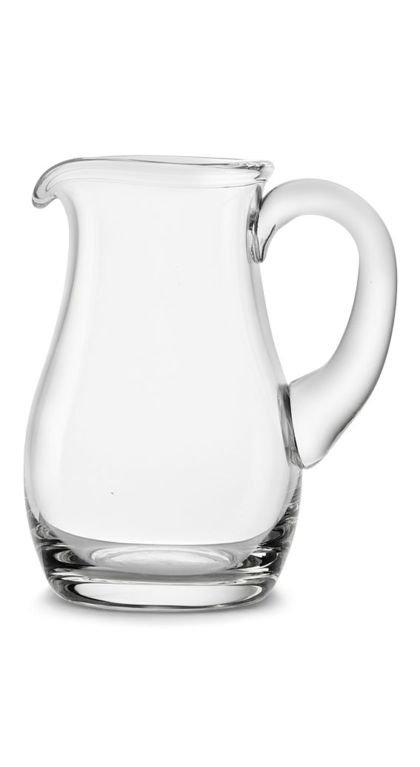

Slide 21


Slide 22
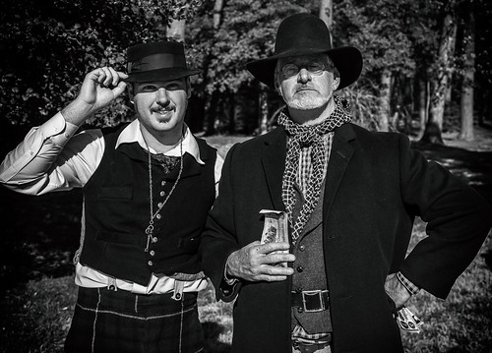

Slide 23
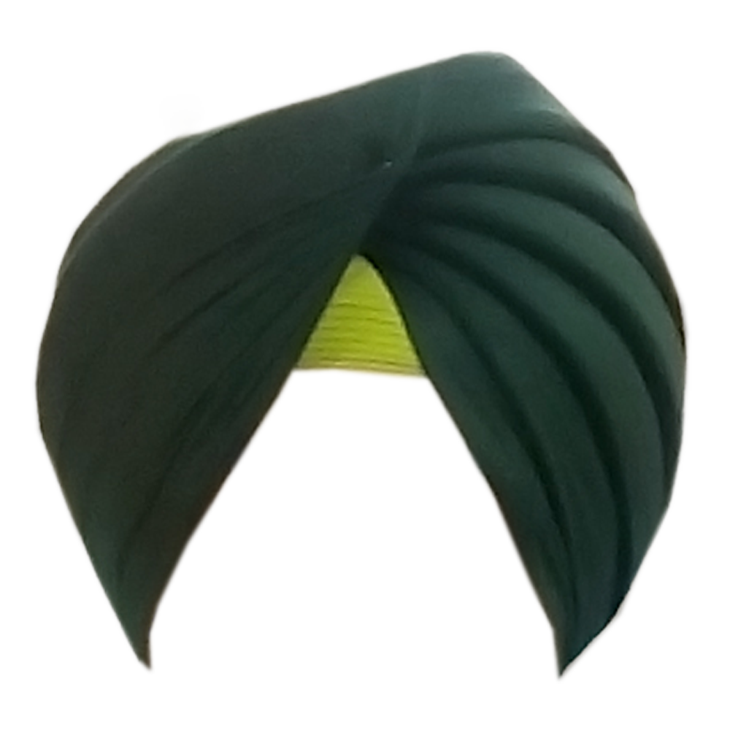

Slide 24
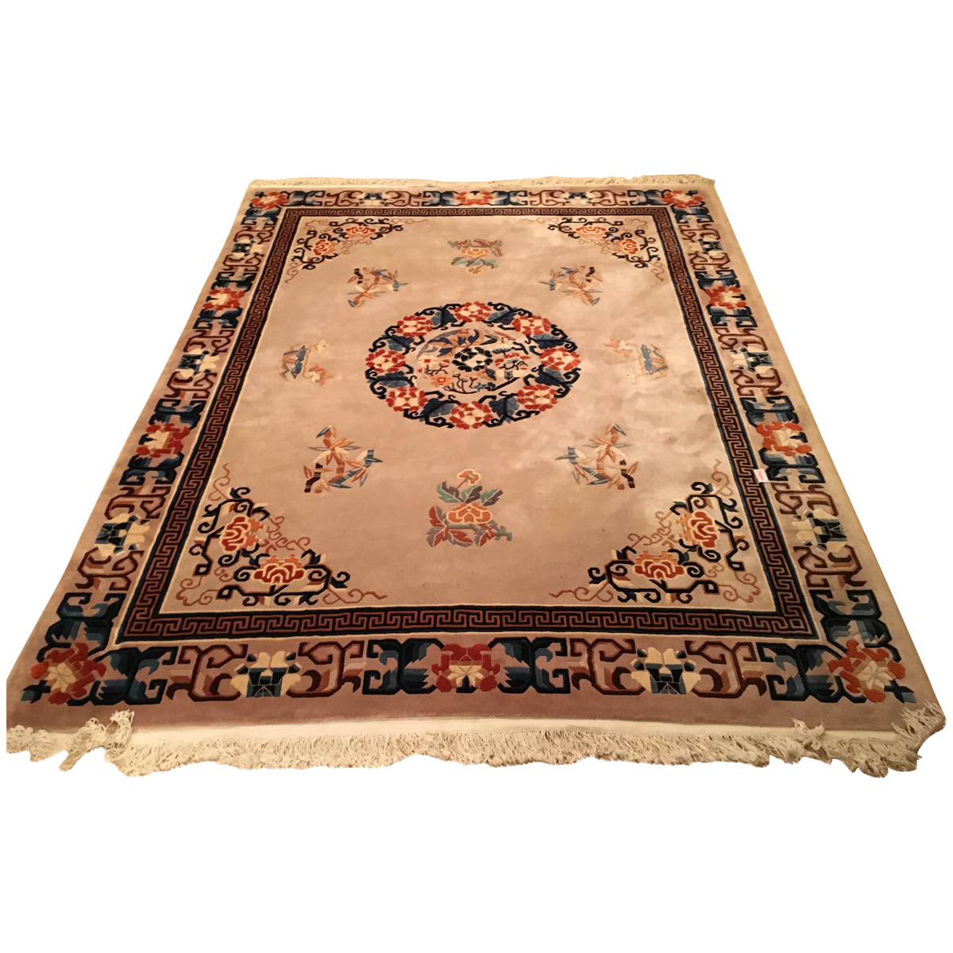

Slide 25
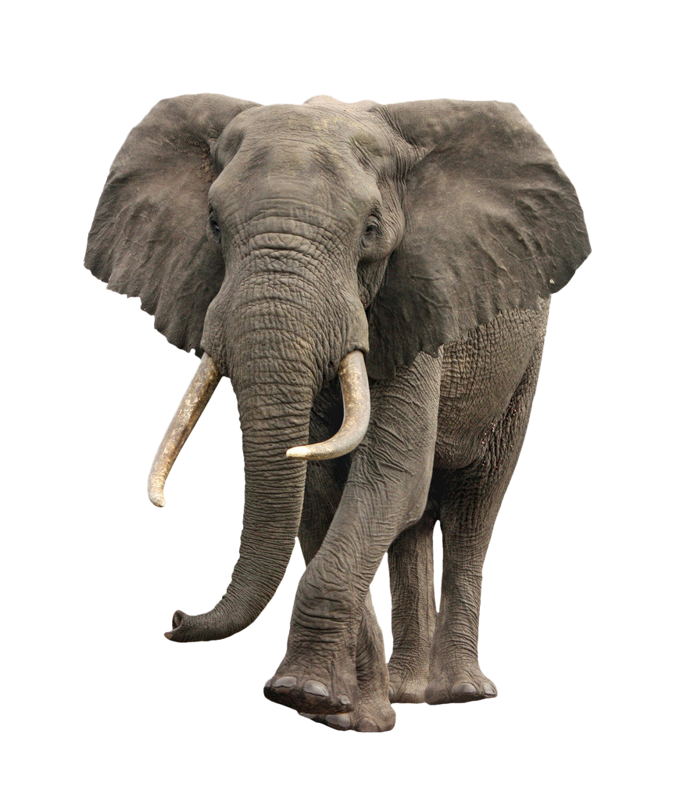

Slide 26


Slide 27
Akhar Labho

Slide 28
There are 10 gaggas hidden in this picture. Try to find them all.
(When a student points out a letter, click on it to reveal).

Slide 29
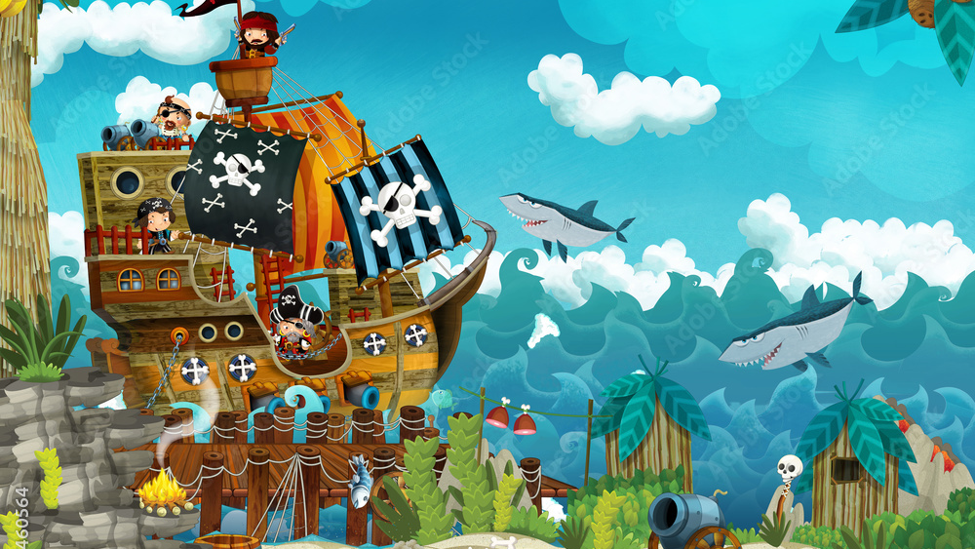




g
g
g
g
g
g
g
g
g
g
Reset

Slide 30
Akhar Pachhaano

Slide 31
A
e
s
h
a
k
K
g
G
|
FIND:
1. GAGGA
2. KAKKA
BONUS:
PAPPA
YAYA
c
C
j
J
\
t
T
f
F
x
q
Q
d
D
n
p
P
b
B
m
X
r
l
v
V

Slide 32



e
s
A
h
a
k
Ç
h
K
s
g
e
a
A
CLICK HERE

Slide 33
Bhulavay Akhar Repeat
PaD ke dasso akhar dey naam.

Slide 34
G
k
g
|
K

Slide 35
|
k
G
g
K

Slide 36
K
g
G
|
k

Slide 37
Varnmala
Naal di naal bolo!

Slide 38


Slide 39

Samapat!
Good Job Bachiyo!

