Slide 1
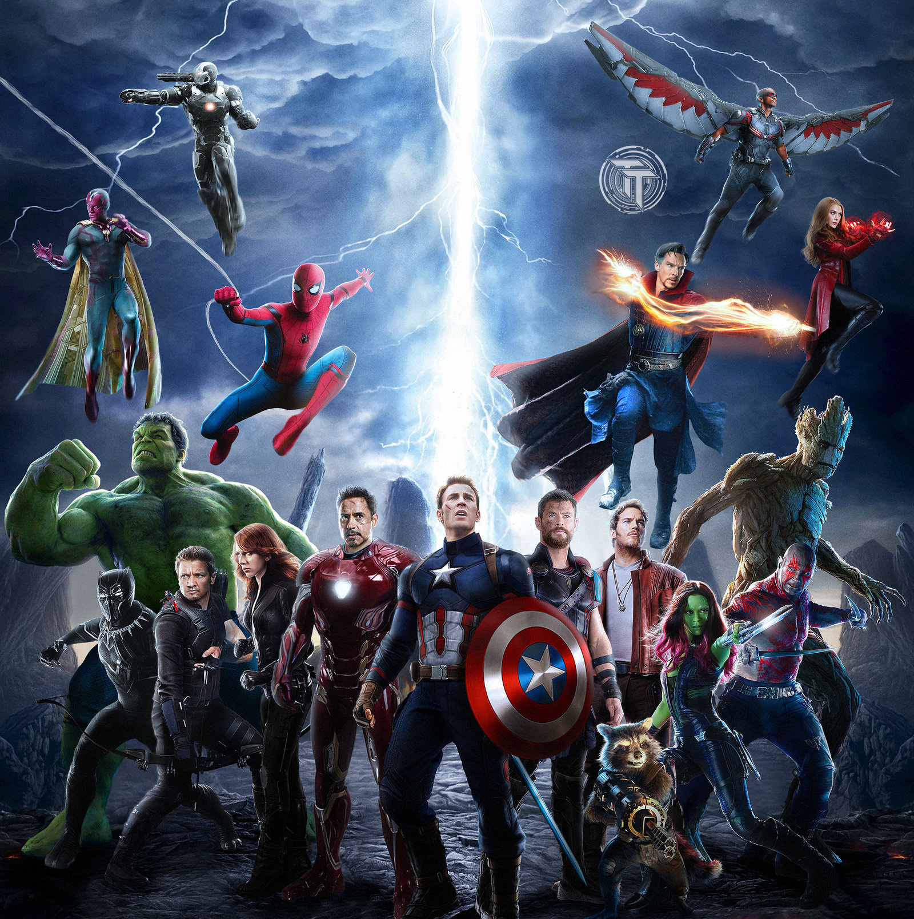

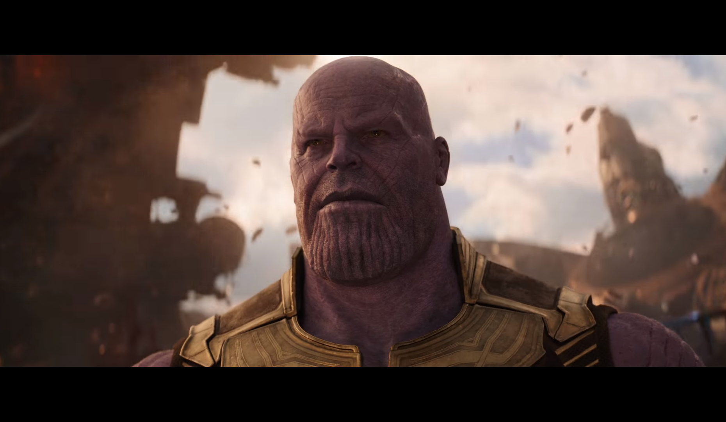

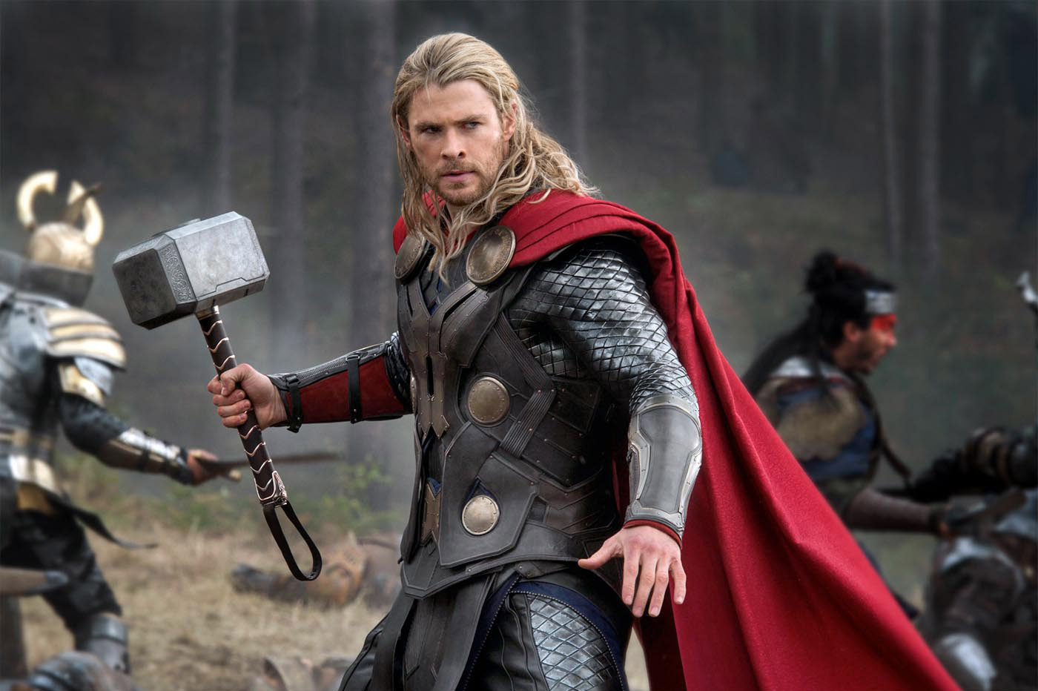
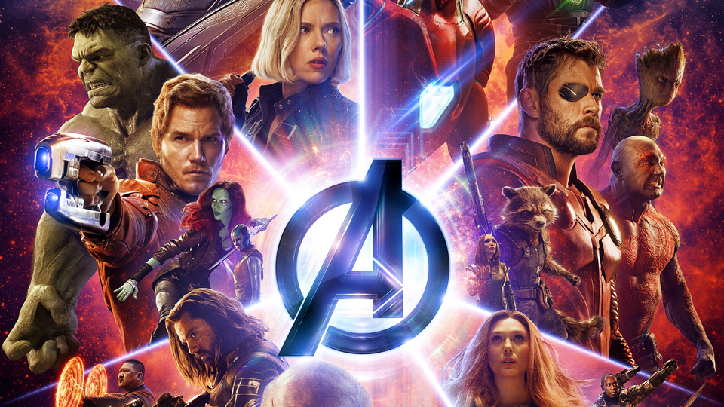
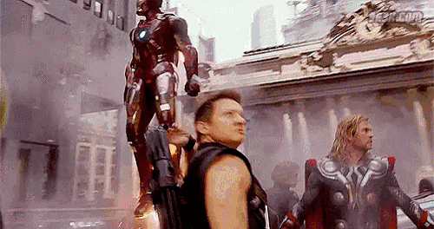
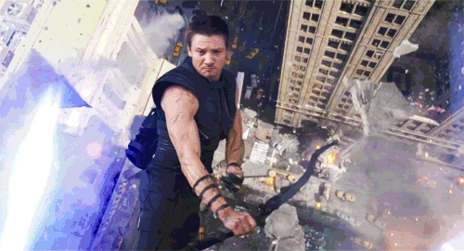
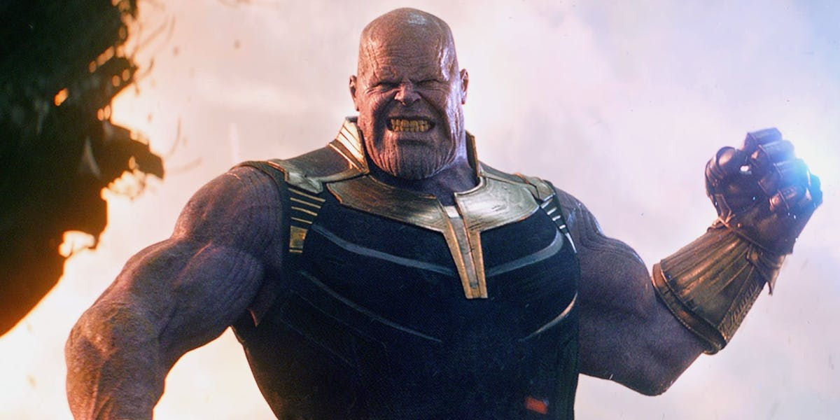
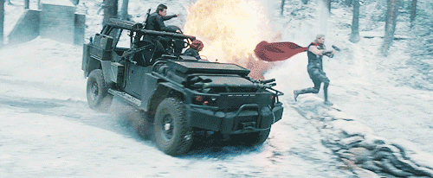

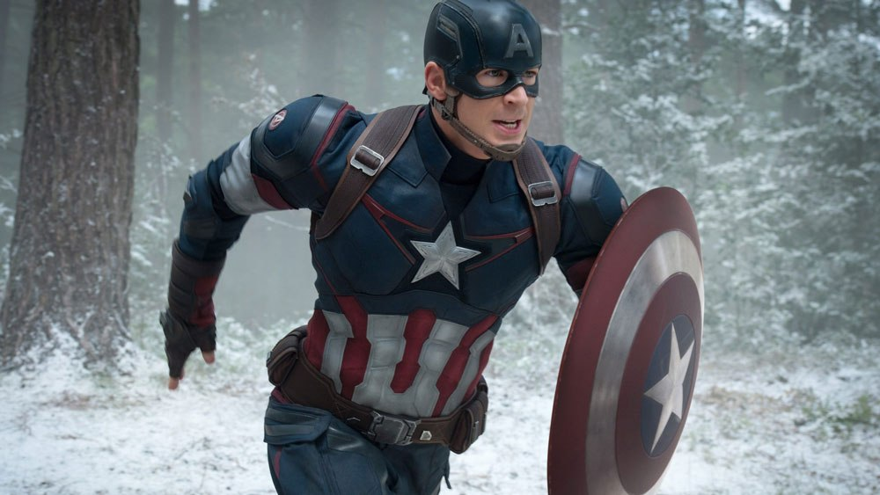
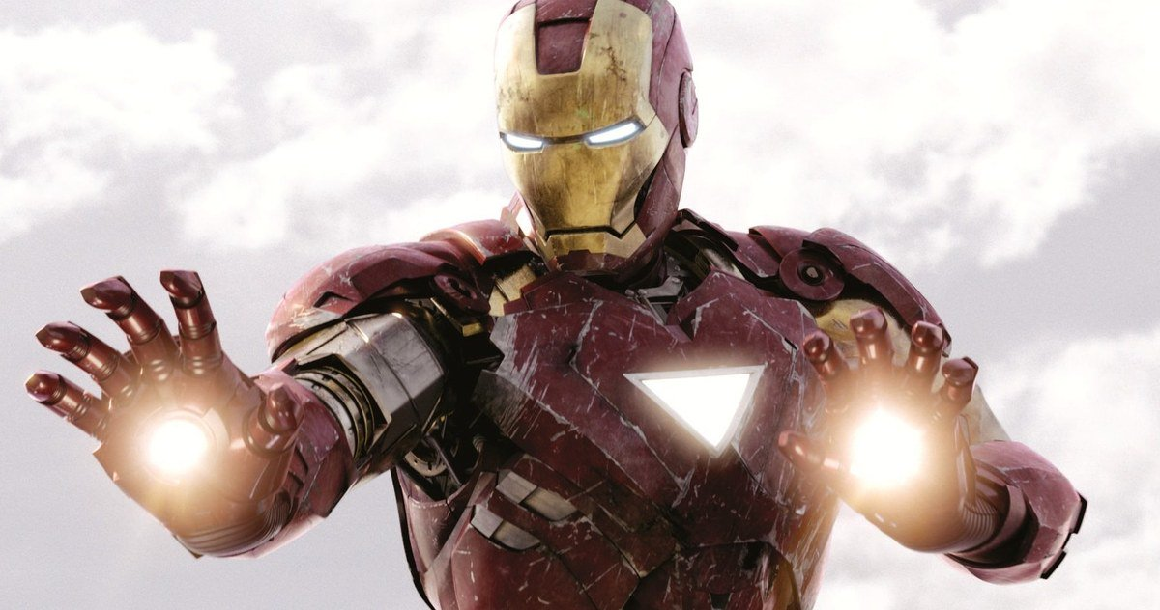
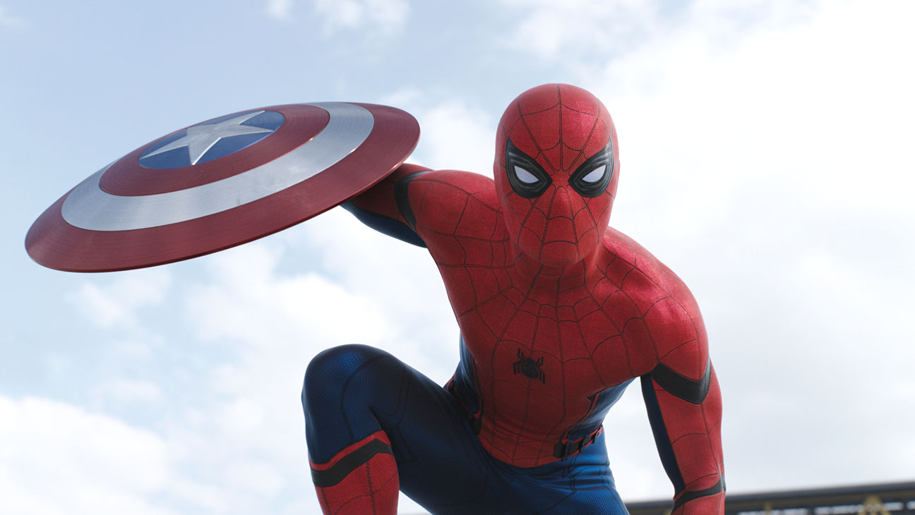
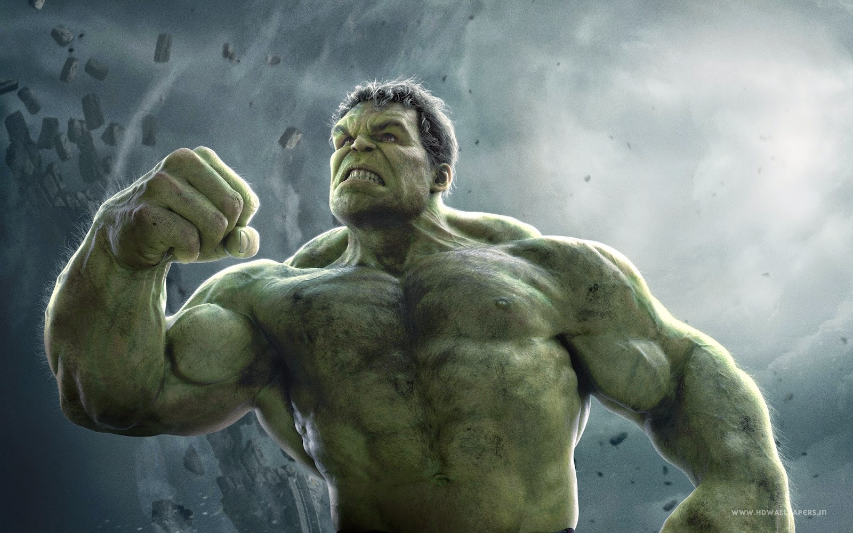

English game
Play Game!
By Alex Harvey

Slide 2
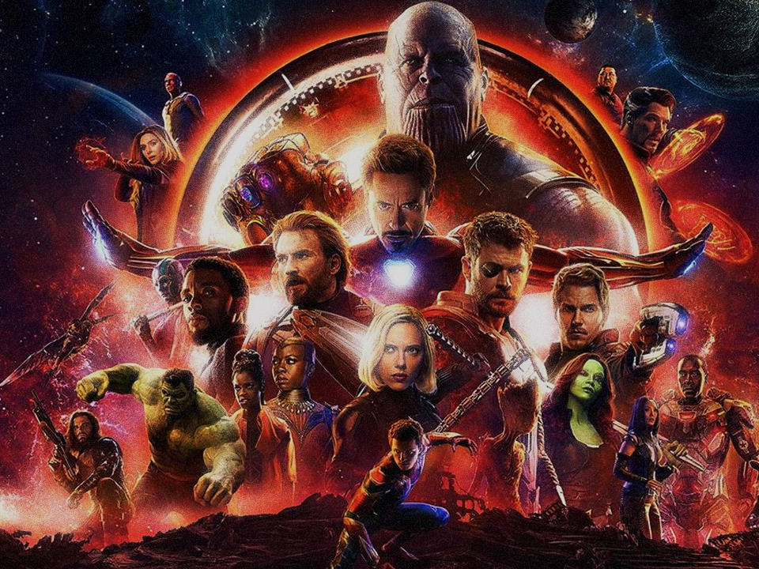
A
B
C
D
E
F
G
H
I
J
K
L
M
N
O
P
Q
R
S
T
U
V
W
X
Y

Slide 3



pg
Feet

Slide 4



1 POINT!

Slide 5
gj
Elephant

Slide 6

2 POINTS!

Slide 7
Kg
Bird

Slide 8
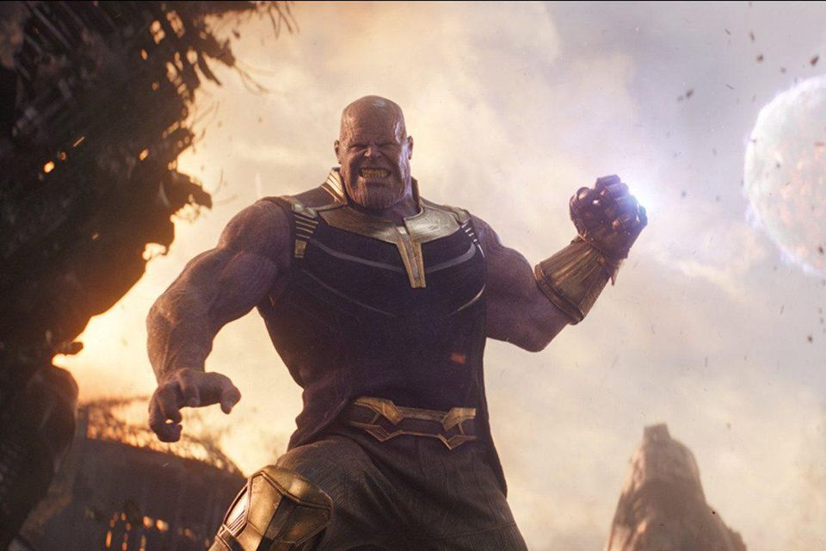
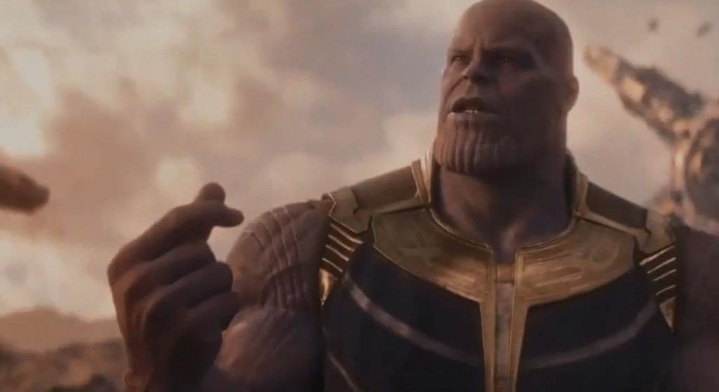
THERE MUST BE BALANCE
CHOOSE A NUMBER
1
2

Slide 9
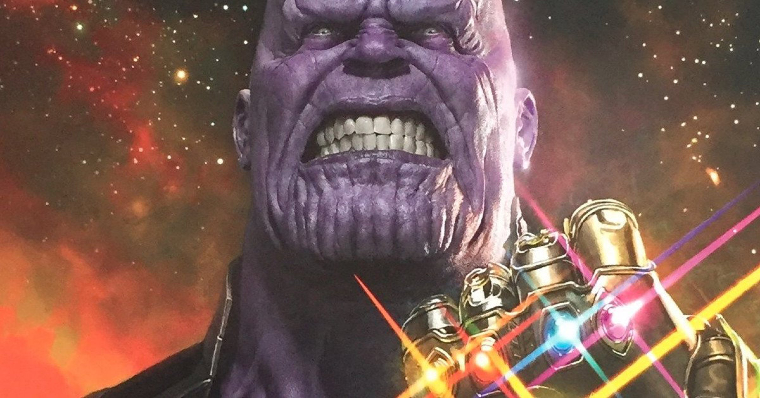
ALL TEAMS
LOSE 1/2 POINTS

Slide 10
TOP TWO TEAMS
LOSE ALL POINTS

Slide 11
kC
Turtle

Slide 12
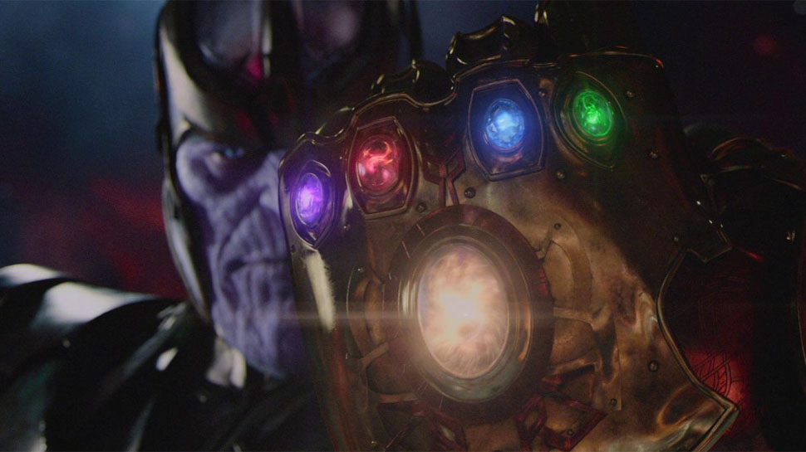
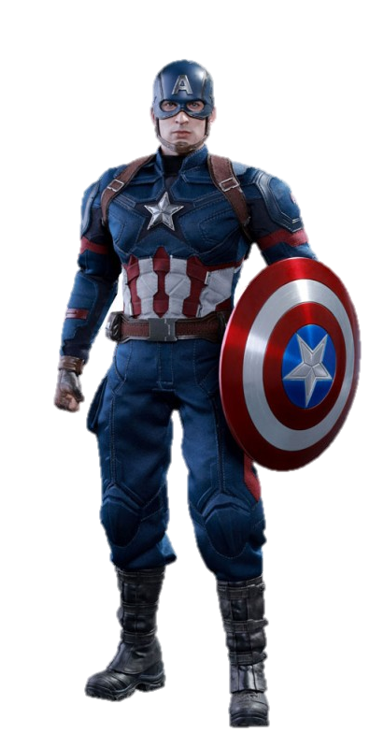
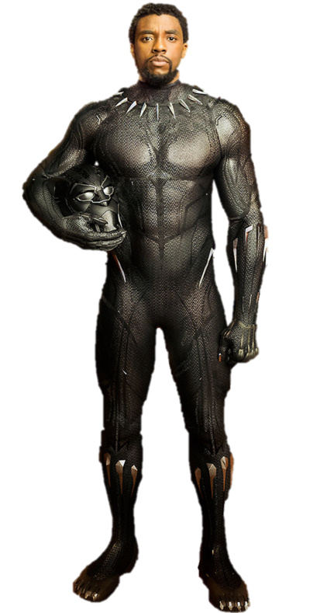
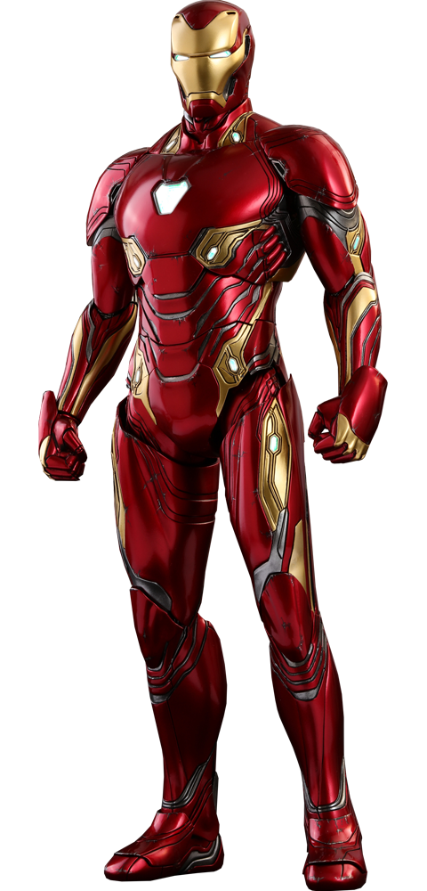
You have to fight Thanos!
Choose a hero…

Slide 13
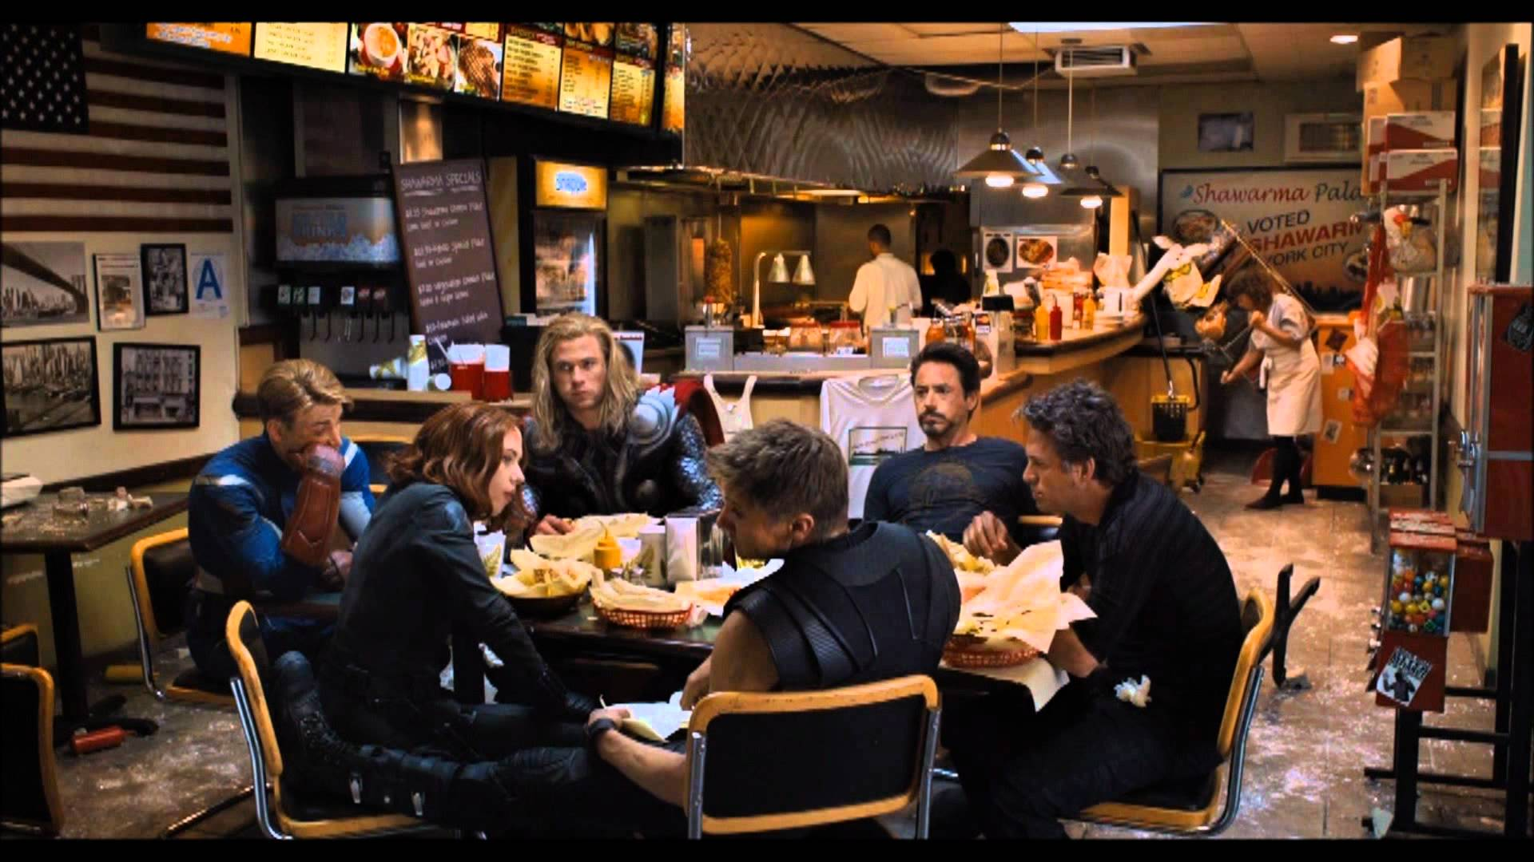
WENT TO EAT INSTEAD!
9 POINTS!

Slide 14
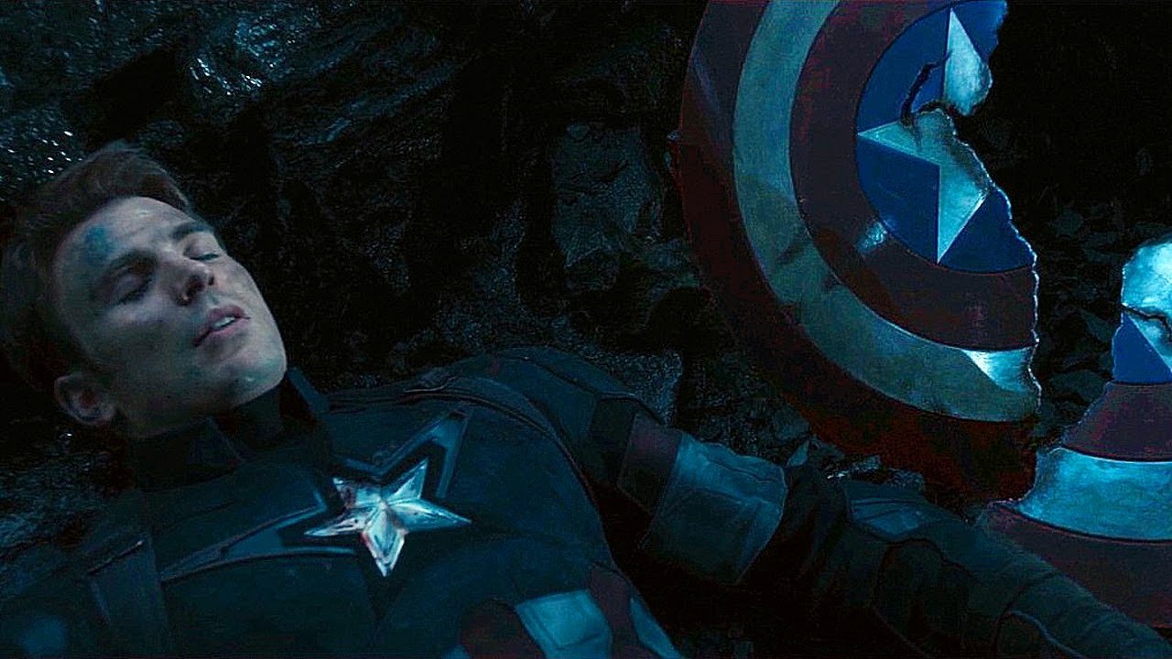
YOU LOST!
LOSE ½ YOUR POINTS!

Slide 15
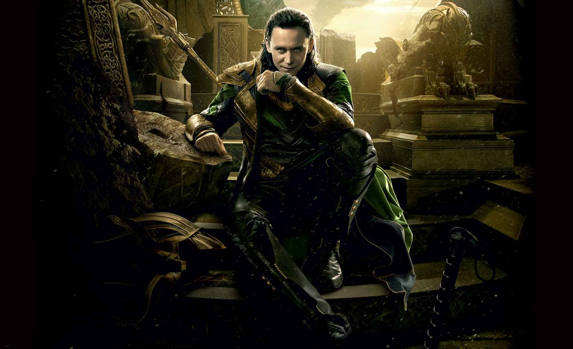
LOKI TRICKED YOU!
CHANGE POINTS!

Slide 16
jl
Water

Slide 17

5 POINTS!

Slide 18
Kr
Donkey

Slide 19
6 POINTS!

Slide 20
kp
Monkey

Slide 21
2 POINTS!

Slide 22
mC
Fish

Slide 23
4 POINTS!

Slide 24
hX
Horse

Slide 25
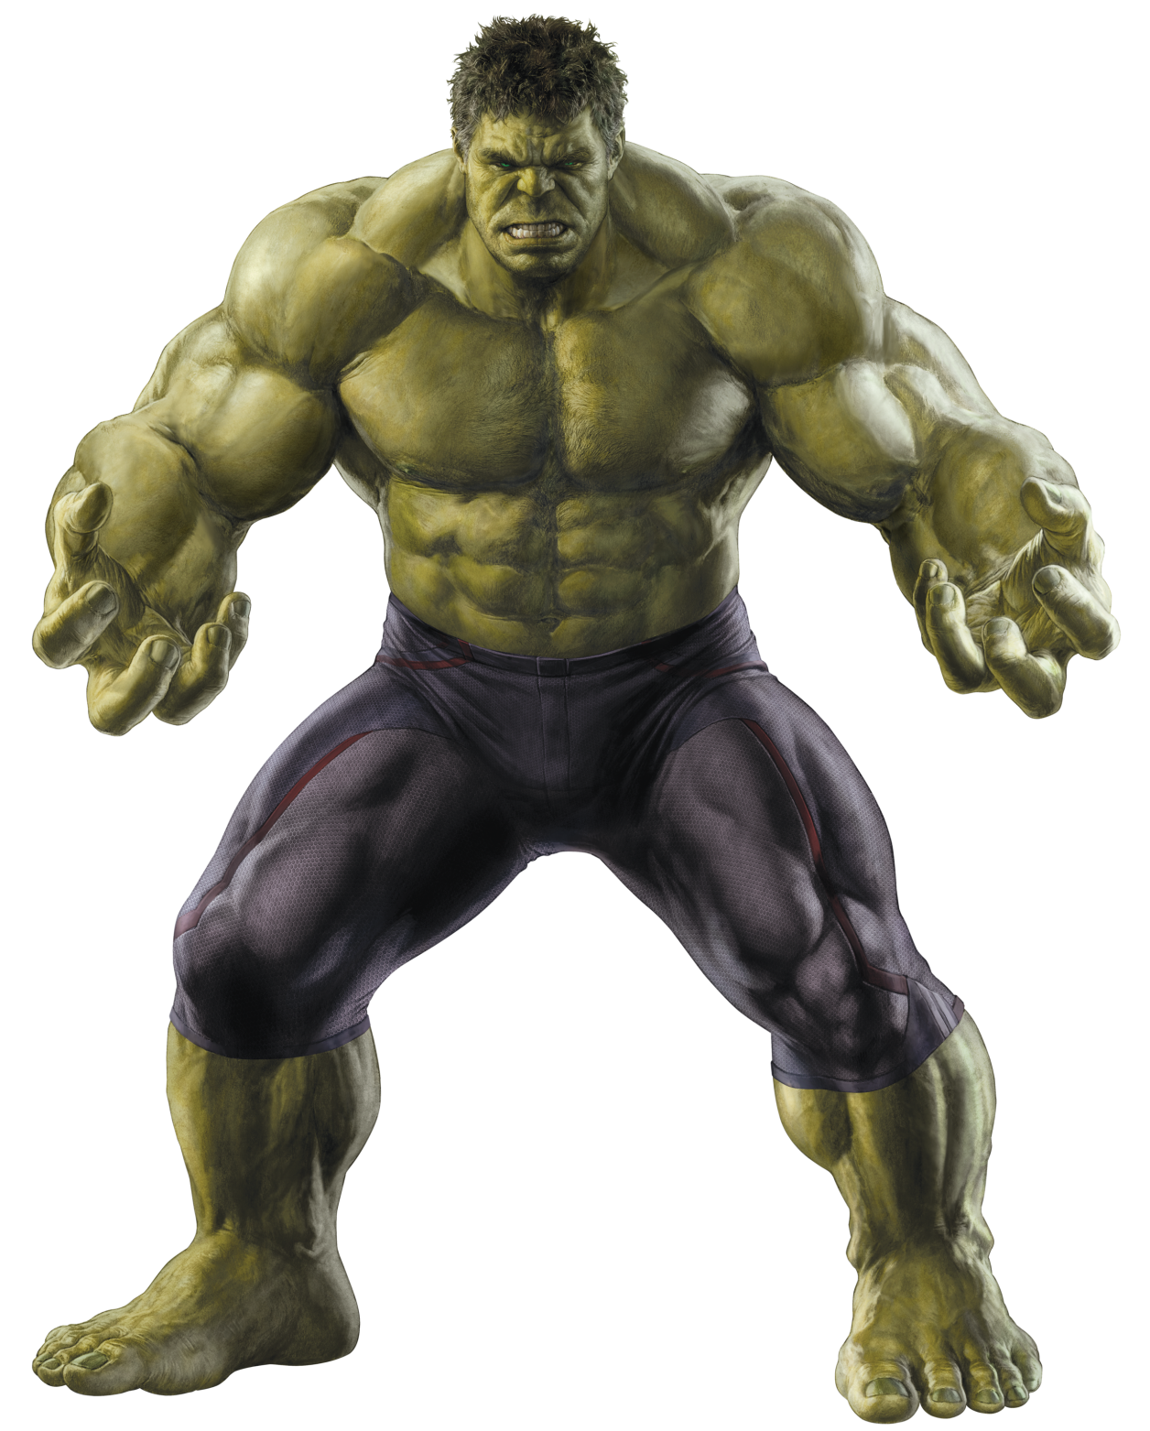
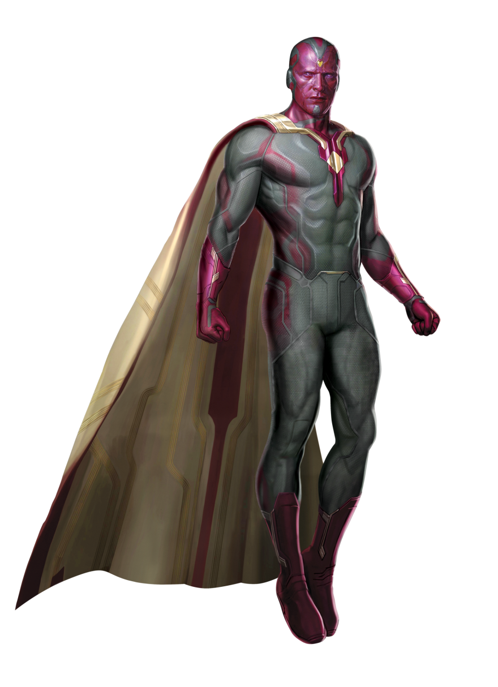
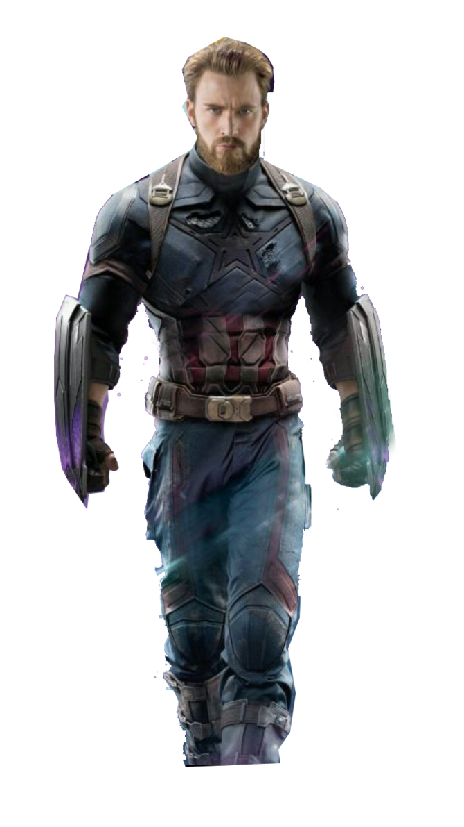
You have to fight Thanos!
Choose a hero…

Slide 26
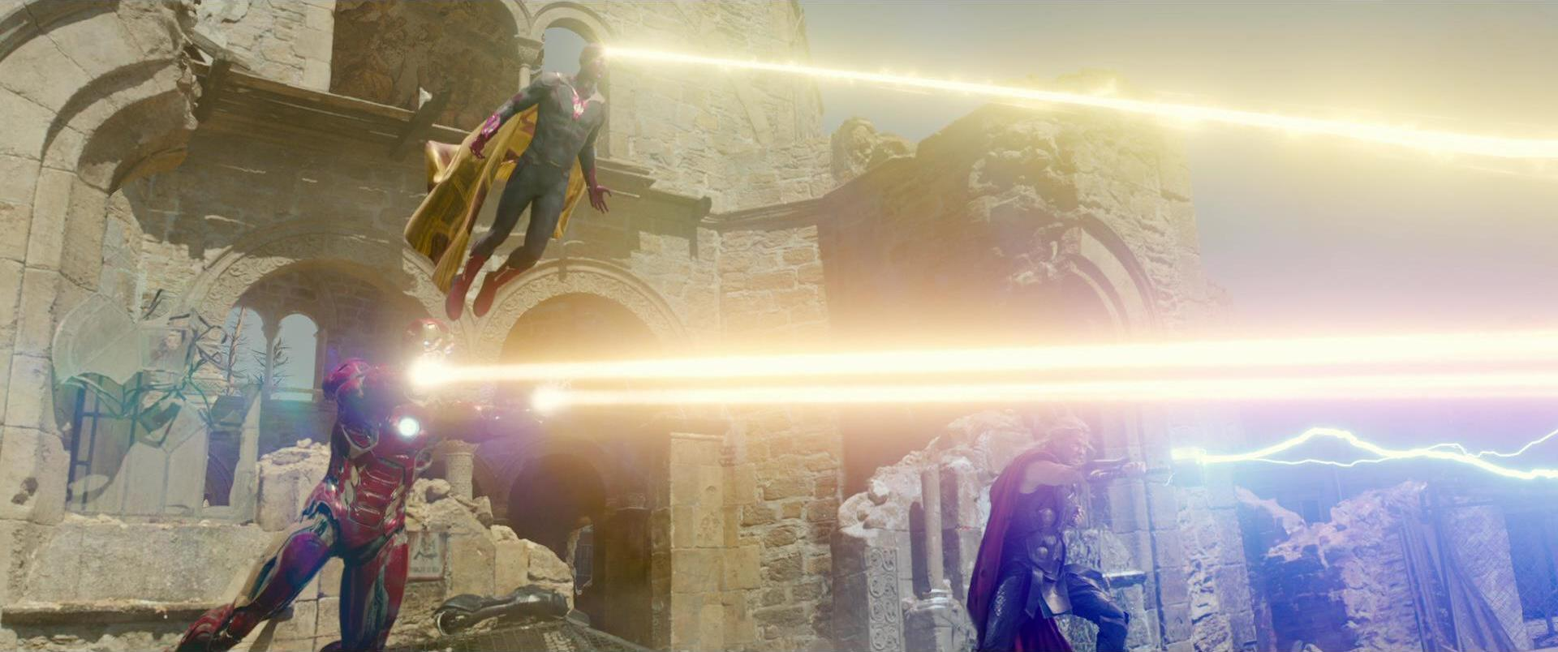
WORKED WITH YOUR FRIENDS!
ALL TEAMS +3 POINTS!

Slide 27
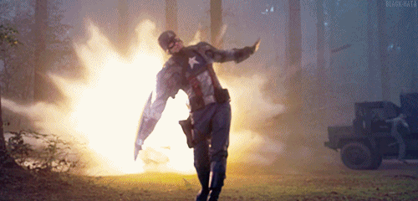
THREW YOUR SHIELD!
7 POINTS!

Slide 28
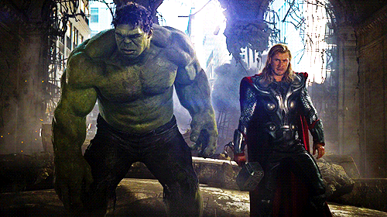
YOU PUNCHED THOR!
-5 TO ANOTHER TEAM!

Slide 29
sg
Dog

Slide 30
5 POINTS!

Slide 31
mg
Path

Slide 32
1 POINT!

Slide 33
kr
Hands

Slide 34
5 POINTS!

Slide 35
Al
Bumblebee

Slide 36
2 POINTS!

Slide 37
dr
Door

Slide 38
You have to fight Thanos!
Choose a hero…

Slide 39
jV
Root

Slide 40
4 POINTS!

Slide 41
ms
Ink

Slide 42
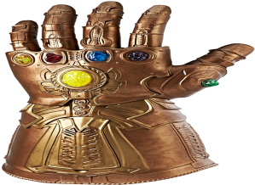
12 POINTS!

Slide 43
Kr
Donkey

Slide 44
5 POINTS!

Slide 45
kC
Tortoise

Slide 46
4 POINTS!

Slide 47
jl
Water

Slide 48
2 POINTS!

Slide 49
kp
Monkey

Slide 50
4 POINTS!

Slide 51
hX
Horse

Slide 52
5 POINTS!

Slide 53
sg
Dog

Slide 54
You have to fight Thanos!
Choose a hero…

Slide 55
WENT TO EAT INSTEAD!
9 POINTS!

Slide 56
THANOS WINS!
LOSE ½ YOUR POINTS!

Slide 57
LOKI TRICKED YOU!
CHANGE POINTS!

Slide 58
Bonus
Win

Slide 59
4 POINTS!

Slide 60
mg
Path

Slide 61
3 POINTS!

Slide 62
ms
Ink

Slide 63
5 POINTS!

