Slide 1
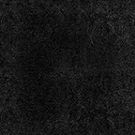


muK

Slide 2
rUp

Slide 3
srUp

Slide 4
mUrq

Slide 5
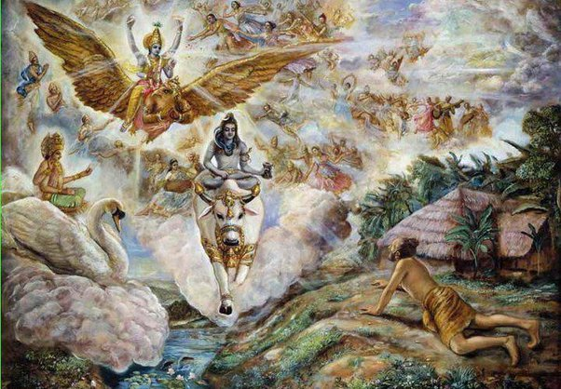
sur

Slide 6
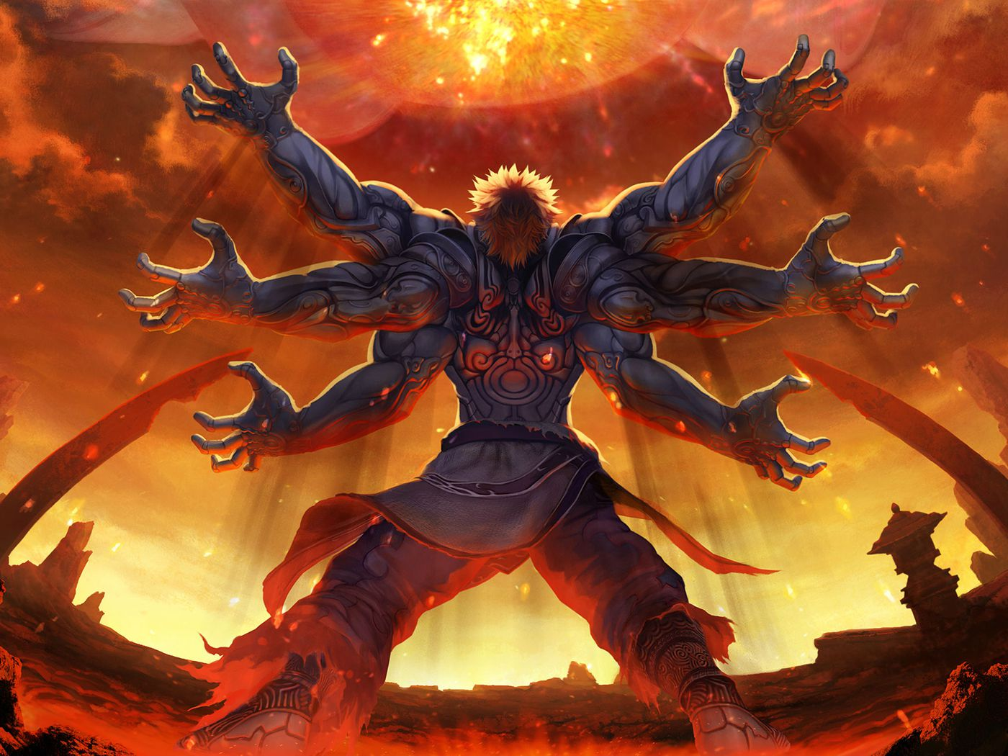
Asur

Slide 7
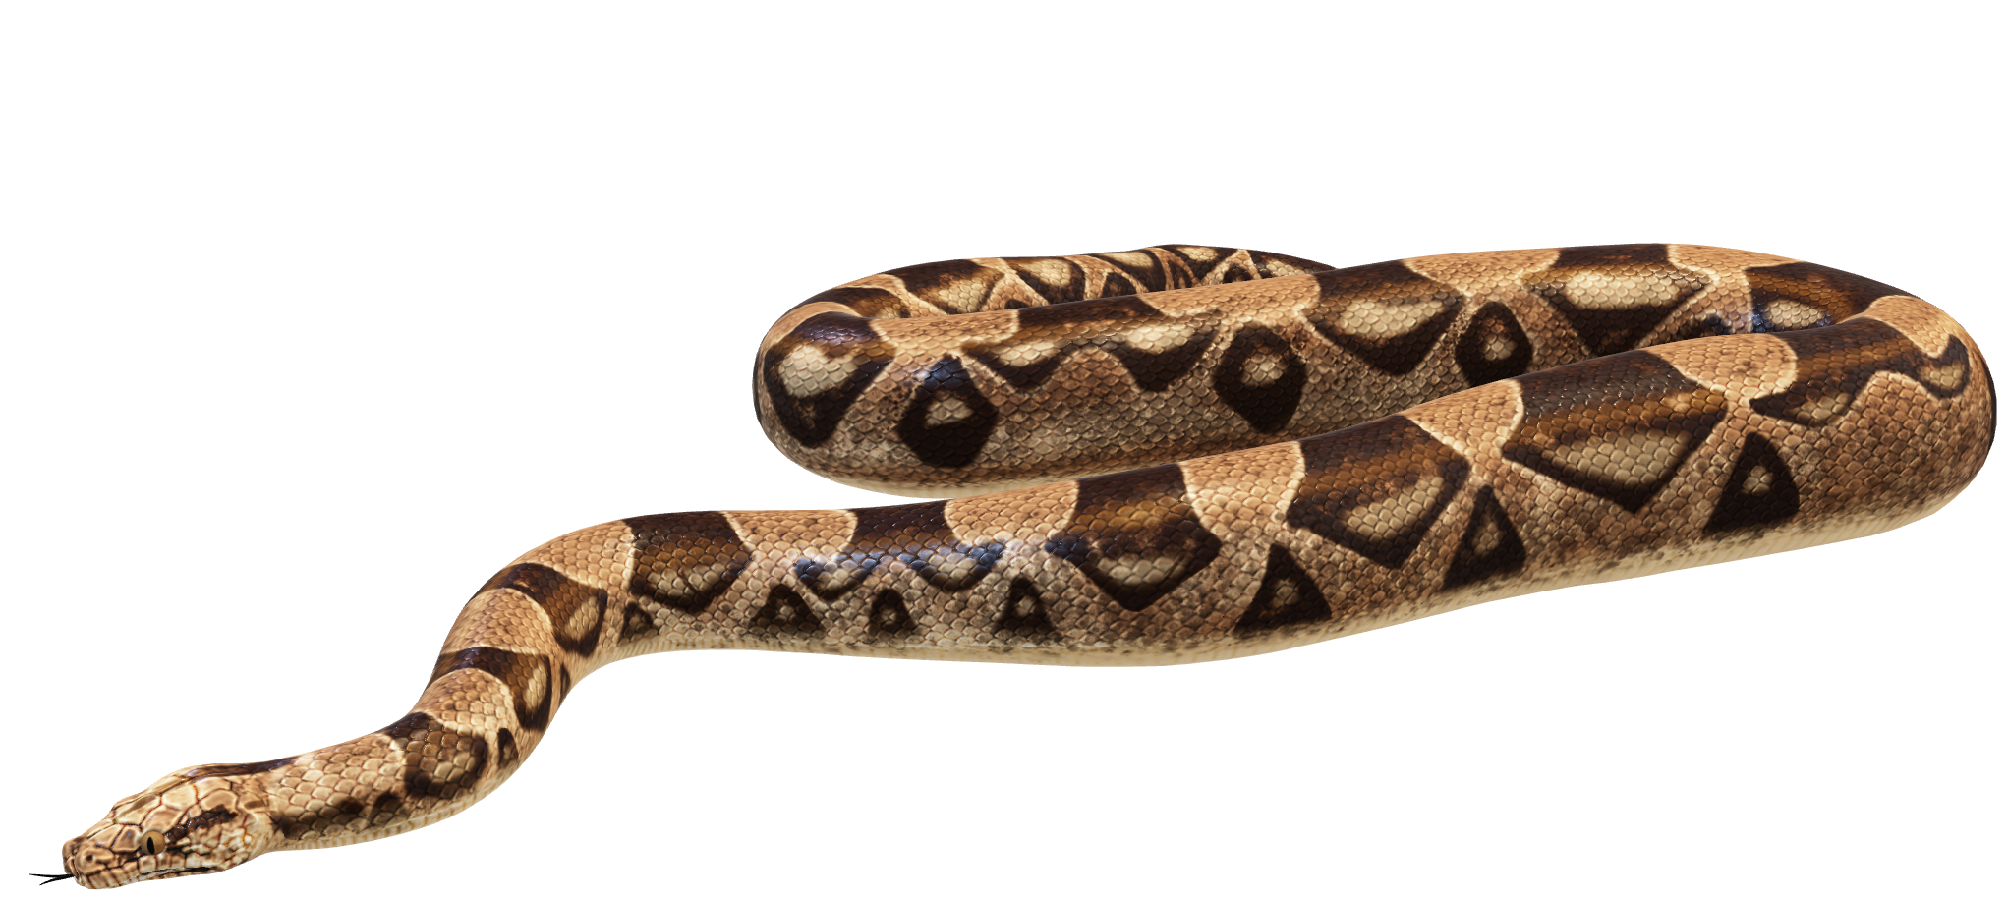
BujMg

Slide 8
AnUp
Unpraisable

Slide 9
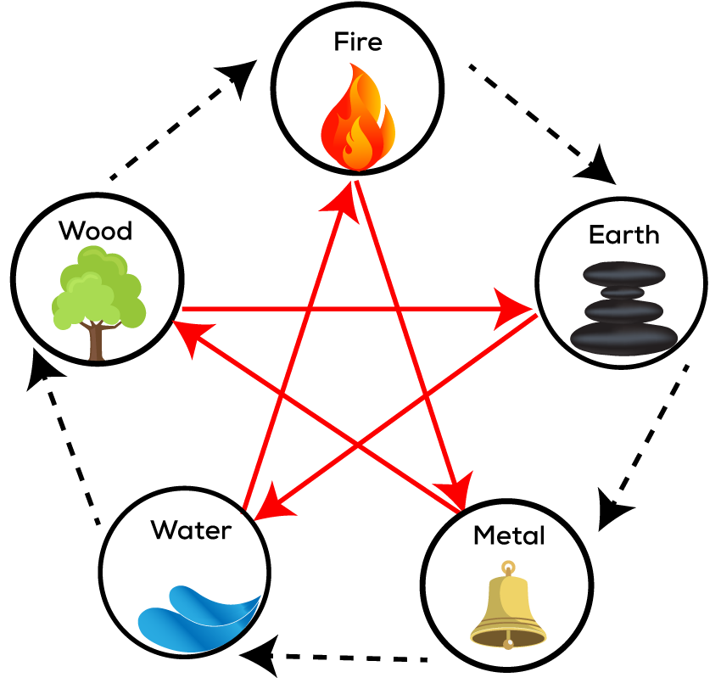
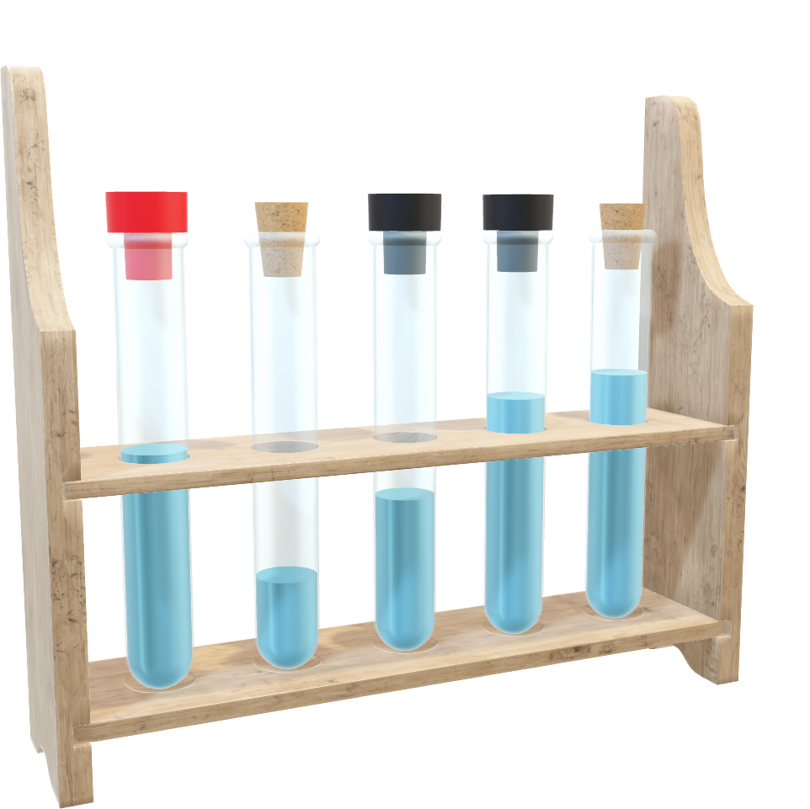
BUq
Elements/essence

Slide 10
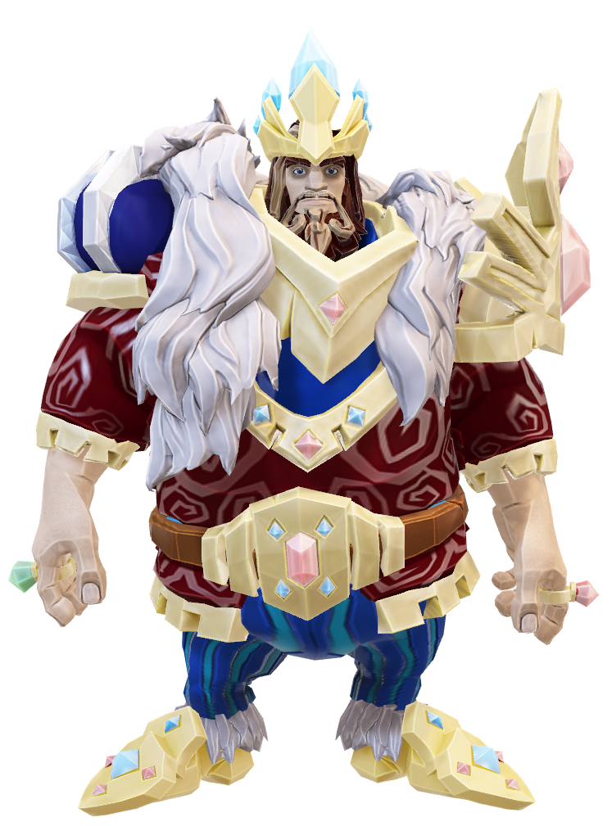
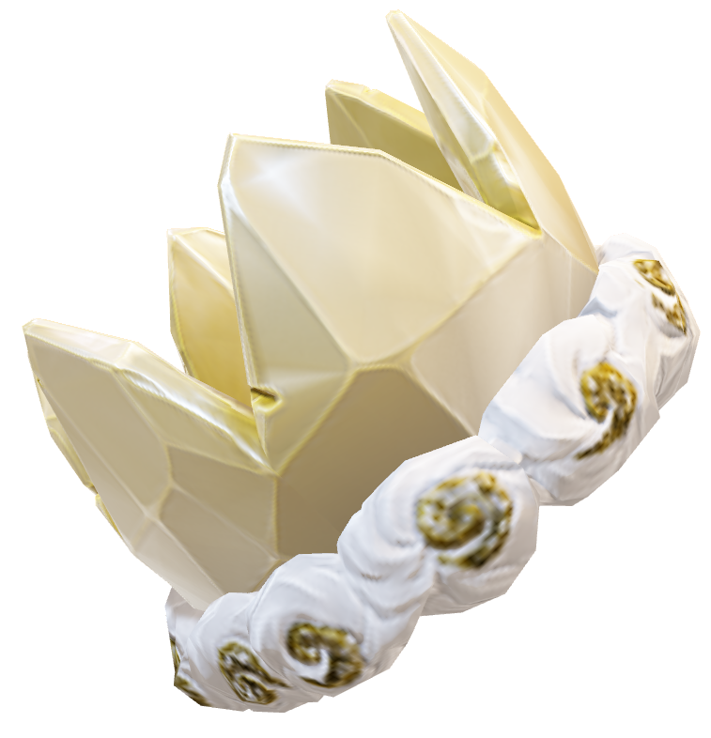
BUp

Slide 11
punIq
Pure

Slide 12
mukq

Slide 13
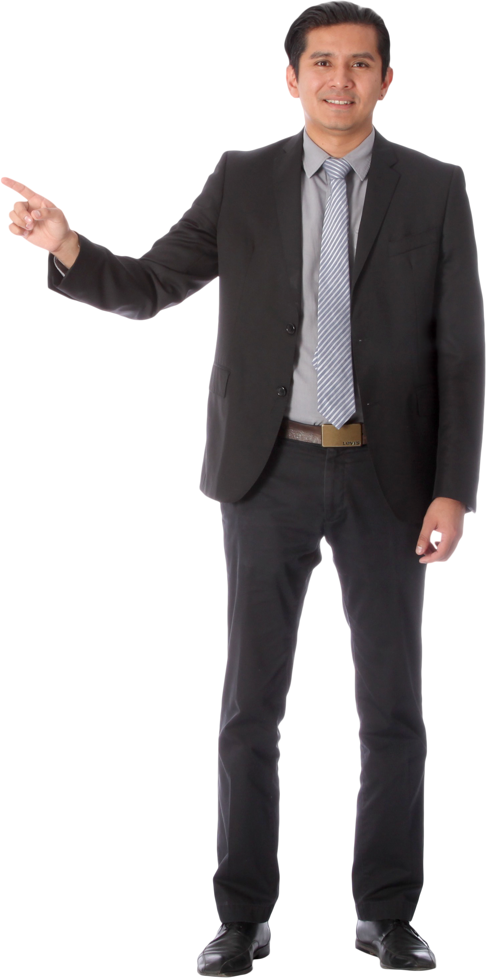
purK

Slide 14
aupmw

Slide 15
gun
trait

Slide 16
AnBau
Without fear

Slide 17
AvDUq
--

Slide 18
rujU
To Face

Slide 19
APvul
Forgiver

Slide 20
husnl
Beauty

Slide 21
Method
jugq

Slide 22
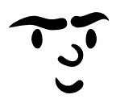
ABUq
Fearless

Slide 23
ADUq

Slide 24
ABU
Without Birth

Slide 25
AjU

