Slide 1



Slide 2
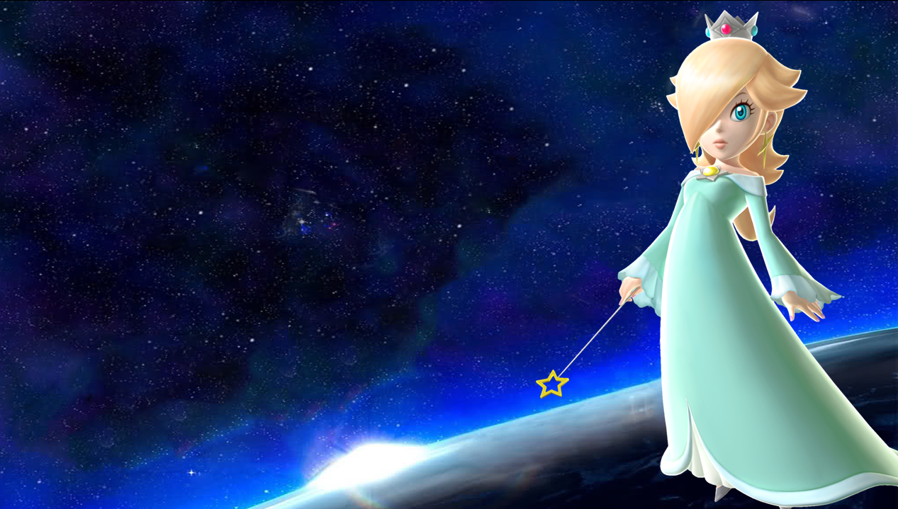







Welcome!
+
points
Many
points!
-
points
Steal
Switch
Destroy

Slide 3
Let’s play!
Are you Ready?

Slide 4
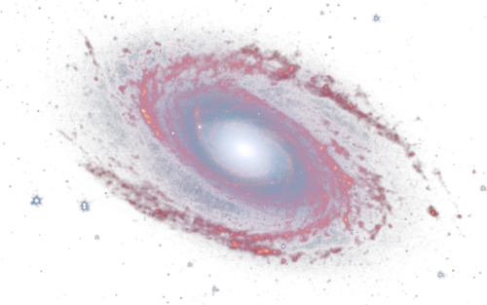
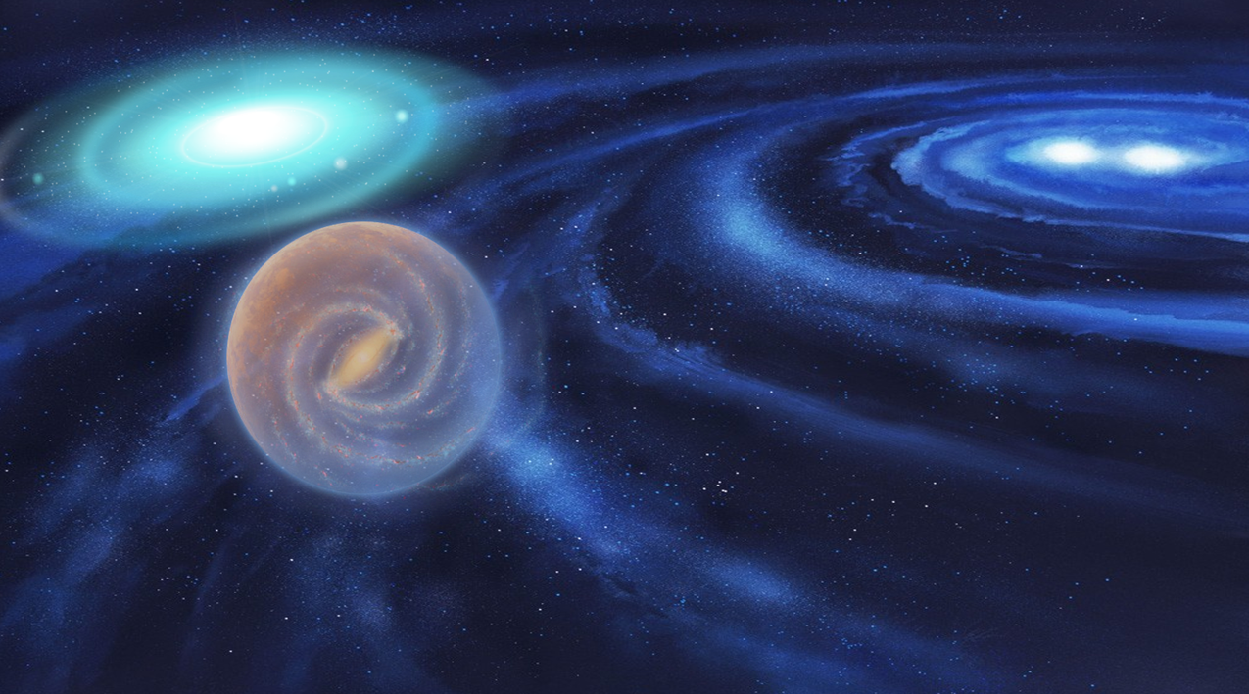















Search the stars….
d
A
g
d
B
K
j
n
C
f
L
e
j
g
Level 2
h
Notes:
Please click around the letter attached to the star to get to a question.
When finished all 15 questions, click the “level 2” arrow to advance to more questions.

Slide 5

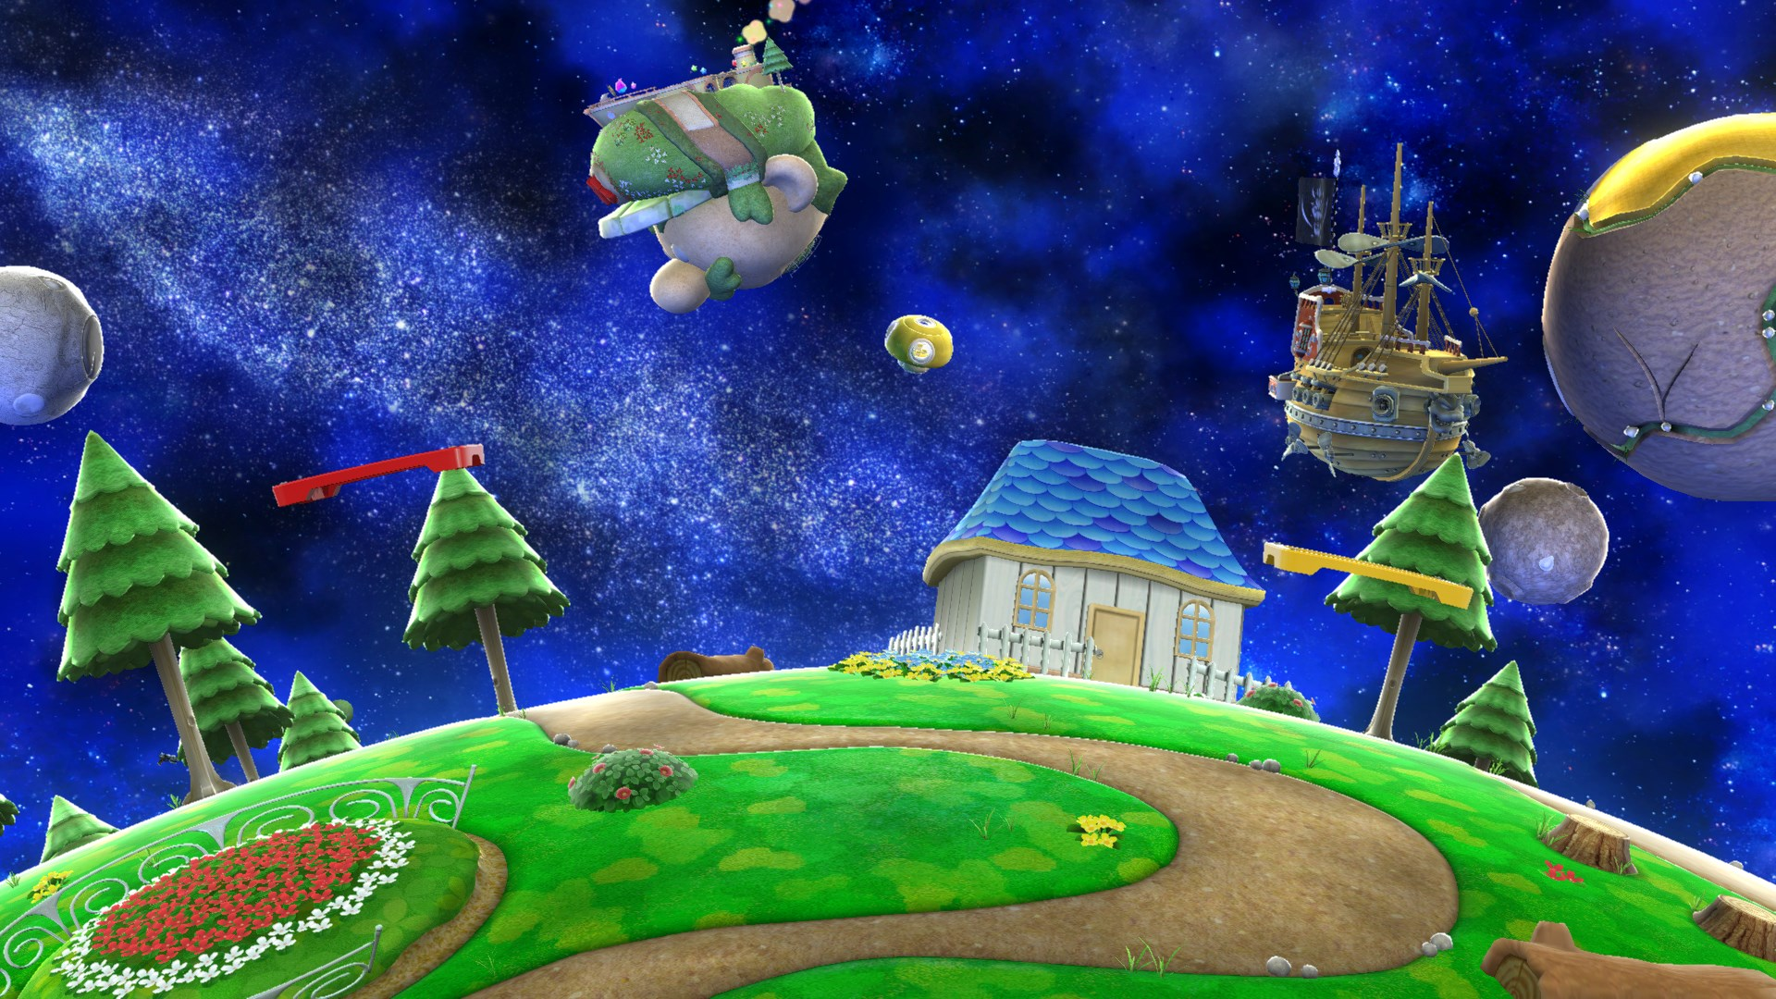







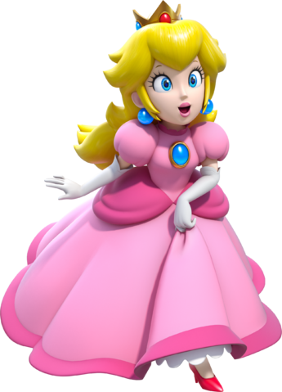







j
Search the planet
C
k
o
i
A
d
g
e
L
B
n
h
f
m
Notes:
Please click around the letter attached to the star to get to a question

Slide 6


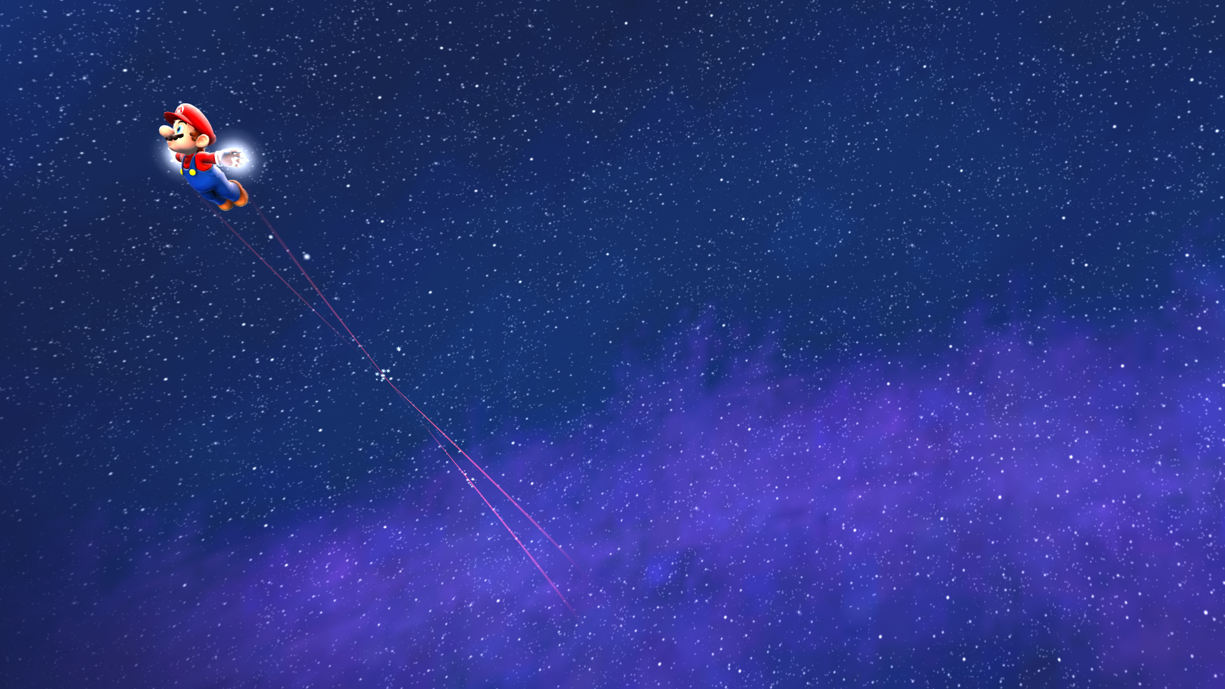

muK
Face/mouth
Notes:
Just press the -> button to move to the prize slide.
Click the little star in the top left hand corner if the students did not answer right.

Slide 7






Choose a pipe…..
A
C
+ 7
Points
B
- 5 Points
- 2 Points
Notes:
Click a pipe for prize.
Click the star to hyperlink

Slide 8



Open the mystery box?
Yes:
Open
No:
+3 points
Notes:
Open the box? Yes or no?
Click the star to hyperlink
Click the star to hyperlink

Slide 9
rUp
Form
Notes:
Just press the -> button to move to the prize slide.
Click the little star in the top left hand corner if the students did not answer right.

Slide 10
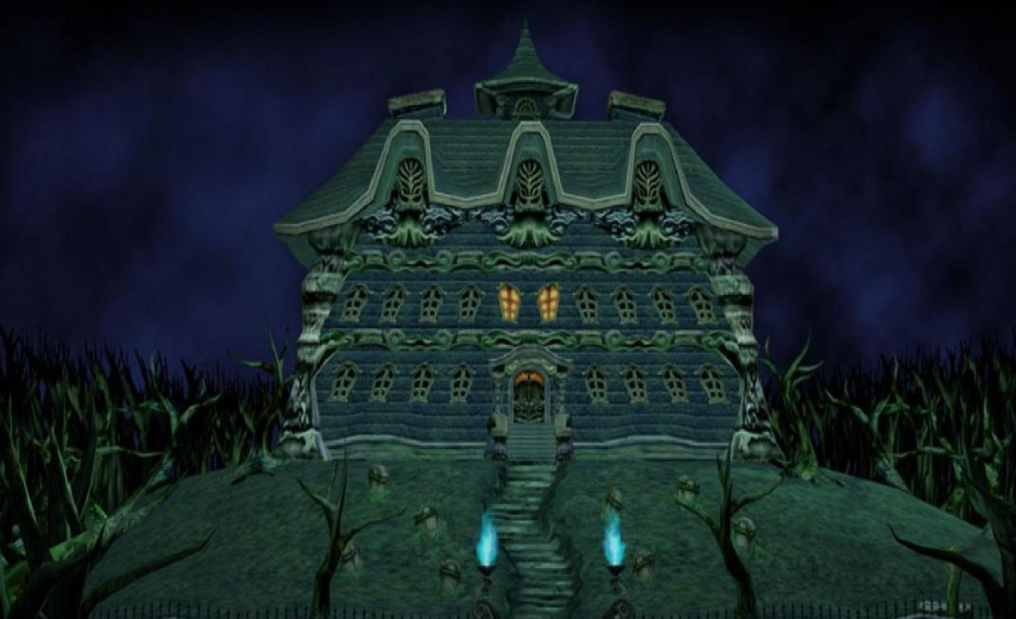





Steal!

Slide 11
Must or mustn’t
We _ _ _ _ _ smoke in the forest
Mustn’t.
Notes:
Just press the -> button to move to the prize slide.
Click the little star in the top left hand corner if the students did not answer right.

Slide 12

+ 3 points
Notes:
Click the star to hyperlink

Slide 13




Open the mystery box?
+ 7
Yes:
Open
No:
+3 points
Notes:
Open the box? Yes or no?
Click the star to hyperlink
Click the star to hyperlink

Slide 14
mUrq
Form
Notes:
Just press the -> button to move to the prize slide.
Click the little star in the top left hand corner if the students did not answer right.

Slide 15


BOMB!

Slide 16
sur
Angels/gods
Notes:
Just press the -> button to move to the prize slide.
Click the little star in the top left hand corner if the students did not answer right.

Slide 17
+ 3 points
Notes:
Click the star to hyperlink

Slide 18
Open the mystery box?
Destroy!
Yes:
Open
No:
+3 points
Notes:
Open the box? Yes or no?
Click the star to hyperlink
Click the star to hyperlink

Slide 19
Asur
Demons
Notes:
Just press the -> button to move to the prize slide.
Click the little star in the top left hand corner if the students did not answer right.

Slide 20



Choose a pipe…..
B
A
- 7 Points
C
- 3 Points
+ 5
Points
Notes:
Click a pipe for prize.
Click the star to hyperlink

Slide 21
BujMg
Snake
Notes:
Just press the -> button to move to the prize slide.
Click the little star in the top left hand corner if the students did not answer right.

Slide 22
+ 3 points
Notes:
Click the star to hyperlink

Slide 23


Open the mystery box?
-5
Yes:
Open
No:
+3 points
Notes:
Open the box? Yes or no?
Click the star to hyperlink

Slide 24
AnUp
Unpraisable
Notes:
Just press the -> button to move to the prize slide.
Click the little star in the top left hand corner if the students did not answer right.

Slide 25
+ 2 points
Notes:
Click the star to hyperlink

Slide 26
Open the mystery box?
Yes:
Open
No:
+3 points
Notes:
Open the box? Yes or no?
Click the star to hyperlink
Click the star to hyperlink

Slide 27
BUp
King
Notes:
Just press the -> button to move to the prize slide.
Click the little star in the top left hand corner if the students did not answer right.

Slide 28
+ 5 points
Notes:
Click the star to hyperlink

Slide 29

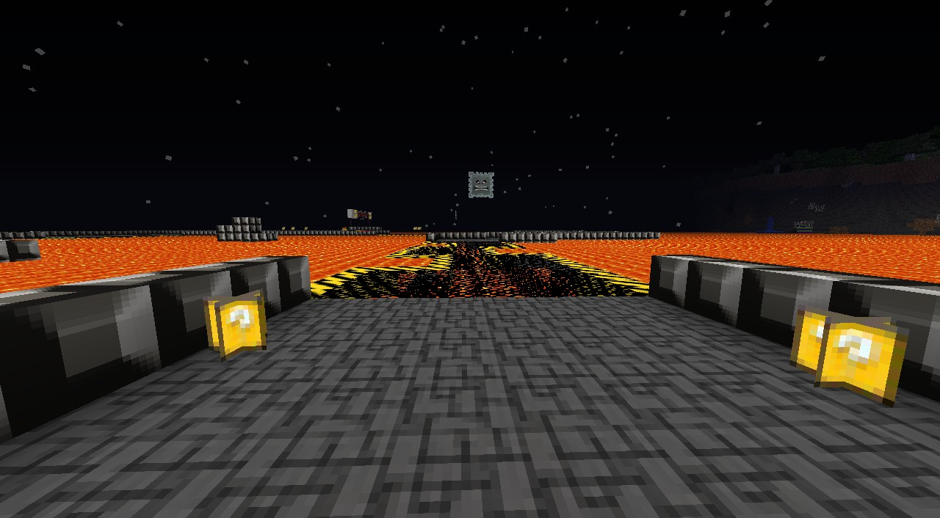


Which One?…..
1
2
3
Notes:
1…2… or 3…? All of them will result in some sort of bomb bonus.
Click the star to hyperlink

Slide 30
punIq
Pure
Notes:
Just press the -> button to move to the prize slide.
Click the little star in the top left hand corner if the students did not answer right.

Slide 31



Change!

Slide 32
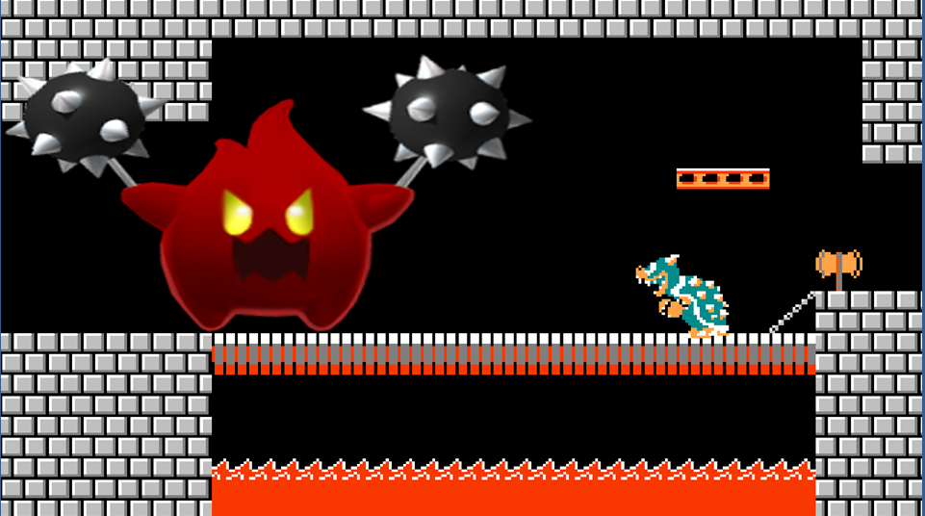
Wait!
FIGHT me!
Rock / Paper / scissors to keep your points…
Notes:
Students must fight rock/paper/scissors with you in order to keep their points.
Teach win = BOMB
Student win = Keep points

Slide 33
mukq
Liberated
Notes:
Just press the -> button to move to the prize slide.
Click the little star in the top left hand corner if the students did not answer right.

Slide 34
+ 5 points
Notes:
Click the star to hyperlink

Slide 35
Open the mystery box?
+ 5
Yes:
Open
No:
+3 points
Notes:
Open the box? Yes or no?
Click the star to hyperlink
Click the star to hyperlink

Slide 36
purK
man
Notes:
Just press the -> button to move to the prize slide.
Click the little star in the top left hand corner if the students did not answer right.

Slide 37


Destroy!

Slide 38
aupmw
praise
Notes:
Just press the -> button to move to the prize slide.
Click the little star in the top left hand corner if the students did not answer right.

Slide 39
+ 2 points
Notes:
Click the star to hyperlink

Slide 40
gun
trait
Notes:
Just press the -> button to move to the prize slide.
Click the little star in the top left hand corner if the students did not answer right.

Slide 41
Wait!
Will you fight me?
Rock / Paper / scissors against Me
Win: Double points
Lose: BOMB!
FIGHT!
NO!
Notes:
Students can choose to fight rock/paper/scissors for prize
Teach win = BOMB
Student win = Double Points

Slide 42
AnBau
Without fear
Notes:
Just press the -> button to move to the prize slide.
Click the little star in the top left hand corner if the students did not answer right.

Slide 43
+ 2 points
Notes:
Click the star to hyperlink

Slide 44
Open the mystery box?
-10
Yes:
Open
No:
+3 points
Notes:
Open the box? Yes or no?
Click the star to hyperlink

Slide 45
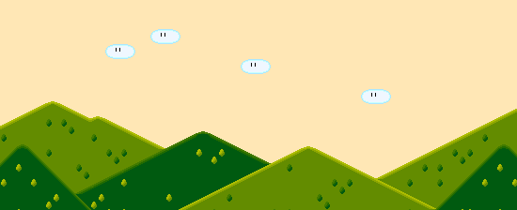


rujU
To face
Notes:
Just press the -> button to move to the prize slide.
Click the little star in the top left hand corner if the students did not answer right.

Slide 46
Change!

Slide 47
APvul
Forgiver
Notes:
Just press the -> button to move to the prize slide.
Click the little star in the top left hand corner if the students did not answer right.

Slide 48
Change!

Slide 49
husnl
beauty
Notes:
Just press the -> button to move to the prize slide.
Click the little star in the top left hand corner if the students did not answer right.

Slide 50
+ 5 points
Notes:
Click the star to hyperlink

Slide 51
Open the mystery box?
Yes:
Open
No:
+3 points
Notes:
Open the box? Yes or no?
Click the star to hyperlink
Click the star to hyperlink

Slide 52

jugq
method
Notes:
Just press the -> button to move to the prize slide.
Click the little star in the top left hand corner if the students did not answer right.

Slide 53
+ 3 points
Notes:
Click the star to hyperlink

Slide 54

ABU
Without birth
Notes:
Just press the -> button to move to the prize slide.
Click the little star in the top left hand corner if the students did not answer right.

Slide 55
+ 5 points
Notes:
Click the star to hyperlink

Slide 56
Open the mystery box?
+ 7
Yes:
Open
No:
+3 points
Notes:
Open the box? Yes or no?
Click the star to hyperlink
Click the star to hyperlink

Slide 57
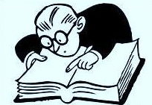
ABUq
Without fear
Notes:
Just press the -> button to move to the prize slide.
Click the little star in the top left hand corner if the students did not answer right.

Slide 58
+ 3 points
Notes:
Click the star to hyperlink

Slide 59
Open the mystery box?
Destroy!
Yes:
Open
No:
+3 points
Notes:
Open the box? Yes or no?
Click the star to hyperlink
Click the star to hyperlink

Slide 60
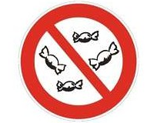
husnl
beauty
Notes:
Just press the -> button to move to the prize slide.
Click the little star in the top left hand corner if the students did not answer right.

Slide 61
+ 3 points
Notes:
Click the star to hyperlink

Slide 62
Open the mystery box?
-10
Yes:
Open
No:
+3 points
Notes:
Open the box? Yes or no?
Click the star to hyperlink

Slide 63
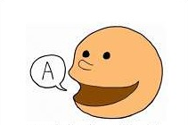
muK
Face/mouth
Notes:
Just press the -> button to move to the prize slide.
Click the little star in the top left hand corner if the students did not answer right.

Slide 64
+ 2 points
Notes:
Click the star to hyperlink

Slide 65
Open the mystery box?
-5
Yes:
Open
No:
+3 points
Notes:
Open the box? Yes or no?
Click the star to hyperlink

Slide 66
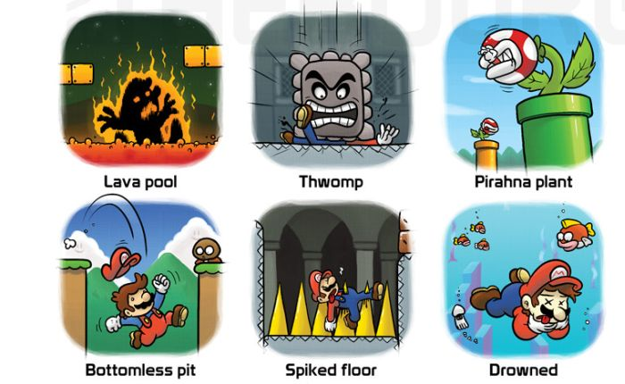
srUp
form
Notes:
Just press the -> button to move to the prize slide.
Click the little star in the top left hand corner if the students did not answer right.

Slide 67
Change!

Slide 68
Open the mystery box?
Yes:
Open
No:
+3 points
Notes:
Open the box? Yes or no?
Click the star to hyperlink
Click the star to hyperlink

Slide 69
mUrq
form
Notes:
Just press the -> button to move to the prize slide.
Click the little star in the top left hand corner if the students did not answer right.

Slide 70
Destroy!

Slide 71
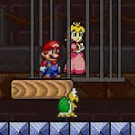
sur
Angels/gods
Notes:
Just press the -> button to move to the prize slide.
Click the little star in the top left hand corner if the students did not answer right.

Slide 72
+ 5 points
Notes:
Click the star to hyperlink

Slide 73
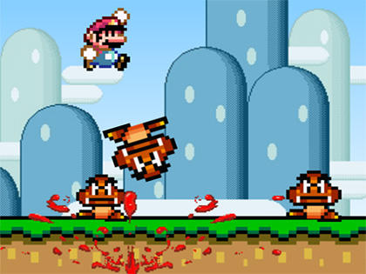
Asur
demons
Notes:
Just press the -> button to move to the prize slide.
Click the little star in the top left hand corner if the students did not answer right.

Slide 74



Choose a pipe…..
B
A
C
+ 2
Points
+ 3 Points
- 10 Points
Notes:
Click a pipe for prize.
Click the star to hyperlink

Slide 75
Open the mystery box?
+ 7
Yes:
Open
No:
+3 points
Notes:
Open the box? Yes or no?
Click the star to hyperlink
Click the star to hyperlink

Slide 76
BujMg
snake
Notes:
Just press the -> button to move to the prize slide.
Click the little star in the top left hand corner if the students did not answer right.

Slide 77
+ 2 points
Notes:
Click the star to hyperlink

Slide 78
Open the mystery box?
-10
Yes:
Open
No:
+3 points
Notes:
Open the box? Yes or no?
Click the star to hyperlink

Slide 79
AnUp
unpraisable
Notes:
Just press the -> button to move to the prize slide.
Click the little star in the top left hand corner if the students did not answer right.

Slide 80
+ 3 points
Notes:
Click the star to hyperlink

Slide 81
Open the mystery box?
Yes:
Open
No:
+3 points
Notes:
Open the box? Yes or no?
Click the star to hyperlink
Click the star to hyperlink

Slide 82
punIq
pure
Notes:
Just press the -> button to move to the prize slide.
Click the little star in the top left hand corner if the students did not answer right.

Slide 83
Steal!

